Slide 1
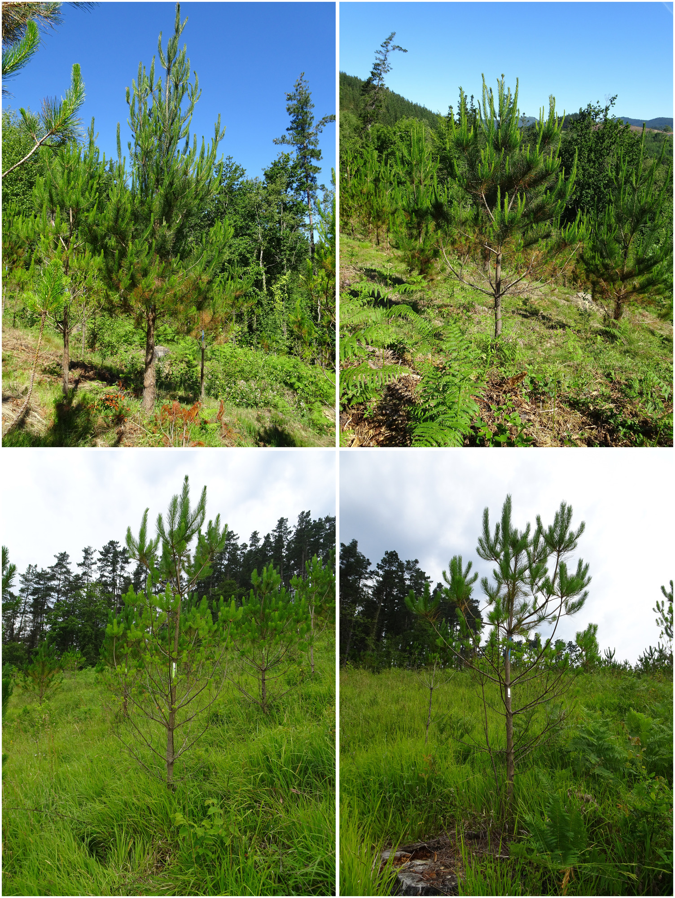
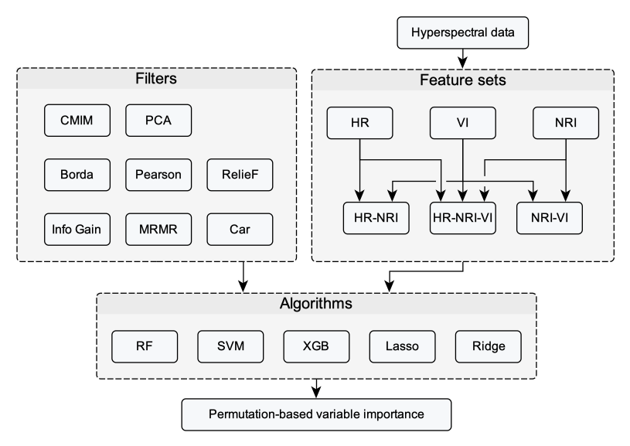
Different levels of defoliation: 10% (top left), 20% (top right), 40% (bottom left), 60% - 70% (bottom right).
Workflow description: Different feature sets are created from the raw hyperspectral data. These are used for modeling (including filter-based feature selection).

