Slide 1


WEEKLY REPORT
September 24 - October 7, 2026 (2 weeks)

Slide 2
REPORT OVERVIEW
September 24 - October 7, 2026 (2 weeks)
798
159
48
10
Total Private Messages
Total Public Comments
Total Seeded Posts
Total Seeded Replies
KEY INSIGHTS
1015 total touchpoints were handled across all channels. Of these, 957 were customer-initiated (private messages and public comments) and 58 were proactive (seeded posts and replies).
Private Messages: Loan Payment / Deduction led with 231 of 798 (28.9%).
Public Comments: App Login Issue led with 60 of 159 (37.7%).
App Login Issue was the leading theme in 2 of 4 channels.
Compared with the previous period, total touchpoints rose by 31.5% (772 → 1015).
Customers locked out near due dates raised repayment concerns.
Notes:
Touchpoint totals are the sum of mapped counts per channel. Customer-initiated = private messages + public comments; proactive = seeded posts + seeded replies.

Slide 3
CUSTOMERS OVERVIEW CONCERNS
This comparison highlights the most prominent and consistent concerns per channel during the monitoring period.
CHANNEL | CONCERN | METRIC | OBSERVATION
Private Messages | Loan Payment / Deduction | 231 | Loan Payment / Deduction accounted for 28.9% of private messages in this period. Supports the main finding.
Public Comments | App Login Issue | 60 | App Login Issue accounted for 37.7% of public comments in this period. Supports the main finding.
Seeded Posts | App Login Issue | 18 | App Login Issue accounted for 37.5% of seeded posts in this period. Supports the main finding.
Seeded Replies | Interest Rate Inquiry | 3 | Interest Rate Inquiry accounted for 30% of seeded replies in this period. Supports the main finding.

Slide 4
PRIVATE MESSAGE ACTIVITY
Customer concerns received through private messages are consistently monitored, with a total of 798 messages handled. The following are the top 5 ranked concerns:
INQUIRY THEME | INTERACTION HANDLED | ACTUAL MESSAGE | HOW WE RESPONDED
Loan Payment / Deduction | 231 | My loan shows overdue but I funded my account before the due date. Was the deduction not processed? | Hi! We are aware of an issue affecting some auto-deductions. Our team is working on it and the deduction should reflect within 1–2 days. We will adjust any affected records on our side.
App Login Issue | 200 | The app will not open after the update. Please help, I need to check my balance today. | Hello! We're sorry for the trouble. Please send us your full name and registered mobile number via private message so our support team can check your account. Thank you for your patience.
Selfie Verification Failed | 71 | My selfie verification keeps failing even in good lighting. | Hello! Please try again in a well-lit area without glasses or a cap. If it still fails, message us so we can assist securely. Do not share your ID or selfie in the comments.
Withdrawal Delayed | 61 | I requested a withdrawal to my e-wallet 3 days ago and it still has not arrived. | Hello, to track this please share the date, amount and destination account of your withdrawal via in-app chat. Our team will check the status.
OTP Not Received | 51 | No OTP again today. I tried three times already. | Hi! Please check your spam/junk folder and make sure your registered number is correct. If you still do not receive it, contact our support via in-app chat.

Slide 5
PRIVATE MESSAGE ACTIVITY
Loan Payment / Deduction
231 · 28.9%
KEY INSIGHTS
App Login Issue
200 · 25.1%
Loan Payment / Deduction led with 231 of 798 messages (28.9%).
The top 3 themes together account for 62.9% of private messages.
Compared with the previous period (134 → 231), the leading theme increased.
Share timely status updates.
Selfie Verification Failed
71 · 8.9%
Withdrawal Delayed
61 · 7.6%
OTP Not Received
51 · 6.4%
Card Activation
48 · 6%
App Maintenance Update
47 · 5.9%
Statement Request
47 · 5.9%
Others
42 · 5.3%
Notes:
Pie shows the share of each theme within Private Messages (denominator = 798 private messages). Slices beyond the top 8 are grouped as "Others".

Slide 6
PUBLIC COMMENTS ACTIVITY
Acme Digital Bank consistently monitors customer concerns raised through public comments, with a total of 159 comments handled. The following are the top 5 ranked concerns:
INQUIRY THEME | RESPONSES SENT | ACTUAL MESSAGE | HOW WE RESPONDED
App Login Issue | 60 | Why can't I sign in? I reset my password twice already. | Hello! We're sorry for the trouble. Please send us your full name and registered mobile number via private message so our support team can check your account. Thank you for your patience.
Loan Payment / Deduction | 25 | Sept 30 pa ako nag-fund para sa due ko ng Oct 1, hindi pa rin nababawas. Please check. | Hello, thank you for letting us know. Please send your registered mobile number by private message so we can verify your payment status.
Selfie Verification Failed | 20 | The face scan says "try again" every time. | Hello! Please try again in a well-lit area without glasses or a cap. If it still fails, message us so we can assist securely. Do not share your ID or selfie in the comments.
Card Activation | 12 | How do I activate my new card? | Hi! Card activation is available under Cards > Activate. If you do not see it, please message us with your registered mobile number.
Statement Request | 12 | How can I get my monthly statement? | Hi! Statements are available in the app under Profile > Statements. A copy can also be sent to your registered email.

Slide 7
PUBLIC COMMENTS ACTIVITY
App Login Issue
60 · 37.7%
KEY INSIGHTS
Loan Payment / Deduction
25 · 15.7%
App Login Issue led with 60 of 159 comments (37.7%).
The top 3 themes together account for 66% of public comments.
Compared with the previous period (70 → 60), the leading theme decreased.
Share timely status updates.
Selfie Verification Failed
20 · 12.6%
Card Activation
12 · 7.5%
Statement Request
12 · 7.5%
Withdrawal Delayed
10 · 6.3%
App Maintenance Update
8 · 5%
OTP Not Received
7 · 4.4%
Others
5 · 3.1%
Notes:
Pie shows the share of each theme within Public Comments (denominator = 159 public comments). Slices beyond the top 8 are grouped as "Others".

Slide 8
SEEDED POST ACTIVITY
A total of 48 seeded posts were published during the 2-week reporting period. The following are the top 5 ranked sampled posts:
INQUIRY THEME | POST COUNT | ACTUAL MESSAGE
App Login Issue | 18 | Anyone else having trouble opening the app today? I messaged the support page and they asked for my details, then someone called me. Fixed after that.
Card Activation | 11 | Has anyone activated the new card already? Was it easy?
Interest Rate Inquiry | 9 | Does anyone know how often the savings interest is credited?
OTP Not Received | 7 | My OTP came in right away today. The transaction was quick.
Withdrawal Delayed | 3 | Transferred to my e-wallet this morning and it arrived in minutes.

Slide 9
SEEDED POST ACTIVITY
App Login Issue
18 · 37.5%
KEY INSIGHTS
Card Activation
11 · 22.9%
App Login Issue led with 18 of 48 posts (37.5%).
The top 3 themes together account for 79.2% of seeded posts.
Compared with the previous period (8 → 18), the leading theme increased.
Share timely status updates.
Interest Rate Inquiry
9 · 18.8%
OTP Not Received
7 · 14.6%
Withdrawal Delayed
3 · 6.3%
Notes:
Pie shows the share of each theme within Seeded Posts (denominator = 48 seeded posts). Slices beyond the top 5 are grouped as "Others".

Slide 10
SEEDED REPLIES ACTIVITY
A total of 10 seeded replies were recorded during the 2-week reporting period. The following are the top 4 ranked posts with seeded replies:
INQUIRY THEME | REPLY COUNT | ACTUAL POST | SEEDED REPLY
Interest Rate Inquiry | 3 | What is the savings rate this month? | Check Savings > Rates in the app, it's listed there.
Loan Payment / Deduction | 3 | Due date was yesterday but my payment was not deducted. What now? | Message their page, they will check it. Mine got fixed in two days.
App Login Issue | 2 | Can't log in to the app, anyone know what's going on? | Same here at first. I messaged their page, they asked for my full name and number, then I could log in the same day.
Card Activation | 2 | How do I activate my card? | Mine was easy, it's under Cards in the app.

Slide 11
SEEDED REPLIES ACTIVITY
Interest Rate Inquiry
3 · 30%
KEY INSIGHTS
Loan Payment / Deduction
3 · 30%
Interest Rate Inquiry led with 3 of 10 replies (30%).
The top 3 themes together account for 80% of seeded replies.
Compared with the previous period (5 → 3), the leading theme decreased.
The sample is small (10 replies); interpret with caution.
Share timely status updates.
App Login Issue
2 · 20%
Card Activation
2 · 20%
Notes:
Pie shows the share of each theme within Seeded Replies (denominator = 10 seeded replies). Slices beyond the top 4 are grouped as "Others".

Slide 12
KEY TRENDS
App Login Issue was the leading theme in 2 of 4 channels.
Loan Payment / Deduction increased from 151 to 256 customer-initiated interactions (+69.5%).
Selfie Verification Failed increased from 56 to 91 customer-initiated interactions (+62.5%).
App Login Issue increased from 239 to 260 customer-initiated interactions (+8.8%).
Interaction volume peaked on 2026-09-30 with 100 touchpoints.

Slide 13
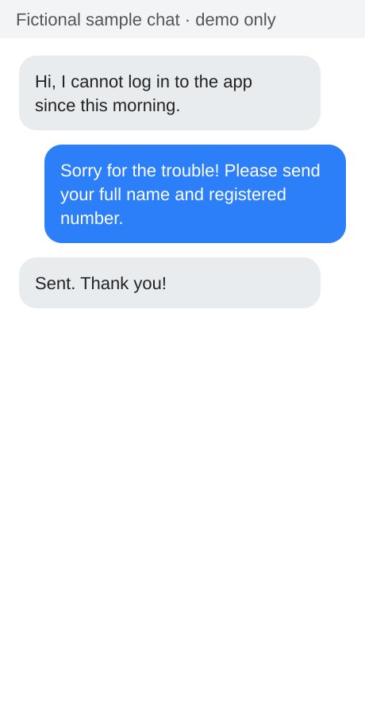
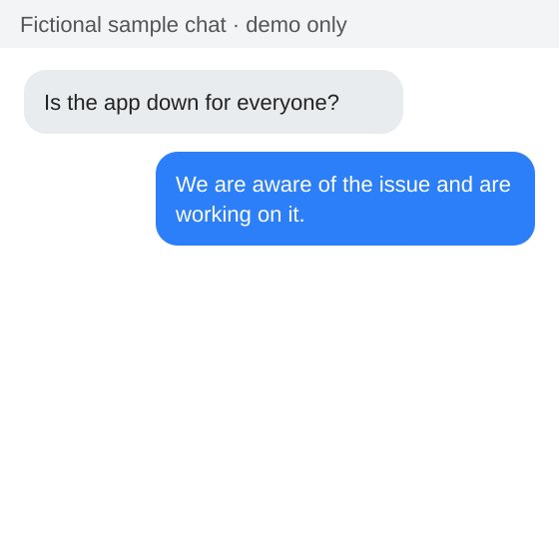
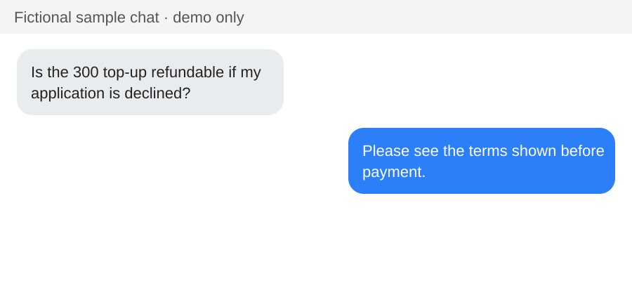
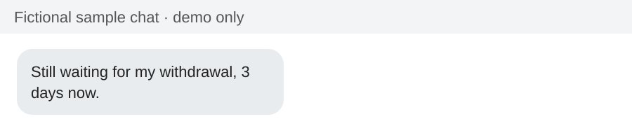
NOTABLE CONCERNS
The following concerns were noted across the monitored channels during the 2-week reporting period:
Comments before seeking assistance.
Fictional example concern 1: customers raised this repeatedly during the period.
Top-up requirement
Extended Case Resolution
Fictional example concern 2: customers raised this repeatedly during the period.
Fictional example concern 3: customers raised this repeatedly during the period.

Slide 14
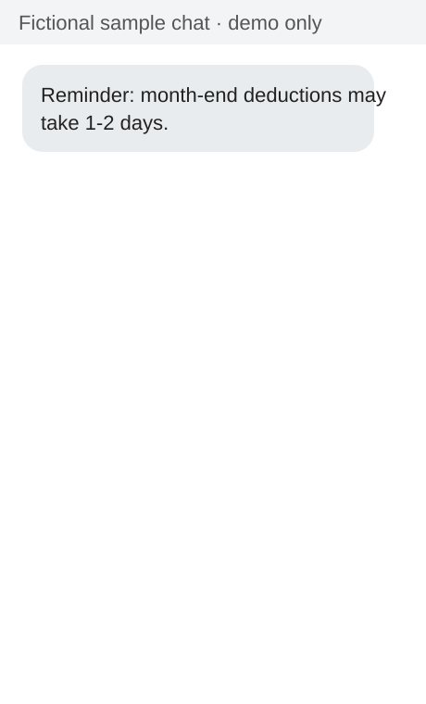
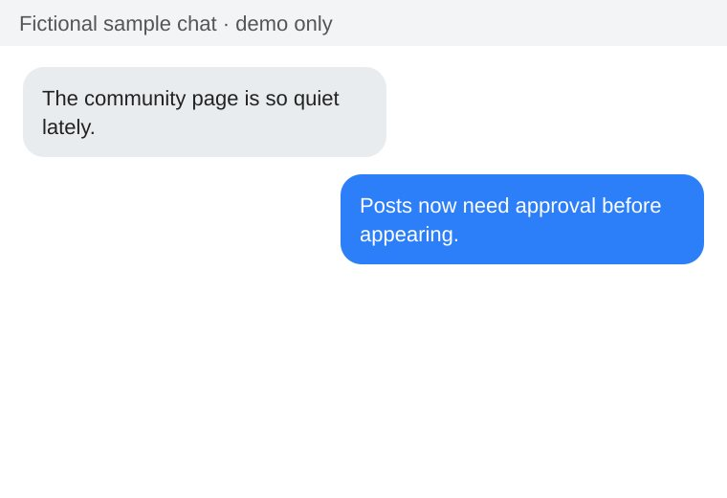
NOTABLE CONCERNS
The following issues were monitored across the community pages over the 2-week reporting period:
Concerns on the loan top-up requirement
Decline in community activity.
Fictional example issue 1: observed across the community pages.
Fictional example issue 2: observed across the community pages.

Slide 15
OPPORTUNITIES FOR IMPROVEMENTS
MONTH-END LOAN ADVISORY
CLEARER TOP-UP AND CANCELLATION TERMS
01
04
A short, evidence-based suggestion that may help set clearer expectations for customers.
A short, evidence-based suggestion that may help set clearer expectations for customers.
FASTER ACCESS RESOLUTION
GSAVE AND OTP UPDATES
02
05
A short, evidence-based suggestion that may help set clearer expectations for customers.
A short, evidence-based suggestion that may help set clearer expectations for customers.
DAILY APP STATUS UPDATE
COMMUNITY ENGAGEMENT MONITORING
03
06
A short, evidence-based suggestion that may help set clearer expectations for customers.
A short, evidence-based suggestion that may help set clearer expectations for customers.

Slide 16
OVERALL SUMMARY
The 2-week (September 24 - October 7, 2026) monitoring period recorded 1015 touchpoints, with App Login Issue and Loan Payment / Deduction the leading customer-initiated concerns (260 and 256 interactions across private messages and public comments). Access and payment uncertainty can affect customer trust. Proposed priorities for the next reporting period: month-end loan advisory, faster access resolution, daily app status update.

Slide 17
THANK YOU!

