Slide 1
GameScope Video Game Sales Analytics Dashboard
A Power BI Data Analytics Project
Presented By:
PATAMATA PRANEEL
ROLL NO: 23HP1A1247
APSSDC DATA ANALYTICS USING POWERBI

Slide 2
Introduction:
The video game industry has become one of the world’s largest entertainment markets. Every year, thousands of games are released across multiple gaming platforms and regions.
Analyzing video game sales data helps identify:
*Popular gaming consoles.
*Best-selling game genres.
*Leading publishers.
*Sales performance over time.

Slide 3
Problem Statement:
The gaming industry generates massive amounts of sales data that are difficult to analyze manually.
Businesses need an interactive dashboard to:
*Monitor sales performance.
*Analyze publisher performance.
*Identify popular genres.
*Track sales trends over time.

Slide 4
Objectives:
Analyze global video game sales.
Compare regional sales (NA, EU/PAL, JP, Other).
Identify top-selling publishers.
Study console popularity.
Analyze genre-wise sales.
Observe sales trends by release year.
Build an interactive dashboard for easy analysis.

Slide 5
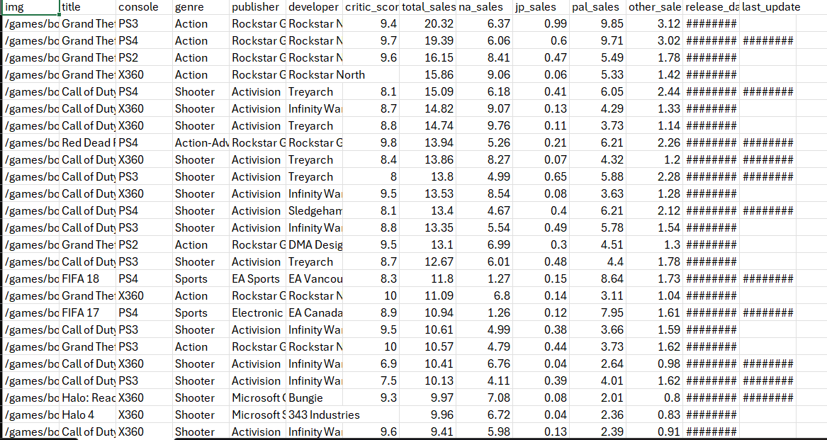
Dataset:
Kaggle (Video Game Sales Dataset)
Dataset Contains:
Game Title
Platform / Console
Publisher
Developer
Genre
Release Year
Critic Score
Total Sales
North America Sales
Japan Sales
PAL (Europe) Sales
Other Region Sales
Dataset Period:
(1971–2024)

Slide 6
Methodology:
Step 4 :
Designed interactive dashboards
Step 1 :
Collected dataset from Kaggle
Step 2 :
Imported data into Power BI
Step 3 :
Cleaned and
transformed data
Step 5 :
Generated business insights

Slide 7
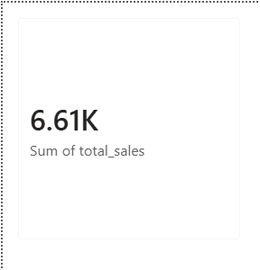
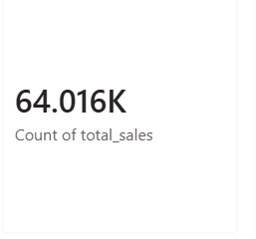
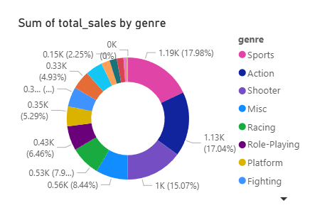
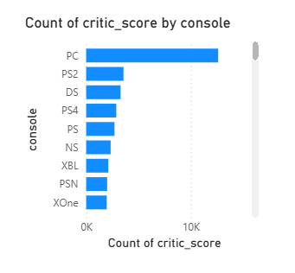
Dashboard Overview:

Slide 8
Conclusion:
The GameScope dashboard successfully converts raw video game sales data into meaningful business insights.Power BI provides interactive visualizations that make sales analysis simple and effective.The dashboard helps users understand:
*Publisher performance
*Console popularity
*Regional sales distribution etc….

Slide 9
Thank You!

