Slide 1


SMART INDIA HACKATHON 2025
Problem Statement ID –SIH25074
Problem Statement Title - Al-Powered Mobile Platform for Democratizing Sports Talent Assessment
Theme- Sports and Fitness
PS Category- Software
Team ID-
Team Name (Registered on portal)

Slide 2
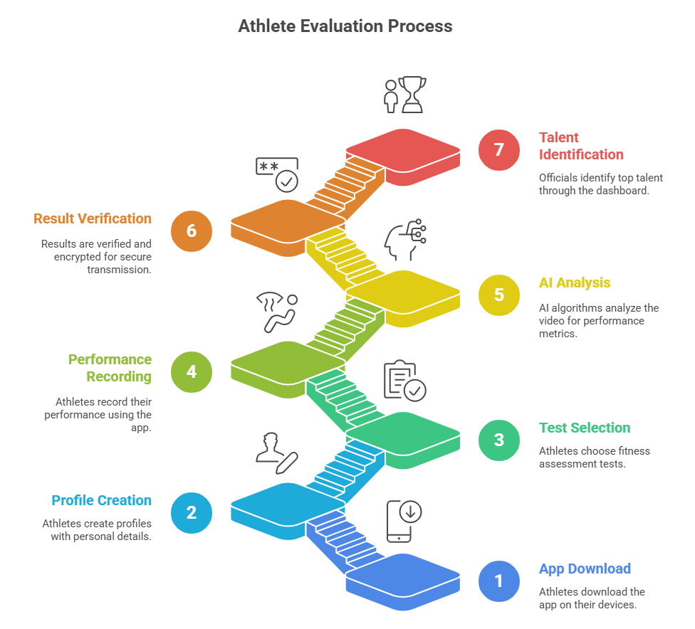
Sports and Fitness
Your Team Name
Problem Statement:
India lacks a fair and scalable system to assess sports talent.
Rural athletes miss opportunities due to limited access and infrastructure.
Solution:
Mobile app records athlete fitness tests, analyzed by AI for accuracy and cheat detection.
Works offline on low-end phones.
Verified results securely sent to SAI for fair, scalable talent assessment.

Slide 3
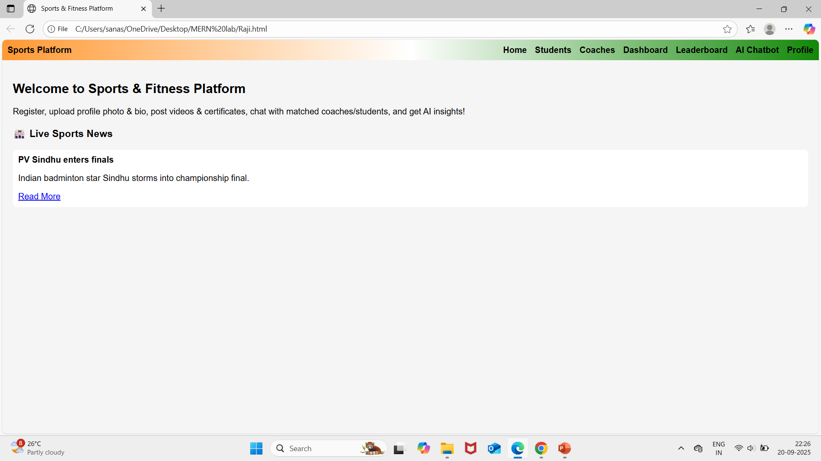
TECHNICAL APPROACH
Your Team Name
Front-end: HTML, CSS, JS – registration, dashboard, leaderboard, chat, profile.
Storage: Local Storage – users, chats, certificates, videos.
AI: Talent assessment, coach-student recommendations, chatbot.
Chat: Real-time student ↔ coach messaging.
News: Live sports updates every 2 mins.
Leaderboard: Ranks + AI insights.

Slide 4
FEASIBILITY AND VIABILITY
Your Team Name
Works with simple web tech (HTML, CSS, JS) & local storage.
Solves real student-coach matching problem with AI insights & chat.
Scalable later with backend & real-time database.
Lightweight, responsive, and cost-effective.

Slide 5
IMPACT AND BENEFITS
Your Team Name
Target Audience: Students & Coaches in local regions.
Social: Connects students with coaches, encourages sports participation.
Economic: Reduces cost/time of finding mentors.
Educational: AI insights help skill & talent assessment.
Environmental: Digital platform reduces paperwork & travel.

Slide 6
RESEARCH AND REFERENCES
Your Team Name
📚 Researches & References
🔹 Sports Updates → ![ESPN logo], ![Goal logo], ![Olympics logo] 🔹 AI & ML Concepts → Research papers + online tutorials 🔹 Govt. Portals → Registration & certification guidelines 🔹 Web Tech → HTML, CSS, JavaScript docs 🔹 Design Insports → Fitness & sports platforms (UI references)

Slide 7
IMPORTANT INSTRUCTIONS
Please ensure below pointers are met while submitting the Idea PPT:
Kindly keep the maximum slides limit up to six (6). ( Including the title slide)
Try to avoid paragraphs and post your idea in points /diagrams / Infographics /pictures
Keep your explanation precise and easy to understand
Idea should be unique and novel.
You can only use provided template for making the PPT without changing the idea details pointers (mentioned in previous slides).
You need to save the file in PDF and upload the same on portal. No PPT, Word Doc or any other format will be supported.
Note - You can delete this slide (Important Pointers) when you upload the details of your idea on SIH portal.

