Slide 1
Maximizing Revenue for Taxi Cab Drivers through Payment Type Analysis Using Python
Name : Patankar Akshay Avinash
Roll No : 23MA40019
Guide : Prof. Pawan Kumar
Department Of Mathematics
IIT Kharagpur.

Slide 2
AGENDA
• Problem Statement
• Data Overview
• Methodology
• Finding and Analysis
• Conclusion

Slide 3
Problem statement
1
In the fast-paced taxi booking sector, making the most of revenue is essential for long-term success and driver happiness.
Our goal is to use data-driven insights to maximise revenue streams for taxi drivers in order to meet this need. Our research aims to determine whether payment methods have an impact on fare pricing by focusing on the relationship between payment type and fare amount.

Slide 4
Data Overview
2
For this analysis, I utilize the comprehensive dataset of Taxi Trip records, used data cleaning and feature engineering procedures to concentrate solely on the relevant coloums essential for investigation.
There are so many columns in the dataset, but as per our problem statement, we only require some fields from the original data. Rest columns are nothing but the unwanted columns for this study. So we will simply remove those columns.

Slide 5
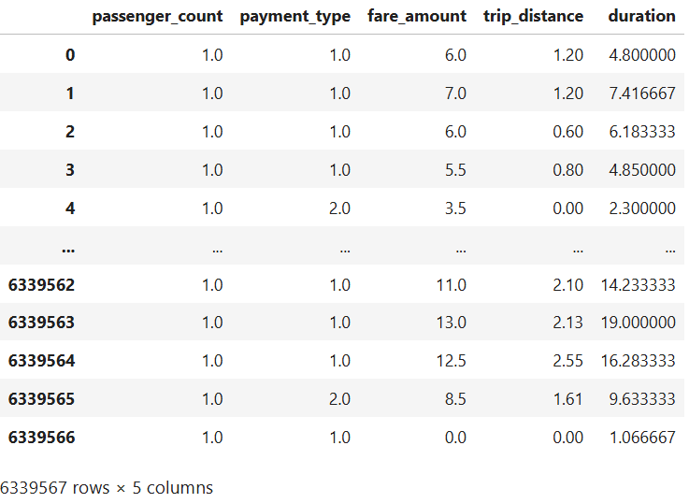
3

Slide 6
Methodology
4
Descriptive analytics
Descriptive analytics is a statistical interpretation used to analyze historical data to identify patterns and relationships. We're interested on exploring the relationship between payment type and passenger behavior concerning trip distance and fare amount. Are there variations in the distribution of payment types concerning different fare amounts or trip distances?
To investigate this, we'll plot histograms to visualize the distribution of passenger counts paying with either card or cash. This will also provide stakeholders with insight into fare amount ranges associated with different payment methods.

Slide 7
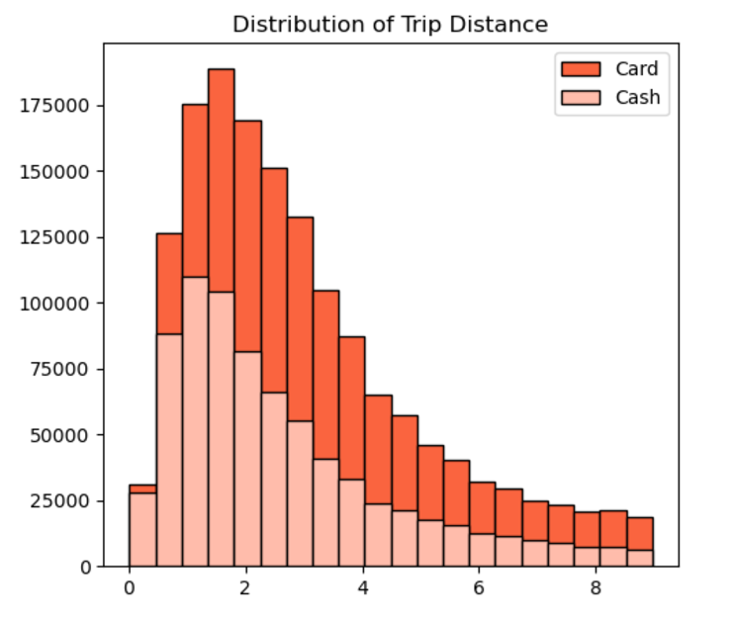
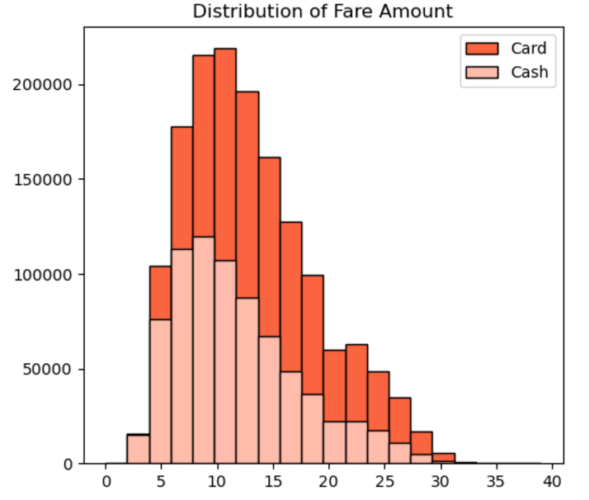
5
Indicates that customers prefers to pay more with cards when they have high fare amount and long trip distance.

Slide 8
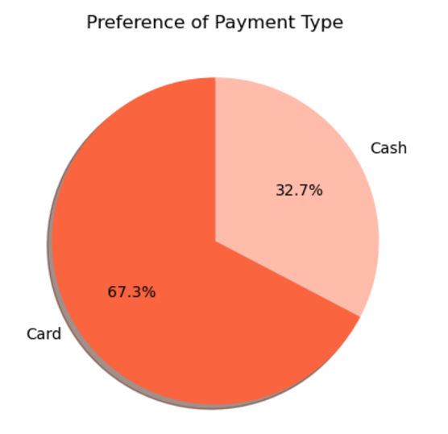
6
This indicates a strong preference among customers for using card payments over cash, potentially due to convenience, security, or incentives offered for card transactions.

Slide 9
Hypothesis Testing
In order to select the most suitable test for our scenario, our initial step involves evaluating whether the distribution of fare amounts adheres to a normal distribution. While the histogram depicted above suggests otherwise, we will further confirm this by generating a QQ plot.
Quantile-quantile (QQ) plots can be used to assess whether the fare amount distributions for each payment type are approximately normally distributed. If the data points closely align with the diagonal line in the plot, it suggests that the data follows a normal distribution.

Slide 10
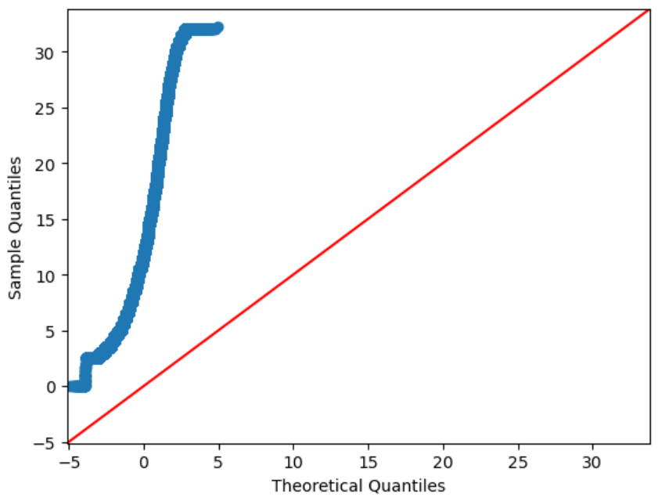
8
The data values clearly do not follow the red 45-degree line, which is an indication that they do not follow a normal distribution. So, z distribution will not be good for this. That’s why we will use T test.

Slide 11
Null hypothesis: There is no difference in average fare between customers who use credit cards and customers who use cash.
Alternative hypothesis: There is a difference in average fare between customers who use credit cards and customers who use cash
With a T-statistic of 165.5 and a P-value of less than 0.05, we reject the null hypothesis, suggesting that there is indeed a significant difference in average fare between the two payment methods.

Slide 12
Finding and Analysis
10
Payment Type Preferences
Card payments account for 67.5% of all transactions, while cash payments make up the remaining 32.5%. This trend highlights the increasing popularity of cashless transactions, likely due to the convenience and ease of using cards.
Passenger Count Analysis
Single-passenger rides dominate both card and cash payments, indicating that individual passengers are the most common customers in the taxi service. In contrast, larger groups are less likely to use taxis and, when they do, tend to prefer cash payments. This preference may arise from the need to split the fare or a desire for more control over payment.

Slide 13
Conclusion
In this project analysis shows that card payments, which are associated with higher fares, offer a significant opportunity for increasing earnings. To capitalize on this, taxi companies should consider encouraging card payments through strategic incentives, such as offering discounts or loyalty rewards for card users. Additionally, improving the payment system to make credit card transactions faster and more convenient could further drive adoption. These insights provide a foundation for data-driven strategies aimed at maximizing revenue in the taxi industry, ultimately benefiting both drivers and companies. Over time, this approach could foster a more consistent and higherpaying customer base. Ultimately, focusing on payment methods can lead to a sustainable revenue model for the industry.

Slide 14
Thank you
Patankar Akshay Avinash
23MA40019
Project Link : ClickHere

