Slide 1
SUPPLY CHAIN
MANAGEMENT
PROJECT

Slide 2
Introduction to the Dataset
This supply chain dataset offers a detailed view of operational efficiency across key logistics and fulfillment areas. It includes information about each product, identified by a unique SKU, along with its category under ProductType. The SupplierName and SupplierLocation columns provide the source details. Metrics such as RestockLeadTime, ManufacturingLeadTime, and SupplierLeadTime indicate various stages of product readiness. Cost-related columns include ManufacturingCost, ShippingCost, and TransportCost, helping assess overall expenditure. OrderQuantity and UnitsSold show demand and successful transactions, while Revenue captures financial performance. ShippingTime, TransportMode, and ShippingCarrier reflect delivery efficiency. Additional quality and customer indicators include DefectRate, CustomerGender, and Route, all of which support deeper insights into supplier reliability and customer experience.

Slide 3
Objective and Primary Aim
Primary Aim -
To design an interactive Power BI dashboard that provides comprehensive insights into the supply chain process—enabling data-driven decisions for inventory management, order fulfillment, supplier performance, transportation efficiency, and cost optimization.
Objectives –
Monitor inventory levels and stock availability across the supply chain.
Track and improve order fulfillment and on-time delivery rates.
Evaluate supplier performance using delivery time and defect metrics.
Analyze cost distribution to identify areas for efficiency and savings.

Slide 4
Technologies Used
Excel :
Data cleaning, formatting, and initial understanding of raw data.
MySQL Workbench :
Performing exploratory data analysis and answering key business questions via SQL queries.
Power BI :
Creating calculated columns/measures (DAX) and building an interactive, slicer-driven dashboard for visualization.

Slide 5
Data Cleaning and Preparation using Excel
To ensure better readability and seamless integration into Power BI, the dataset was first cleaned and formatted in Excel. Key changes made include:
Renamed columns to more descriptive and user-friendly titles
Corrected data types to align with their values
Handled null or blank values where applicable to avoid errors during analysis.
Formatted column headers consistently
Removed unnecessary columns not required for analysis.

Slide 6
Exploratory Data Analysis
To gain meaningful insights from the raw data and guide the development of the Power BI dashboard, extensive exploratory data analysis (EDA) was conducted using SQL. This process involved drafting a wide range of targeted business questions to explore different aspects of the supply chain, such as inventory levels, supplier performance, order fulfillment, transportation efficiency, and cost distribution. Through structured SQL queries, patterns were identified in areas like defect rates, delivery times, order quantities, and shipping costs. The insights gathered from these queries not only validated the data’s accuracy but also helped define the most relevant KPIs and metrics to visualize. This analytical phase laid the foundation for building focused and actionable visuals within the dashboard. All SQL queries, along with their corresponding insights, are well-documented and available for reference in the GitHub repository.

Slide 7
Power BI Dashboard
The Power BI dashboard was designed to provide a comprehensive view of the Supply Chain Management process by organizing the analysis into six key sections: Overview, Inventory Management, Order Fulfillment, Supplier Performance, Transportation Efficiency, and Supply Chain Costs. We began with an Overview page featuring high-level KPIs like Total Inventory Value, On-Time Delivery Rate, and Supply Chain Costs.
Interactive navigation buttons were added to allow easy access to each section.
Throughout the dashboard, we created multiple DAX measures to calculate meaningful metrics such as average delivery time, defect rates, and cost distribution. Visuals like KPI cards, bar charts, and pie charts were used to present data clearly and effectively. Each page was thoughtfully designed to align with business objectives, offering actionable insights in a clean and interactive format.

Slide 8
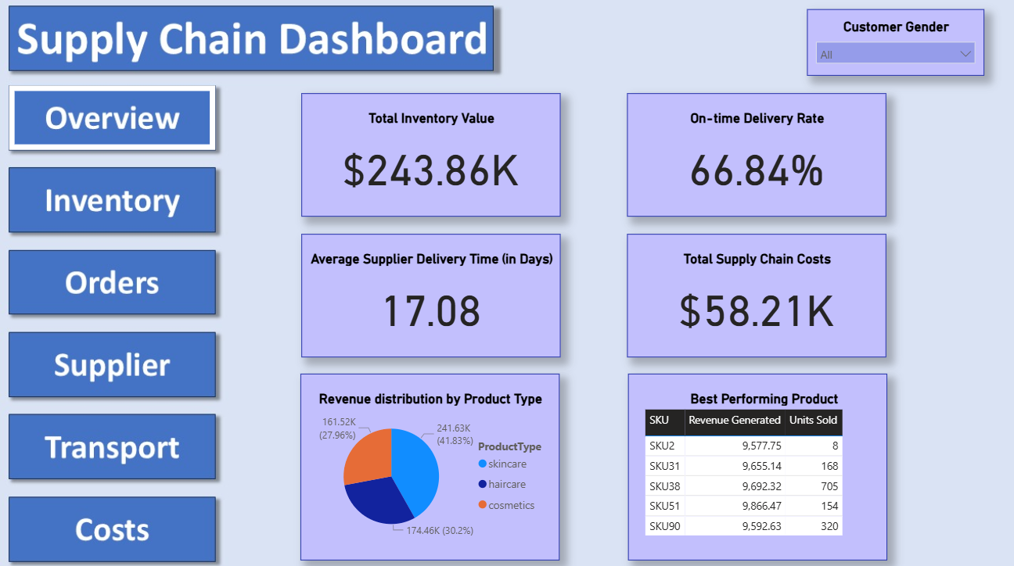
Here is an image of the Overview page from the dashboard.

Slide 9
Conclusion & Recommendation
Key Findings:
The supply chain shows strong operational efficiency with timely deliveries and quick supplier response times.
Transportation emerges as the most significant contributor to overall supply chain costs.
Recommended Actions:
Focus on optimizing transportation logistics to reduce cost impact and improve efficiency.
Continue monitoring supplier performance metrics to maintain quality and delivery standards.

