Slide 1
Student Performance Report

Slide 2
Introduction:
This report presents an overview of student performance, highlighting key personal information, academic goals, and achievements of exemplary students to provide a holistic academic progress view.

Slide 3
01
Student Profiles

Slide 4
Basic personal information and academic goals:
Profiles include name, age, college, CGPA, attendance, AI ranking, and personal academic goals such as building smart systems or inventing AI kernels. Contact details and locations are also summarized.

Slide 5
Academic achievements and awards:
Achievements cover hackathon wins, internships, research presentations, and leadership roles in project development, showcasing technical skills and innovation in AI and software engineering.

Slide 6
Financial status and fee reports:
Both students, Sayed and Hussen, have cleared their total fees of ₹30,000 and ₹31,000 respectively. Reimbursements and building fees are detailed, confirming stable financial standings for smooth academic progression.

Slide 7
02
Academic Performance

Slide 8
Semester-wise subject marks and grades:
Sayed and Hussen's performance is detailed semester-wise with subject marks and grades. For instance, Sayed scored between 82 to 93 across subjects, while Hussen consistently achieved high A grades with marks above 90.

Slide 9
Comparison of SGPA across semesters:
Sayed's SGPA improved progressively from 8.53 to 9.03 by semester five. Hussen's SGPA is exemplary, maintaining above 9.27 throughout, peaking at 9.87 in the final semester.

Slide 10
Highlights of exceptional academic records:
Hussen excelled with a top 1% AI ranking and multiple national-level awards, while Sayed secured hackathon wins and notable internships, demonstrating high technical and research capabilities.

Slide 11
Conclusions:
The presented data confirms strong academic records and financial reliability for both students. Their achievements and progressive performance indicate promising futures in AI and software development.

Slide 12
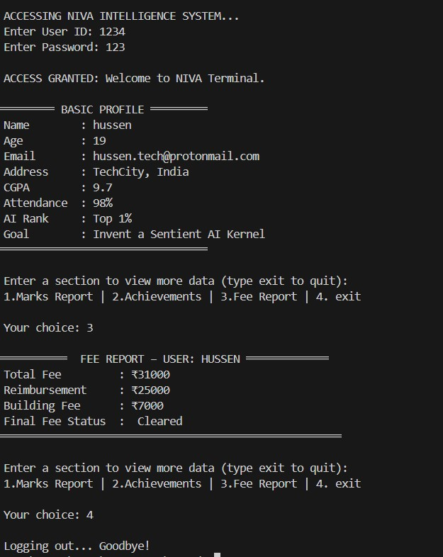
CODE OUTPUT:

Slide 13
THANK YOU

