Slide 1
Project Braille Buddy
A simple learning tool

Slide 2
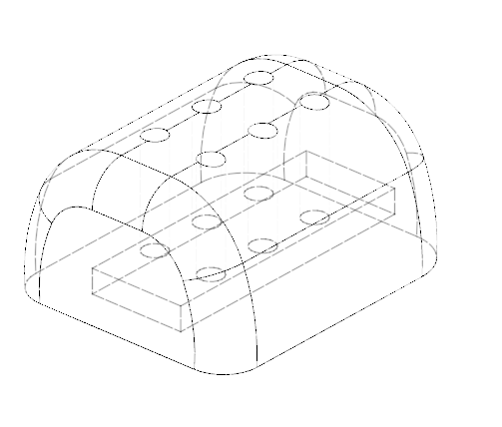
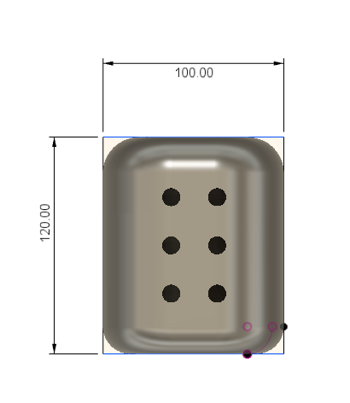
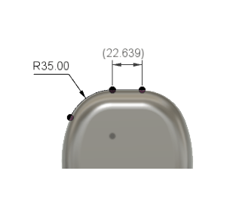
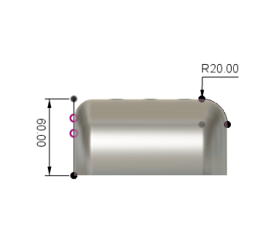
The tiny size is to mimic how braille is actually taught and read. (Views: wirefame, top, front, side )

Slide 3
Main Function
The Braille Buddy acts as a way to translate text on a screen into a physical representation of braille
The simplicity opens the door for expansion in functionality
Targeted towards teaching braille to kids and people who have recently been blinded
Cheaper alternative to other learning resources

Slide 4
Learning tool
Games/Web Apps
Similar to DuoLingo for braille
Strung together for more advanced use
Potential Applications/Expansion

Slide 5
How It Works
A character is entered by the user (a)
The character is then compared to an array containing the “b-code” ( a → ‘12’ )
The b-code is then broken down into separate integers (‘12’ → ‘1’, ‘2’)
These correspond to the six servos in the Braille Buddy ( i.e. ‘1’ raises 1, ‘2’ raises 2 )
1
4
2
5
3
6

Slide 6
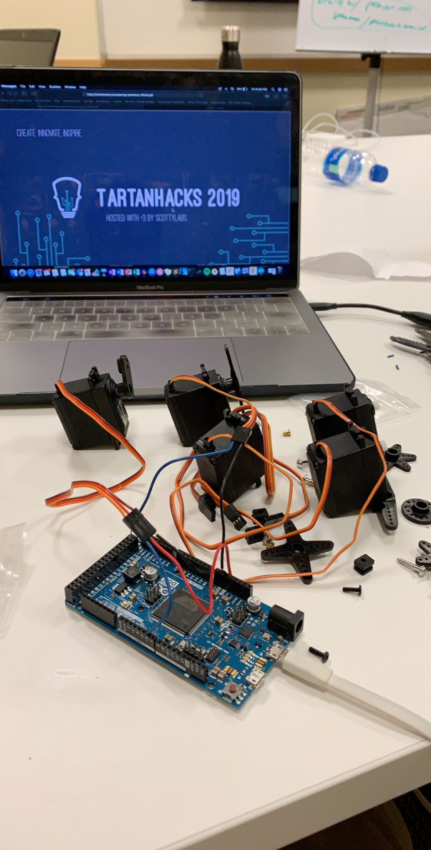
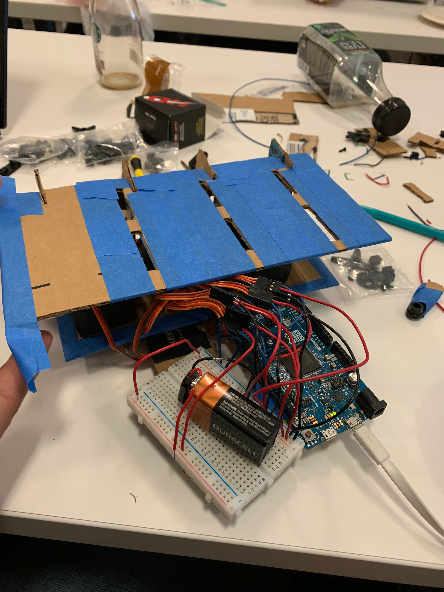
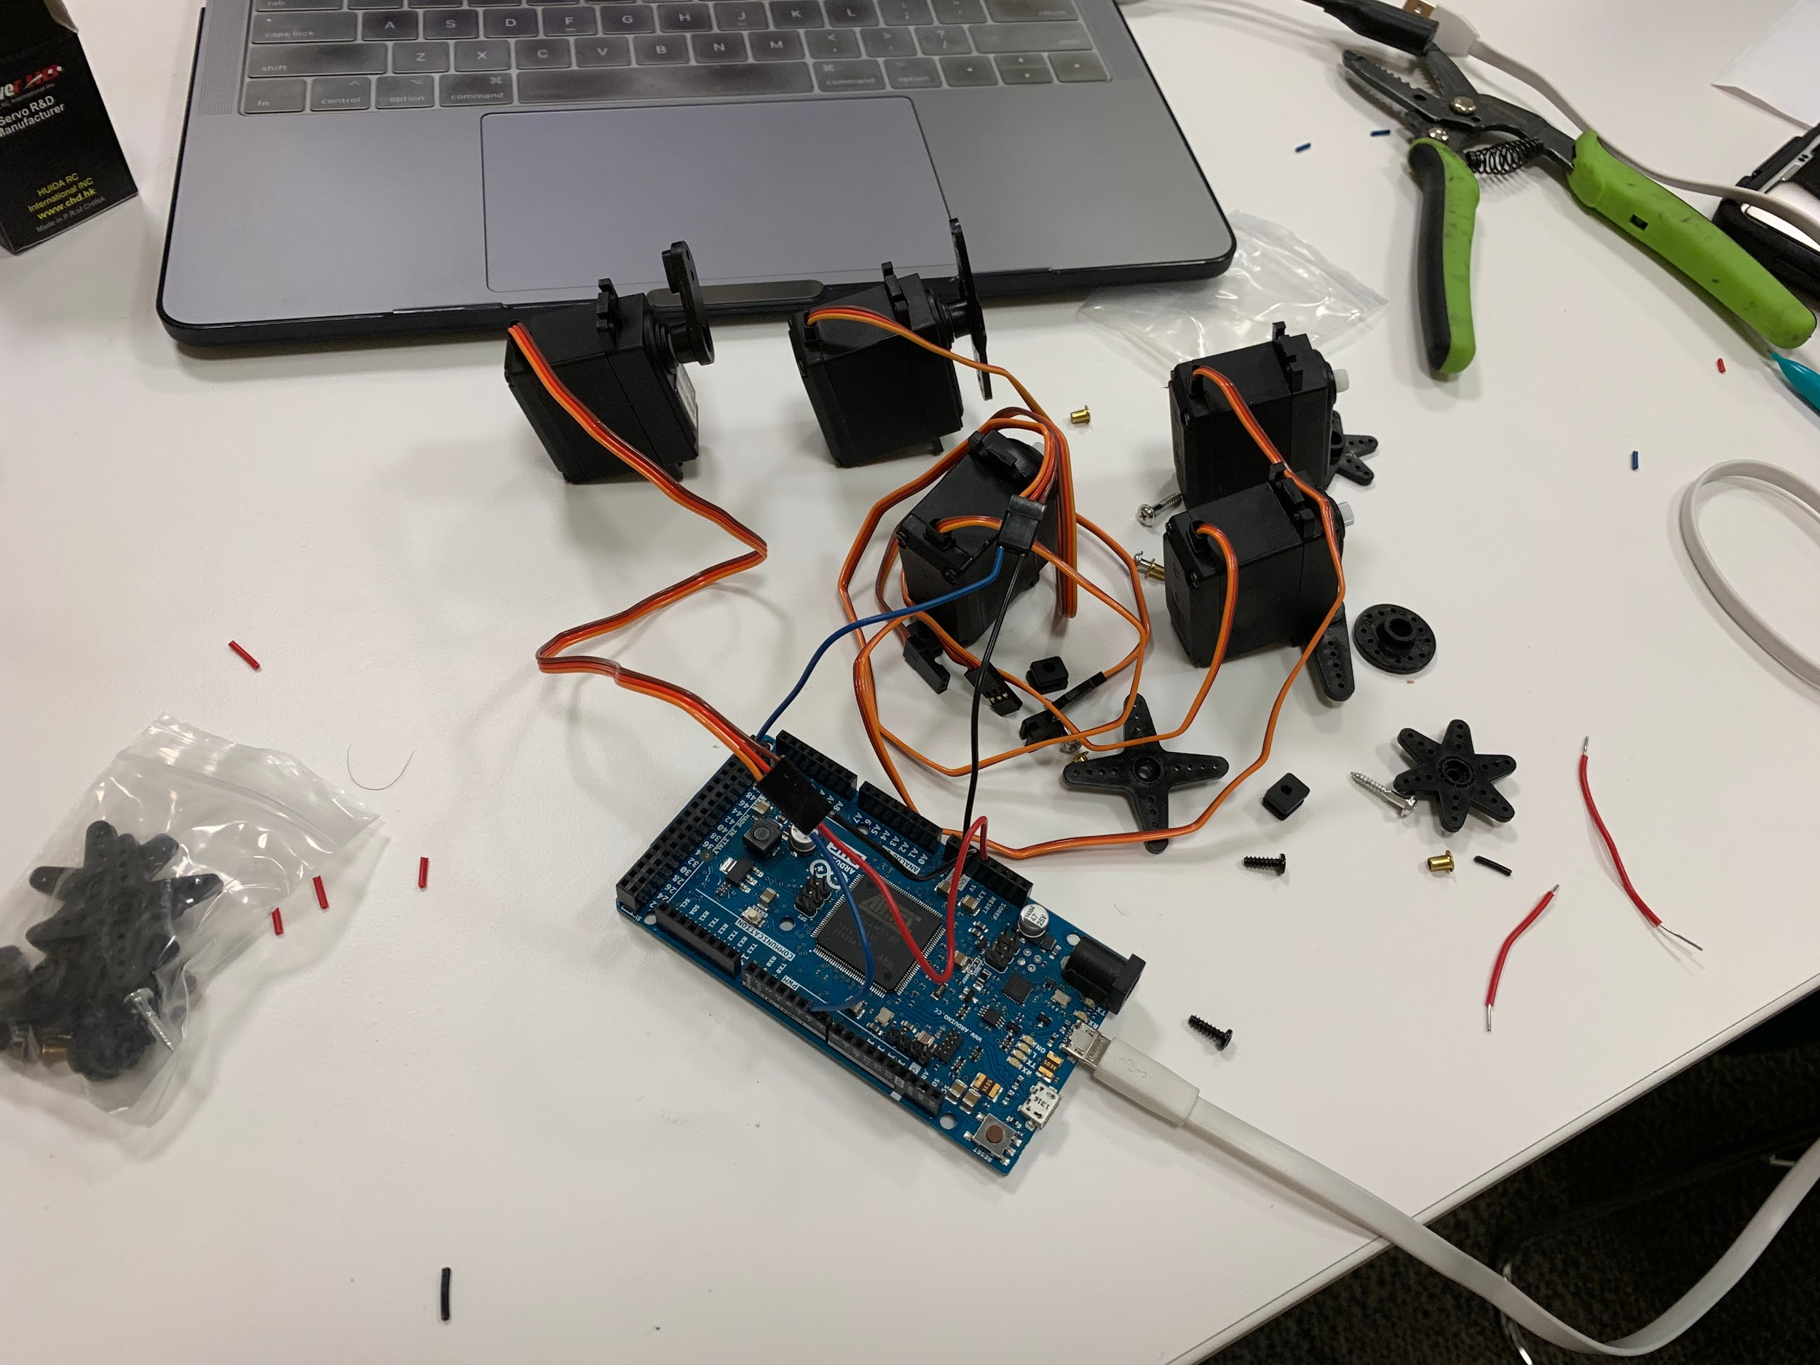
Dev Pics

