Slide 1
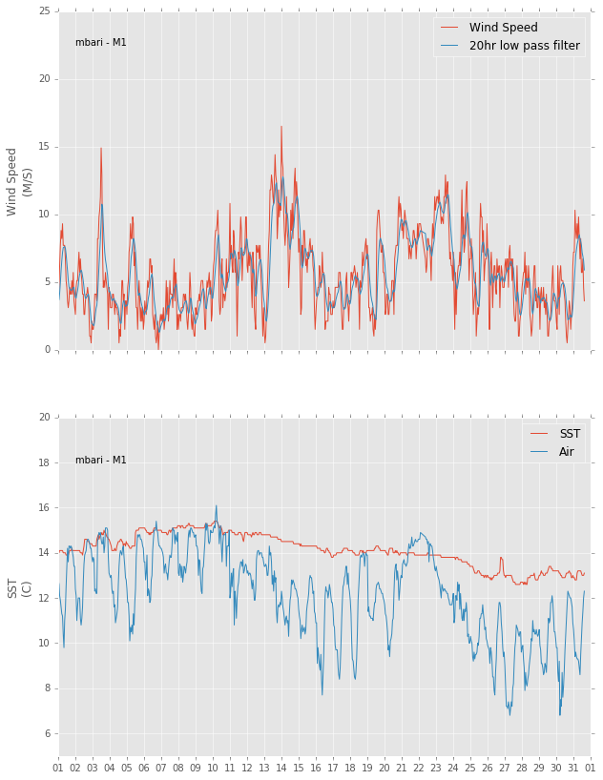
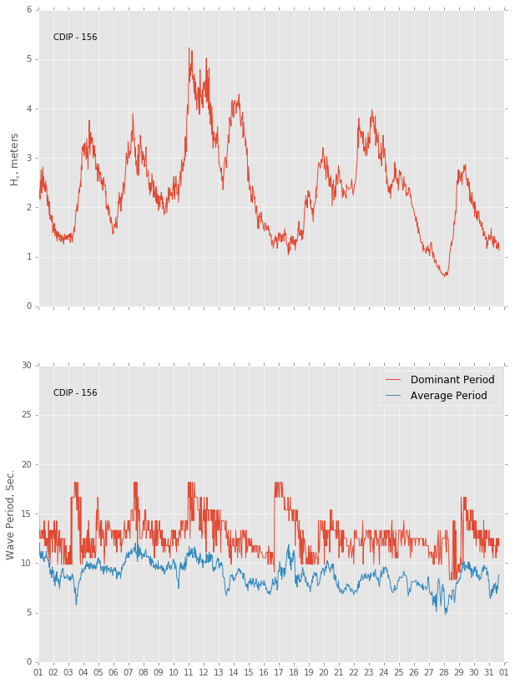
December 2015 – Wind and Wave Field
MBARI M1 Mooring
CDIP 156 – Wave Riding Buoy
Wind Speed
Significant Wave Height
Temperature
Wave period

Slide 2
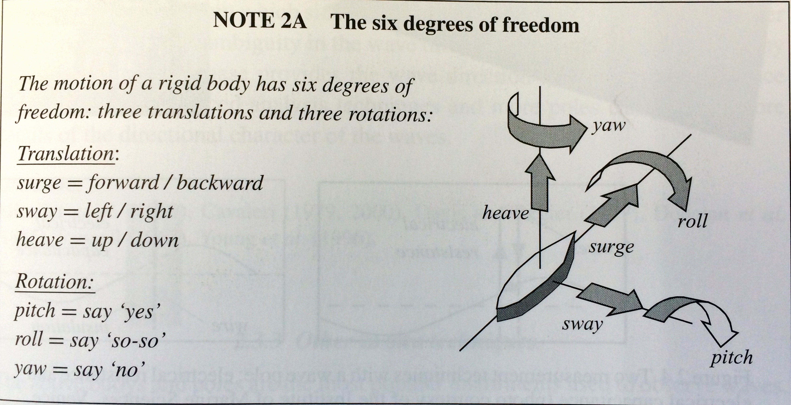
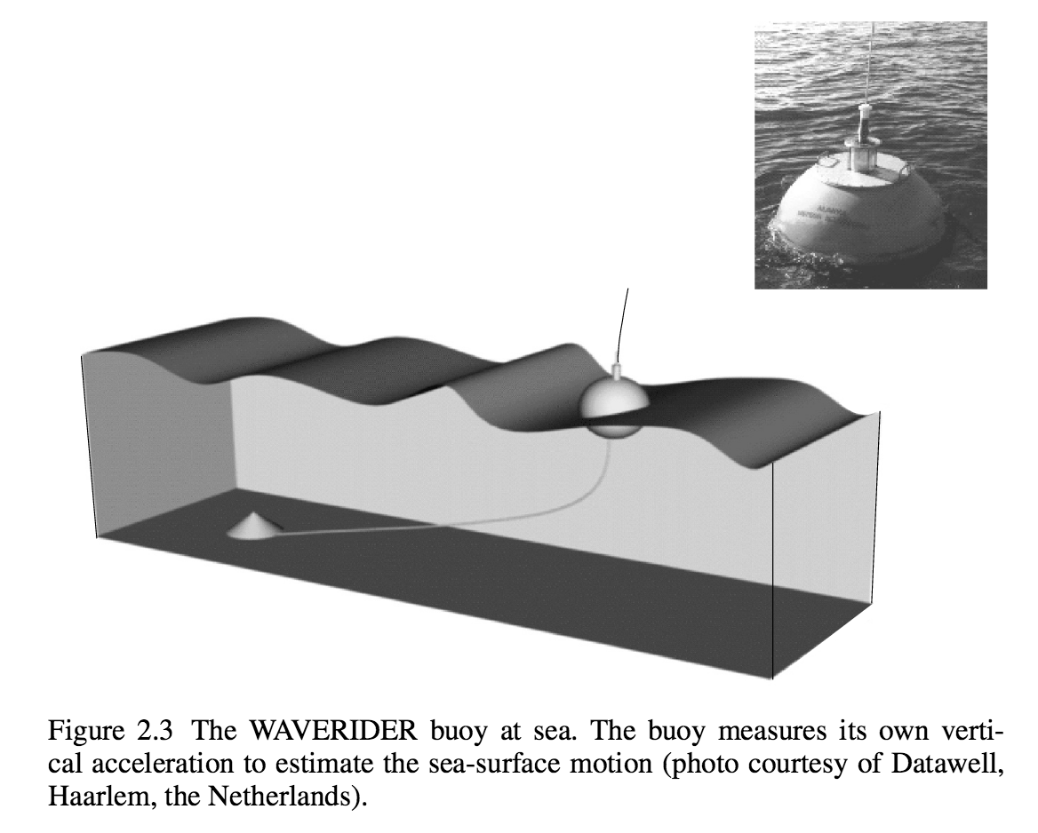
Significant Wave Height
Waves in Oceanic and Coastal Waters, Leo H. HolthuijsenBook

Slide 3
Getting the data
Distributed Oceanographic Data Systems (DODS)
http://dods.ndbc.noaa.gov/thredds/
THREDDS Data Servers (TDS) is a web server application for providing remote access to data and metadata for scientific datasets.
Uses the OPeNDAP – Open Source Project for a Network Data Access Protocol – Simple access to remote data
NetCDF files (.nc) – Network Common Data Form
Pandas Dataframe

Slide 4
Issues and moving foreword
- Issues with wind directions on M1-Data

Slide 5
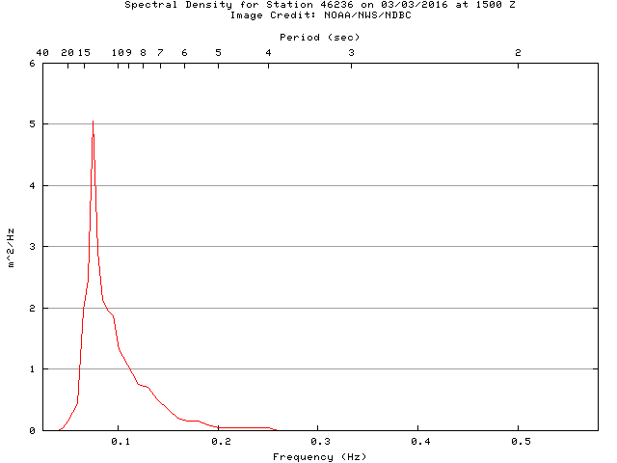
Dominant or peak wave period, DPD, is the period corresponding to the frequency band with the maximum value of spectral density in the nondirectional wave spectrum.
NBDC

