Slide 1
Hello! Tell us a bit about yourselves
Mentimeter

Slide 2
SDMs

Slide 3


Who are we?

Slide 4
How will this workshop run?

Slide 5
Species Distribution Modelling 101

Slide 6
Key resources
Guillera‐Arroita et al. (2015). Is my species distribution model fit for purpose? Matching data and models to applications. Global ecology and biogeography.
Guisan et al. (2017). Habitat suitability and distribution models: with applications in R. Cambridge University Press.
Araújo et al. (2019). Standards for distribution models in biodiversity assessments. Science advances.
Zurell et al. (2020). A standard protocol for reporting species distribution models. Ecography.

Slide 7
Key messages
Modelling is often more art than science
We make many decisions along the way
We need to be transparent and clear about these decisions
We need to spend time understanding the effect of our decisions

Slide 8
Getting started – some questions to ask yourself
What is the aim of my model?
Explanation
Mapping
Transfer
Araújo et al. (2019). Standards for distribution models in biodiversity assessments. Science advances.

Slide 9
Getting started – some questions to ask yourself
What is the aim of my model?
Explanation
Mapping
Transfer
Araújo et al. (2019). Standards for distribution models in biodiversity assessments. Science advances.

Slide 10
Getting started – some questions to ask yourself
What are my model outputs going to be used for?
Spatial prioritisation
Guillera‐Arroita et al. (2015). Is my species distribution model fit for purpose? Matching data and models to applications. Global ecology and biogeography.

Slide 11
Koala ecology (relevant for SDM)

Slide 12
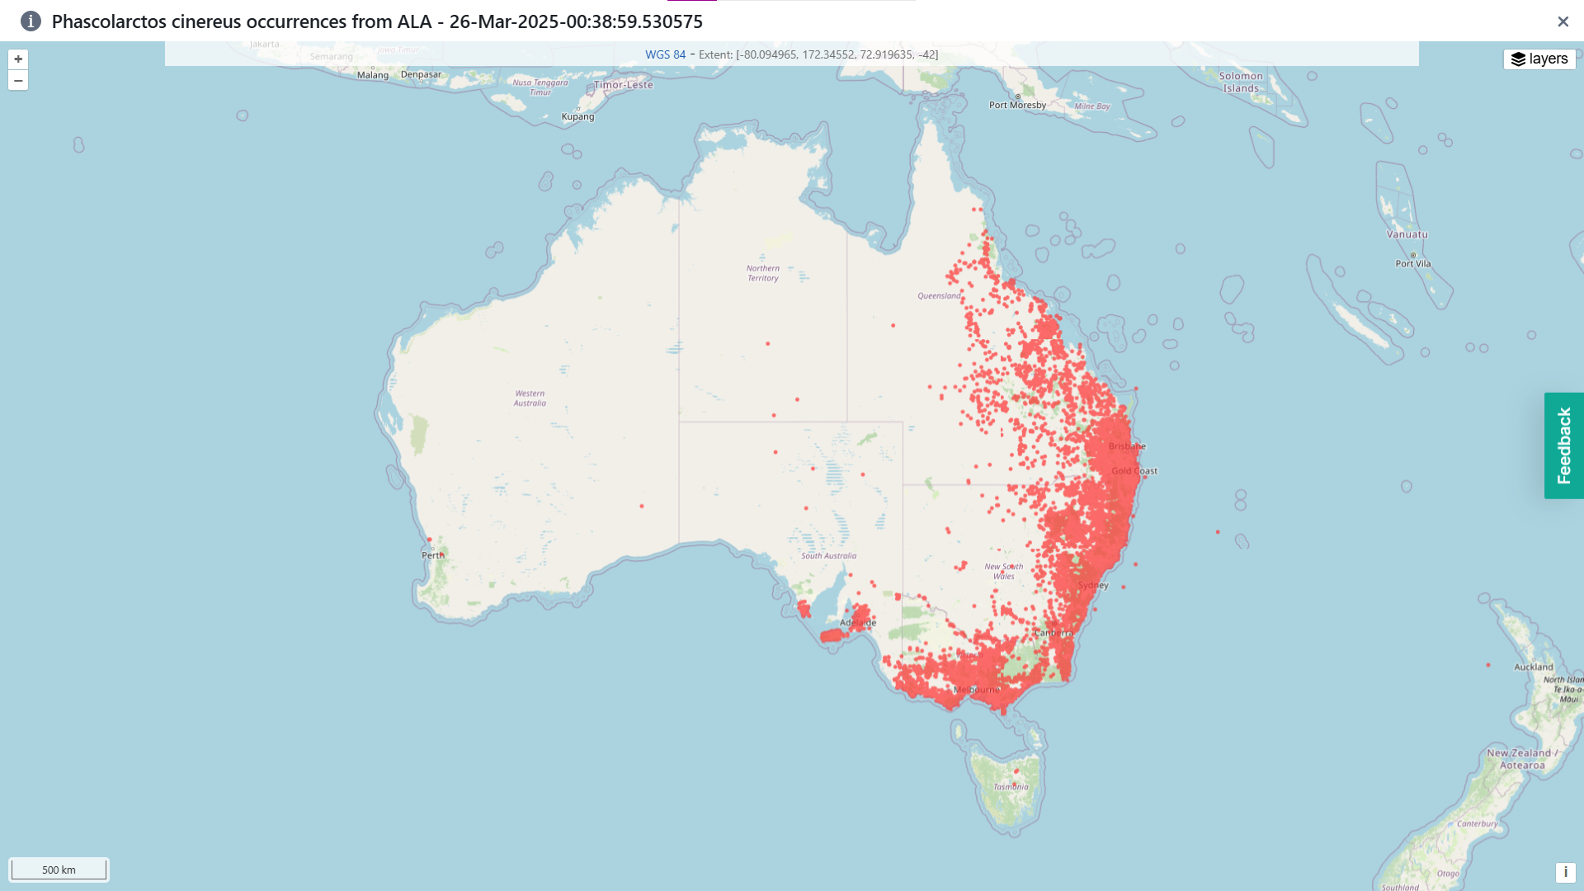

Slide 13

There are many tools out there…

Slide 14
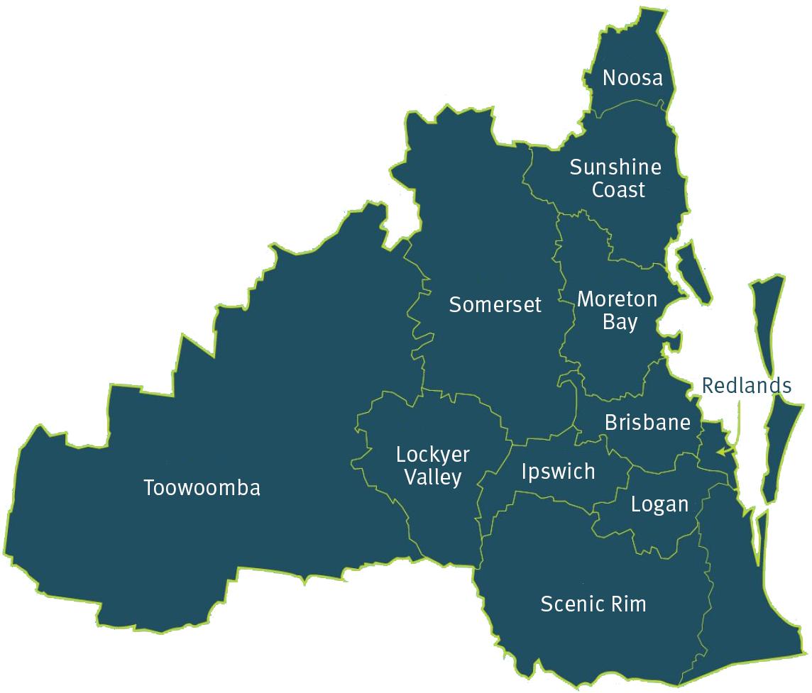
Study region – South East Queensland

Slide 15
