Slide 2
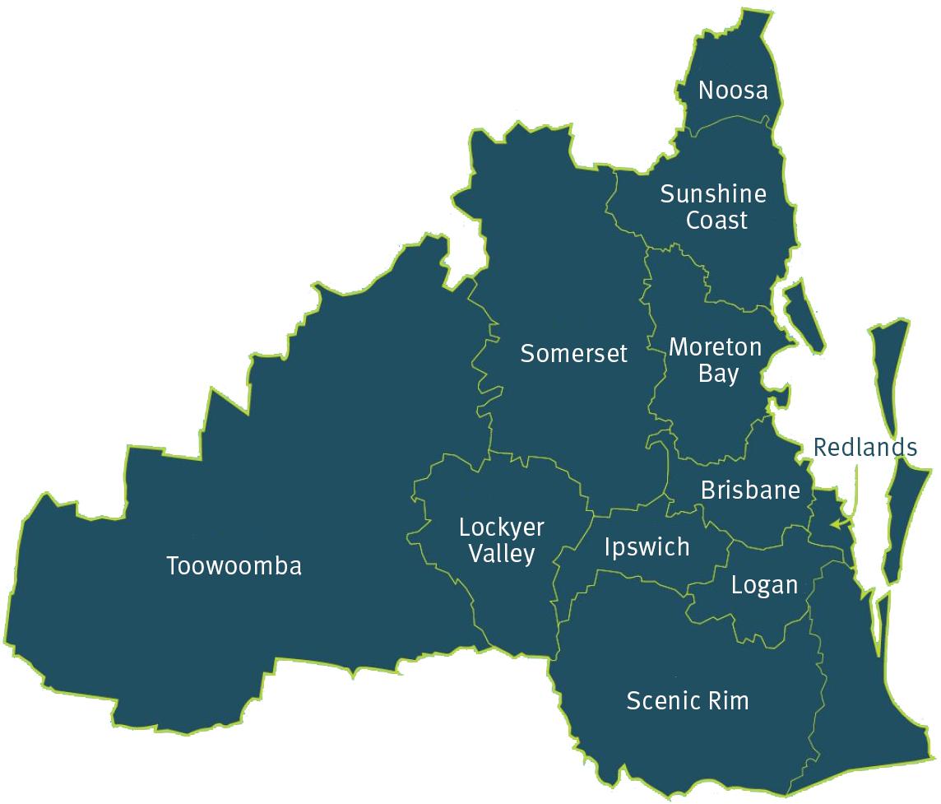
Study region – South East Queensland

Slide 3
