Slide 1

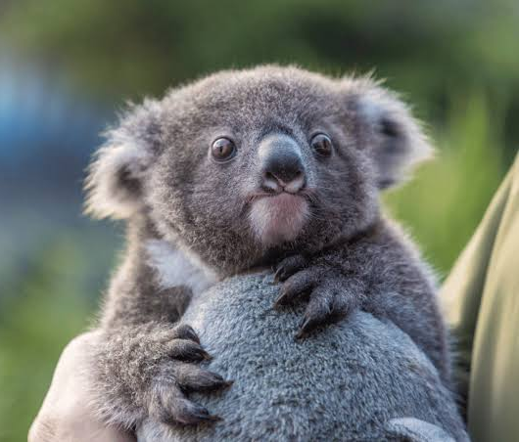

Modelling the SEQ koala distribution under current and future climate scenarios
Charlotte Patterson, QUT
Scott Forrest, QUT, CSIRO

Slide 2

Acknowledgement of Traditional Owners
QUT – Turrbal and Yugara
Lands on which data were collected

Slide 3


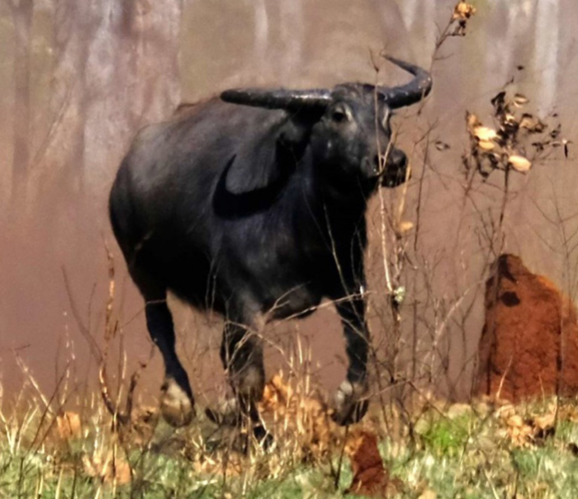
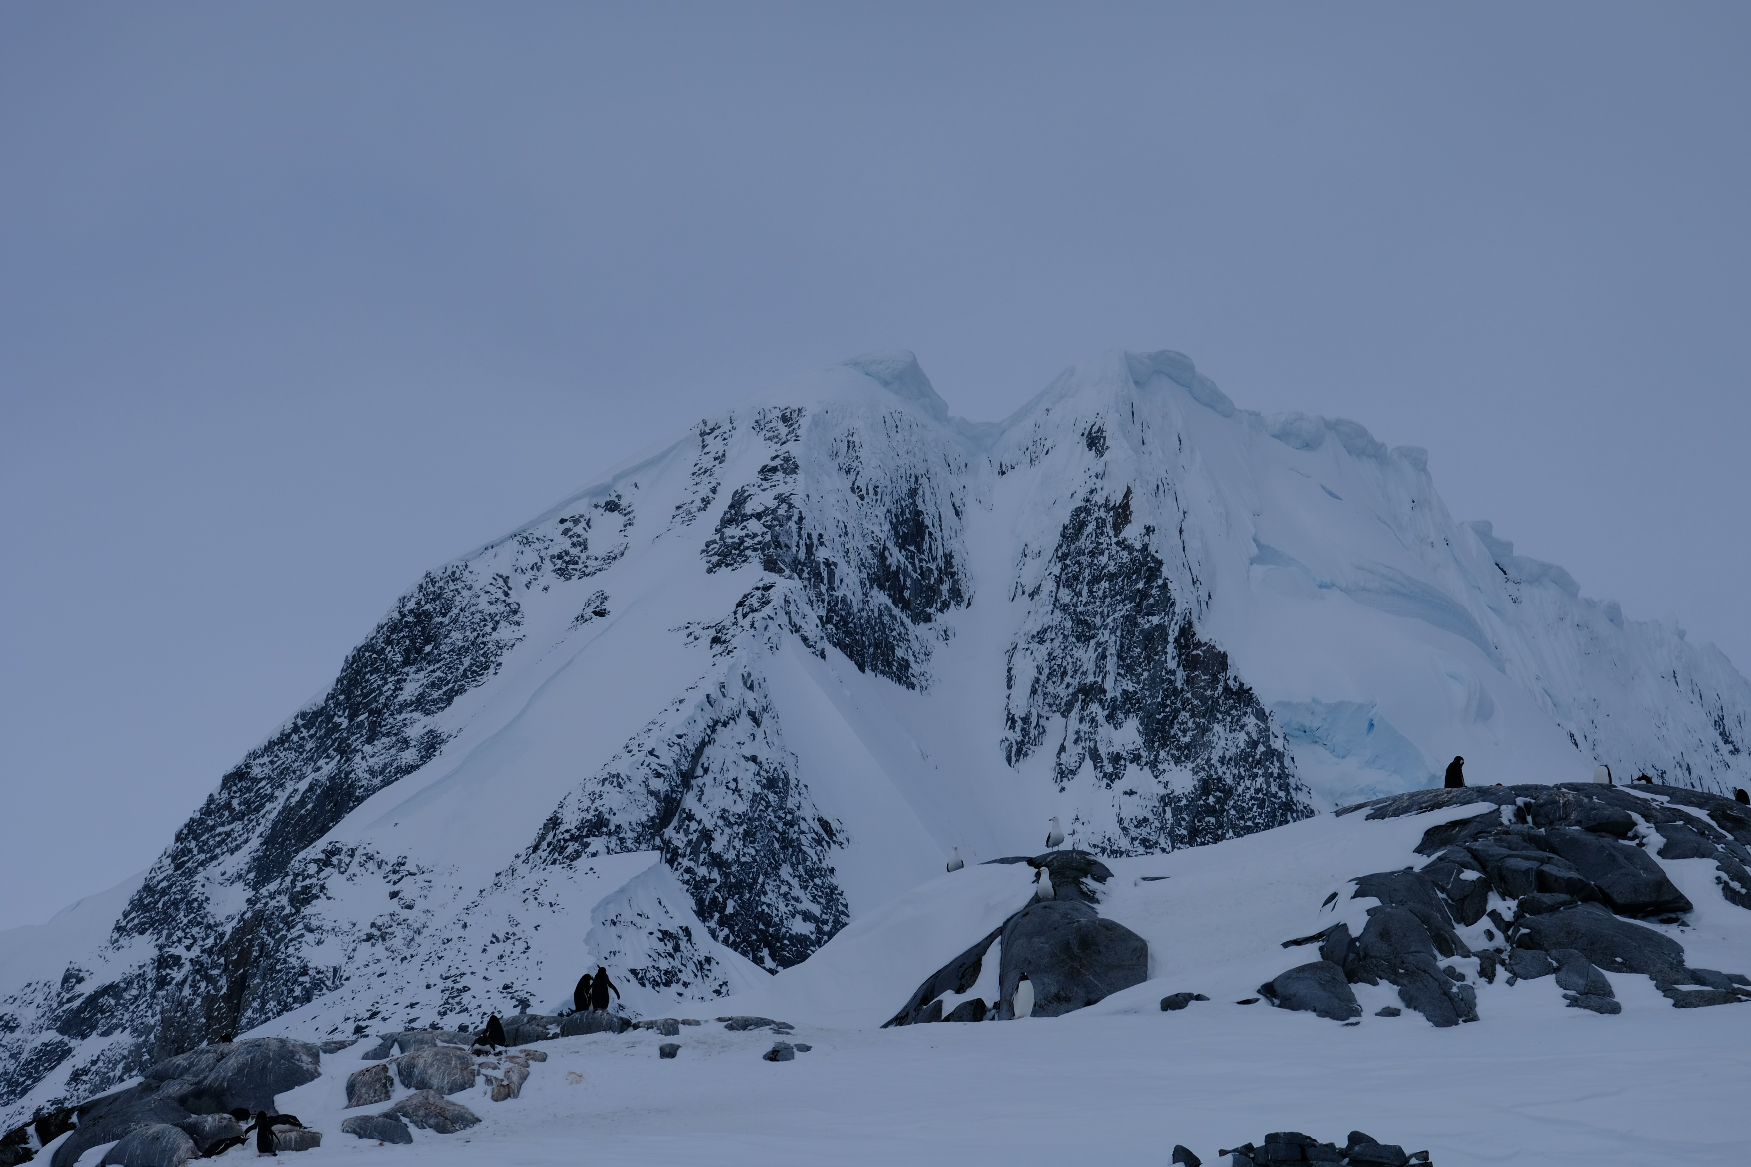
Who are we?
Not koala experts !

Slide 4




How will this workshop run?
Workshop outline:
Intro to SDMs
(Some) Koala ecology
Coded example of SDM workflow
https:// geospatial-community.github.io/ICCB_geospatial_tools_conservation
Look out for:
Spots where careful thought is needed for your SDM application
Key messages
Foundational resources

Slide 5
Where have we been and where are we headed?
Session 1 | Session 2 | Session 3 | Session 4 | Session 5
Intro to geospatial data and tools | Downscaled climate projections | Koala SDMs | Spatial conservation planning | Making maps with QGIS
Jason Flower, Mitch Rudge, Catherine Kim, EcoCommons team | Ralph Trancoso, Sarah Chapman, Rohan Eccles | Charlotte Patterson, Scott Forrest | Brooke Williams, Caitie Kuemple | Emma Hain, Nyall Dawson, Jason Flower
Where are we going to place protected areas to secure future populations of koalas under climate change scenarios?

Slide 6
Take home message
Modelling is often more art than science. There are many ways to model species, none of them the ‘right way’. Some can, however, be more appropriate for a study question or species.
We make many decisions along the way and need to be transparent and clear about these decisions.

Slide 7
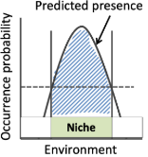
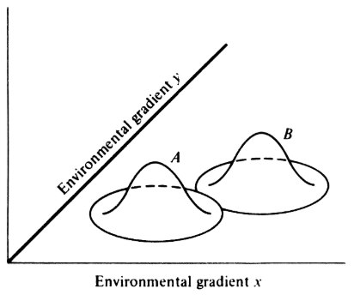
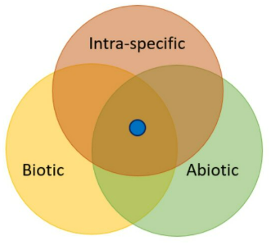
The SDM question: Where are species and why are they distributed as they are?
Ecological Niche Models; Habitat Suitability Models; Climate Envelope Models
http://www.zo.utexas.edu/courses/bio373/chapters/Chapter13/Chapter13.html
Takola & Schielzeth (2022)
Guisan et al. (2017). Habitat suitability and distribution models: with applications in R. Cambridge University Press.
Notes:
Based on niche theory – basically that in environmental space there’s some optimal area for a species occurrences. Can look at this in multiple dimensions. We might call this the species climatic niche. Of course this isn’t solely what drives a species. Once we consider other things like dispersal or competition, we might call that the realised niche.

Slide 8

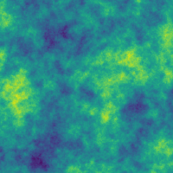
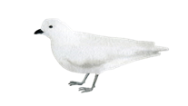

The SDM question: Where are species and why are they distributed as they are?
Ecological Niche Models; Habitat Suitability Models; Climate Envelope Models
Environmental variables
-Soil moisture
-Temperature
etc.
Interpolated probability of spp. presence
Guisan et al. (2017). Habitat suitability and distribution models: with applications in R. Cambridge University Press.

Slide 9
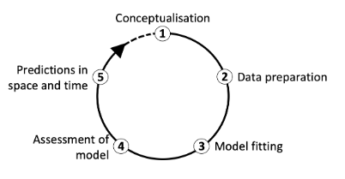
An SDM workflow
Zurell et al. (2020). A standard protocol for reporting species distribution models. Ecography.

Slide 10
Conceptualisation: Some questions to ask yourself
What is the aim of my model?
Explanation
Mapping
Transfer (spatial and/or temporal)
Araújo et al. (2019). Standards for distribution models in biodiversity assessments. Science advances.

Slide 11
Conceptualisation: Some questions to ask yourself
2. What are my model outputs going to be used for?
Testing hypotheses about a species’ ecology
Spatial prioritisation for protection
Choosing where to survey
Clearly defining your model’s purpose guides your workflow
Guillera‐Arroita et al. (2015). Is my species distribution model fit for purpose? Matching data and models to applications. Global ecology and biogeography.
Notes:
Down a scale of don’t need to be that accurate to need to be really accurate.

Slide 12
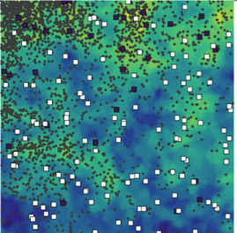

Data for modelling a species distribution
Presence-only
Occurrence/incidental records
Citizen science databases
Presence-absence
Systematic surveys
Atlases
Your data limit what is possible with SDMs. Prioritise quality over quantity.
Notes:
Gold standard is PA but mostly we don’t have PA. Always try to get some. This usually drives the type of model that you can do.

Slide 13
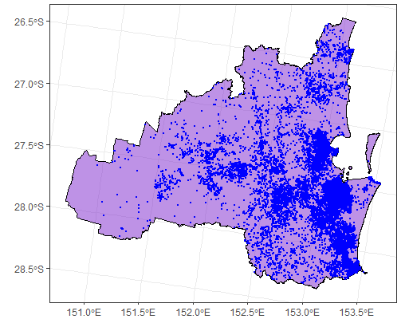
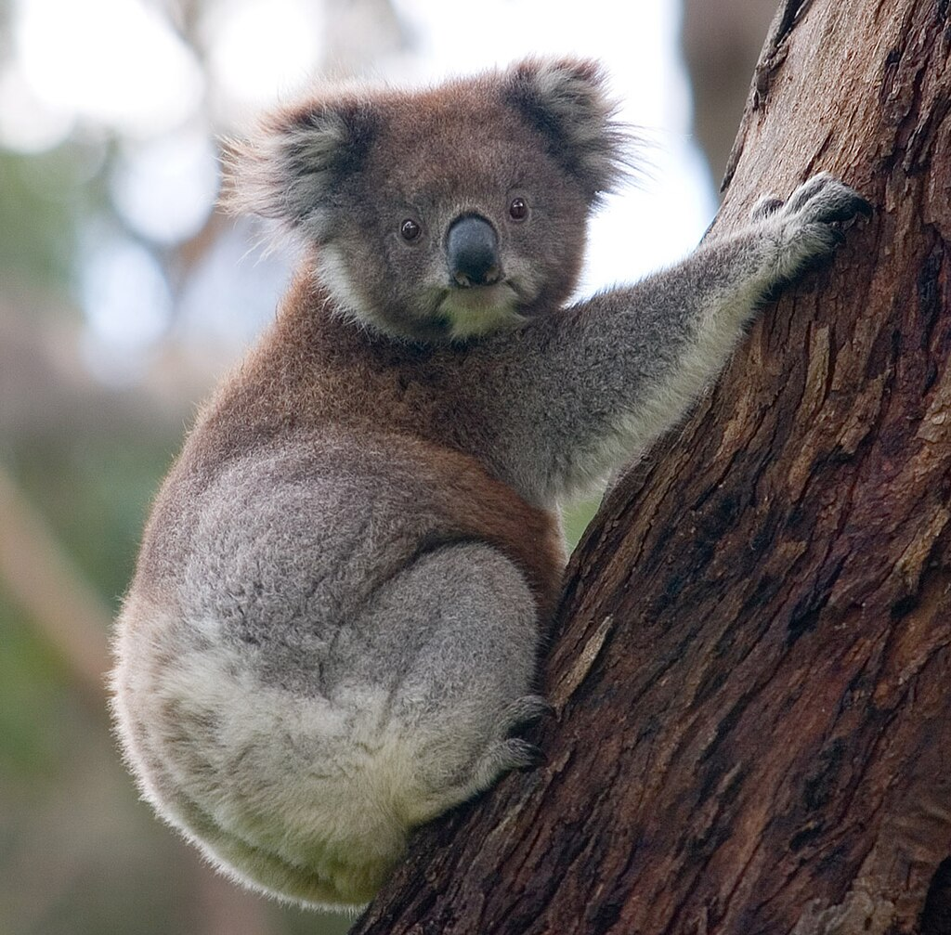




Koala data from the ALA
https://galah.ala.org.au/R/articles/quick_start_guide.html
Photo by DAVID ILIFF. License: https://creativecommons.org/licenses/by-sa/3.0/

Slide 14
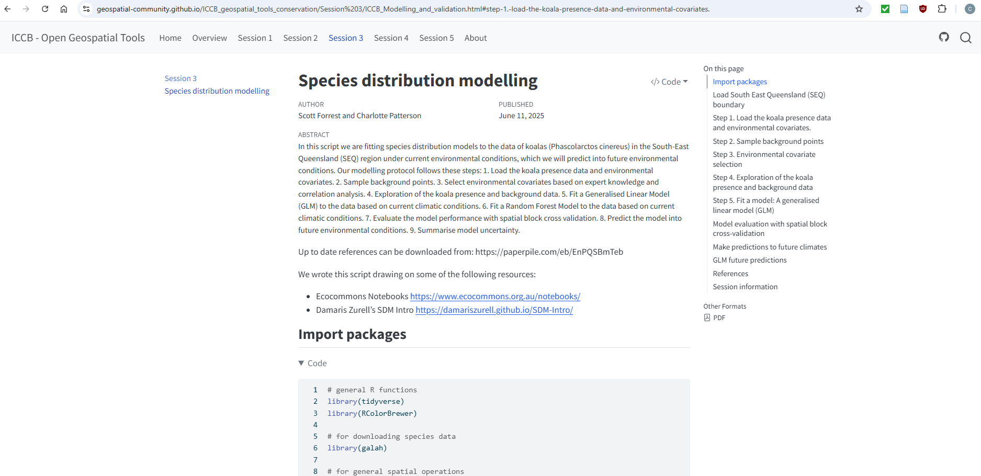
Have a go: Data preparation
https://geospatial-community.github.io/ICCB_geospatial_tools_conservation
Questions:
How many koala presences are there in QLD? How about SEQ?
What sources do the data come from?
What years are they from?

Slide 15
Background selection
Many ‘presence-only’ approaches rely on the selection of background or ‘pseudo-absence’ points
These points are contrasted against environmental conditions where your species was found
Background selection is a critical step in presence-only SDMs. Choices reflect your understanding of your study species.
Notes:
Gold standard is PA but mostly we don’t have PA. Always try to get some. This usually drives the type of model that you can do.

Slide 16
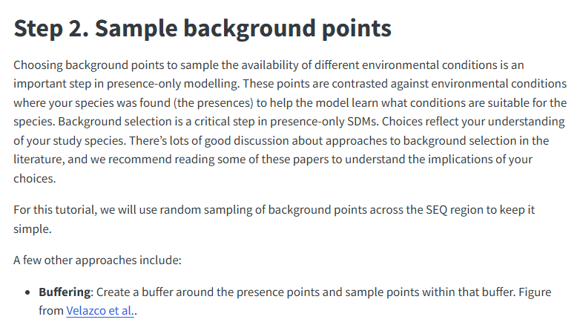
Have a go: Background selection
https://geospatial-community.github.io/ICCB_geospatial_tools_conservation

Slide 17
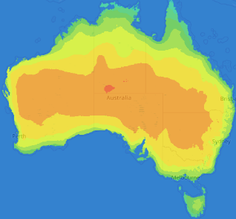
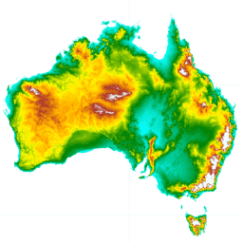
Environmental layers
Raster data representing covariates that can be used to describe a species’ niche.
Common examples are:
‘Bioclim’ variables related to temperature and precipitation
Topographic variables like elevation
Satellite-derived measures of vegetation
Notes:
Key consideration here includes: how relevant are they for defining a species’ niche? What’s available? At what resolution?

Slide 18

Koala (Phascolarctos cinereus)
Found in open forest and woodland
Dependent on specific feeding trees*
~ 30 species of Eucalyptus
Sensitive to land-use change
*a spatial layer of these trees can be used as a mask
Photo by DAVID ILIFF. License: https://creativecommons.org/licenses/by-sa/3.0/

Slide 19
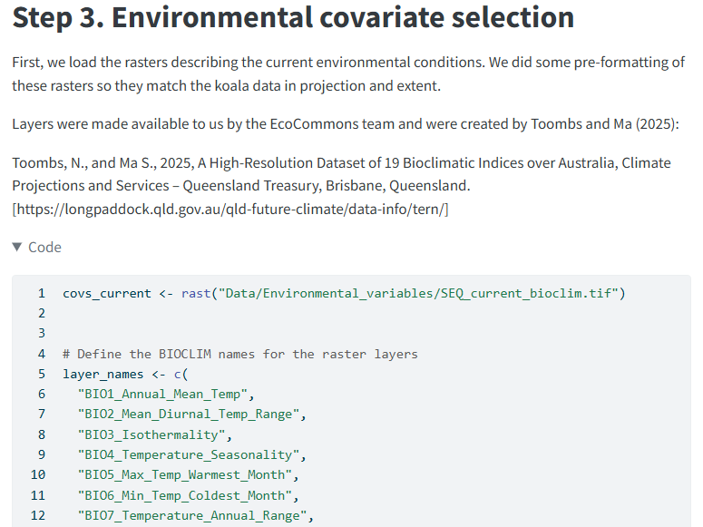
Let’s look at our covariates & explore our data
https://geospatial-community.github.io/ICCB_geospatial_tools_conservation

Slide 20
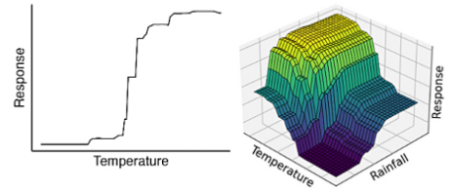
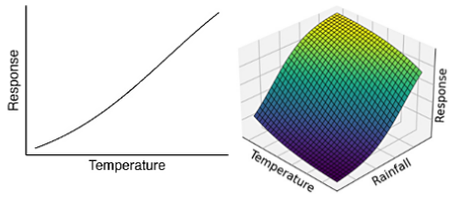
Models and algorithms
There’s no one ‘right’ model to use – different models are best for different contexts. Sometimes multiple models must to be tried to find the best approach.
Models differ in their flexibility and interpretability
Spectrum from linear to highly non-linear
Different strengths depending on model aim
Generalised Linear Model (GLM)
Generalised Additive Model (GAM)
Random Forest (RF)
Maximum entropy modelling (Maxent)
Deep learning approaches
Convolutional neural networks

Slide 21
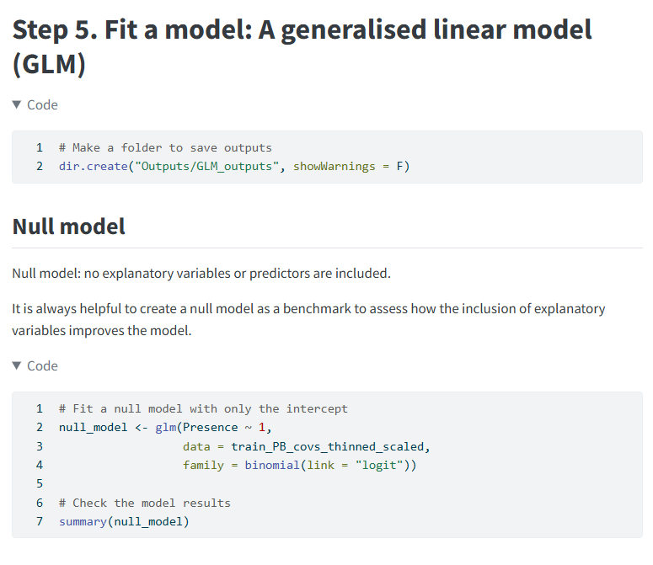
Time to fit some models!
https://geospatial-community.github.io/ICCB_geospatial_tools_conservation

Slide 22
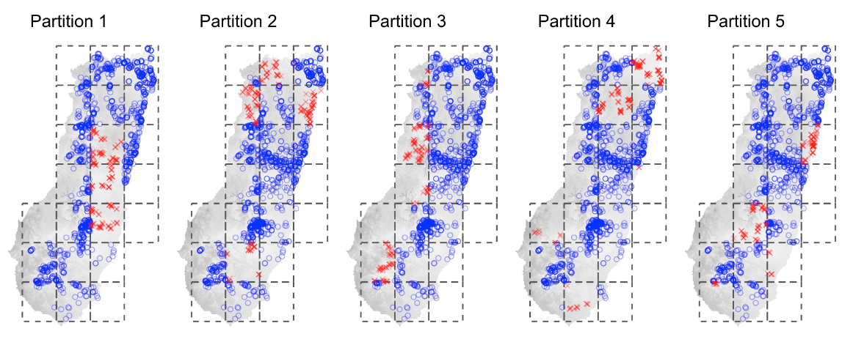
Validating SDMs
Cross-validation (CV)
Hold out a subset of the data to test the model’s predictions against
Spatial block CV
Truly independent presence-absence data is the gold standard
Valavi et al. (2023)

Slide 23
Validating SDMs – Evaluation metrics
‘Threshold-dependent’ or ‘Threshold-independent’
Calibration (e.g., Boyce Index)
Discrimination (e.g., AUC ROC)
Multiple metrics can describe different aspects of model performance – some more or less relevant to your study
Notes:
Calibration = model correctly predict conditional probability of presence
Discrimination = model can discriminate between occupied and unoccupied sites

Slide 24
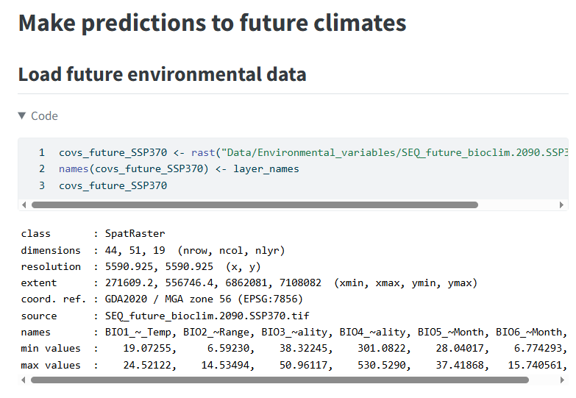
Let’s predict the future for koalas
https://geospatial-community.github.io/ICCB_geospatial_tools_conservation

Slide 25
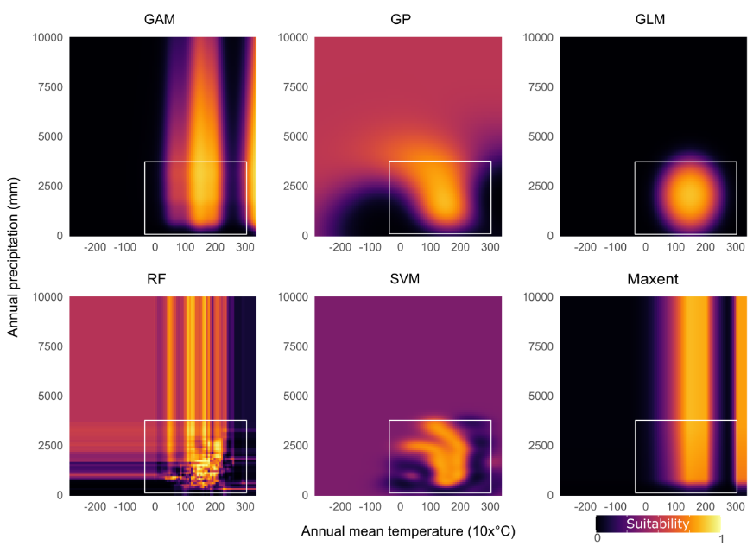
Predicting into the unknown & uncertainty
Velazco et al. (2023) How far can I extrapolate my species distribution model? Exploring shape, a novel method. Ecography.

Slide 26
Take home message
Modelling is often more art than science. There are many ways to model species, none of them the ‘right way’. Some can, however, be more appropriate for a study question or species.
We make many decisions along the way and need to be transparent and clear about these decisions.

Slide 27
Thanks everyone!

