Slide 1
Basic PIC-C I2C Communication
Arnan (Roger) Sipitakiat
Department of Computer Engineering, Chiang Mai University, Thailand

Slide 2
I2C Basics
I2C is a Bus. Serial is point-to-point
Master and Slave pair
Master must start the communication
Slave can only respond
Slave has a 8-bit address
Bit 0 is reserved for direction control

Slide 3
Basic I2C Bus Setup
5V
MASTER
SLAVE 1
SLAVE 2
Pull-up Resistors
SDA
SCL

Slide 4
i2C Commands in PIC-C
Master Only
I2c_start()
I2c_stop()
Slave Only
I2c_isr_state()
Master & Slave
I2c_read()
I2c_write()

Slide 5
Sending 1 Byte to Slave
MASTER
SLAVE
I2c_start()
I2c_write(slave addr | 0)
I2c_write(registerAddress)
I2c_write(value)
I2c_stop()
Address | Content
0 | 0
1 | 0
2 | 0
3 | 0
4 | 0
5 | 0
6 | 0
7 | 0

Slide 6
Reading 2 bytes from slave
MASTER
SLAVE
I2c_start()
I2c_write(slave addr | 0)
I2c_write(registerAddress)
I2c_start()
I2c_write(slave addr | 1)
Value1 = I2c_read()
Value2 = I2c_read(0)
I2c_stop()
Address | Content
0 | 0
1 | 0
2 | 0
3 | 0
4 | 0
5 | 0
6 | 0
7 | 0

Slide 7
Write ค่า 50 ไปยัง Register 5 ของ slave ที่มี address = 100
I2c_start();
I2c_write(100 | 0);
I2c_write(5);
I2c_write(50);
I2c_stop();

Slide 8
Write ค่า 1000 ไปยัง Register 5 (ไบท์บน), 6 (ไบท์ล่าง) ของ slave ที่มี address = 100
I2c_start();
I2c_write(100 |0);
I2c_write(5);
I2c_write(1000 >> 8); // upper byte of 1000
I2c_write(1000 & 0xFF); // lower byte of 1000
I2c_stop();

Slide 9
Read ค่าจาก Register 5 ของ slave ที่มี address = 100
Int returnValue;
I2c_start();
i2c_write(100 |0);
I2c_write(5);
I2c_start();
I2c_write(100 | 1);
returnValue = i2c_read(0);
I2c_stop();

Slide 10
Read ค่าเซ็นเซอร์ 2 byte จาก Register 5,6 ของ slave ที่มี address = 100
Int v1,v2;
I2c_start();
i2c_write(100 |0);
I2c_write(5);
I2c_start();
I2c_write(100 | 1);
v1 = i2c_read();
V2 = i2c_read(0);
I2c_stop();

Slide 11
Example I Controlling the Display Module Address = 0xB0
Register Address | Function
2 | High Byte
3 | Low Byte

Slide 12
Example Program
// i2c1 - Master
#use i2c(MASTER, I2C1)
// Show the number 100 on the screen
I2c_start();
I2c_write(0xB0 | 0); // display module address
I2c_write(2); // show number command
I2c_write(0);
I2c_wirte(100);
I2c_stop();

Slide 13
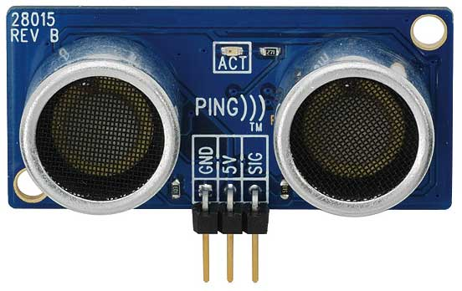
Example II Reading from the ultrasonic sensor

Slide 14

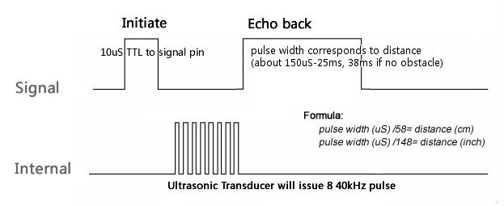
How the module works

Slide 15
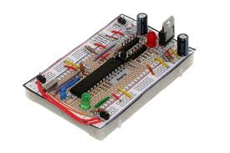

Direct Connection to the module You need to do all the timing yourself
Implement timing

Slide 16
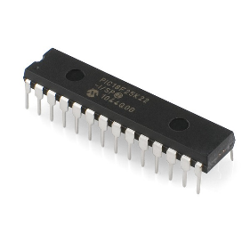
Offload to an I2C Host
Let an I2C host perform the timing
I2C
Take care
of timing

Slide 17
Tradeoffs of offloading
The Good
The sensor is simpler to use.
The main processor is free to do other things.
More modular.
The Bad
More expensive
Must be careful of timing problems on the I2C host

Slide 18
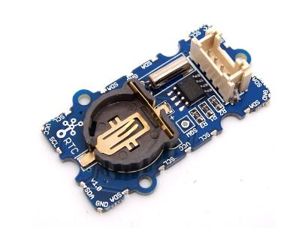
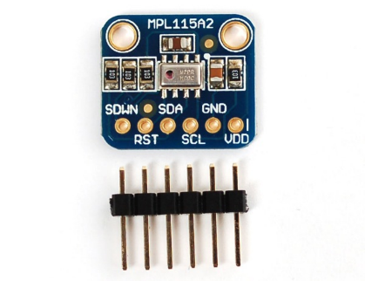
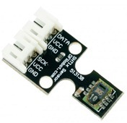
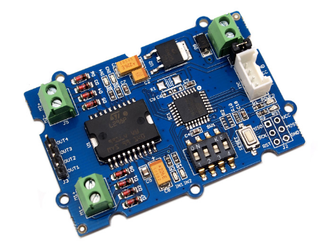
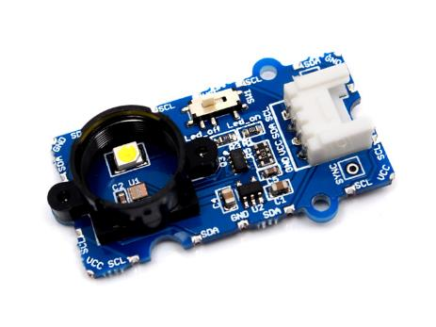
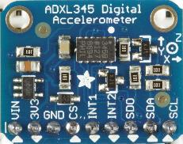
Example 3: I2C devices on the market
Digital Clock
Barometer
Temperature & RH
Color Sensor
Accelerometer
Motor Driver

Slide 19
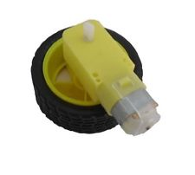

Motor Driver Module
Register Address | Function
0x82 | Speed (0-255)
0x84 | PWM Frequency
0xAA | Direction (0/1)
0xA1 | Select Motor A (0/1)
0xA5 | Select Motor B (0/1)

Slide 20
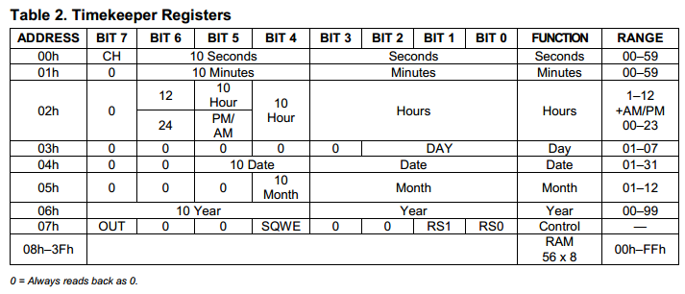

Clock Module Module address = 0xD0

