Slide 1
SuperFoodsMax
Addressing the Challenges of Increasing Engagement of Customers
Presented by Patricia Reyes
Notes:
Hello, Everyone! I am going to discuss an important topic that will drive the growth and success of SuperFoodsMax. This analysis will give insights to the business problem of addressing the challenges of increasing engagement of customers. The aim of this analysis is to improve the frequency of customers’ engagements by identifying personal preferences of each customer segments.

Slide 2
Ethical and Legal Considerations on Data Privacy
Customer identities are excluded to maintain privacy and confidentiality.
By implementing these ethical and legal considerations, the analysis prioritizes data security and anonymity
Notes:
Before I start, I would like to address the ethical and legal considerations on data privacy.

Slide 3
Assumptions to consider:
Stagnating Revenue Growth.
There is a concerning trend of stagnant revenue growth due to the failure of increasing the average spend among our loyal customers. This calls for a renewed focus on encouraging higher spending levels.
Conversion of First Time customers
There is an issue with first-time customers not transitioning into loyal customers. This conversion bottleneck needs to be addressed to expand our loyal customer base.
Behaviour of promiscuous customers
Some customers with promiscuous shopping habits are indeed big spenders. However, they tend to limit their purchases to a specific range of commodities. We must explore ways to broaden their product selection.
Notes:
As I begin my presentation, it is crucial to acknowledge some key assumptions that frame my analysis.
Stagnating Revenue Growth.
Conversion of First Time customers
Behavior of promiscuous customers

Slide 4
Supporting Questions:
Which loyalty types has the highest spending?
What are the distribution of different customer segments (household type and age band) to loyalty segment?
What products can we strategize to different customer segments to improve their engagement?
Notes:
To guide our analysis, let's consider the following supporting questions:

Slide 5
Which loyalty type has the highest spendings?
Revenue Distribution
Transaction Frequency
Average Spending
Notes:
Which loyalty type has the highest spendings?
Our first step is to identify the loyalty types that exhibit the highest spending patterns. This knowledge will guide us in targeting efforts towards maximizing revenue from our most valuable customer segments.
In this question we will look at the following:
Revenue Distribution by Loyalty
Transaction Frequency by Loyalty
Yearly Average Spending Amount by Loyalty

Slide 6
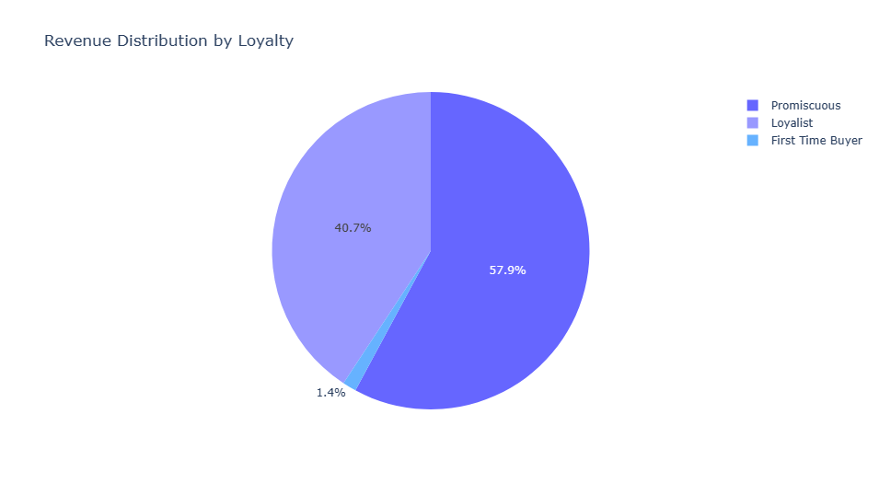
Revenue Distribution
Notes:
The pie chart provides a clear picture of the revenue distribution among the loyalty types over a four year timeframe. Promiscuous customers stand out as the primary revenue drivers, followed by Loyalists, while First time Buyers make a fair contribution. These insights underscore the necessity of targeted strategies that focus on maximising revenue potential from Promiscuous customers to Loyalists, while also devising effective conversion tactics to elevate the revenue contribution of First Time Buyers.

Slide 7
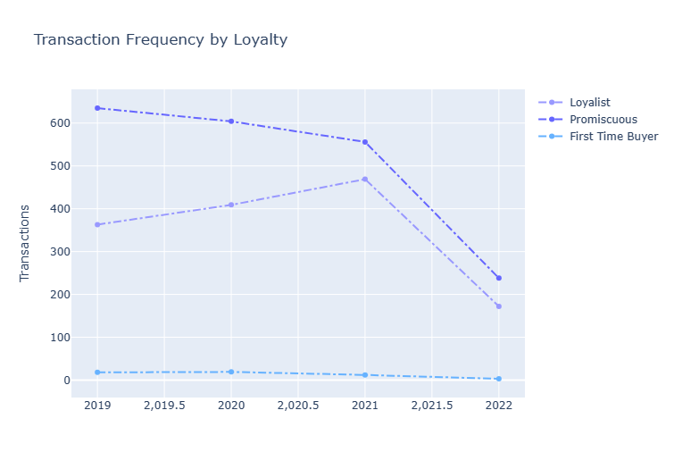
Transaction Frequency
Notes:
The insights drawn from this line chart explain the patterns in customer transaction activities.
For Promiscuous customers, the line chart depicts a gradual decline in transaction frequency over the four years. In 2019, Promiscuous customers conducted 635 transactions, which dipped to 604 in 2020 and further decreased to 556 in 2021. However, the most significant drop is observed in 2022, where transaction frequency plummeted to a mere 238. This severe decline raises questions about the factors contributing to this drop and warrants a thorough examination of potential reasons, such as changing consumer preferences, external economic influences, or alterations in marketing strategies.
In contrast, Loyalist customers display a more fluctuating trend in transaction frequency. In 2019, Loyalist customers engaged in 363 transactions, which increased to 409 in 2020. The upward trajectory continued in 2021, reaching 469 transactions, indicating a positive growth pattern. However, mirroring the trend seen among Promiscuous customers, there is a substantial drop in transaction frequency for Loyalist customers in 2022, where the count decreased to 172. This sharp decline necessitates a deeper analysis to identify the triggers for this downturn and inform strategic interventions.
First Time buyers consistently exhibit lower transaction frequencies across the entire four-year span. With only 18 transactions in 2019, 19 in 2020, 12 in 2021, and a mere 3 in 2022, the line chart accentuates the challenge in converting First Time buyers into more active participants. This persistent low transaction frequency underscores the need for dedicated efforts to enhance engagement, loyalty, and repeat business from this segment.
The declining transaction frequency among Promiscuous and Loyalist customers in 2022, along with the consistent low engagement of First Time buyers, present strategic opportunities for SuperFoodsMax. Addressing these trends requires an informed approach that integrates customer insights, loyalty enhancement strategies, and potentially re-evaluating marketing tactics to invigorate transaction frequency and foster sustained revenue growth.

Slide 8
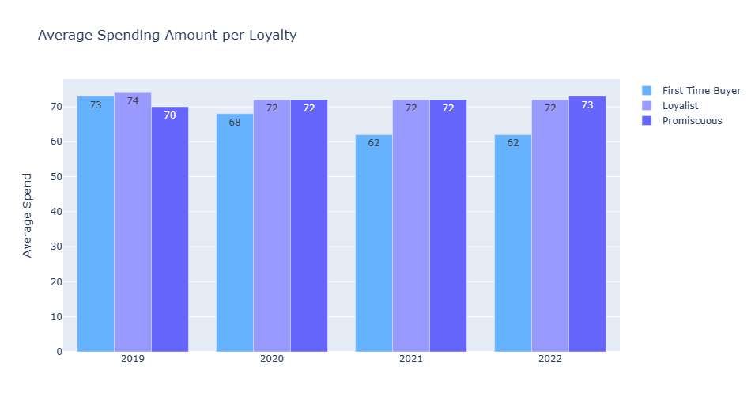
Average Spending
Notes:
Over the course of 4 years, from 2019 to 2022, the chart above reveals distinct variations in average spending per transactions among the three loyalty segments: Loyalist, Promiscuous, and First time buyers.
Loyalists exhibited the highest average spending per transaction at $73 in 2019. It went down to $72 in 2020 to 2022.
Promiscuous customers spent an average of $70 on 2019 and it went up to $72 for 2020, remained consistent for 2021. It slightly increased to $73 for 2022.
First Time Buyers spent an average of $73 at 2019. It went on a decline to $68 for 2020, and went further down to $62 for 2021 and 2022.
The fluctuation average spending pattern of First Time buyers call for concentrated efforts to enhance their conversion into loyal customers. Additionally, understanding the factors behind the consistent and higher spending of Promiscuous customers can inform strategies to promote loyalty and encourage increased spending accross all loyalty types. The consistent spending pattern of Loyal customers also indicates the need for initiatives to maintain their engagement and spending levels.

Slide 9
What are the distribution of different customer segments (household type and age band) to loyalty segment?
Household Type Distribution per Loyalty Segment
Age Band Distribution per Loyalty Segment
Notes:
Distribution of Customer Segments by Loyalty Type
Understanding the distribution of different customer segments – such as household type and age band – across different loyalty segments is crucial. This insight will enable us to tailor our engagement strategies to each segment's unique characteristics.

Slide 10
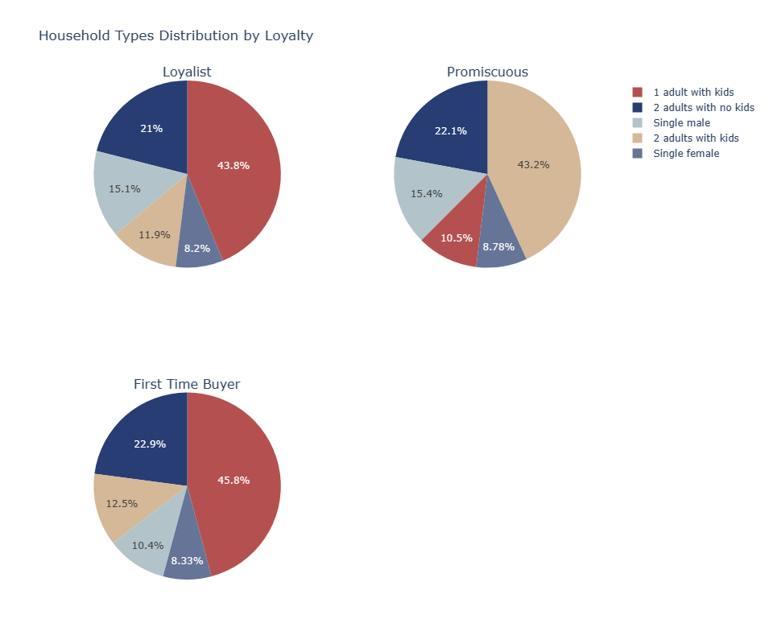
Household Type Distribution per Loyalty Type
Notes:
The pie chart illuastrates the distribution of households accross different loyalty types within SuperFoodsMax' customer base.
1. Loyalists customers have consistently demonstrated commitment at SuperFoodsMax. The highest proportion of Loyalists belongs to the household type '1 adult with kids', compromising of 587 loyalist customers. Additionally, "2 adults with no kids" and "Single Male" are significant contributors with 282 and 203 loyalists customers.
2. Promiscuous customers, who tend to shop around different stores, exhibit a notably different distribution across household types. The highest count is observed in the '2 adults with kids' category, representing 811 customers. This insight implies that families with children may be more inclined to explore multiple shopping options. Additionally, '2 adults with no kids' and 'Single male' households also contribute significantly, with 415 and 290 customers respectively. This suggests that Promiscuous customers have varied household compositions and preferences.
3. First Time Buyers, as expected, exhibit a smaller count across all household types compared to Loyalists and Promiscuous customers. However, among the limited First Time Buyers, "1 adult with kids" and "2 adults with kids" households show notable presence with 22 and 6 customers respectively. This signals a potential opportunity to convert these families into loyal customers through targeted engagement. Personalized offers, and familty-oriented promotions can drive conversion and loyalty among this group.

Slide 11
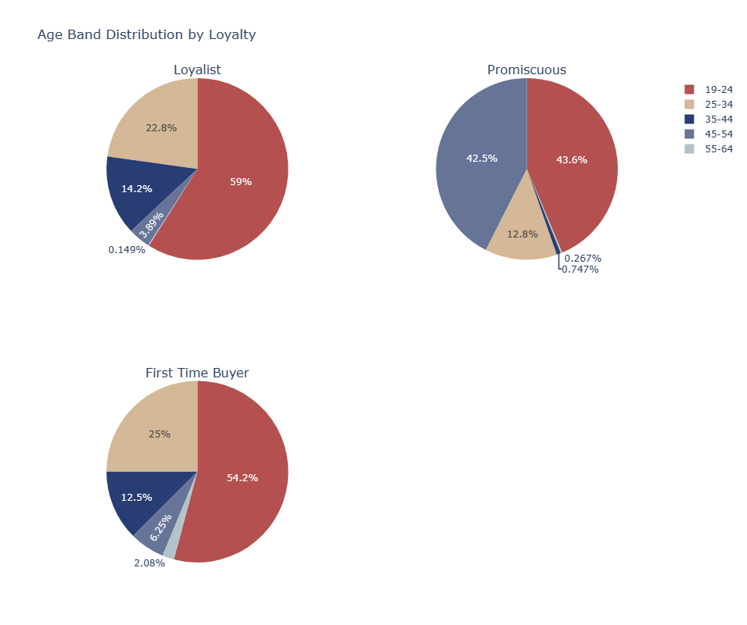
Age Band Distribution per Loyalty Type
Notes:
The pie charts depicting the distribution of age bands accross different loyalty types offers valuable insights into the demographic of SuperFoodsMax's customers.
1. Customers, Age 19-24 stands out among all the loyalty types. They consists of 59% of the Loyalist customers, 43.6% of Promiscuous customers, and 54.2% of our First Time Buyers. The strong engagement of customers aged 19-24 suggests a need for targeted strategies catering to the preferences and shopping behavious of this age group. Promotions focused on convenience, affordability, and personalization could further engage and retain these customers.
2. The declining engagement on among the other later age band indicate changing priorities as customers enter their mid-career and family building stages.

Slide 12
What products can we strategize to different customer segments to improve their engagement?
Analyse commodities that enjoyed by all segments
Department Engagements and Revenues
Top 5 commodities in all departments
Analyse commodities that resonates with family households and age band
Baby Care
Dairy Products
Analyse commodities that resonates with single female and single male
Department Engagements
Top 5 Grocery and Produce commodities
Notes:
Product Strategy for Enhanced Engagement
By analyzing our customers' preferences and behaviors, we can identify specific products that resonate with different customer segments. Developing personalized strategies that align with these preferences will help us enhance engagement and drive conversions.

Slide 13
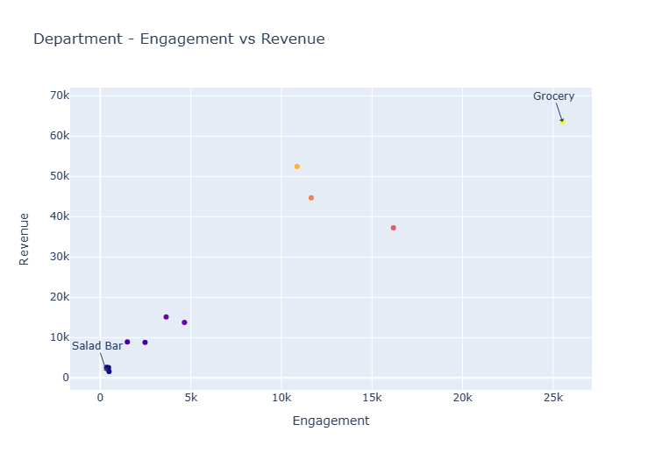
Department – Engagement vs Revenues
Notes:
This scatter plot illustrates the relationship between engagement and revenue for different departments. Grocery stands out with the highest engagement and highest revenue. Other stands out are Meat, Pharmaceutical, and Produce.
Based on the insight provided, we can allocate marketing efforts and resources to categories with high engagement and revenue to further boost sales and customer satisfaction.

Slide 14
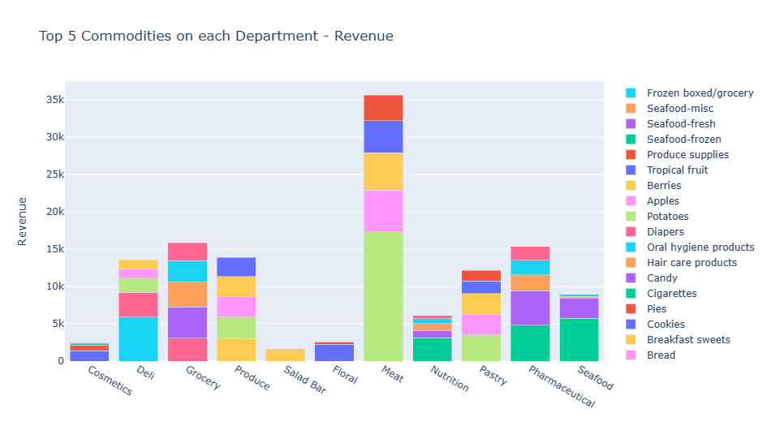
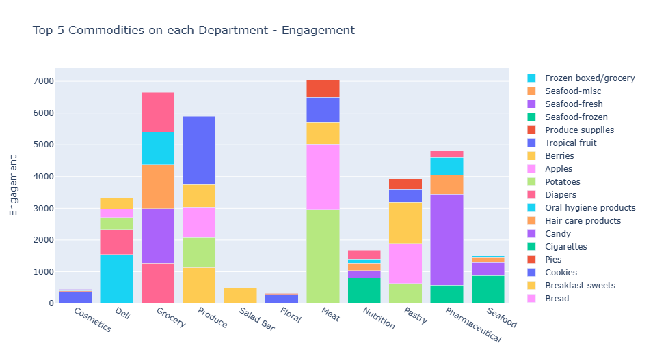
Top 5 commodities on each department
Revenue
Engagement
Notes:
The analysis of the top 5 commodities on each department based on both revenue and engagement reveals valuable insights into the departmental performance, emphasizing strategic opportunities between revenue generation and customer engagement.
1. Revenue Focused Analysis
- The top 5 commodities on the Meat department, collectively contribute significanlty to the department's revenue, exceeding $35,000. This underscores strong consumer demand and succesful sales within the Meat Department.
- While the top 5 commodities contribute notable revenue in these departments, they fall short of the Meat Department's performance, with revenue totaling over $15,000 each.
2. Engagement-Focused Analysis:
- Similarly, the Meat Department secures the highest customer engagement, amassing over 7,000 engagements. This reflects the department's ability to effectively capture customer interest and interactions.
- Following closely, the Grocery Department records approximately 6,500 engagements, showcasing its successful consumer appeal.

Slide 15
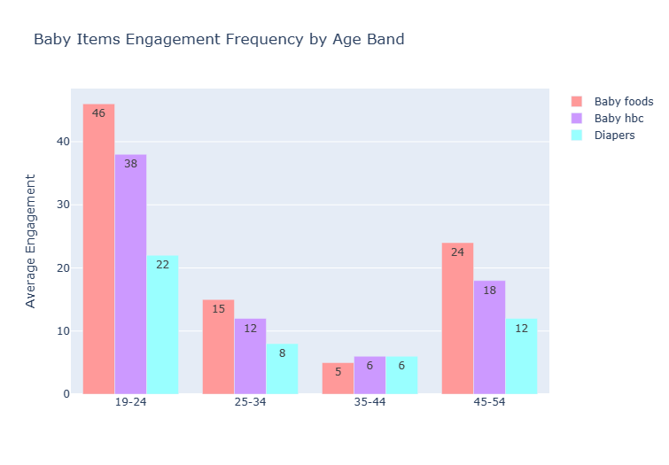
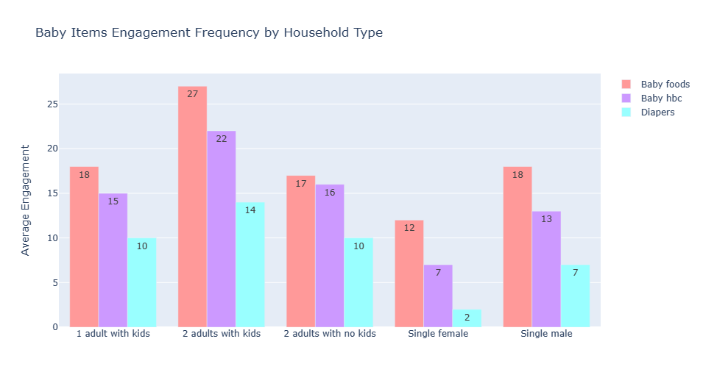
Family Oriented Commodities Baby Care
Baby Care by Household Type
Baby Care by Age Band
Notes:
Household Type:
The grouped bar chart reveals intriguing patterns in average engagement accross baby items per household.
Insights:
1. Among households with kids, both single and couples, Baby Foods exhibit relatively high average engagement. This suggests that families with children, regardless of household composition, show a strong interest in this commodity.
2. Similar to Baby Foods, Baby HBC products also demonstrate substantial engagement across different household types. This implies that products catering to the health and beauty needs of infants and children hold a consistent appeal.
3. Diapers, a fundamental necessity for families with young children, receive significant engagement from households with kids. Interestingly, households with two adults and kids show a higher engagement with this commodity compared to households with just one adult and kids.
4. Both Single Females and Single Males exhibit lower engagement across all commodities compared to households with kids. Baby Foods garner relatively higher engagement among Single Males, potentially indicating their role as caregivers. Diapers, understandably, have the least engagement across both Single Female and Single Male households.
5. Households without Kids: Households with two adults and no kids display moderate engagement with Baby Foods and Baby HBC, suggesting that these products might cater to specific needs even in households without children. Diapers exhibit lower engagement in these households, reflecting their lack of relevance.
Age Band:
These insights underscore the need for SuperFoodsMax to tailor its marketing strategies and product offerings according to the distinct preferences and priorities of different age bands. For the 19-24 age group, emphasizing baby care commodities and providing resources for young parents could enhance engagement. In the 25-34 age band, SuperFoodsMax can explore strategies that cater to potential parenting considerations while still valuing personal well-being. For older age bands, focusing on broader wellness offerings while acknowledging reduced engagement with baby care products could be a strategic approach.

Slide 16
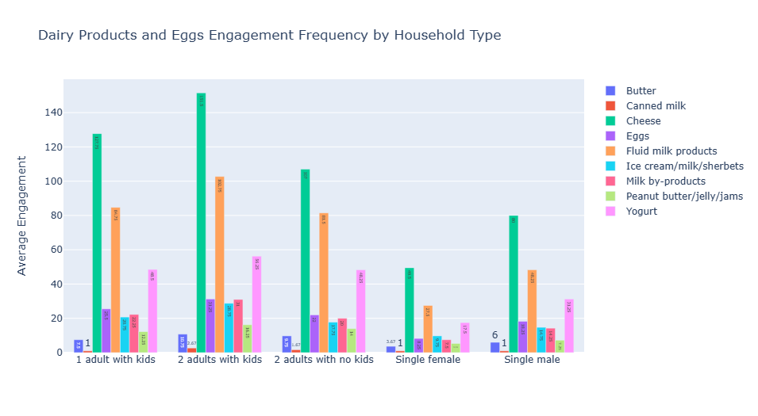
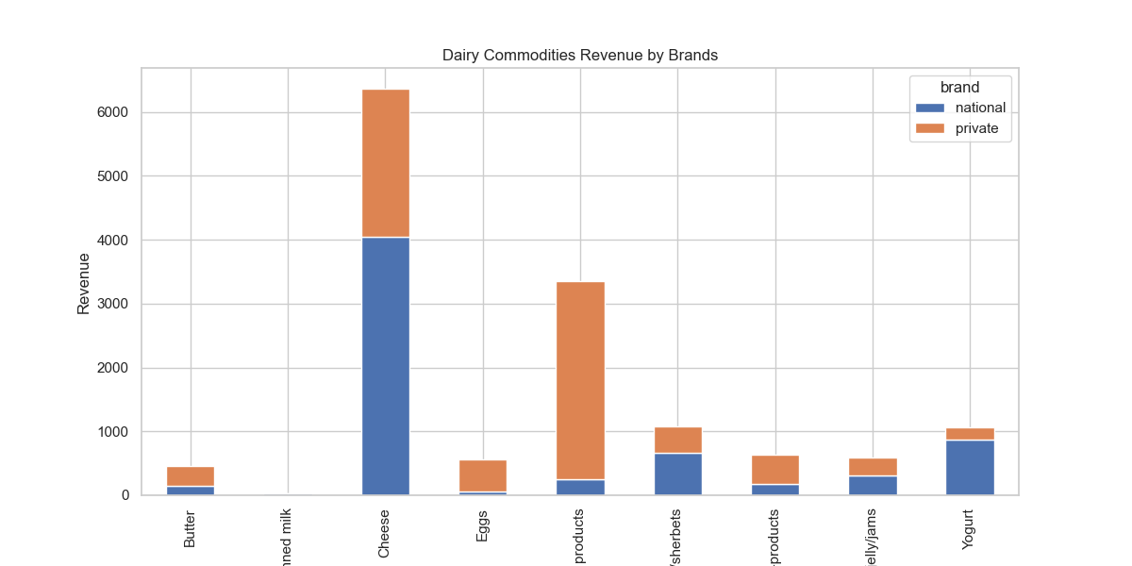
Dairy Products
Engagement Frequency
Dairy Revenue by Brands
Notes:
First Chart:
Insight:
There is a huge Cheese engagement in all household types. Cheese is prominently favored by all household types.
Fluid milk products is also the second favored among all household types.
Couples (with or without kids) seem to favor butter in their purchases. Single female and Single male household shows comparatively lower engagement with butter.
Yogurt seems to resonate more with households comprising couples, especially those with children.
Second Chart: Insight:
Preference for national brands for the following items: Cheese, Yogurt, Peanut Butter/Jelly/Jams, and Ice cream/Milk/Sherbets products.
Private brands are leading in Butter, Fluid Milk Products, and Milk by-products.
Recommendation:
SuperFoodsMax can target promotion of cheese among 'Single females', or yogurt for household with kids.
To boost revenue in categories like Canned Milk, and butter SuperFoodsMax can implement promotions to encourage purchases.
While national brands are popular, SuperFoodsMax must maintain a balance between private brands and national brands across various categories can provide customers with more choices and appeal to different segments of the market.

Slide 17
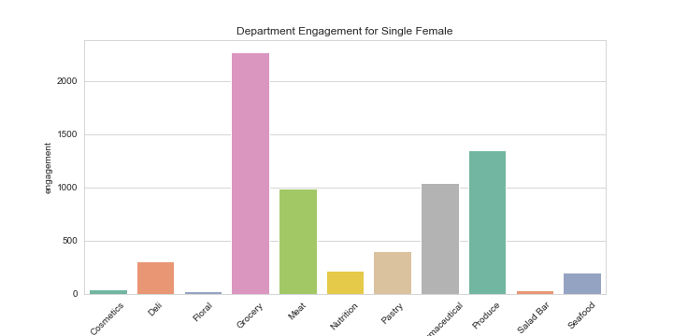
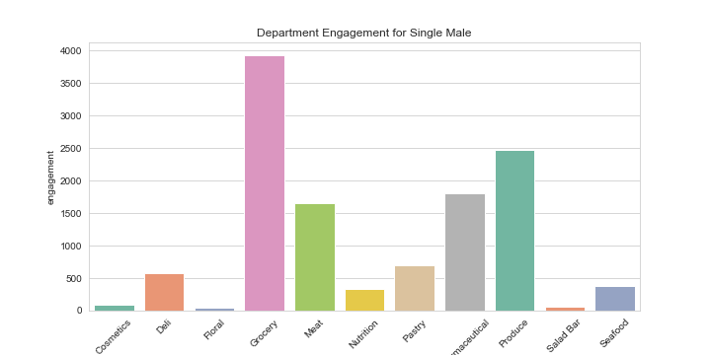
Commodities that resonates with Single customers
Department Engagement for Single Female
Department Engagement for Single Male
Notes:
Single female and single male customers has the same level of engagement in all the departments.
Special attention can be given to Grocery and Produce departments as they show high engagement from both groups.
Continuous monitoring of engagement and feedback will enable SuperFoodsMax to refine it strategies and enhance customer satisfaction.

Slide 18
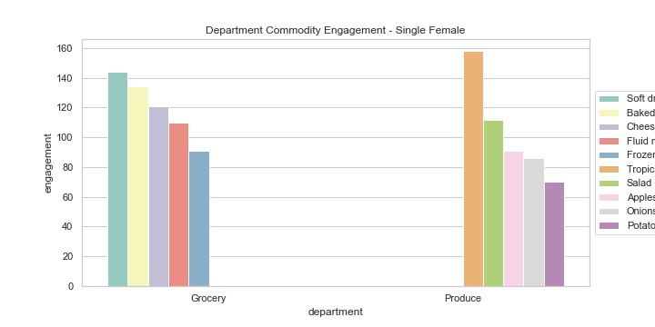
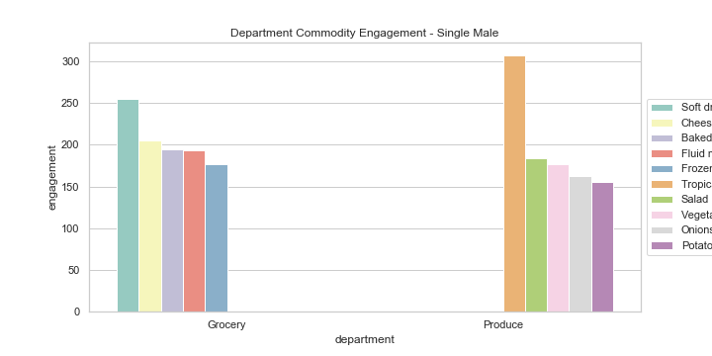
Top 5 Commodities on stand out departments: Grocery and Produce
Single Female
Single Male
Notes:
Grocery Department Insights:
Both single females and single male customers show an almost parallel engagement on all the top 5 commodities on the Grocery Department. There is a slight difference for Cheese, on which single male customers have higher engagement on this category. However, Cheese is still at the top 5 of the single female customers.
Produce Department Insights:
Both single females and single male customers show an almost parallel engagement on the top commodities on the Produce Department. Except for two commodities. Apple is much preferred by single female customers and comparatively lower for single males. Vegetables – All Others is notable for single males.
To enhance engagement and satisfaction, SuperFoodsMax could consider offering more product variety within these top commodities and providing promotions that align with the preferences of single females and single males.
Collaboration with brands and suppliers to curate offerings that resonate with both genders could drive customer loyalty and repeat purchases.
Tracking these engagement patterns over time will enable SuperFoodsMax to adjust their strategies to meet evolving customer preferences and shopping behaviors.

