Slide 1




Workshop
Javascript
Basics
André Eberhard
Karlsruhe
05/11/2018
www.ptvgroup.com

Slide 2
About me
André Eberhard
Department xServer internet
Joined 2013
Mostly JavaScript/Azure (+ some .NET)
FOTO
HIER
EINKLEBEN

Slide 3
What was sent in
Async ~ Callbacks
Angular (JS)
Browsers & Buttons
Tutorials
JavaScript ~ (Web) Development
I am unfamiliar with the basics.
Transpile Code
Leaflet
ES6

Slide 4

What we will do
Language basics
Widely used language features
Common pitfalls
(Un)expected behavior
Ask questions
Get Answers ☺
Exercise
Active learning

Slide 5
Expected results
Ability to work with data
(high-level) representation, access, modification, comparison
Control the program
scope, closures, sync vs. async operations
Implement a REST client

Slide 6

What we will NOT do
Frameworks & Trends
Fundamentals required to understand
„Web Development“
Fundamentals required to implement
ES2015+ (ES6+)
Fundamentals required to appreciate
Fixing bugs
„We use Angular, our view does not work as intended.“

Slide 7
What we will NOT do
OOP Patterns
often not needed
functional trend
too many possibilities
abstraction technique
„leaky abstraction“
…
Giving absolute advice
e.g. prototyping vs. simple object creation

Slide 8
Agenda Part I
Introduction (~30min)
What and why?
Basics Primitives (~30min)
Numbers, Strings, Objects & Arrays
Truth and Equality (~60min)
Operators, Booleans & Expressions
Scope & Closures (~90min)
Explained by example

Slide 9
Agenda Part II
Asynchronous Programming (~60min)
Synchronous & asynchronous operations, flow control
Learning by Doing (~120min)
Test application, xServer internet monitoring subset
Summary
Workshop (6.5h)
Lunch (1h)
Coffee (0.5h)

Slide 10
What is JavaScript?
Why do we struggle so hard?
types
freedom
…
slow
…
…
…
similar,
not equal
interpreted,
not compiled
…
complicated
not a
programming language
$%&!
…
the name
…
the syntax
does not work
poor understanding
…
abusing the language
…
…
rumors

Slide 11
What is JavaScript?
What is it used for?
dynamic, multi-paradigm browser language
targeted at designers
released 1997
European Computer Manufacturers Association (ECMA) & Technical Committee 39 (TC39)
DOM manipulation within browsers
since NodeJS, for everything on every platform
scripting, servers
Current state
Who uses it?
trello
largest platform in the world
fast, community driven growth
annual specification improvements/additions
implementations in different engines
de facto standard ES6
additions like TypeScript
netflix
ptv!!
paypal
„the internet“
uber
nasa
walmart
ebay

Slide 12
JavaScript @ PTV
xSi
deployment
MaaS
xSi monitoring frontend
Map&Guide
xServer
Doc
xSi monitoring backend
IMPACT

Slide 13
Step 1 – Primitives
String
Object
mostly as in other languages
dynamic key/value store
can store everything dynamically
ability to add/delete properties
Number
„Array“
one number type
MAX_VALUE vs. MAX_SAFE_INTEGER
very special object
numbers as object keys
has many helpful methods

Slide 14
Step 2 – Booleans
Booleans
true/false representation
truthy/falsy
equality
strict vs. sloppy comparison

Slide 15
Step 3 – Functions, Scopes, Closures
Functions
Scopes
function vs. method
functions as first-class objects
higher-order functions ☺
have their own scope
variable substitution
callbacks
sync vs. async
global scope (window, global, …)
function scope
hoisting in ES5
block scope (ES6+)
Closures
functions enclose their scope
persistent scope access
values vs. references

Slide 16



Step 3 addition – map, filter, reduce
map
Same lenght, different objects
filter
Same objects, different length
reduce
Single value

Slide 17
Step 4 – Test Application
Address: http://172.23.112.52:8888
Notes
Model
NodeJS REST API (also in JavaScript ☺)
No authentication
/api/start start a test
/api/running/full get all running tests
/api/running/ids get all running ids
/api/id/:id/full get a test by its id
/api/id/:id/status get the status of a test by id

Slide 18
Step 4 – Test Application Tasks
Basic tasks
Advanced tasks
Start a test and get its current status
How many of the currently running tests have already executed more than 50% of their tests? Print their amount and ids to the console.
Which of the currently running tests are explicitly including xMap tests?
For a finished test, find how many distinct tags were executed for the passed steps.
Which of the currently running tests are explicitly including xMap and xLocate tests?
* Start a test, wait for its completion and log the result to the console.
** Start a test. Then, periodically fetch the whole test. In each iteration, print the distinct orders of the already passed tests. If the orders are the same, print nothing.
*** For a running test, find the distinct tags of all currently passed steps. Print the newly arrived tags compared to the last poll iteration.
**** Write a wrapper function that takes an id as parameter and waits for the corresponding test to complete. The complete test result is then passed in a callback to the calling function.

Slide 19
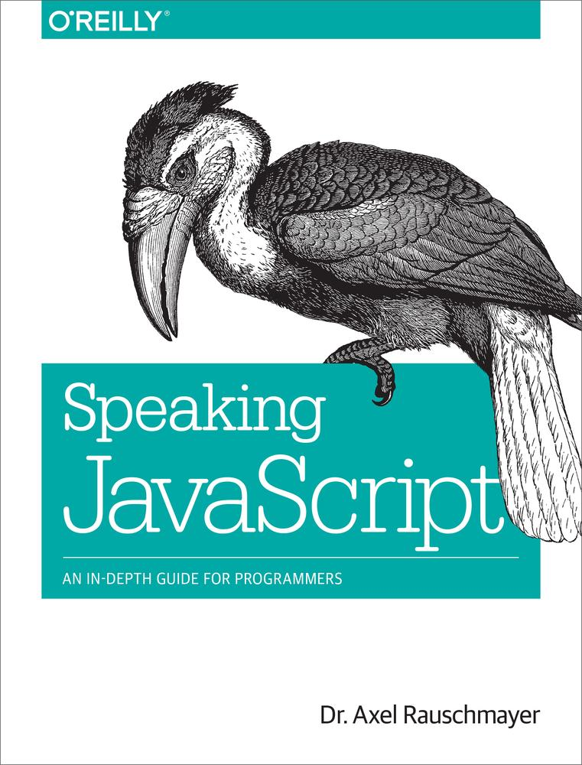

Further readings
About JS
https://www.youtube.com/watch?v=2pL28CcEijU
https://auth0.com/blog/a-brief-history-of-javascript
http://www.ecma-international.org
https://tc39.github.io/process-document
https://tc39.github.io/ecma262
Documentation
https://developer.mozilla.org/en-US/docs/Web/JavaScript/Reference/Global_Objects/Number
https://developer.mozilla.org/en-US/docs/Web/JavaScript/Reference/Global_Objects/Array
https://developer.mozilla.org/en-US/docs/Web/JavaScript/Reference/Global_Objects/Object
https://developer.mozilla.org/en-US/docs/Web/JavaScript/Reference/Global_Objects/String
https://developer.mozilla.org/en-US/docs/Web/JavaScript/Closures
https://developer.mozilla.org/en-US/docs/Glossary/Truthy
https://developer.mozilla.org/en-US/docs/Glossary/Falsy
Closures
https://codeburst.io/explaining-value-vs-reference-in-javascript-647a975e12a0

Slide 20
Give Feedback ☺
www.ptvgroup.com

