Slide 1
TrackML Particle Tracking Challenge
High Energy Physics particle tracking in CERN detectors
MATE T580, Spring 2018
David Freiburg Cassandra Pate

Slide 2
CHALLENGE OVERVIEW
“Can machine learning assist high energy physics in discovering and characterizing new particles?”
Led by machine learning and physics scientists at CERN
Reconstruct trajectories from the particle information (“hits”) collected by the detector.
”Connect the dots”
”No physics background required”
SECTION TITLE | 2

Slide 3
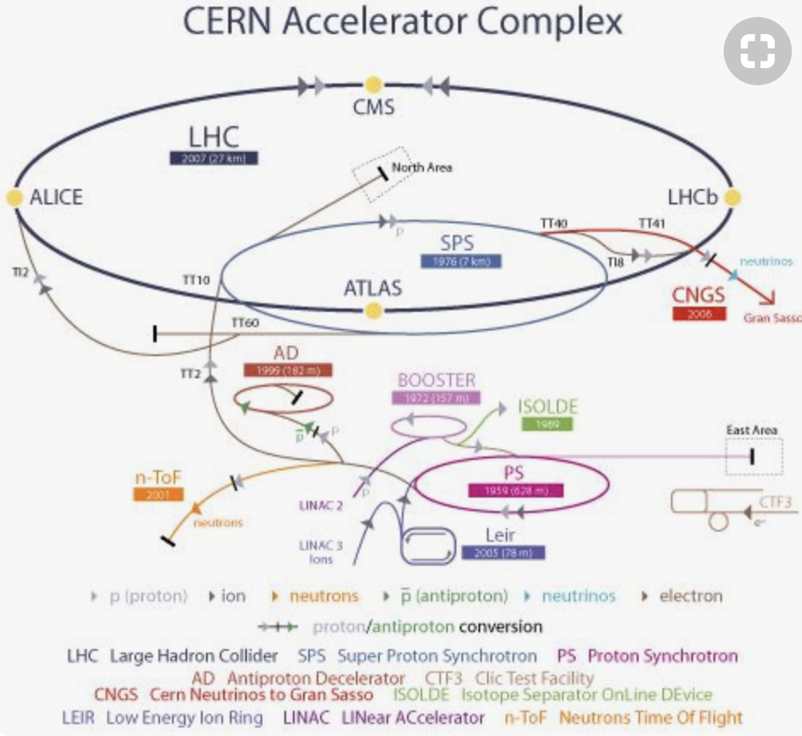
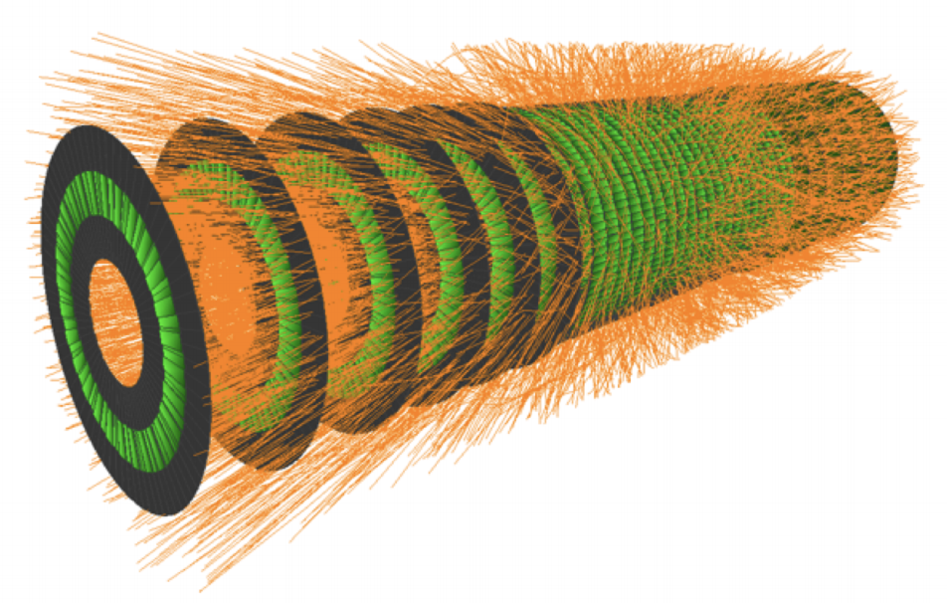
CERN & THE ATLAS EXPERIMENT
SECTION TITLE | 2

Slide 4
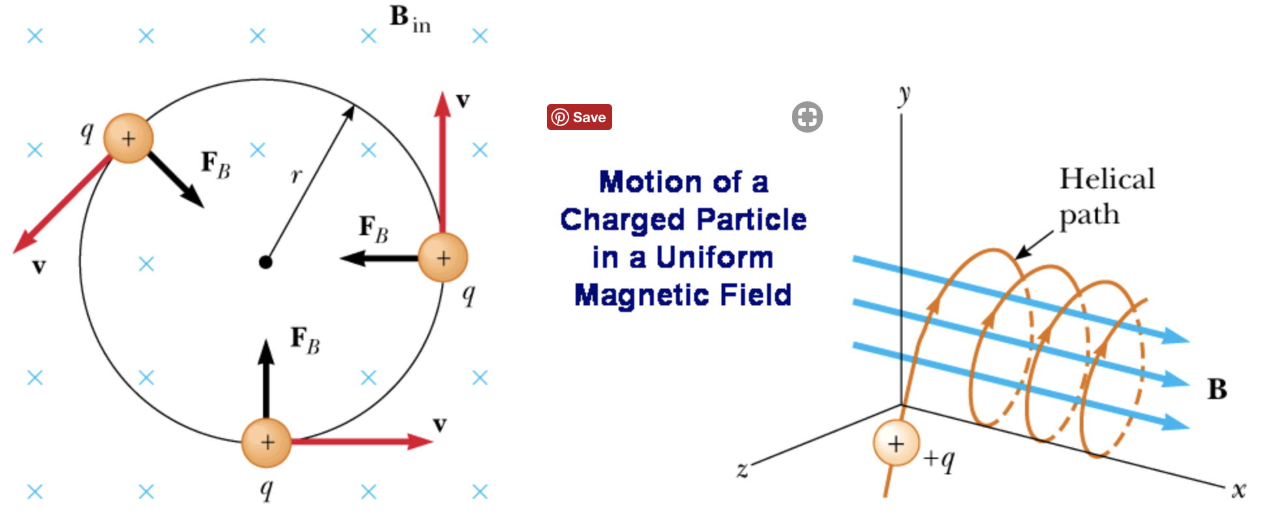
Particle movement through ATLAS
SECTION TITLE | 2

Slide 5
ABOUT THE DATA
Event hits
Event hit cells
General descriptor copy to further explain context
General descriptor copy to further explain context
General descriptor copy to further explain context
General descriptor copy to further explain context
General descriptor copy to further explain context
General descriptor copy to further explain context
Event Particles
Event truths
General descriptor copy to further explain context
General descriptor copy to further explain context
General descriptor copy to further explain context
General descriptor copy to further explain context
General descriptor copy to further explain context
General descriptor copy to further explain context
SECTION TITLE | 2

Slide 6
DBScan
General descriptor copy to further explain context
General descriptor copy to further explain context
General descriptor copy to further explain context
General descriptor copy to further explain context
General descriptor copy to further explain context
General descriptor copy to further explain context
General descriptor copy to further explain context
General descriptor copy to further explain context
General descriptor copy to further explain context
SECTION TITLE | 2

Slide 7
HEADLINE
General descriptor copy to further explain context
General descriptor copy to further explain context
General descriptor copy to further explain context
HEADLINE
General descriptor copy to further explain context
General descriptor copy to further explain context
General descriptor copy to further explain context
HEADLINE
General descriptor copy to further explain context
General descriptor copy to further explain context
General descriptor copy to further explain context
SECTION TITLE | 2

Slide 8
HEADLINE
General descriptor copy to further explain context
General descriptor copy to further explain context
General descriptor copy to further explain context
HEADLINE
General descriptor copy to further explain context
General descriptor copy to further explain context
General descriptor copy to further explain context
HEADLINE
General descriptor copy to further explain context
General descriptor copy to further explain context
General descriptor copy to further explain context
SECTION TITLE | 2

