Slide 1
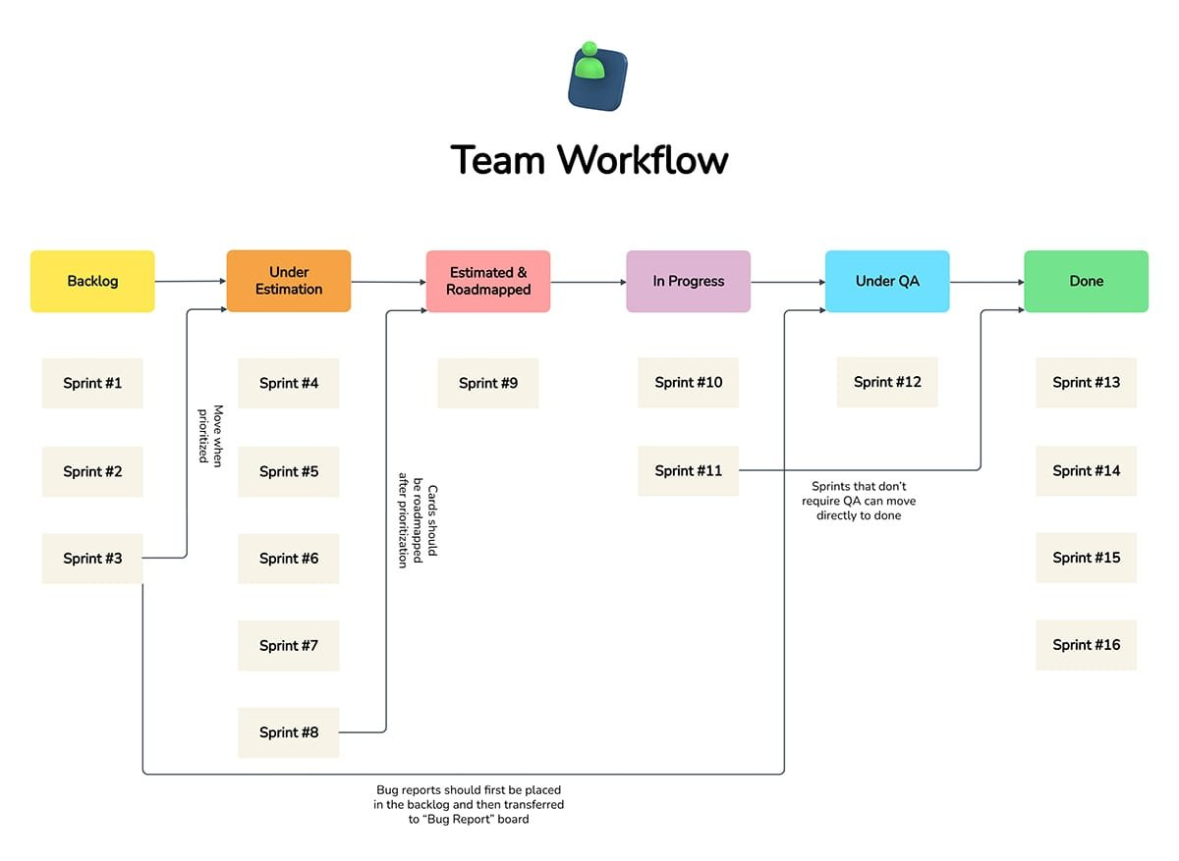
Auto Summary
Sprint #2
Sprint #3
Sprint #5
Sprint #6
Sprint #7
Team Workflow
Sprint #10
oneznyoud oye
inoys spue>
paddewpeos aq
Sprint #8 = ———~*
Sprint #11. ——+
Sprint #12
Sprints that don't
require QA can move
directly to done
Bug reports should first be placed
in the backlog and then transferred
to “Bug Report” board
Sprint #13
Sprint #14
Sprint #15
Sprint #16

