Slide 1

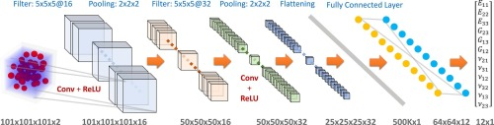
ARTIFICIAL INTELLIGENCE
ES 612
DEEP LEARNING
CONVOLUTION NETWORKS
https://www.sciencedirect.com/science/article/abs/pii/S0927025620303414

Slide 2
CONTENTS
Flattening and Fully Connected Layer
SOFTMAX
Back propagation
Gradient Descent
Stochastic Gradient Descent (SGD)
Batch Normalization
Residual Network (Res-Net)

Slide 3
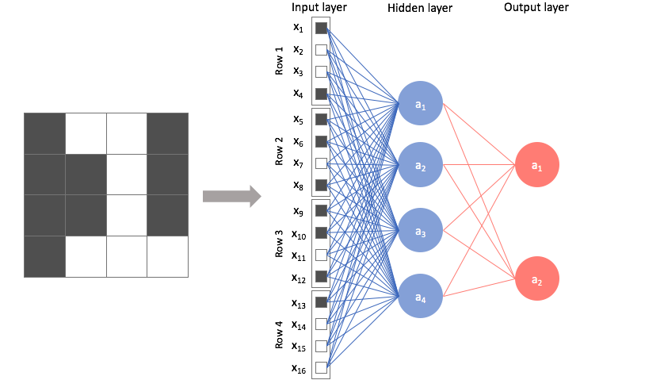
FLATTENING AND FULLY CONNECTED LAYER
https://www.google.com/url?sa=i&url=https%3A%2F%2Fwww.jeremyjordan.me%2Fconvolutional-neural-networks%2F&psig=AOvVaw2V1XKVYgn1c6kFSI3SRwtF&ust=1618037736572000&source=images&cd=vfe&ved=0CAIQjRxqFwoTCKCtoMfK8O8CFQAAAAAdAAAAABAd

Slide 4
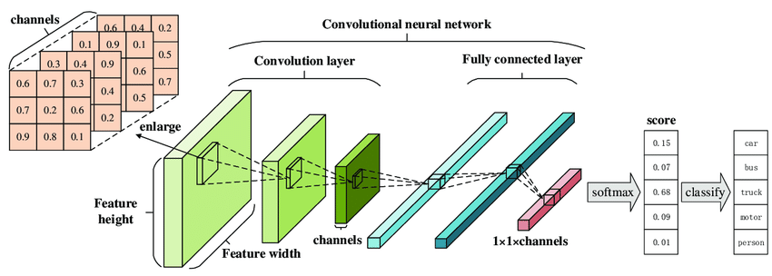
SOFTMAX
https://www.google.com/url?sa=i&url=https%3A%2F%2Fwww.researchgate.net%2Ffigure%2FArchitecture-of-a-Convolutional-Neural-Network-CNN-The-traditional-CNN-structure-is_fig1_330106889&psig=AOvVaw0MmX814UGnyaXruZJUjiNb&ust=1618038038545000&source=images&cd=vfe&ved=0CAIQjRxqFwoTCIjyo9jL8O8CFQAAAAAdAAAAABBb

Slide 5
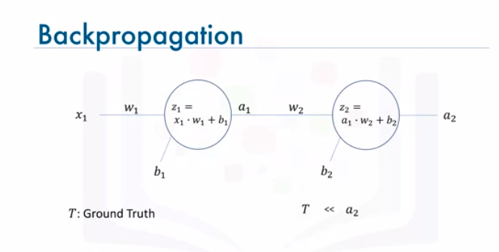
https://www.coursera.org/lecture/introduction-to-deep-learning-with keras/backpropagation-lfbxX

Slide 6
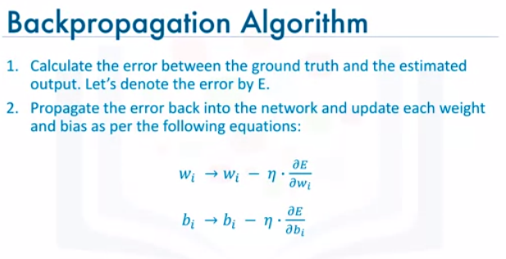
https://www.coursera.org/lecture/introduction-to-deep-learning-with keras/backpropagation-lfbxX

Slide 7
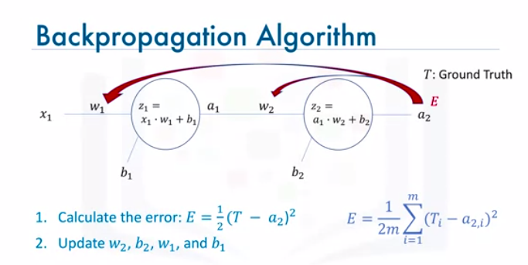
https://www.coursera.org/lecture/introduction-to-deep-learning-with keras/backpropagation-lfbxX

Slide 8
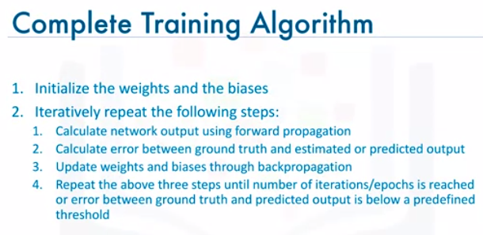
https://www.coursera.org/lecture/introduction-to-deep-learning-with keras/backpropagation-lfbxX

Slide 9
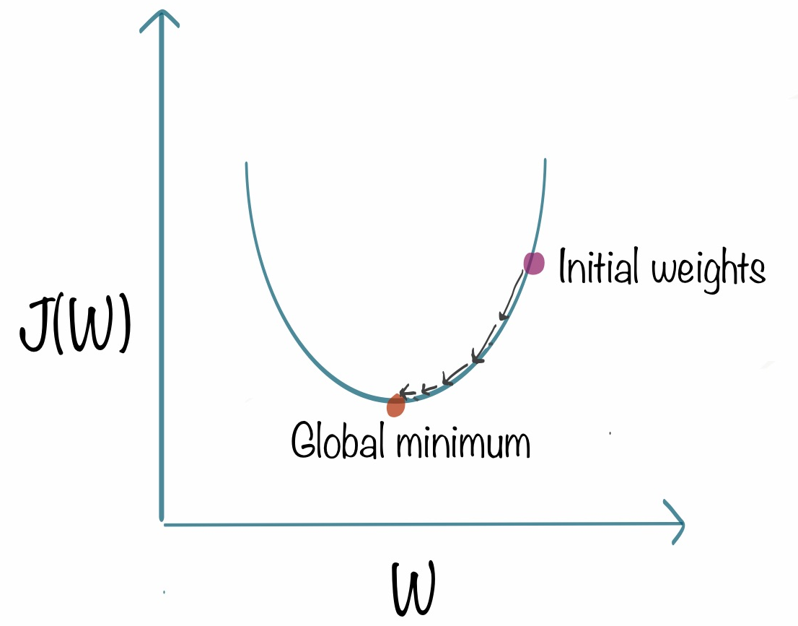
GRADIENT DESCENT
https://www.google.com/url?sa=i&url=https%3A%2F%2Fwww.kdnuggets.com%2F2018%2F06%2Fintuitive-introduction-gradient-descent.html&psig=AOvVaw3L2xOs1IA_qYKIzARz-dwg&ust=1618042923105000&source=images&cd=vfe&ved=0CAIQjRxqFwoTCNilru7d8O8CFQAAAAAdAAAAABAP

Slide 10
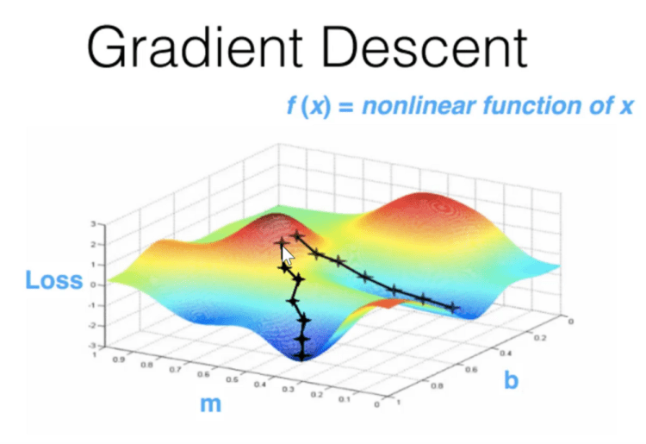
https://www.google.com/url?sa=i&url=https%3A%2F%2Fartofbetterprogramming.com%2F2020%2F07%2F03%2Fstochastic-gradient-descent-algorithms-topics-of-machine-learning%2F&psig=AOvVaw3L2xOs1IA_qYKIzARz-dwg&ust=1618042923105000&source=images&cd=vfe&ved=0CAIQjRxqFwoTCNilru7d8O8CFQAAAAAdAAAAABAD

Slide 11
BATCH NORMALIZATION
Standardize data for training
Transforming all the data into same scale
Normalizes the output from activation function z = ( x- m ) / s
Multiply normalized output by arbitrary parameter, g z * g
Add arbitrary parameter b, to resulting product ( z * g ) + b

Slide 12
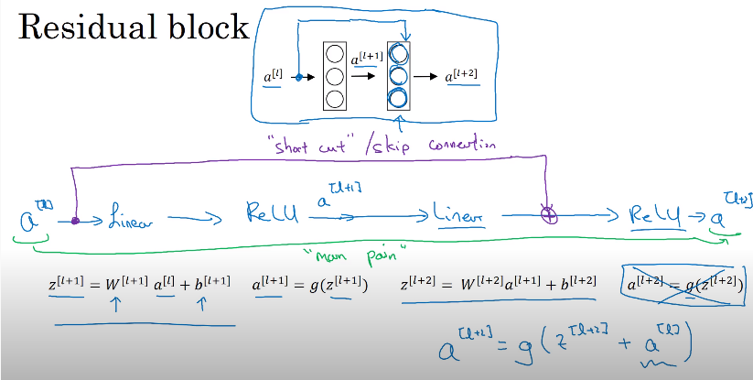
RESIDUAL NETWORK
https://www.youtube.com/watch?v=ZILIbUvp5lk

Slide 13
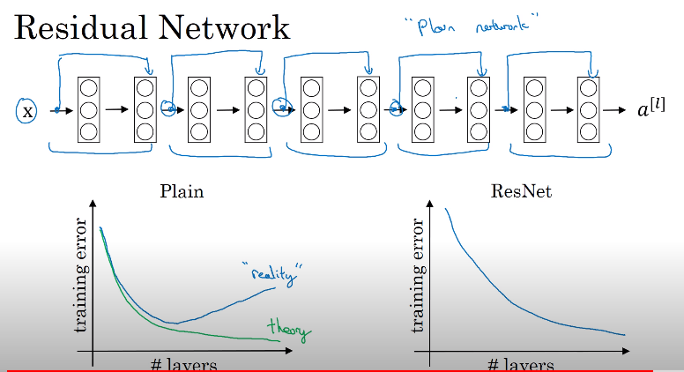
RESIDUAL NETWORK
https://www.youtube.com/watch?v=ZILIbUvp5lk

