Slide 1

Data analysis of GWAS for Biodigestibility of Alfalfa in multi-environment
Smit Patel
Research associate

Slide 2
Data
Available data
Analysis performed
Phenotype data for 2018, 2019, 2020 and 2020
Exploratory scatter plots
Heat map combined with dendrogram
Principal component analysis
K-means clustering
Couldn’t produce correlation matrix

Slide 3
Questions
Design of experiment for mixed model analysis (Single trial and Stagewise)
Units of fractional rate of ruminal digestion
Repetition of indigestible protein (column name "C")
Ammonia is consistently zero (column name "A1")
Requirement of plots
Complete dataset (Genomic and phenomic)

Slide 4
Plots
Only includes data from 2018

Slide 5
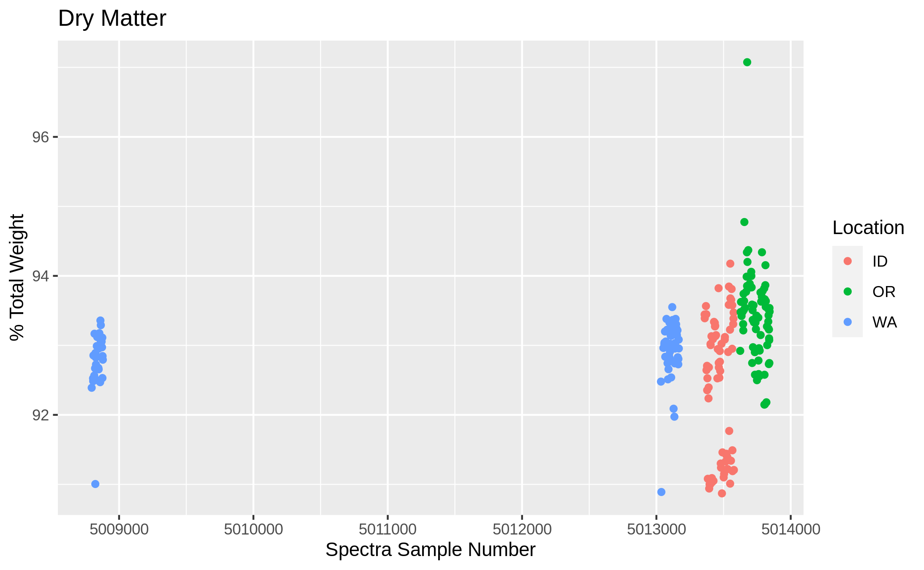
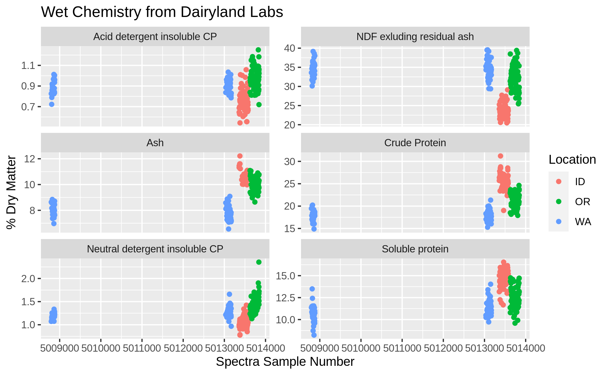
Wet chemistry

Slide 6
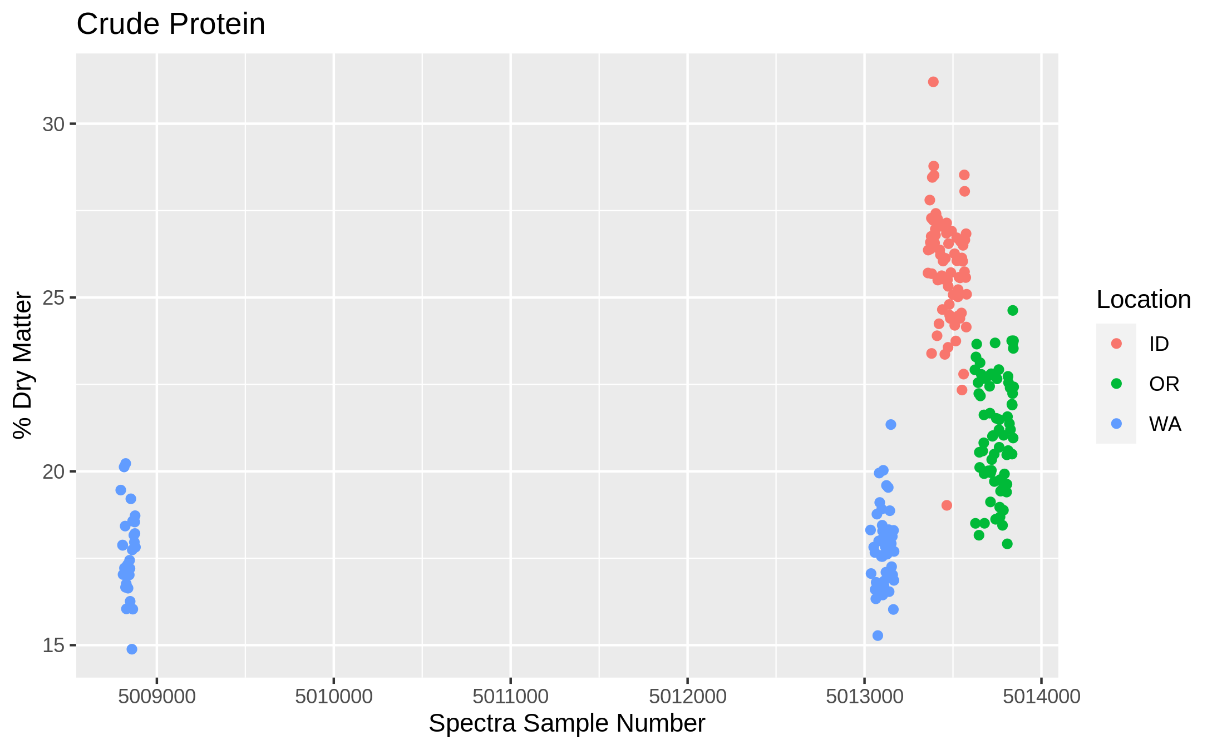
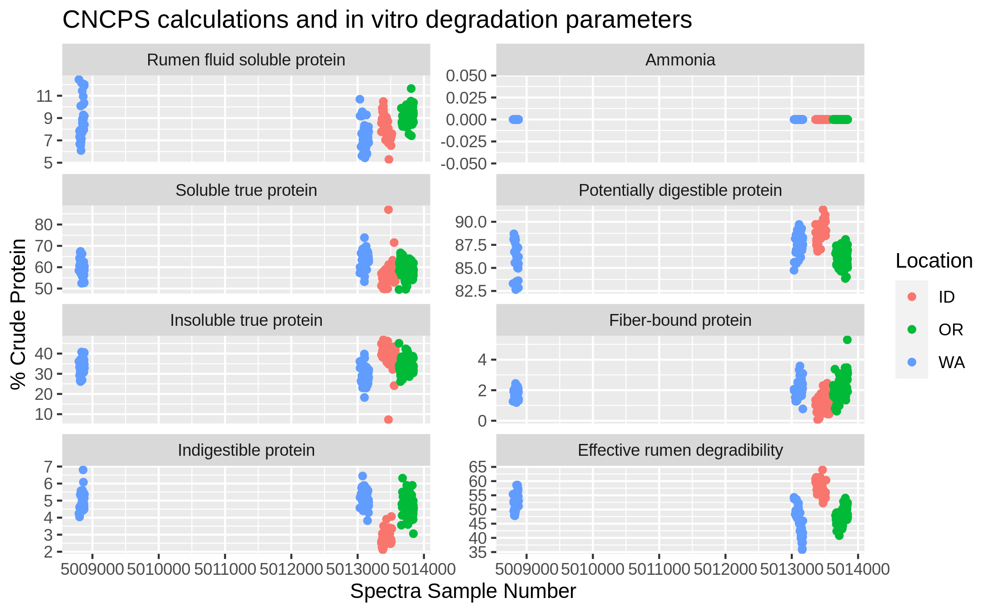
CNCPS calculations and in vitro degradation parameters

Slide 7
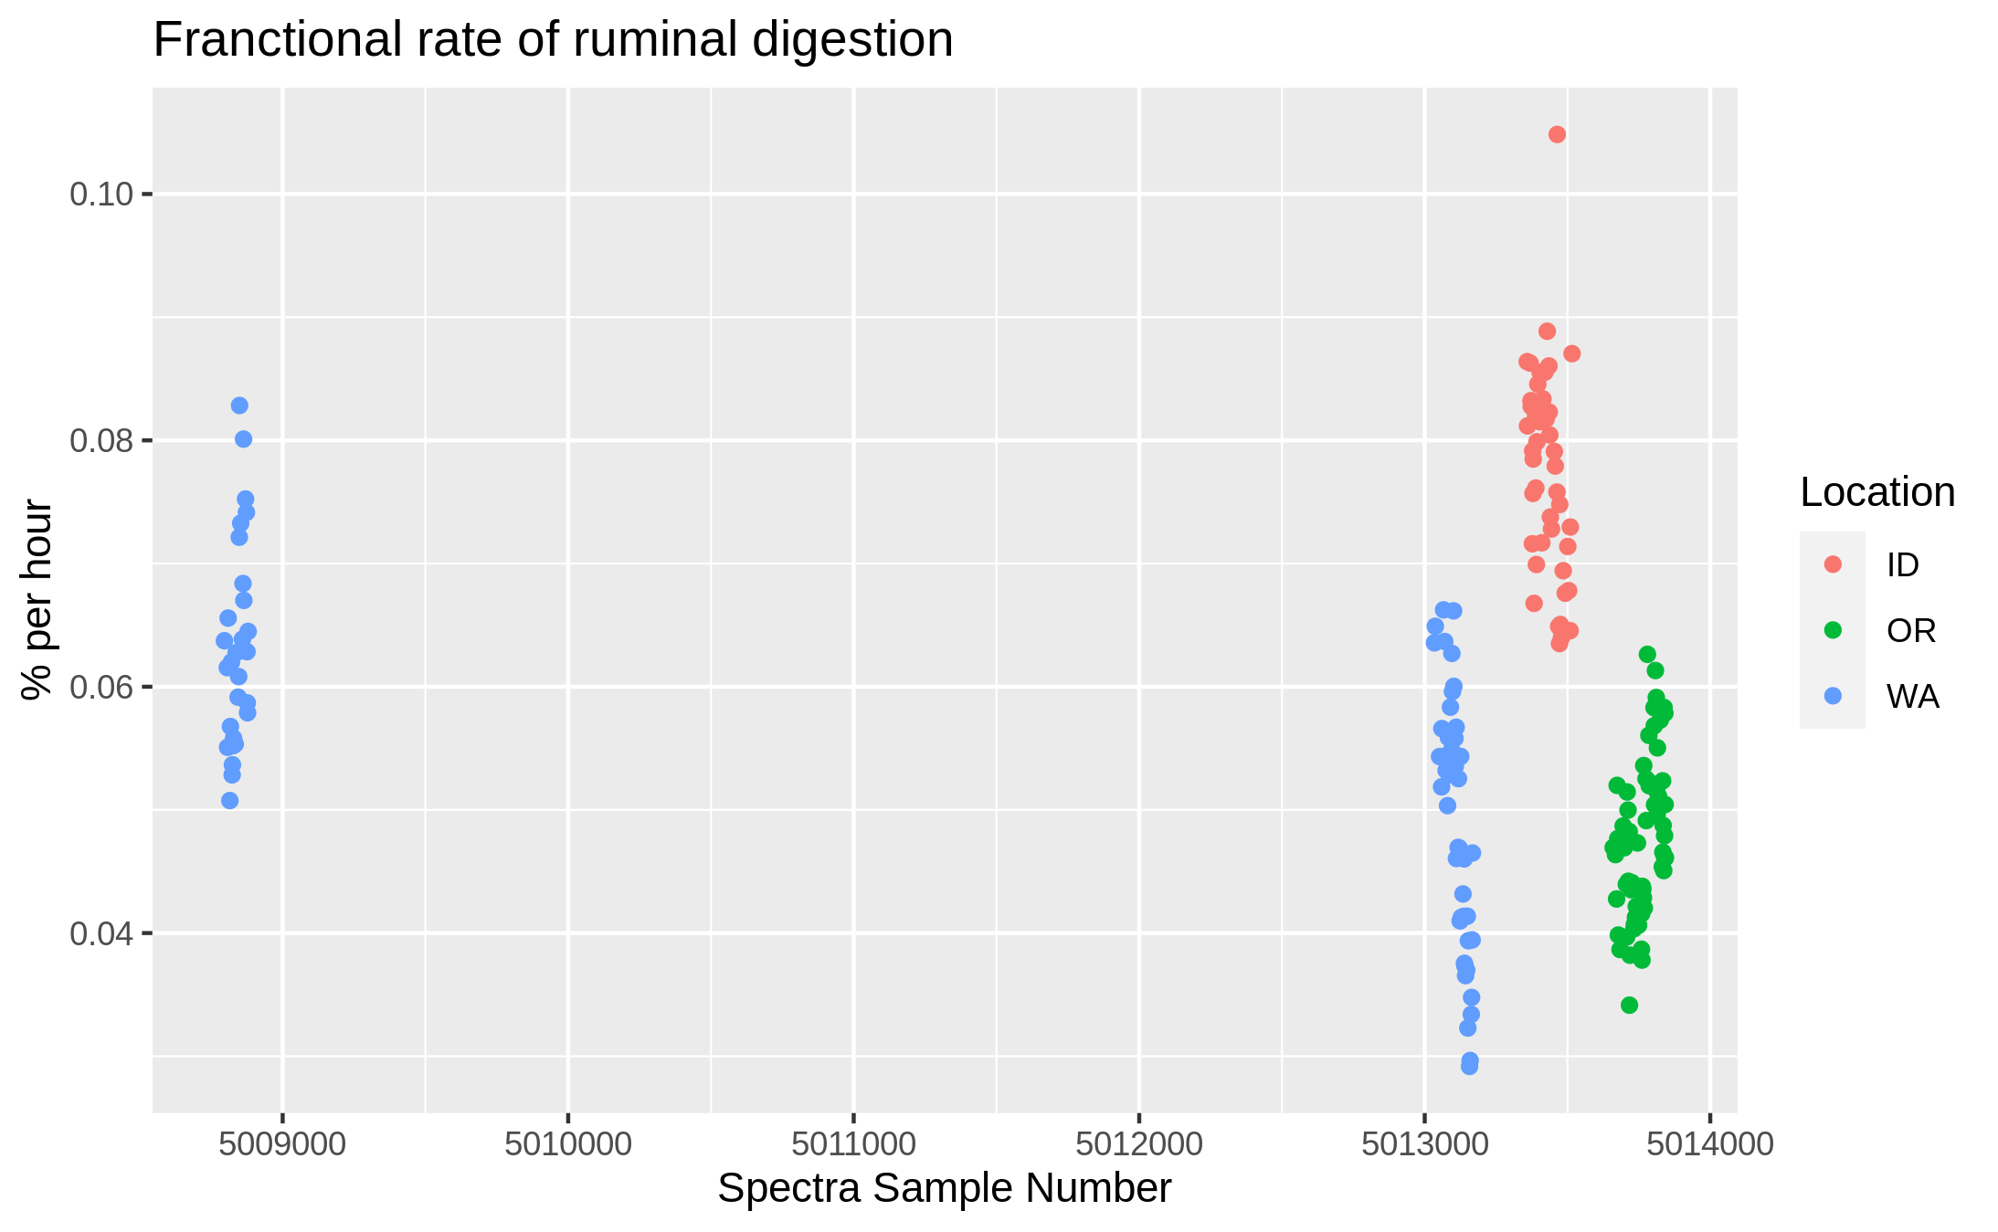
Fractional rate of ruminal digestion

Slide 8
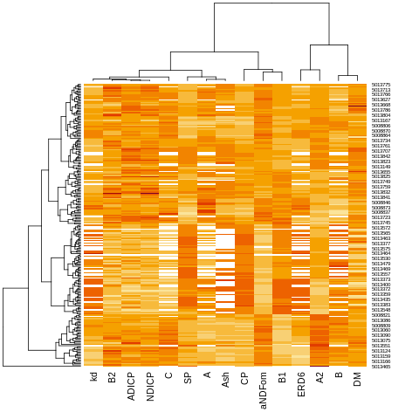
Heatmap and dendrogram

Slide 9
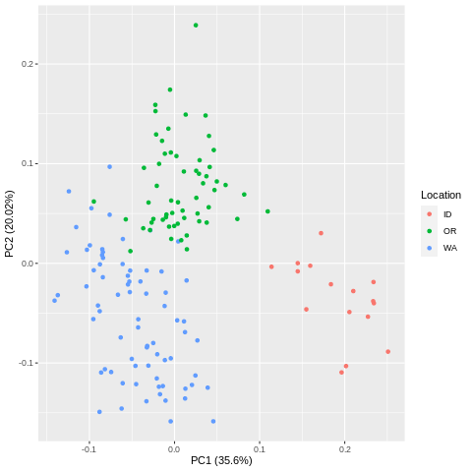
Principal Component Analysis

Slide 10
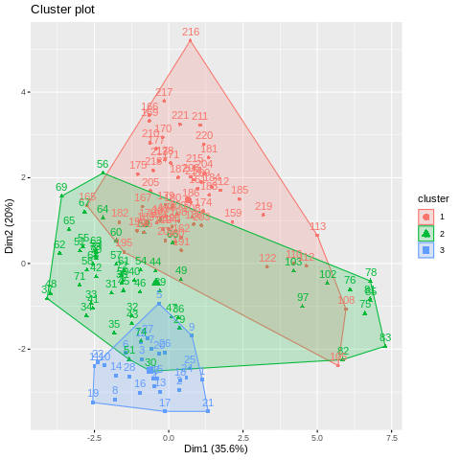
K-means clustering

