Slide 1
AME 480/580 Introduction to nuclear engineering
Nuclear reactions
1/19/18

Slide 2
references
Fundamentals of Nuclear Reactor Physics by E. E. Lewis
Introduction to Nuclear Engineering by J. R. Lamarsh and A. J. Baratta
https://en.wikipedia.org/wiki/Stable_nuclide
https://en.wikipedia.org/wiki/Ionization_chamber

Slide 3
Outline
Question: Would you guys rather have homework problems on a separate file or is the way we are doing okay?
Question: You guys don’t mind me asking you guys questions right? Please feel free to speak up and express your opinions on how the class should be conducted. We are all learning. I’m learning as well so if you have any comments or criticism, please speak up and I’ll try to work on it. ☺
Unclear things from last time
Neutron multiplication revisited
Fissile/fertile materials
Nuclear stability and radioactive decay
Saturation activity
Decay chains
Summary

Slide 4
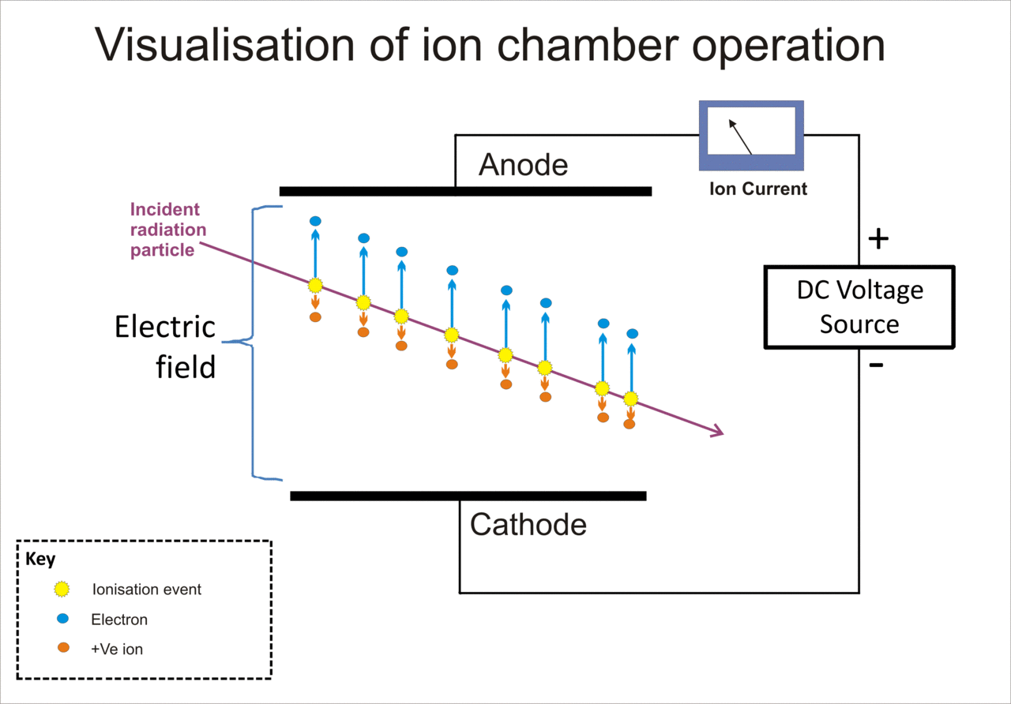

Things I wish I had explained better last time
Is this the correct reaction? ${}_{1}^{2}H+{}_{1}^{2}H→{}_{1}^{1}H+{}_{2}^{3}{He}+4.02 MeV$.
NO! I have a typo here…very sorry about this.
The correct reaction is ${}_{1}^{2}H+{}_{1}^{2}H→{}_{1}^{1}H+{}_{1}^{3}H+4.02 MeV$.
New rule: Whoever finds mistakes like these in lecture will get 5 points in extra credit for that homework cycle for each mistake found.
How do we detect radiation?
In general, different particles interact with materials differently. We generally measure detectable changes in these materials to detect radiation. One example is something called an ionization chamber: It is a gas filled radiation detector and is widely used to measure x-rays, gamma rays, and beta particles. It detects radiation by measuring the charge from the number of ion pairs created within gas caused by incident radiation.
“A voltage potential is applied between the electrodes to create an electric field in the fill gas. When gas between the electrodes is ionized by incident ionizing radiation, ion-pairs are created and the resultant positive ions and dissociated electrons move to the electrodes of the opposite polarity under the influence of the electric field. This generates an ionization current which is measured by an electrometer circuit.” - wiki
Useful links:
https://en.wikipedia.org/wiki/Ionization_chamber
https://www.nrc.gov/about-nrc/radiation/health-effects/detection-radiation.html#prd
https://phyusdb.files.wordpress.com/2013/03/radiationdetectionandmeasurementbyknoll.pdf

Slide 5
Other questions
Is fusion safer than fission?
Strictly speaking, we are going to shield off any radiation that comes out of reactors. So from a safety point of view, they should both be safe so long as shielding is done right.
Is H more stable than U (based on binding energy per nucleon)?
No. But depends on the isotope of H we are talking about. For example H-3 is unstable. We will talk more about stability of nuclides today.
Also in general nuclides with higher binding energy per nucleon are less likely to decay than the ones with less. However, exceptions may exist.

Slide 6
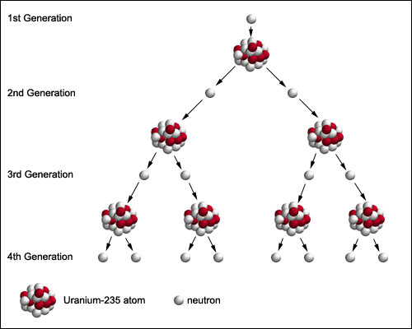

Neutron Multiplication revisited for clarity
As a neutron travels and interacts with ambient material – they either scatter or get absorbed. If they absorb, and conditions are conducive to fission (and we will talk about what “conducive” means in the next chapter), we see fission.
If each fission, then produces more neutrons, these new neutrons further interact with ambient material and cause further fission in the material and so on. This is the fission chain reaction. This is the idea nuclear reactors operate on.
We characterize this chain reaction by defining a multiplication factor, k.
The multiplication factor is essentially the ratio of number of fission neutrons born in one generation to that in the preceding generation:
$$k=\frac{number of neutrons in n^{th}generation}{number of neutrons in {n−1}^{th}generation}$$

Slide 7

Preliminary math on $k$
Let the number of neutrons in a system at t=0 be $n_{0}$
The number of neutrons in the next generation is $n_{1}$
Now, $k=\frac{n_{1}}{n_{0}}$ ➔ $n_{1}=kn_{0}$
Assuming the multiplication factor stays constant over time, the second generation will have $n_{2}=kn_{1}=k.kn_{0}=k^{2}n_{0}$…generalizing this result to $i^{th}$ generation, we have, $n_{i}=k^{i}n_{0}.$
Note that our relation is in terms of generation number which is not necessarily useful. We want to have this relation as a function of time now. What do we do?
First we define a neutron lifetime, $l$, as average time from birth (through fission), aging (slowing down due to scattering) and death (absorption) for neutrons.
Then, on an average, the time at which the $i^{th}$ generation is born is $t=i.l$ and the number of neutrons present in the system at time, $t$, is
$$n\left(t\right)=k^{i}n_{0}=k^{t/l}n_{0}$$

Slide 8

Neutron multiplication continued
The neutron population will increase, decrease or remain the same depending on the value of k.
If k > 1 → supercritical; k < 1 → subcritical; k = 1 → critical
Now let us consider multiplication behavior when k ~ 1.
In order to do that, let us recall relations between exponential function and a logarithm (inverse functions):
$x=e^{\ln{x }}$; $\ln{x^{y}}=y\ln{x}$; so $x^{y}=e^{\ln{x^{y}}}=e^{y\ln{x}}$.
Now apply these relations to $n\left(t\right)=k^{t/l}n_{0}=n_{0}e^{(t/l)\ln{k}}$
Now note that we want to evaluate the value of $n(t)$ when $k\sim 1$. In order to do that, expand $\ln{k}$in Taylor series around 1:
$$\ln\left(k\right)= \sum_{i=1}^{∞}{\frac{{\left(−1\right)}^{i+1}}{i}{\left(k−1\right)}^{i}}$$
Keeping the first term and ignoring higher order terms (why can you do that?), we find that
$$\ln\left(k\right)≈k−1$$
Then,
$$n\left(t\right)=n_{0}e^{(t/l)\ln{k}}=n_{0}e^{\frac{\left(k−1\right)t}{l}}$$
Therefore, neutrons show exponential growth/decay. The idea of multiplication will be studied at length later on.

Slide 9
Fissile/fertile materials
Two classes of material are primarily important in reactor design – fissile materials and fertile materials
Fissile – Will undergo fission when bombarded with neutrons. Example: U-235
Fertile – Will capture neutrons, transmute into something that is fissile by radioactive decay. They may also go fission directly without transmutation but they would have to be hit by high energy neutrons. Example U-238.
Fissile and fertile materials, together, are classified as fissionable materials.
The only naturally occurring fissile material is U-235. It constitutes about 0.7% of naturally occurring U. The rest is mostly U-238, which is only fertile and not fissile.
For long term purposes, it would be prudent to consider using fertile materials in fuel complex. Reactors that use such fuel would “breed” fissile materials by transmuting fertile materials which would then be burnt to produce heat and eventually generate power. Such reactors are called breeders.
We don’t have too many of them due to proliferation concerns.

Slide 10

Fissile/fertile materials continued
Some examples of fertile materials transmuting to fertile materials are:
$${}_{0}^{1}n+{}_{92}^{238}U→{}_{92}^{239}U\underset{→}{β^{−}}{}_{93}^{239}{Np}\underset{→}{β^{−}}{}_{94}^{239}{Pu}$$
There is strong probability that if a neutron hits Pu-239, it will fission. However there is also a small possibility that it will transmute to Pu-240 which is fertile.
Hitting Pu-240 with a neutron results in Pu-241 which is again fissile.
Another fertile material (and this is now being seriously considered as a next-gen fuel option) is Th-232:
$${}_{0}^{1}n+{}_{90}^{232}{Th}→{}_{90}^{233}{Th}\underset{→}{β^{−}}{}_{91}^{233}{Pa}\underset{→}{β^{−}}{}_{92}^{233}U$$
Thorium is much more readily available in Earth’s crust. Moreover, it is more attractive from a non-proliferation view point.
Homework (10 points): Watch the following talk and summarize it. Also add your own views through any other research you might conduct on Th-fueled nuclear reactors:
https://www.youtube.com/watch?v=yGhEdcwXxdE

Slide 11
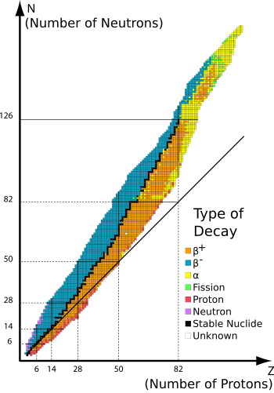
Nuclear Stability and radioactive decay
So far, we’ve been throwing around the word “stable” without really knowing what it means in the context of nuclear physics. Let’s look at it now.
Essentially, a nucleus is stable if it does not transform into some other nucleus autonomously.
The stability of nuclei depends heavily on the ratio of neutrons to protons. If the ratio is too large or too small, the nucleus becomes “unstable” and emits a particle autonomously to become stable. A more detailed presentation will take a lot of time and is beyond the scope of this course.
For our purpose we will say that the decay happens when the nuclide is far away from the band of stability as depicted in the figure.
Decay happens so that the daughter nuclide is closer to the line of stability than before.
Note that decay is not necessarily a one step process. It may undergo several decay steps to eventually get to a stable nucleus.

Slide 12

Nuclear Stability and radioactive decay continued
$β^{−}$ decay: When nuclei have excess neutrons, they undergo $β^{−}$ decay. In this reaction, one of the neutrons is converted into proton while emitting an electron ($β^{−})$ and an antineutrino. The number of neutrons is reduced and we move towards line of stability. Example:
$${}_{8}^{19}O→{}_{9}^{19}F+{}_{−1}^{0}{β^{−}}+{}_{0}^{0}{\overline{ν}}$$
$β^{+}$ decay: When nuclei are lacking in neutrons, they undergo $β^{+}$ decay. In this reaction, one of the nuclear protons is transformed into a neutron and a positron and a neutrino are emitted. The number of protons is thus reduced and we move towards line of stability. Example:
$${}_{8}^{15}O→{}_{7}^{15}N+{}_{1}^{0}{β^{+}}+{}_{0}^{0}ν$$
$α$ decay: Observed predominantly in heavy nuclides, alpha decay is relatively rare in light nuclei. This particle is the nucleus of ${}_{2}^{4}{He}$ with two protons and two neutrons. This reduces atomic number by 2 and atomic mass number by 4. Example:
$${}_{92}^{238}U→{}_{90}^{234}{Th}+{}_{2}^{4}{He}$$
Homework (10 points): Several other nuclear decay reactions occur in nature. Find out about any 5 other reactions and describe them in your own words. Extra points (1 point each) if you write about more than 5.

Slide 13

Fission products
Recall our fission reaction from last time: ${}_{0}^{1}n+{}_{92}^{235}U→2{}_{0}^{1}n+{}_{54}^{140}{Xe}+{}_{38}^{94}{Sr}+200 MeV$
But as we said last time fission products don’t always have to be the same.
However, there is one common trait, one fission product will be significantly heavier than the other at low neutron energies.
Therefore we group fission products into two broad categories:
Light group – Atomic mass number between 80-110
Heavy group – Atomic mass number between 125-155
Probability of fission yielding products of equal mass increases with increasing neutron energy. Adjoining figure demonstrates fission product yield in percent for U-235.
There is a scientifically more efficient way to yield products of equal mass – call Chuck Norris – he can karate chop atoms right down the middle…but that might be too economically prohibitive.
There are about 40 fission product pairs that can result from fission of U-235.
Each of these fission product pair will have its own characteristic decay chain which means we eventually end up with around 200 fission products in the reactor eventually.
So now what is this decay chain?
Fission fragments are not always stable. They decay…not necessarily directly to a stable nuclide. On their way to the relevant stable nuclide, they undergo several radioactive decay reactions giving rise to a chain of nuclides that result from decay. This chain of nuclides is the decay chain.
Example:
${}_{54}^{140}{Xe}\underset{→}{β^{−}}{}_{55}^{140}{Cs}\underset{→}{β^{−}}{}_{56}^{140}{Ba}\underset{→}{β^{−}}{}_{57}^{140}{La}\underset{→}{β^{−}}{}_{58}^{140}{Ce}$

Slide 14

Decay heat
Around 8% of the 200 MeV of energy produced from fission is attributable to the beta decay of fission products and gamma decay associated with it.
Therefore, even after the shutdown of the chain reaction, radioactive decay will produce significant amount of heat.
This heat is called the decay heat. The power generated by this heat is approximated using the Wigner-Way formula:
$$P_{d}\left(t\right)=0.0622P_{0}\left[t^{−0.2}−{\left(t_{0}+t\right)}^{−0.2}\right]$$
Where, $P_{d}\left(t\right)$ is the power generation due to radioactive decay; $P_{0}$ is the power before shutdown; $t_{0}$ is the time, in seconds, of power operation before shutdown; $t$is time, in seconds, elapse since shutdown.
As a result of decay heat, cooling must be provided to prevent over-heating of reactor fuel for a significant amount of time after reactor shutdown.
Homework (10 points): A reactor operates at ${10}^{3}$ MW for 1 yr. Calculate the power from decay heat a) after 1 day b) one month. Repeat a and b if reactor only operated for 1 month at that power.

Slide 15

Radioactive decay Law
In order to understand behavior of fission products, rates of conversion of fertile to fissile materials, and other phenomena related to reactor physics, we must quantify behavior of radioactive materials.
Radioactive decay law: The rate of decay is proportional to the number of nuclei present: $\frac{dN\left(t\right)}{dt}∝N(t)$
Each radioisotope has its own characteristic proportionality constant – the decay constant, $λ$. Then, if the number of nuclei present at an arbitrary time is N, then the rate of decay is
$$\frac{dN}{dt}=−λN$$
Hmm…so this is a linear, first order ODE. How do you solve it?
Is the equation separable? Yes. Then lets separate and integrate both sides:
$$\frac{dN}{dt}=−λN→\frac{dN}{N}=−λdt→ \int_{N_{0}}^{N_{t}}{\frac{dN}{N}}=−λ\int_{0}^{t}{dt}→\ln\left(N_{t}\right)−\ln\left(N_{0}\right)=−λ\left(t−0\right)→\ln\left(\frac{N_{t}}{N_{0}}\right)=−λt →e^{ln\left(\frac{N_{t}}{N_{0}}\right)}=e^{−λt}$$
Finally,
$$N_{t}=N_{0}e^{−λt}$$
Where, $N_{0}$ is the initial number of nuclei and $N_{t}$ is the final number of nuclei at time t.

Slide 16

Half-life (not the video game)
Units of radioactivity:
Curies (Ci) = 3.7$×{10}^{10}$ disintegrations per second.
Becquerel (Bq) = 1 disintegration per second.
The time it takes for one-half of the radioactive nuclei to decay.
Okay problem for class…lets think about how we would calculate half life of nuclei with decay constant $λ$.
We want to go from N to $\frac{N}{2}$ and our decay constant is $λ.$
Then $N_{0}=N$, $N_{t}=\frac{N}{2}$.
Using decay law,
$$N_{t}=N_{0}e^{−λt}$$
$$→\frac{N}{2}=N e^{−λt_{\frac{1}{2}}}$$
$$→\ln\left(\frac{1}{2}\right)=−λt_{\frac{1}{2}}$$
$$→−0.693 =−λt_{\frac{1}{2}}$$
$$→t_{\frac{1}{2}}=\frac{0.693}{λ}$$

Slide 17

All that Is fine but how do you calculate the number of atoms in the first place?
To calculate the number of atoms, we go back to Avogadro’s law and the definition of gram atomic weight.
Recall gram atomic weight is the weight in grams equal to the atomic weight.
Avogadro’s law states that the number of atoms in one gram atomic weight of any substance is a constant - $N_{A}=0.602×{10}^{24}$
Then if we have m grams of some arbitrary substance with an atomic mass of M, then the total number of atoms in m grams of that substance is? $→\frac{mN_{A}}{M}$
Number density or atom density: For a material with density $ρ$, the number density is defined as number of atoms per cc of that material and it can be calculated according to: $\frac{ρN_{A}}{M}$
Homework (10 points): Half-life of U-238 is 4.51e9 years, half-life of U-235 is 7.13e8 years. Earth was formed 4.5 billion years ago, therefore the isotopic abundance of U-235 has been decreasing relative to U-238. Define enrichment as $\frac{N^{235}}{N^{235}+N^{238}}$. Present day U enrichment is ~0.7%.
Calculate the enrichment of U when earth was formed.
How long ago was the enrichment 4%?

Slide 18

Saturation activity
Radionuclides are produced at a constant rate in reactors – reactors operating at constant power will generally produce fission fragments at a constant rate.
In such situations, we determine time-dependence of inventory of an isotope produced in reactor at a rate of $A_{0}$ nuclei per unit time by adding a source term to the decay law equation:
$$\frac{dN}{dt}=−λN+A_{0} →\frac{dN}{dt}+λN=A_{0}$$
So now, if we want to solve the above equation, how do we solve it? We use integrating factor.
Note that $\frac{d}{dt}\left(Ne^{λt}\right)=\frac{dN}{dt}e^{λt}+λNe^{λt}=\left[\frac{dN}{dt}+λN\right]e^{λt}$,
Then if we multiply the equation, $\frac{dN}{dt}+λN=A_{0}$ by an “integrating factor”, $e^{λt}$, we get $\left[\frac{dN}{dt}+λN\right]e^{λt}=A_{0}e^{λt}$.
Now using the relation from the line above, we have:
$$\frac{d}{dt}\left(Ne^{λt}\right)=A_{0}e^{λt}$$
Now integrate both sides from time, t = 0 to t:
$$\int_{0}^{t}{dt}\frac{d}{dt}\left(Ne^{λt}\right)=\int_{0}^{t}{dt}A_{0}e^{λt} → N_{t}e^{λt}−N_{0}e^{λ0}=A_{0}\int_{0}^{t}{dt}e^{λt}=\frac{A_{0}\left(e^{λt}−e^{λ0}\right)}{λ}=\frac{A_{0}\left(e^{λt}−1\right)}{λ}$$

Slide 19

Saturation activity continued
Now, assuming the initial concentration was for the relevant radioisotope is 0, we have
$$N_{t}e^{λt}=\frac{A_{0}\left(e^{λt}−1\right)}{λ}$$
A simple rearrangement of the above equation returns:
$$λN_{t}=A_{0}\left(1−e^{−λt}\right)$$
Here, $λN_{t}$ is activity measured in Bq.
Initially the activity will increase linearly with time because for, $λt≪1 (\sim 0)$, $e^{−λt}\sim 1−λt$… why? Expand in Taylor series and ignore higher order term, you’ll see it.
Homework (5 points): Expand the above exponential in Taylor series and prove that initially the activity will increase linearly.
After several half-lives, the exponential term will become vanishingly small. At that time we see the activity become nearly constant → $λN_{∞}≈A_{0}$. This is saturation activity. We can see the buildup to saturation activity in the adjoining figure.
Radioisotopes with shorter half-lives achieve saturation activity faster.
This is an important concept because, radioisotopes affect core composition and core-composition determines how efficiently your reactor works.
Homework (10 points): Consider the reaction ${}_{0}^{1}n+{}_{92}^{238}U →{}_{ 92}^{239}U \underset{→}{β^{−}} {}_{93}^{239}{Np} \underset{→}{β^{−}} {}_{94}^{239}{Pu}$ for a reactor. If U-239 is produced in the reactor at a constant rate, how long will it take Pu-239 to reach ½ of its saturation activity?
Half-life for Np is 2.36 days. Assume U-239 decays instantaneously.

Slide 20
Next time
Decay chains
Summarize Ch. 1
If we have time, we start Ch. 2

