Slide 1
AME 480/580 Introduction to nuclear engineering
Neutron interactions
1/24/18

Slide 2
references
Lewis
Lamarsh and Baratta
Lewis and Miller
https://www.mathsisfun.com/data/probability.html
https://www.nuclear-power.net/nuclear-power/reactor-physics/nuclear-engineering-fundamentals/neutron-nuclear-reactions/macroscopic-cross-section/
http://www.kayelaby.npl.co.uk/atomic_and_nuclear_physics/4_7/4_7_3.html

Slide 3
Introduction
The behavior of nuclear reactors depends on the behavior of neutrons emitted from fission as they interact with matter.
On an average, one of the two of more neutrons that are created by fission must survive to create subsequent fission.
The concept of cross-section is at the core of neutron interactions.
These cross-sections, their dependence on neutron kinetic energy, and the relative probability that a collision will result in scattering, capture, or fission form the physical data on which properties of chain fission chain reaction rest.
In this chapter, we will study:
Neutrons’ behavior as they travel through material – cross-sections, mean free path
Different types of cross-section – scattering, absorption, fission
Neutron kinetic energy spectrum
Cross-section dependence on neutron kinetic energy
Distribution of energies of scattered neutrons

Slide 4
Outline-today
Neutron cross-sections
Microscopic and macroscopic cross-sections
Uncollided flux
Nuclide densities
Enriched Uranium

Slide 5
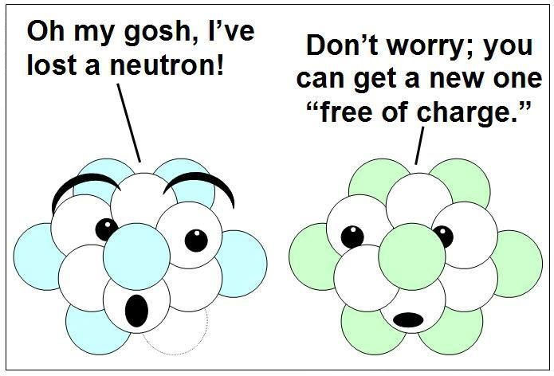
Jimmy the Neutron
Neutrons are neutral particle (as everyone knows)
Neither electrons surrounding nucleus nor electric field generated by protons in nucleus affect neutron path.
Neutrons travel in straight lines.
They only deviate from their path when they collide with a nucleus to be scattered into a new direction or absorbed.
The life of a neutron consists typically of a large number of scattering collisions followed by absorption.
Consider a single tightly packed layer of atoms perpendicular to neutron path.
The fraction of the tightly packed layer of atoms that will actually block a neutrons is an extremely small number.
To a neutron traveling through a solid, space appears to be quite empty. On an average neutrons penetrate many millions of layers of atoms between collisions with nuclei.
If the target material is thin (e.g. piece of paper) , nearly all neutrons are expected to pass through without any collision.

Slide 6


Microscopic cross-section
Consider a beam of neutrons traveling in x-direction as indicated in the adjoining figure.
Let $I(x)$ be the beam intensity after penetrating $x cm$ into the material.
If the beam travels a distance $dx$, the fraction of neutrons colliding with nuclei will be the same as the fraction of $1 cm^{2}$ cross section area that is shadowed by nuclei.
We will assume that if $dx$ is small, and nuclei are randomly placed, shadowing of one nucleus by another can be ignored (except when we are looking at a single crystal).
The shadowed area corresponding to one atom is the microscopic cross-section of that atom. This represents effective target area of a single target nucleus for an incident neutron.
Another way to look at the idea of cross-section is through the idea of number of collisions in a target per second being proportional to the number of atoms in the target and beam intensity. The cross-section is the proportionality constant.
Microscopic cross-section is measured in barns $({10}^{−24}cm^{2})$
Let,
$v=$ neutron speed $\left[\frac{cm}{s}\right]$
$n^{′′′}=$ beam’s neutron density $\left[\frac{neutrons}{cc}\right]$
$I=n^{′′′}v \left[\frac{neutrons}{cm^{2}s}\right]=$ neutron intensity

Slide 7
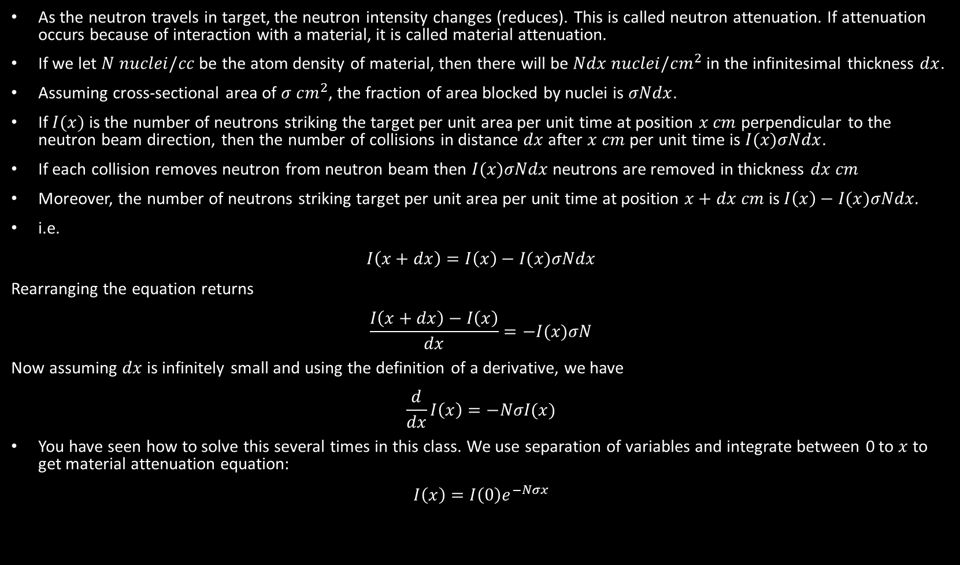
Neutron attenuation
As the neutron travels in target, the neutron intensity changes (reduces). This is called neutron attenuation. If attenuation occurs because of interaction with a material, it is called material attenuation.
If we let $N nuclei/cc$ be the atom density of material, then there will be $Ndx nuclei/cm^{2}$ in the infinitesimal thickness $dx$.
Assuming cross-sectional area of $σ cm^{2}$, the fraction of area blocked by nuclei is $σNdx$.
If $I(x)$ is the number of neutrons striking the target per unit area per unit time at position $x cm$ perpendicular to the neutron beam direction, then the number of collisions in distance $dx$ after $x cm$ per unit time is $I(x)σNdx$.
If each collision removes neutron from neutron beam then $I(x)σNdx$ neutrons are removed in thickness $dx cm$
Moreover, the number of neutrons striking target per unit area per unit time at position $x+dx cm$ is $I\left(x\right)−I(x)σNdx$.
i.e.
$$I\left(x+dx\right)=I\left(x\right)−I(x)σNdx$$
Rearranging the equation returns
$$\frac{I\left(x+dx\right)−I\left(x\right)}{dx}=−I(x)σN$$
Now assuming $dx$ is infinitely small and using the definition of a derivative, we have
$$\frac{d}{dx}I\left(x\right)=−NσI(x)$$
You have seen how to solve this several times in this class. We use separation of variables and integrate between 0 to $x$ to get material attenuation equation:
$$I\left(x\right)=I\left(0\right)e^{−Nσx}$$

Slide 8

macroscopic cross-section and probabilities
Macroscopic cross-section is the product of number density and microscopic cross-section. It represents effective target area of all nuclei contained in unit volume of the material.
$Σ=σN cm^{−1}$
Probabilities:
$$Probability of an event=\frac{\# events}{total \#}$$
$dI\left(x\right)=$ # collisions in distance $dx$ after $x cm$ per unit time is $I(x)σNdx$
$I\left(x\right)=$ # neutrons striking the target per unit area per unit time at position $x cm$
$\frac{dI\left(x\right)}{I\left(x\right)}=σNdx=Σdx=$ probability will collide in the next $dx$
If we recall the material attenuation equation, $I\left(x\right)=I\left(0\right)e^{−Nσx}=I\left(0\right)e^{−Σx}$, and rearrange it, we have $\frac{I\left(x\right)}{I\left(0\right)}=e^{−Σx}$
$I\left(x\right)=\text{\# }\text{neutrons} \text{striking} \text{the} \text{target} \text{per} \text{unit} \text{area} \text{per} \text{unit} \text{time} \text{at} \text{position} x cm$
$I(0)=\text{\# }\text{neutrons} \text{striking} \text{the} \text{target} \text{per} \text{unit} \text{area} \text{per} \text{unit} \text{time} \text{at} \text{position} 0 cm$
$\frac{I\left(x\right)}{I\left(0\right)}=e^{−Σx}=$ probability that a neutron will travel a distance $x$ without making a collision

Slide 9

Probabilities and mean free path
$$Joint Probability of two events=P\left(A,B\right)=P\left(A\right)P\left(B\right)=Likelihood of more than one event occuring simultaneously$$
Find the probability that a neutron will make its first collision in dx.
This is the probability that it survives till x and then collides in dx. Both these probabilities were calculated in the previous slide.
Therefore the joint probability that a neutron will survive till x ($e^{−Σx}$) and that it will collide in dx ($Σdx$) is
$$p\left(x\right)dx=Σdxe^{−Σx}$$
The mean distance travelled by a neutron between collisions is called the mean free path.
$$Expected value= \int_{−∞}^{∞}{dx f(x) p(x)}$$
We want to calculate mfp which is in terms of distance, $x$. Therefore, the function $f(x)$ will be $x$. Moreover the limits of integration will go from $0 to ∞$ because our function is distance which can not be negative.
The probability function will come from the joint probability we have defined above because we want the particle to travel a distance and then we want it to collide. Then,
$$mfp= \int_{0}^{∞}{dx xΣe^{−Σx}}=\frac{1}{Σ}$$

Slide 10
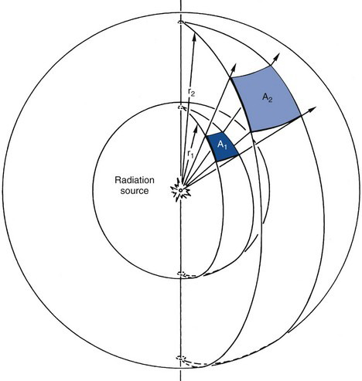

Uncollided flux and attenuation
Suppose the density of uncollided neutrons in a system is $n_{u}^{′′′}\left(x\right)\frac{neutrons}{cc}$, and neutron speed is $v\frac{cm}{s}$. Then uncollided flux of neutrons, $φ_{u}\left(x\right)=n_{u}^{′′′}\left(x\right)v neutrons per cm^{2} per s$. This is the same quantity as $I(x)$ which included neutrons that had not made a collision.
Consider a point source that emits $s_{p}$ neutrons per unit time.
In a vacuum, there is no material attenuation and are attenuated only in a geometric sense.
At any location, all uncollided neutrons will travel radially outward from the source.
Then at a distance $r$, neutrons will pass through a surface area of $4πr^{2}$ (because that is the area of a sphere). Then the number of uncollided neutrons passing unit area at a distance $r$ is
$$φ_{u}\left(r\right)=\frac{s_{p}}{4πr^{2}}$$
With neutron traveling further in radial direction (increasing r), the area increases and the flux decreases. This is geometric attenuation.
If we were to incorporate material effects and material attenuation, we know that $e^{−Σr}$ fraction of neutrons will survive a distance r. Therefore after accounting for both material and geometric attenuation,
$$φ_{u}\left(r\right)=\frac{s_{p}e^{−Σr}}{4πr^{2}}$$
Note: We care about attenuation for shielding and detection purposes.

Slide 11
Homework

Slide 12

Nuclide/number density and macroscopic cross-sections
So far we have encountered several formulas that require number densities. E.g. macroscopic cross-section.
We had defined number density of a nuclide as $N=\frac{ρN_{A}}{A}$ where $ρ \left[\frac{g}{cc}\right]$ was the mass density of the nuclide, $N_{A}$is the Avogadro’s number and $A [g]$ is the atomic weight.
The macroscopic cross section, then is $Σ=Nσ=\frac{ρN_{A}}{A}σ$.
More often than not, however, we will be dealing with mixtures of nuclides. In such situations how do we find atom densities and macroscopic cross-sections?
In such situations, we find out atomic fractions of each constituent and work with those fractions.
Let $\frac{N^{i}}{N}=\frac{number density of nuclide i in the mixture}{total number density of mixture}=\frac{number of atoms of nuclide i in the mixture}{total number of atoms in mixture}=$ atomic fraction of nuclide $i$
Then atomic weight of the mixture is $A=\sum_{i}{\frac{N^{i}}{N}A^{i}}$ …$i$ is an index used to represent different nuclides of that mixture.
The macroscopic cross-section of a mixture is $Σ=\frac{ρN_{A}}{\sum_{i}{\frac{N^{i}}{N}A^{i}}}\sum_{i}{\frac{N^{i}}{N}}σ^{i}=\frac{ρN_{A}}{A}\sum_{i}{\frac{N^{i}}{N}}σ^{i}$.

Slide 13

Nuclide density and macroscopic cross-sections continued
Example: Microscopic cross-section of H and O is $σ^{H}$ and $σ^{O}$ respectively. Calculate macroscopic cross-section of $H_{2}O$.
The macroscopic cross-section of a mixture is $Σ=\frac{ρN_{A}}{\sum_{i}{\frac{N^{i}}{N}A^{i}}}\sum_{i}{\frac{N^{i}}{N}}σ^{i}=\frac{ρN_{A}}{A}\sum_{i}{\frac{N^{i}}{N}}σ^{i}$
For water, we have two atoms of H and one atom of O per one molecule of water.
Then, $Σ=\frac{ρN_{A}}{\sum_{i}{\frac{N^{i}}{N}A^{i}}}\sum_{i}{\frac{N^{i}}{N}}σ^{i}=\frac{ρ^{H_{2}O}N_{A}}{2A^{H}+A^{O}}\left(2σ^{H}+σ^{O}\right)=\frac{ρ^{H_{2}O}N_{A}}{A^{H_{2}O }}\left(2σ^{H}+σ^{O}\right)$
We may define a composite number density and microscopic cross-section for molecules:
$$N^{H_{2}O}=\frac{ρ^{H_{2}O}N_{A}}{A^{H_{2}O }}, σ^{H_{2}O}=2σ^{H}+σ^{O}$$
The macroscopic cross-section, then, is
$$Σ^{H_{2}O }=N^{H_{2}O}σ^{H_{2}O}$$

Slide 14

Volume and mass fraction
Often we are given materials in terms of volume fractions.
Let $V$ be the volume of mixture and $V_{i}$ be volume of constituent $i$.
The volume fraction is then $\frac{V_{i}}{V}$ and $\sum_{i}{V_{i}}=V.$
In such cases, the macroscopic cross-section is calculated by
$Σ=\sum_{i}{\frac{V_{i}}{V}N_{i}σ^{i}}$, where $N_{i}=\frac{ρ_{i}N_{A}}{A^{i}}$
If we are given data in terms of mass fraction, $\frac{M^{i}}{M}=\frac{ρ^{i}V^{i}}{ρV}$, with $M=\sum_{i}{M^{i}}$ and $ρ=\frac{M}{V}.$
If we combine definitions of mass fraction with $Σ=\sum_{i}{\frac{V_{i}}{V}N_{i}σ^{i}}=\sum_{i}{\frac{V_{i}}{V}\frac{ρ_{i}N_{A}}{A^{i}}σ^{i}}$, we get
$$Σ=\sum_{i}{\frac{M^{i}}{M}\frac{ρN_{A}}{A^{i}}σ^{i}}$$
How exactly? Multiply and divide by density and combine density and volume to get respective mass

Slide 15


Enriched uranium
Natural U contains ~0.7% U-235 and ~99.3% U-238 (atomic).
We do not use natural uranium in most nuclear systems. We often customize fuel such that the atomic fraction of U-235 is modified. This process is called enrichment.
Atomic enrichment: The ratio of U-235 atoms to total number of U atoms.
$${\tilde{e}}_{a}=\frac{N^{235}}{N^{235}+N^{238}}, \left(1−{\tilde{e}}_{a}\right)=\frac{N^{238}}{N^{235}+N^{238}}$$
$$Σ^{U}=\frac{ρ^{U}N_{A}}{{\tilde{e}}_{a}A^{235}+\left(1−{\tilde{e}}_{a}\right)A^{238}}\left({\tilde{e}}_{a}σ^{235}+\left(1−{\tilde{e}}_{a}\right)σ^{238}\right)$$
Mass (or weight) enrichment:
$${\tilde{e}}_{w}=\frac{M^{235}}{M^{235}+M^{238}}, \left(1−{\tilde{e}}_{w}\right)=\frac{M^{238}}{M^{235}+M^{238}}$$
$$Σ^{U}=ρN_{A}\left(\frac{M^{235}}{M}\frac{1}{A^{235}}σ^{235}+\frac{M^{238}}{M}\frac{1}{A^{238}}σ^{238}\right)=ρN_{A}\left({\tilde{e}}_{w}\frac{1}{A^{235}}σ^{235}+(1−{\tilde{e}}_{w})\frac{1}{A^{238}}σ^{238}\right)$$
Homework (10 points): Show that ${\tilde{e}}_{a}=\frac{1.10276{\tilde{e}}_{w}}{(1+0.01276 {\tilde{e}}_{w})}$. What is atomic enrichment if mass enrichment is 20%?
$$Σ= \frac{ρN_{A}}{A}\sum_{i}{\frac{N^{i}}{N}}σ^{i}$$
$$Σ= \sum_{i}{\frac{V_{i}}{V}\frac{ρ_{i}N_{A}}{A^{i}}σ^{i}}$$
$$Σ=\sum_{i}{\frac{M^{i}}{M}\frac{ρN_{A}}{A^{i}}σ^{i}}$$

Slide 16
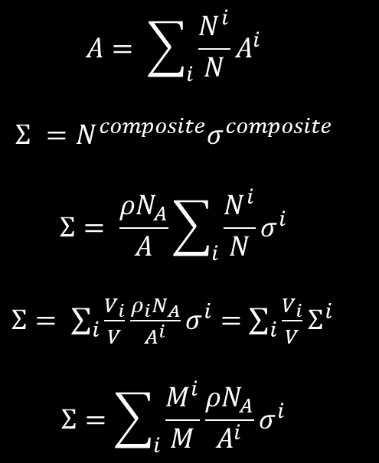

Example
Calculate macroscopic cross-section of 8% enriched $UO_{2}$ (atomic) mixed in a 1:3 volume ratio with graphite (carbon).
$σ^{235}=607.5 b, σ^{238}= ,11.8 b σ^{O}=3.5 b, σ^{C}=4.9 b, ρ^{UO_{2}}=11\frac{g}{cc} and ρ^{C}=1.6\frac{g}{cc}$
Okay so lets look at the problem. We have $UO_{2}$ where U is 8% enriched. Moreover that is then mixed with C in a volume ratio of 1:3. So lets do this step-by-step.
Steps: Start from what you want. You want macroscopic xs of a 1:3 volume ratio mixture. Which means you use
$$Σ= \sum_{i}{\frac{V_{i}}{V}\frac{ρ_{i}N_{A}}{A^{i}}σ^{i}} which simplifies to\sum_{i}{\frac{V_{i}}{V}Σ^{i}}$$
We have two species in the mixture: $UO_{2}$ and C. Therefore,
$$Σ=fraction Σ^{UO_{2}}+fraction Σ^{C}$$
The volume fraction is 1:3 so there are 4 parts. Fractions will be ¼ and ¾ . Therefore $Σ=\frac{1}{4}Σ^{UO_{2}}+\frac{3}{4}Σ^{C}$.
Now we have new unks - $Σ^{UO_{2}}$ and $Σ^{C}$. Here use the formulas we have in the right hand column as shown in the next slide.
Once we have both macroscopic cross-sections, we can calculate what we want to calculate.
$$A= \sum_{i}{\frac{N^{i}}{N}A^{i}}$$
$$Σ^{ }=N^{composite}σ^{composite}$$
$$Σ= \frac{ρN_{A}}{A}\sum_{i}{\frac{N^{i}}{N}}σ^{i}$$
$Σ= \sum_{i}{\frac{V_{i}}{V}\frac{ρ_{i}N_{A}}{A^{i}}σ^{i}}=$ $\sum_{i}{\frac{V_{i}}{V}Σ^{i}}$
$$Σ=\sum_{i}{\frac{M^{i}}{M}\frac{ρN_{A}}{A^{i}}σ^{i}}$$

Slide 17

$$UO_{2}$$
Start by calculating composite microscopic xs (cross-section henceforth):
$$σ^{U}={\tilde{e}}_{a}σ^{235}+\left(1−{\tilde{e}}_{a}\right)σ^{238}=0.08∗607.5+\left(1−0.08\right)∗11.8=59.5 b$$
$$σ^{UO_{2}}=σ^{U}+2σ^{O}=59.5+2∗3.5=66.5 b$$
Start by calculating atomic weight of $UO_{2}$
$$A^{UO_{2}}=A^{U}+2A^{O}=\left({\tilde{e}}_{a}A^{235}+\left(1−{\tilde{e}}_{a}\right)A^{238}\right)+2A^{O}≈238+2∗16=270$$
Now calculate macroscopic xs:
$$Σ^{UO_{2}}=N^{UO_{2}}σ^{UO_{2}}=\frac{ρ^{UO_{2}}N_{A}}{A^{UO_{2}}}σ^{UO_{2}}=\frac{11∗0.6023∗{10}^{24}}{270}66.5∗{10}^{−24}=1.63 cm^{−1}$$
Graphite
$$Σ^{C}=N^{C}σ^{C}=\frac{ρ^{C}N_{A}}{A^{C}}σ^{C}=\frac{{1.6∗0.6023∗{10}^{24}∗4.9∗10}^{−24}}{12}=0.39 cm^{−1}$$
Now calculate the combined macroscopic cross-section of the mixture:
$$Σ= \sum_{i}{\frac{V_{i}}{V}\frac{ρ_{i}N_{A}}{A^{i}}σ^{i}}= \sum_{i}{\frac{V_{i}}{V}Σ^{i}}=fraction Σ^{UO_{2}}+fraction Σ^{C}=\frac{1}{4}Σ^{UO_{2}}+\frac{3}{4}Σ^{C}=0.7 {cm}^{−1}$$
$$A= \sum_{i}{\frac{N^{i}}{N}A^{i}}$$
$$Σ^{ }=N^{composite}σ^{composite}$$
$$Σ= \frac{ρN_{A}}{A}\sum_{i}{\frac{N^{i}}{N}}σ^{i}$$
$Σ= \sum_{i}{\frac{V_{i}}{V}\frac{ρ_{i}N_{A}}{A^{i}}σ^{i}}=$ $\sum_{i}{\frac{V_{i}}{V}Σ^{i}}$
$$Σ=\sum_{i}{\frac{M^{i}}{M}\frac{ρN_{A}}{A^{i}}σ^{i}}$$

Slide 18
Homework

Slide 19

Reaction types
Thus far we have considered the possibility of collision and the xs that characterizes that possibility is the total xs, $σ_{t}$
A neutron that collides with nucleus can either be absorbed or scattered.
Absorption ($σ_{a})$ and scattering ($σ_{s})$ xs characterize neutron absorption and scattering respectively such that
$$σ_{t}=σ_{a}+σ_{s}$$
Scattering process can be broken down into elastic (KE and momentum are conserved) and inelastic (momentum conserved, KE not …some energy of neutron given to nucleus). They are denoted by $σ_{n}$ and $σ_{n^{′}}$ respectively.
$$σ_{s}=σ_{n}+σ_{n^{′}}$$
Absorption can be broken down into capture ($σ_{γ})$ and fission ($σ_{f})$ where
$$σ_{a}=σ_{f}+σ_{γ}$$
The total xs is then
$$σ_{t}=σ_{a}+σ_{s}=σ_{f}+σ_{γ}+σ_{n}+σ_{n^{′}}$$
Macroscopic xs are
$$Σ_{x}=Nσ_{x} where x=f, γ, n, n^{′}, a, s…$$
Moreover,
$$Σ_{t}=Σ_{a}+Σ_{s}=Σ_{f}+Σ_{γ}+Σ_{n}+Σ_{n^{′}}$$

