Slide 1

Customer Data Platform Monthly Demo
May 2022
1

Slide 2

agenda
Introduction to Problem Statement
Record Linkage Package
Working of Probabilistic matching models
Splink Package
Setting and Parameters
Use Cases
Q&A

Slide 3
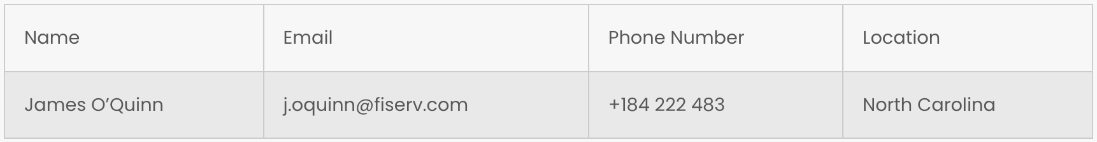

Introduction
Probabilistic Matching also known as data matching, entity resolution, and many other terms is the task of finding records in a data set that refer to the same entity across different data sources. This entities can be a person, product etc.
Dataset A
Dataset B

Slide 4
Record Linkage Package
Pre-Processing
Indexing
Blocking
Comparison & Similarity
Classification/
Clustering
Lowercase / Uppercase
Stop words removal
Postcode Clean Up
Removal of Irrelevant Symbols
Full indexing
Sorted neighbourhood
Levensthein similarity
Jarowlinker similarity
Jaccardian Similarity
Longest Common Substring (LCS)
Classification algorithms
Clustering algorithms
User defined algorithms
Neural networks

Slide 5
General working of Probabilistic Matching model
Assign a prior probability for matching of pair of records.
Comparison of each column in the pairs is performed . Increment the prior probability if column agrees/ matches and decrement the prior probability if its disagrees/not matches
The quantum of increment and decrement to the prior probability depends upon the amount of evidence for match and mismatch contained in a column.
Columns with higher no. of distinct values tend to have stronger evidence of match if columns match because any two values chosen at random will be less likely to match by coincidence.
For e.g. a match on dob column is more informative than match on gender column

Slide 6
Splink Package
Pre-Processing
Indexing/
Blocking
Generate Comparison vector
Calculating m and u Probabilities
Estimate the match weight and match probability
Prior probability is computed
Gamma index represents the level of similarity between a pair value, it can be one or zero
m_probability is probability of column matching when records matches
u_probability is probability of column matching when records does not matches
These paramets are calculated iteratively by EM algorithm
Posterior probability of match is computed using the u_probability , m_probability and prior odds
Match weight is also calculated here.
Lowercase / Uppercase
Stop words removal
Postcode Clean Up
Removal of Irrelevant Symbols

Slide 7
Example Calculation
Let, prior odds=0.047,
for a record pairs having six columns
posterior odds = prior odds × product of all
likelihood
likelihood= m for agreement
u
likelihood= 1-m for disagreement
1-u
Posterior probability = Posterior odds
1 + Posterior odds

Slide 8
Settings and Few Parameters
link_type
Proportion_of_matches
blocking_rules
comparison_columns
num_levels
em_convergence
max_iterations
Seting = {
"link_type": "dedupe_only",
"blocking_rules": [
"l.state = r.state"
],
"comparison_columns": [
{
"col_name": "given_name",
"num_levels": 2,
"term_frequency_adjustments": True
},
{
"col_name": "surname"
},
{
"col_name": "address_1",
"term_frequency_adjustments": True
},
{
"col_name": "address_2"
},
{
"col_name": "suburb"
} ,
{
"col_name": "postcode"
},
{
"col_name": "date_of_birth"
}
],
"em_convergence": 0.01
}

Slide 9
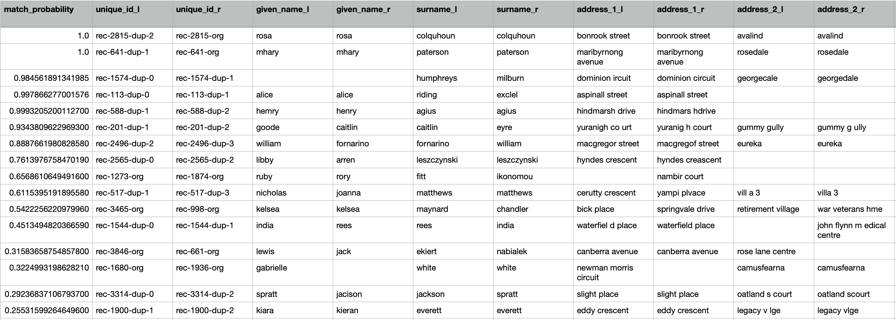
Random Matched Record

Slide 10
Uses Cases in other areas
Government and Public Sector: it can used to detect frauds in passport application, license.
Banking and Finance: banks and financial services institutions utilize data matching to identify culprits as part of anti-money laundering initiatives, meet KYC compliance requirements, or carry out FICO credit scoring.
Healthcare: Matching medical records with other data to study the effect of things like drugs, treatments, and the environment.
E-commerce: In e-commerce, an everyday use case is all the platforms comparing prices. They use data matching to locate identical products from different stores, even if they don't have the same description
Sales and marketing: Data matching can help clean up email lists to get rid of duplicates and dirty data.

Slide 11
Questions?

