Slide 1

ICWSTCSC – 2016 B V M Engineering College
Paper Id: 372
Roof Mounted Low Profile UHF antenna for Auto motives
Jay C Patel,
ME (EC) ,
Parul Institute of Tech.,Vadodara
External Guide
Dr. J M Rathod,
Associate Prof.,BVM
Mr. Nimesh Patel
Manager,
Bombardier Transportation
Internal Guide
Mr.Niraj Tevar
Asst.Professor,E&C
Ms.Tanvi Shah
Asst. Professor, E&C
PIT

Slide 2
OUTLINE
OBJECTIVE
INTRODUCTION
LOW PROFILE ANTENNA
LITERATURE REVIEW
SIMULATION PLATFORMS
WORK PLAN & METHODOLOGY
SIMULATION OF PROPOSED DESIGN IN CST
CONCLUSION
REFRENCES

Slide 3
Objectives
The main objective to design and simulation of Roof mounted vehicular antenna is
Designing low profile antenna that has small dimensions for UHF band, which can be used for mounting on to the Roof of the Rolling Stock Trains’ in Bombardier Transportation India Ltd.
The Simulation and optimization of the antenna is done by using CST Microwave studio software.
The S-parameter of the antenna has been investigated for the given frequency band using this software.
Finally, If the antenna will meet the requirements then it will be fabricated and simulated results will be compared with the test results of the fabricated antenna.

Slide 4
Introduction
An antenna is a device used to transform an RF signal, travelling on a conductor, into an electromagnetic wave in free space. ^{[9][10]}
The vehicle roof may be considered for mounting various antenna systems operating over the range of frequencies 400-520MHz.^{[6]}
Considering both, these antennas’ utility, and omnipresence in the field, make them a prime subject of study. We focus primarily on the effects in the UHF-band regions for the mounted antennas for better efficiency and radiation.^{[6]}

Slide 5
Motivation
No doubt that the Railway Transportation has a great future but as we know that the High Speed Train’s RF equipments’ are almost never be the subject of the prime study.
We can utilized the available resources and make the low cost and effective UHF antenna. Hence the cost will be reduced to great extend.

Slide 6
Frequency selection
This frequency is shared by the Rolling stock Railway Authorities for Radio Services. Railroad radio operations have entailed two major areas: train movement authorities and intra-crew activities. Train Movement authorization utilize private communication systems to transmit train moment authorization between dispatchers and locomotive crew. ^{[11]}
This 450-460 MHz frequency is used for point-to-train communication. This allocated to the service in which the Railway Authorities are primarily eligible are assigned within 35 miles (Approx. 56 km) of the proposed base station.^{[11]}
That’s why the frequency band 400-520 MHz has been selected.

Slide 7
Low profile antenna
What is Low Profile Antenna ?
The general concept of the low profile is “small height and small width”.
Basically it is monopole antenna with the reduced height and width. A monopole antenna is a class of radio antenna consisting of a straight rod-shaped conductor, often mounted perpendicularly over some type of conductive surface, called a ground plane.^{[5]}

Slide 8
LITERATURE SURVEY
Sr. No. | Title of the Paper | Author & Publication | Previous Work | Proposed Work
1 | A Detailed Experimental study on the benefits of electrically grounding glass mounted global positioning system antennas to the vehicle roof ^{[1]} | Daniel N. Aloi, Ashley Steffes, Elias Ghafari, Mohammad S. Sharawi, Microwaves, Antennas & Propagation, IET (Volume:8 , Issue: 10), March – 2014 | The position of the antenna on the vehicle and its importance. It also present the study on the effect of antenna mounting parameters like tilt angle, the distance of the antenna from the rooftop of the vehicle and differentiate the grounding antenna to the rooftop versus not-grounding to the rooftop. | It gives idea about the position of the antenna installed onto the roof. It also suggests that with the use of the distance of the antenna from its rooftop enhanced its performance .

Slide 9
LITERATURE SURVEY (Cont..)
Sr. No. | Title of the Paper | Author & Publication | Previous Work | Proposed Work
2 | Design of 3.1–12 GHz Printed Elliptical Disc Monopole Antenna with Half Circular Modified Ground Plane for UWB Application ^{[2]} | Ashraf A. Adam ,Sharul Kamal Abdul Rahim, Kim Geok Tan , Ahmed Wasif Reza , Wireless Personal Communication March 2013, Volume 69, Issue 2, pp. 535-549, Springer - 2013 | This paper discusses an elliptical monopole antenna for UWB application. The design includes a half-modified circular ground plane with two short I-shaped sleeves in the middle to enhance the S-parameter characteristics across the whole UWB frequency band. The operating frequency range of the design is 3.1-12 GHz. | How to use ground plane effectively to optimize the return loss and antenna performance.

Slide 10
LITERATURE SURVEY (Cont..)
Sr. No. | Title of the Paper | Author & Publication | Previous Work | Proposed Work
3 | Low-Profile Internal Automotive Antenna for WiBro Vertical Polarized Signal Reception ^{[4]} | Seunghee Baek and Sungjoon Lim , Antennas and Propagation Society International Symposium (APSURSI), IEEE-2010. | This paper presents design procedure of printed inverted F antenna for automotive to mount on to the roof. The proposed antenna is design at the frequency 2.42 GHz. The Omni-directional radiation pattern can be achieved in the azimuth plane. | Use to get the vertical polarization & radiation pattern of the antenna. It is also useful to prove the fact when the antenna is mounted on to the roof of the vehicle then it will have the better performance.

Slide 11
LITERATURE SURVEY (Cont..)
Sr. No. | Title of the Paper | Author & Publication | Previous Work | Proposed Work
4 | Low-Profile, Multi-Element, Miniaturized Monopole Antenna ^{[5]} | Wonbin Hong and Kamal Sarabandi, IEEE Transactions On Antennas & Propagation, Vol. 57, No. 1, January 2009. | This paper discusses a low-profile, electrically small antenna with omnidirectional vertically polarized radiation similar to a short monopole antenna is presented. The antenna features less than dimension in height and or smaller in lateral dimension. The antenna is matched to a 50 ῼ coaxial line without the need for external matching. It has the swastik type design. | This paper gives idea about the basic antenna parameters and antenna lateral dimensions which is used for the antenna designing for the frequency 460 MHz.

Slide 12
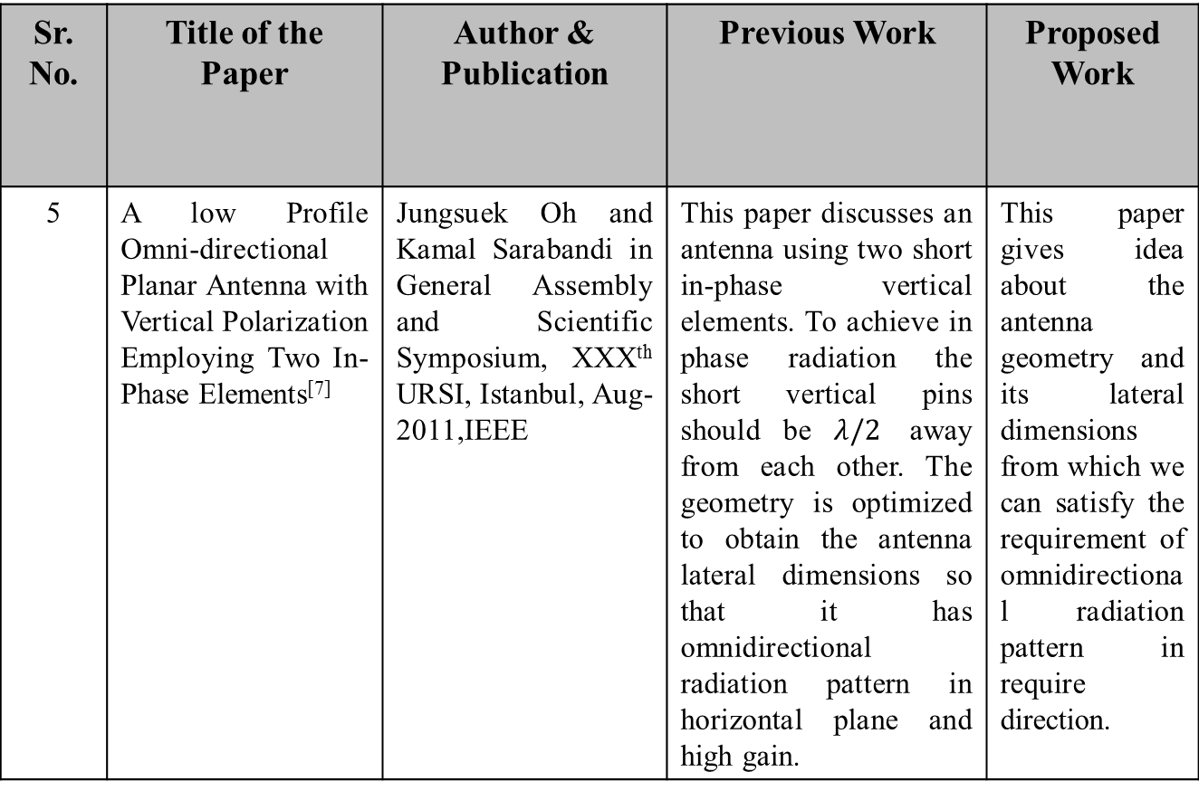
LITERATURE SURVEY (Cont..)
Sr. No. | Title of the Paper | Author & Publication | Previous Work | Proposed Work
5 | A low Profile Omni-directional Planar Antenna with Vertical Polarization Employing Two In-Phase Elements^{[7]} | Jungsuek Oh and Kamal Sarabandi in General Assembly and Scientific Symposium, XXXth URSI, Istanbul, Aug-2011,IEEE | This paper discusses an antenna using two short in-phase vertical elements. To achieve in phase radiation the short vertical pins should be $λ/2$ away from each other. The geometry is optimized to obtain the antenna lateral dimensions so that it has omnidirectional radiation pattern in horizontal plane and high gain. | This paper gives idea about the antenna geometry and its lateral dimensions from which we can satisfy the requirement of omnidirectional radiation pattern in require direction.

Slide 13
Problem statement
Problem Issue:
In High speed Rolling stock trains Generally they can used the control antenna kit that has the folded dipole in it and the performance of the same can be degraded as the lacking of aerodynamic structure and installation near the pantograph of the trains in Bombardier Transportation India Ltd and 120 kW power are used for testing the coaches. So sometimes these antenna can be damaged permentatly or will affect the antenna performance.
Problem Definition:
“The work will include designing and simulation, low profile UHF antenna for Roof mounted vehicular and Heavy duty applications such like Trains.”

Slide 14
Existing work v/s proposed work
Existing Work | Proposed Work
Very High Cost (INR 12000 Approx.) | Less cost (INR 6500 Approx.)
Complex Installation Process | Easy Mounting (M6/M8 Stud Mounting)
Power loss : 18.4 % | Power Loss <= 8 %
Vertical Dipole antenna | Compact (Reduced sized Monopole antenna)
Bandwidth – 10 MHz | Bandwidth <= 40 MHz
Radiation Pattern – Defected omnidirectional due to installation near the pantograph | Radiation Pattern – Omni directional over the most fraction of frequency Band
Table 1 Comparison of existing work v/s Proposed work

Slide 15
simulation platforms
1. | CST Microwave Studio 14 (Computer Simulation Technology ) ^{[15]}
2. | HFSS 13( High Frequency Structural Simulator )
3. | MATLAB ( MATrix LABoratory )
4. | Auto CAD 2012 and AutoVeu
CST Microwave Studio 14 ^{[15]}
FDTD (Finite Differential Time Domain) Computational Technique
Fast simulation
Need less memory space, less RAM
HFSS 13
FEM (Finite Element Method)Computational Technique
Need high memory

Slide 16
simulation platforms (cont.)
CST Microwave Studio 14 ^{[15]}
CST MICROWAVE STUDIO (CST MWS) is a specialist tool for the 3D EM simulation of high frequency components. CST MWS enables the fast and accurate analysis of high frequency (HF) devices such as antennas, filters, couplers, planar and multi-layer structures.
The three pillars of CST’s are :
Accuracy
Speed
Usability

Slide 17
Work plan & Methodology
Designing smooth aerodynamic low profile antenna structure for the frequency range 400-520 MHz.
Verifying the results in terms of S₁₁,VSWR,Gain, Directivity, Polarization and Power.
Simulating designs and analysing results.
Simulate the antenna with the different material and analysing the results for the same.
Simulate the antenna with and without the ground plane of different size and analysing the results.

Slide 18
Work plan & Methodology(cont.)
START
Design Low Profile antenna
Verify S-Parameter, VSWR, Power
Simulate the Design
Achieve Desired Results
Modification in the Geometrical Parameter
END
figure 1 Work flow diagram of Proposed designs

Slide 19
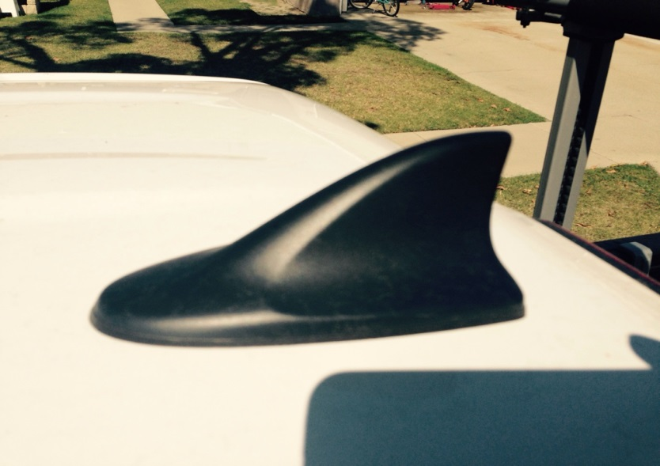
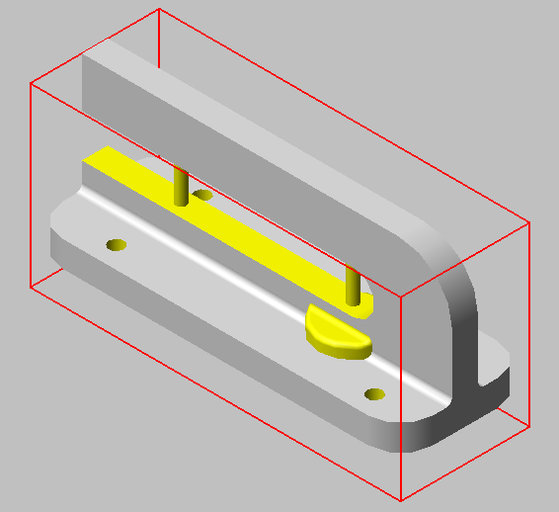
Low profile antenna
figure 2 Low Profile Shark fin
antenna mounted on car*
figure 3 Isometric view of Proposed design
of Low Profile automotive roof mounted antenna
* This image is taken from http://www.therpmstore.com/store/p/603-VG-Shark-Fin-Antenna-for-Mazda.html

Slide 20
Advantages
Simple & Low Profile Design ^{[5]}
Good Bandwidth (BW)^{[5][7]}
Good Omni-Directional Radiation Pattern ^{[5]}
Lower cost
Easy Mounting

Slide 21
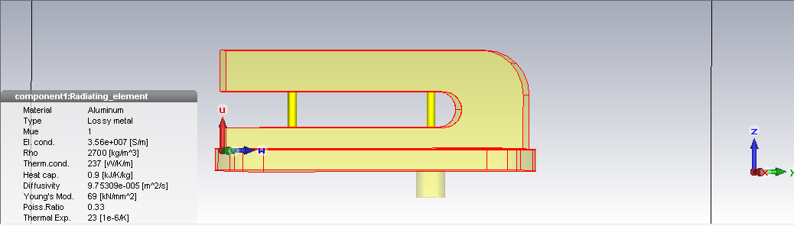
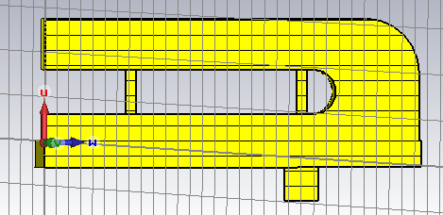
Low profile antenna
Parameters | Equations | Expected Values
Wavelength (λ) | c * f | 65.21 cm
Antenna length (L) | L = λ/34 to λ/32 | 19.75 to 2.037 cm
Distance between two antenna (d) | λ / 8 to λ / 2 | 8.18 to 32.60 cm
figure 4 Proposed design of low profile antenna
Table 2 General design Parameters
of low profile antenna ^{[5]}
Sr No. | Parameter | Value
1 | Frequency | 400-520 MHz
2 | Wavelength | 0.6521 mm
3 | Polarization | Linear/vertical
4 | Height of Radiating element ^{[5]} | 20 mm
5 | Material | Aluminium
figure 5 cutting plane normal
to the x
Table 3 Proposed Design Parameters

Slide 22
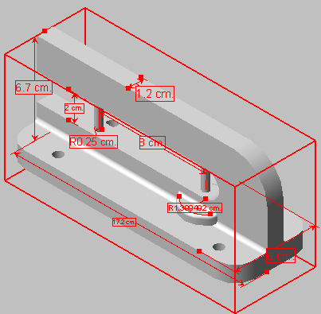
Low profile antenna
figure 6 Proposed design
Measurements
Parameters | Value
Frequency Range | 400-520 MHz
Center Frequency (f) | 460 MHz
Wavelength (w) | 65.21 cm
Input Radius of antenna (Rin) | 0.25 cm
Antenna length (L)^{[5]} | 20 cm
Distance between two antenna (d) | 80 cm
Impedance of co-axial feed line ^{[5]} | 50 ῼ
Material | Aluminium
Table 4 considered design parameters for low profile antenna

Slide 23
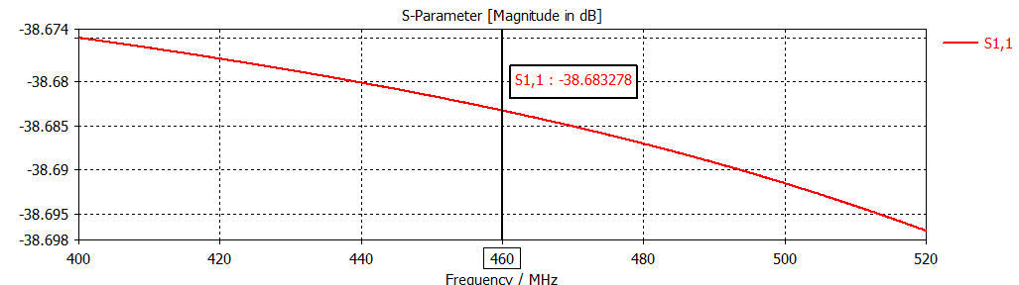
S parameter
The S₁₁ at the 460 MHz is -38.68.
figure 8 S₁₁ at 460 MHz

Slide 24
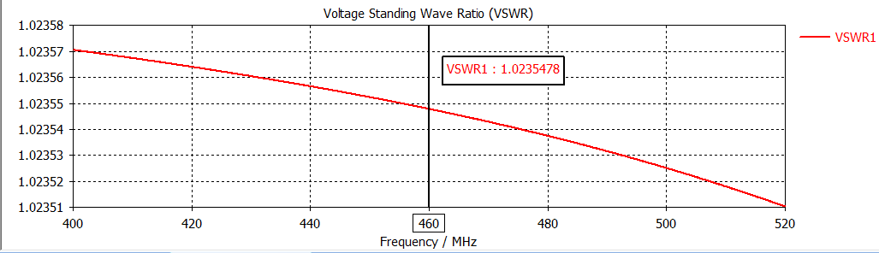
VSWR
The VSWR at the 460 MHz is 1.0235478.
figure 9 VSWR at 460 MHz

Slide 25
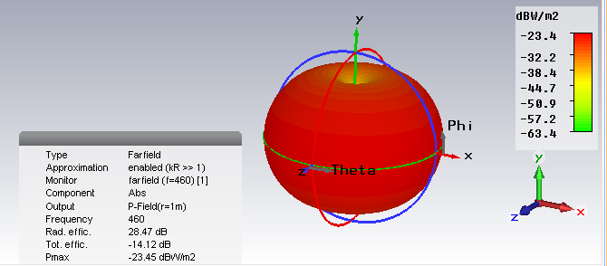
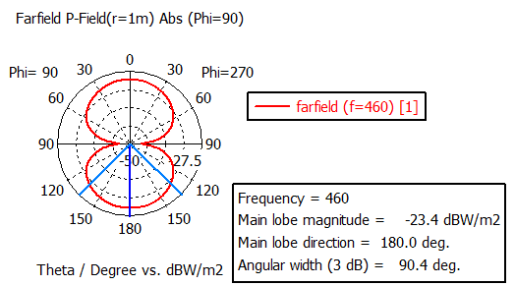
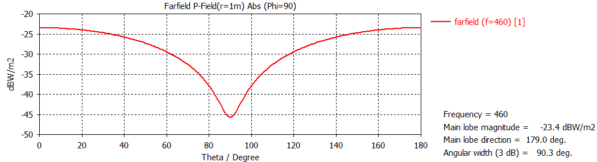
Radiation pattern
figure 14 3D vertically Polarized radiation pattern at 460 MHz
figure 15 Simulated Polar Gain Pattern at 460 MHz
figure 16 Simulated Cartesian plot of P-field at 460 MHz

Slide 26
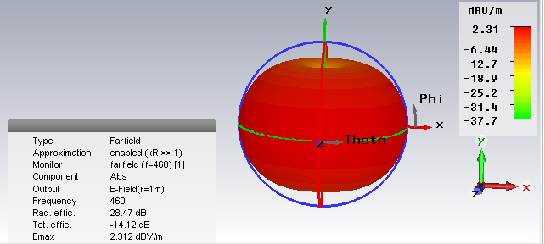
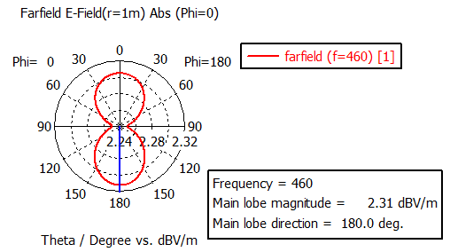
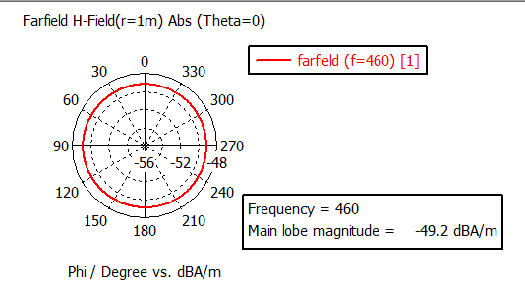
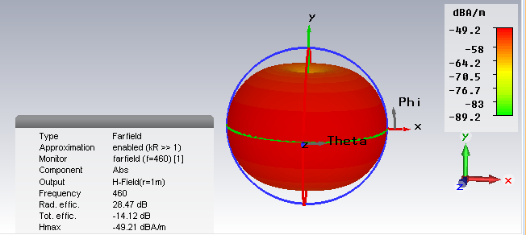
Far field E & H Pattern
figure 10 Simulated result of E-Pattern at f=460 MHz
figure 11 Polar plot of E-field at 460 MHz
figure 12 Polar plot of H-field at 460 MHz
figure 13 Simulated result of H-field at f=460 MHz

Slide 27
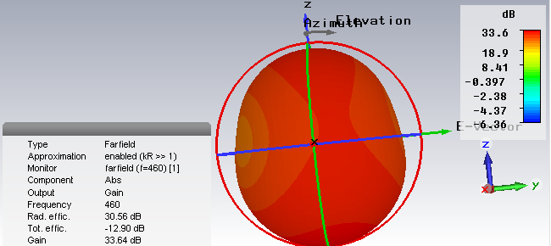
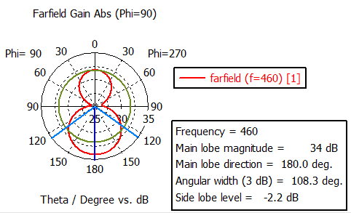
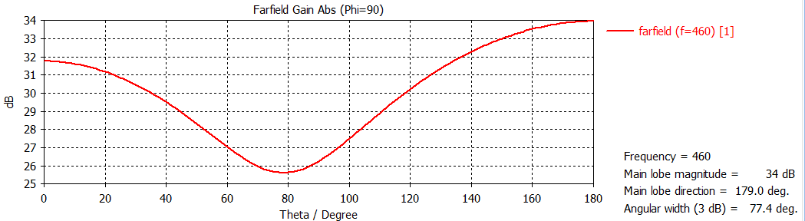
Gain
figure 17 3D Gain Pattern at 460 MHz
figure 18 Polar plot of Gain Pattern at 460 MHz
figure 19 Cartesian plot of Gain Pattern at 460 MHz

Slide 28
CONCLUSION
The proposed antenna can be operated at resonance frequency of 460 MHz in the range of 400MHz to 520MHz frequency band for Roof mounted vehicular and heavy duty application. The same is achieved by using mechanically stable & aerodynamic structure and to reduce the overall antenna dimension. The overall size of the proposed antenna is compact. It’ll also has the better reception ability for vertical polarized signals and good bandwidth.
Parameter | Simulated value
S₁₁ | -38.61 dB
VSWR | 1.0235478
Bandwidth | <=120 MHz (wideband)
Polarization | Linear/vertical
Gain | 34 dB
Power | <=20 watts
Table 5 Achieved Simulated Design Parameters

Slide 29
REFERENCES
Daniel N. Aloi, Ashley Steffes, Elias Ghafari, Mohammad S. Sharawi “A Detailed Experimental study on the benefits of electrically grounding glass mounted global positioning system antennas to the vehicle roof ” Microwaves, Antennas & Propagation, Volume:8 , Issue: 10, IET , March – 2014.
Ashraf A. Adam ,Sharul Kamal Abdul Rahim, Kim Geok Tan , Ahmed Wasif Reza “Design of 3.1-12 GHz Printed Elliptical Monopole Antenna with Half circular Modified Ground Plane” Wireless Personal Communications March 2013, Volume 69, Issue 2, pp 535-549, Springer – 2013.
Seunghee Baek and Sungjoon Lim “Low-Profile Internal Automotive Antenna for WiBro Vertical Polarized Signal Reception” Antennas and Propagation Society International Symposium (APSURSI), IEEE-2010.
Wonbin Hong and Kamal Sarabandi “Low-Profile, Multi-Element, Miniaturized Monopole Antenna” IEEE Transactions on Antennas and Propagation, Vol.57,No.1,January,IEEE-2009.
Jungsuek Oh and Kamal Sarabandi “A low Profile Omni-directional Planar Antenna with Vertical Polarization Employing Two In-Phase Elements” in General Assembly and Scientific Symposium, XXXth URSI, Istanbul, August,IEEE-2011.
Jianxin Liang “Antenna Study and Design for Ultra Wideband Communication Applications”Thesis – University of London-2006.
J D Kraus, Ronald J Marhefka, Ahmad S Khan “Antennas And Wave Propagation 4th Edition”.
Constantine A. Balanis “ANTENNA THEORY ANALYSIS AND DESIGN-2nd Edition”.
National Archives and Records Administration (NARA) Staff “The code of Federal Regulations of the United states of America” Pg.496.

Slide 30
REFERENCES (CONT..) web links
http://www.ece.mcmaster.ca/faculty/nikolova/antenna_dload/current_lectures
http://www.electronics-tutorials.com/antennas/antenna-basics.htm
http://www.jrtr.net/jrtr42/f04_lac.html
https://www.cst.com
https://en.wikipedia.org/wiki/Bombardier_Talent
http://www.andrew.cmu.edu

Slide 31

THANK YOU

