Slide 1


BANSAL INSTITUTE OF SCIENCE & TECHNOLOGY, BHOPAL
DEPARTMENT OF COMPUTER SCIENCE & DEPARTMENT
“ Finance Tracker ”
Session Jan-July 2025
Dr. Kailash Patidar
Professor and Head, CSE
Dr. Shital Gupta
Project Guide
Asst. Professor, CSE
Project Group Member 1. Aman Singh
2. Kunjdev Patel
3. Abhishek Patel
4. Abhishek Patel
1

Slide 2
CONTENT
Abstract
Introduction
Methodology/Approach/Flow
Proposed System/Objectives
Technology Stack (H/W & S/W Requirement)/Tool
Conclusion
Future Scope
References
2

Slide 3
ABSTRACT
A Finance Tracker App is a digital tool that helps users manage their money by tracking income and expenses. It transforms financial data into easy-to-understand insights through features like categorized transactions, real-time budget tracking, and analytics.
By connecting with bank accounts and credit cards, the app automatically records financial activities, reducing the need for manual entry. It provides visual summaries, such as graphs and charts, to help users understand their spending habits and trends. Additionally, the app sends reminders for upcoming bills and alerts for overspending, assisting users in staying on top of their finances.
Overall, a Finance Tracker App simplifies money management, offering a clear and organized view of one's financial situation.

Slide 4
INTRODUCTION
In today's busy world, handling money properly is very important for a stable and secure future. A Finance Tracker App is a helpful tool that allows people and businesses to keep track of their income, expenses, savings, and investments in a simple and organized way. This app makes money management easy by automatically recording financial activities and reducing the need for manual tracking. With its user-friendly design and smart features, the Finance Tracker App helps users stay in control of their finances, understand their spending habits, and make better financial decisions. It also provides useful insights, reminders for bill payments, and alerts for overspending. By using this app, individuals can manage their budget effectively, build good saving habits, and work towards their financial goals with confidence and ease.

Slide 5
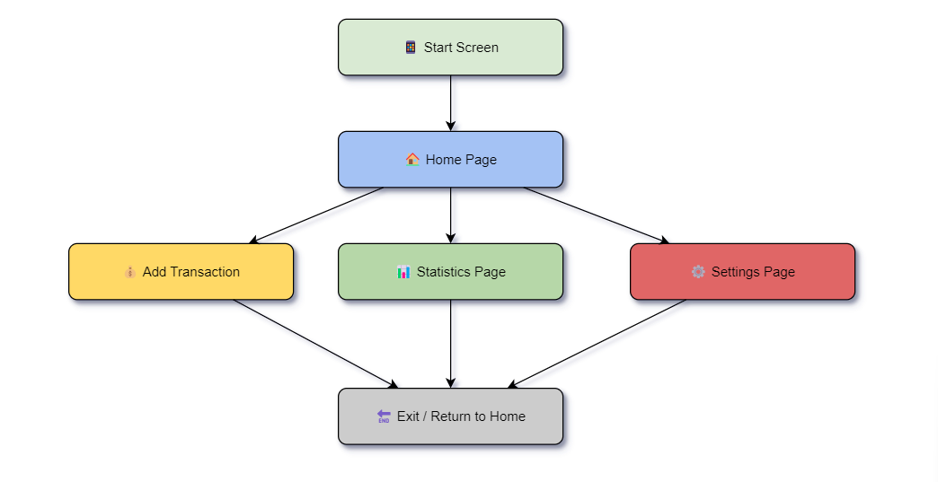
METHODOLOGY

Slide 6
OBJECTIVES
The main purpose of the Finance Tracker App is to help users keep their money organized and manage their financial activities easily. This app lets users manually add their income and expenses, keeping a clear record of their transactions. By tracking spending habits, users can see where their money goes and make better financial decisions. The app also helps people set savings goals and stick to a budget, making it easier to manage daily expenses. With simple tools for analyzing income and expenses, users can understand their financial situation and plan. The goal is to make budgeting stress-free, encourage better saving habits, and support users in reaching their financial goals.

Slide 7
TECHNOLOGY STACK
The Finance Tracker App is developed using the following technologies :
Frontend Flutter (for building a cross-platform, user-friendly UI)
Backend & Database – SQLite (for managing and storing financial data locally)

Slide 8
CONCLUSION
The Finance Tracker App is a simple yet effective tool for managing personal finances. It enables users to manually track their income and expenses, helping them gain better financial control. By using Flutter for the UI and SQLite for data storage, the app ensures a seamless experience with offline accessibility. This project provides an intuitive way for users to analyze their spending patterns, set budgets, and develop better financial habits. Overall, the app serves as a valuable financial companion, promoting smarter money management and financial awareness.

Slide 9
FUTURE SCOPE
The Finance Tracker App has significant potential for future improvements and enhancements. Some key areas for expansion include: –
Cloud Integration – Storing data on cloud platforms for cross-device accessibility and backup.
Advanced Analytics – Implementing AI-driven insights and spending predictions to help users manage finances more effectively.
Expense Categorization – Using machine learning to automatically categorize expenses based on transaction descriptions.
Multi-Currency Support – Enabling users to track expenses in different currencies for global usability.

Slide 10
REFERENCES
Flutter Documentation – https://flutter.dev/docs (For UI development)
SQLite Documentation – https://www.sqlite.org/docs.html (For database management)
Dart Programming Language – https://dart.dev/ (For app logic and backend development)

