Slide 1

Image colorization & Image captioning
19012531010 ALAY PATEL (CE-AI)
Collage Project Guide
Prof. Amit Dangi sir
Company Project Guide
Meet Patel sir

Slide 2
Introduction
Colorization of grayscale or b/w images is very useful to colorized our old memories. There are various advantages.it use various pre-trained models to perform colorization.it mainly depends on CNN. Till the date there is very few complex model exist with high accuracy. Image colorization involves various complex scenarios starting from making an architecture of a model ,training model, validating model, etc.
Captioning images automatically is one of the heart of the human visual system. There are various advantages if there is an application which automatically caption the scenes surrounded by them and revert back the caption as a plain message. It uses various pre-trained models to perform the task of detecting objects and uses CNN and LSTM to generate the captions. It uses Transfer Learning based pre-trained models for the task of object Detection. This model can perform two operations. The first one is to detect objects in the image using Convolutional Neural Networks and the other is to caption the images using RNN based LSTM(Long Short Term Memory). Interface of the model is developed using Django, which is a web development framework of python. The main use case of this project is to help visually impaired to understand the surrounding environment and act according to that. Caption generation is one of the interesting and focussed areas of Artificial Intelligence which has many challenges to pass on. Caption generation involves various complex scenarios starting from picking the dataset, training the model, validating the model, creating pre-trained models to test the images ,detecting the images and finally generating the captions

Slide 3
Existing system
Imagecolorizer.com
Image Colorizer is our basic AI feature that could add color to black and white pictures naturally. Sometimes, you wished you could get back old damaged photos or see them in colour the unique features of the Image colorizer online tool can come to your rescue. These features are straightforward to use and save your time. A 95% satisfaction rate with more than 4000 plus visitors at the site implies that people like this online tool's features very much.
Hotpot.ai
Colorize pictures with AI, turning black and white photos to colour in seconds. Reimagine the past by colorizing pictures of ancestors and historic figures. Our technology is currently based on OpenCV Model and proprietary enhancements.
Colorizer.cc
Colorize.cc - is AI service which colorize black and white photo and video. In few clicks you can touch the magic of machine learning technologies. Colorize hundreds of your family photos in few minute

Slide 4
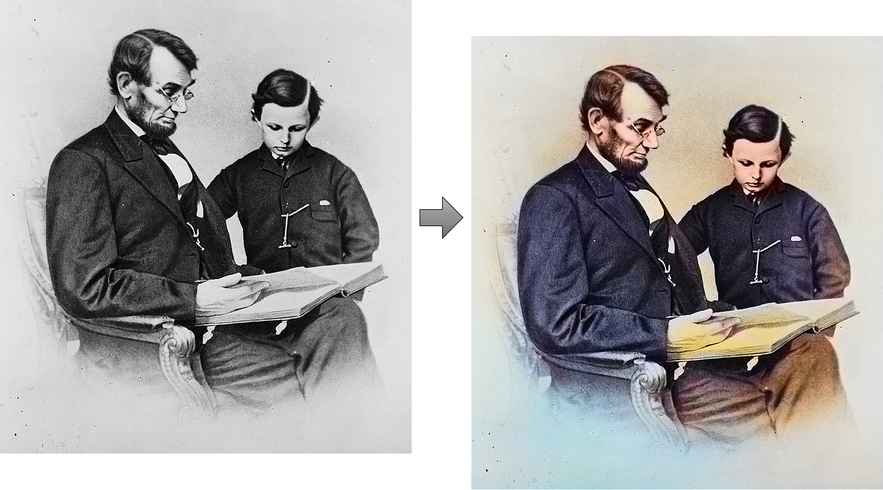
Demo of image colorization

Slide 5
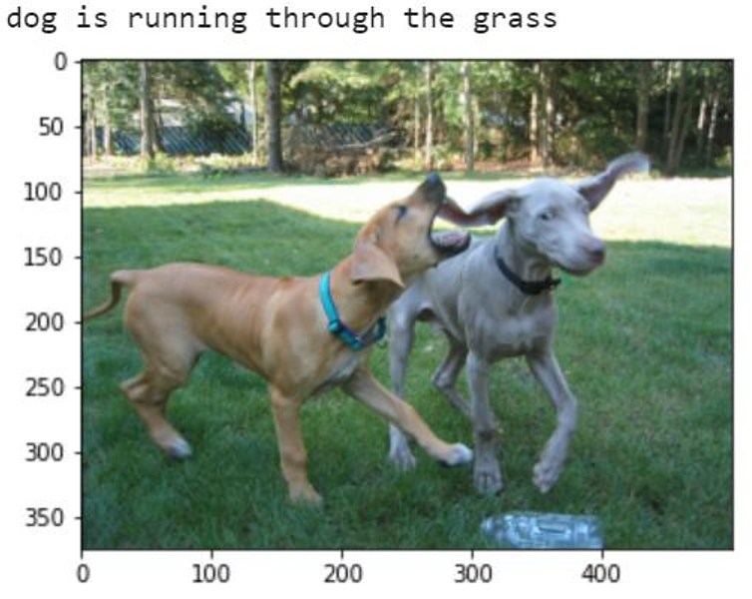
Demo of image captioning

Slide 6
How our system works
UPLOAD PHOTO
EXECUTE MODEL
(IN BACKEND)
DOWNLOAD IMAGE

Slide 7
Dataset Used For colorization
Flickr8k
10,000 images
Downloaded from Kaggle
Because of lower computational power I trained on less amount of data

Slide 8
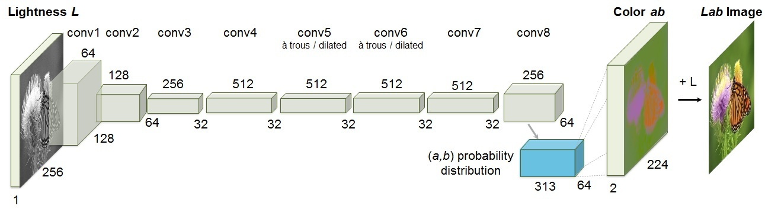
Model used in COLORIZATION
Architecture from Zhang et al.’s 2016 ECCV paper

Slide 9
we can’t use RGB color space as it doesn’t have information regarding illumination. So we have to use LAB color space
Lab encodes color information differently:
The L channel encodes lightness intensity only
The a channel encodes green-red.
And the b channel encodes blue-yellow
Since the L channel encodes only the intensity, we can use the L channel as our grayscale input to the network.
From there the network must learn to predict the a and b channels. Given the input L channel and the predicted ab channels we can then form our final output image.
The entire (simplified) process can be summarized as:
Convert all training images from the RGB color space to the Lab color space.
Use the L channel as the input to the network and train the network to predict the ab channels.
Combine the input L channel with the predicted ab channels.
Convert the Lab image back to RGB.

Slide 10
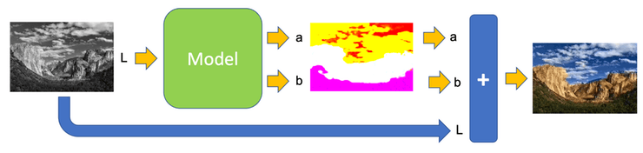
Summarization

Slide 11
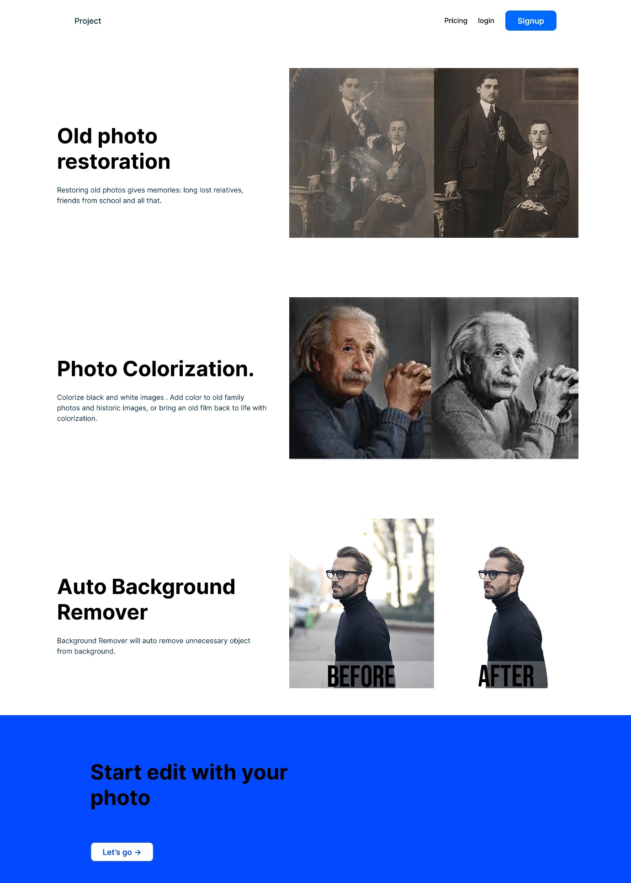
Prototype

Slide 12
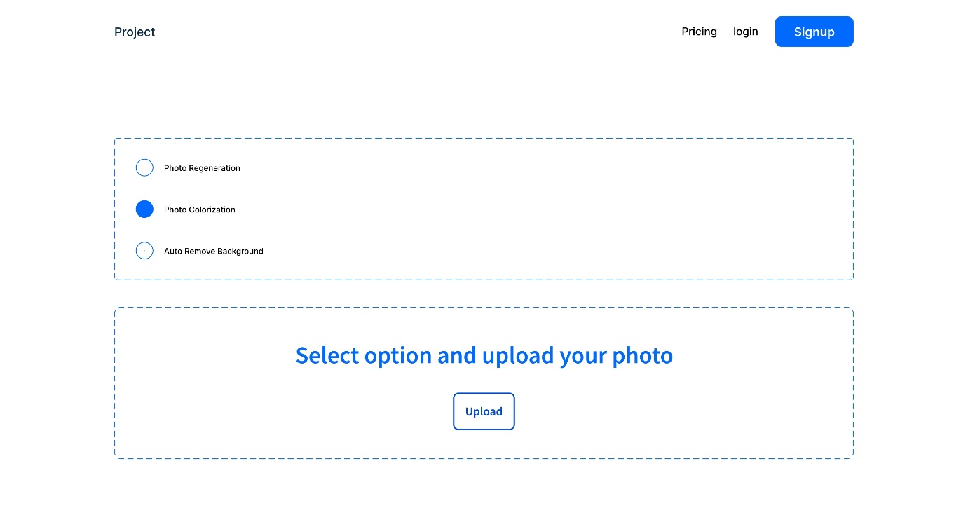
Prototype

Slide 13
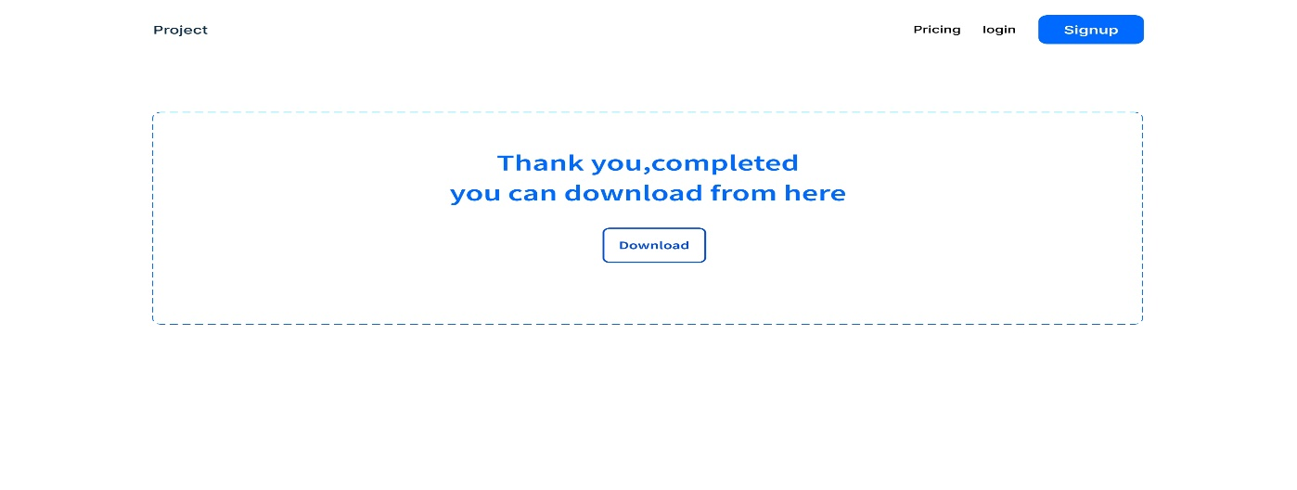
Prototype

