Slide 1
CALENDAR SOFTWARE
Presented by
Dhruvi Patel
Vimal Patel
Smit ShAh
Ami Patel
Jay Patel

Slide 2
OBJECTIVE
The purpose of this project is to provide a user-friendly Calendar Software which includes features like schedule planning and organizing events in a timely manner with a peculiar feature called "Language Picker".
Goal: The calendar software will be efficient as well as convenient for the user.

Slide 3
PROJECT TIMELINE
Project planning
Resources
Software Design
Cost estimation
Software implementation
Software testing
Deployment

Slide 4
Functional Requirements:
The user should be able to do following:
Look for the events
Pick any language
Delete any events
Send the invites
Make modifications
Generate and display monthly/weekly list
Identified using a unique username and login password

Slide 5
Non-Functional Requirements:
Product Requirements | Organizational Requirements | External Requirements
Space Performance Usability | Operational Developmental | Safety/Security Regulatory

Slide 6
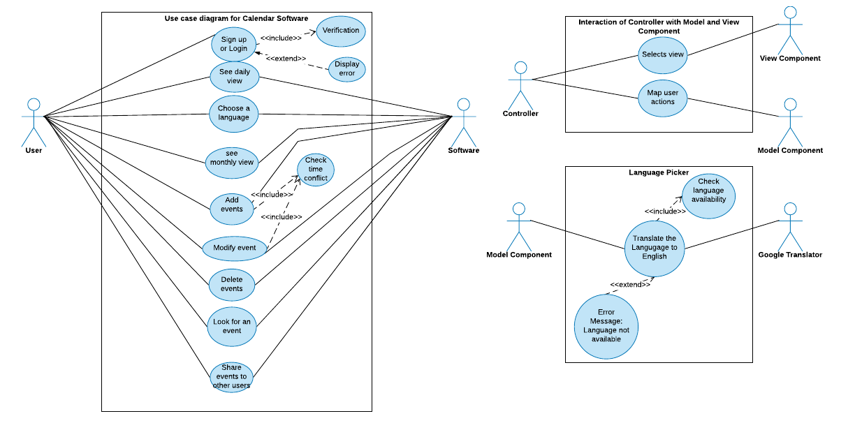
Use Case Diagram

Slide 7
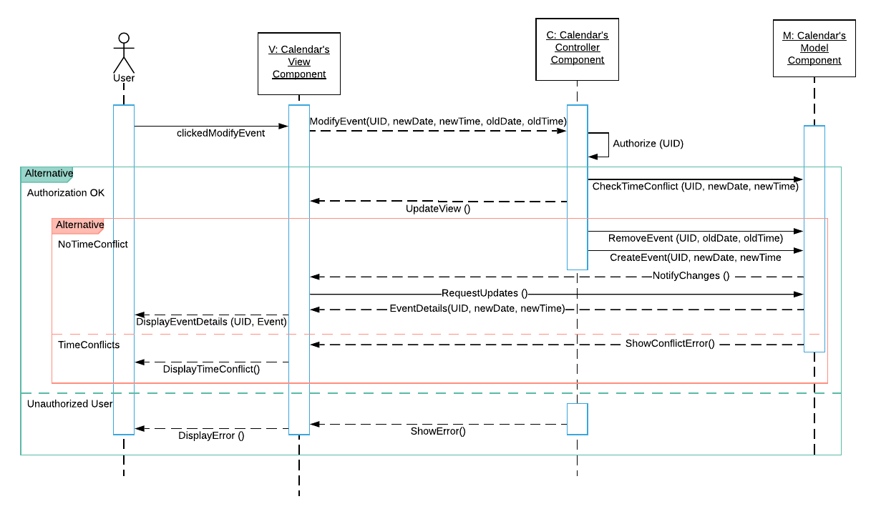
Sequence Diagram (Modify Event)

Slide 8
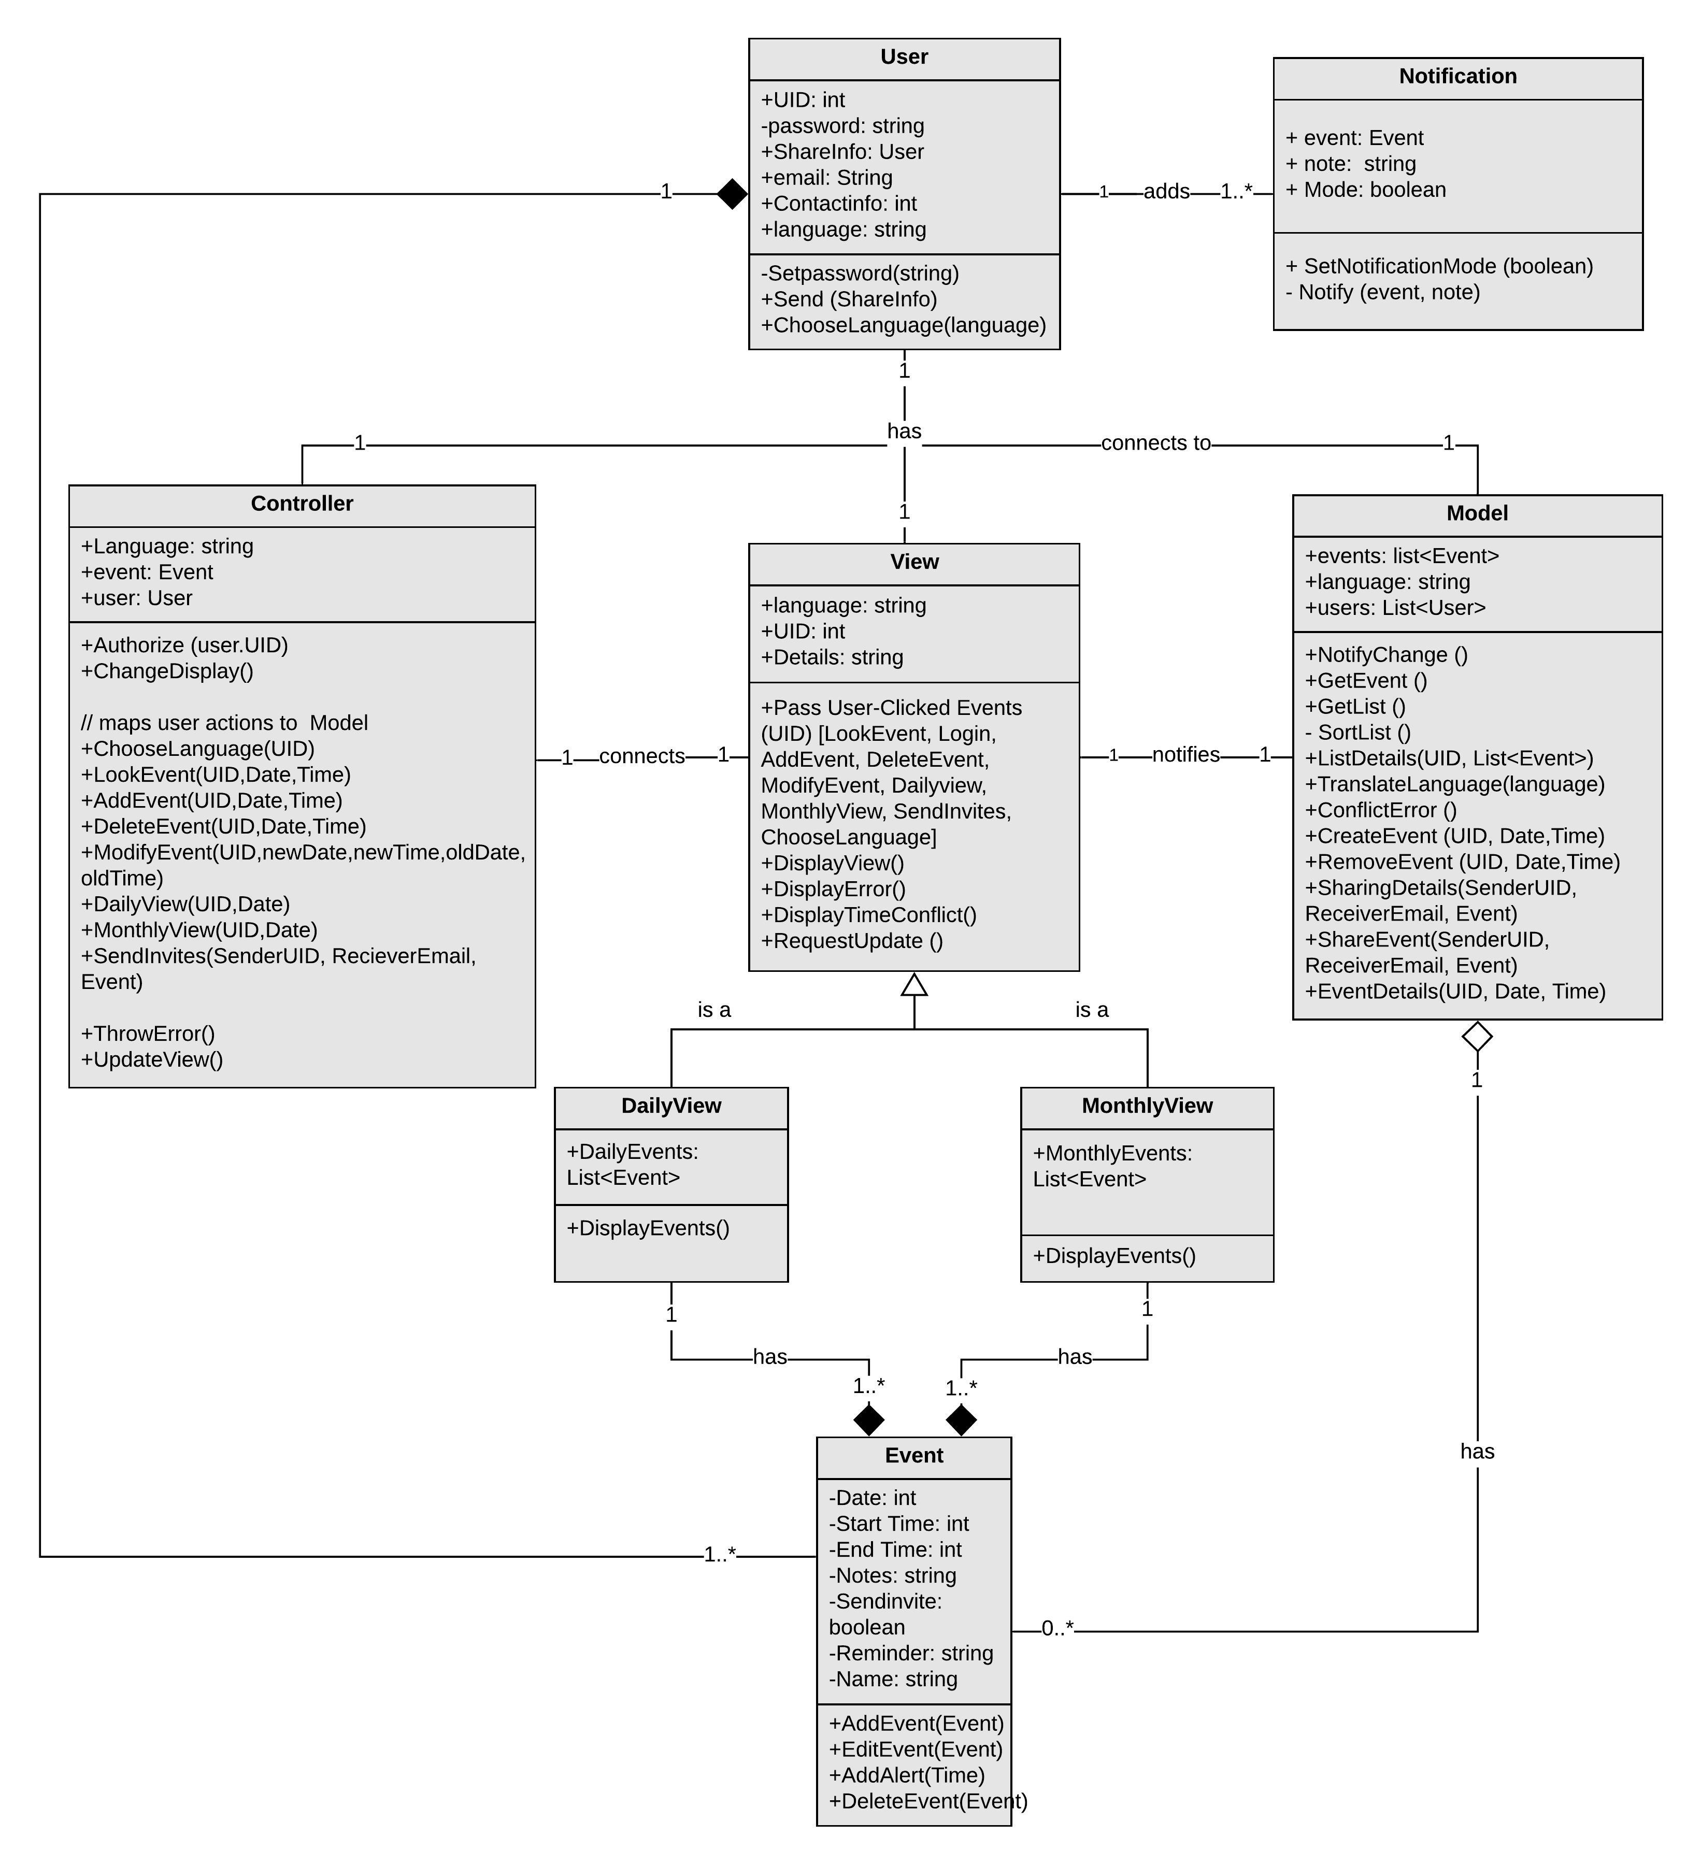
Class Diagram

Slide 9
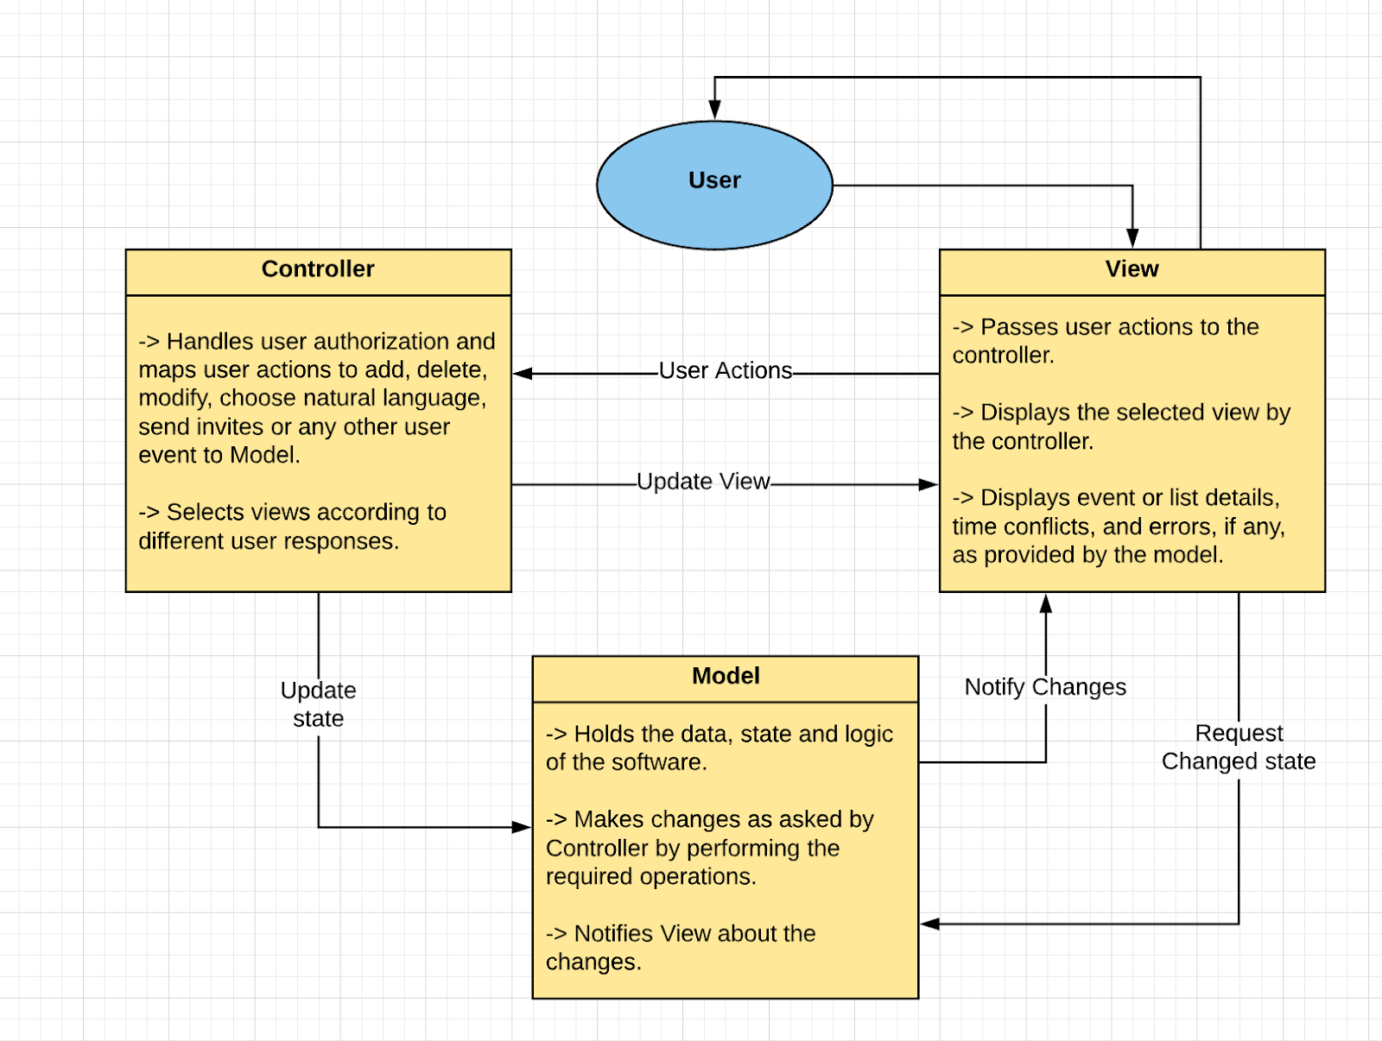
Architecture Design (MVC)

Slide 10
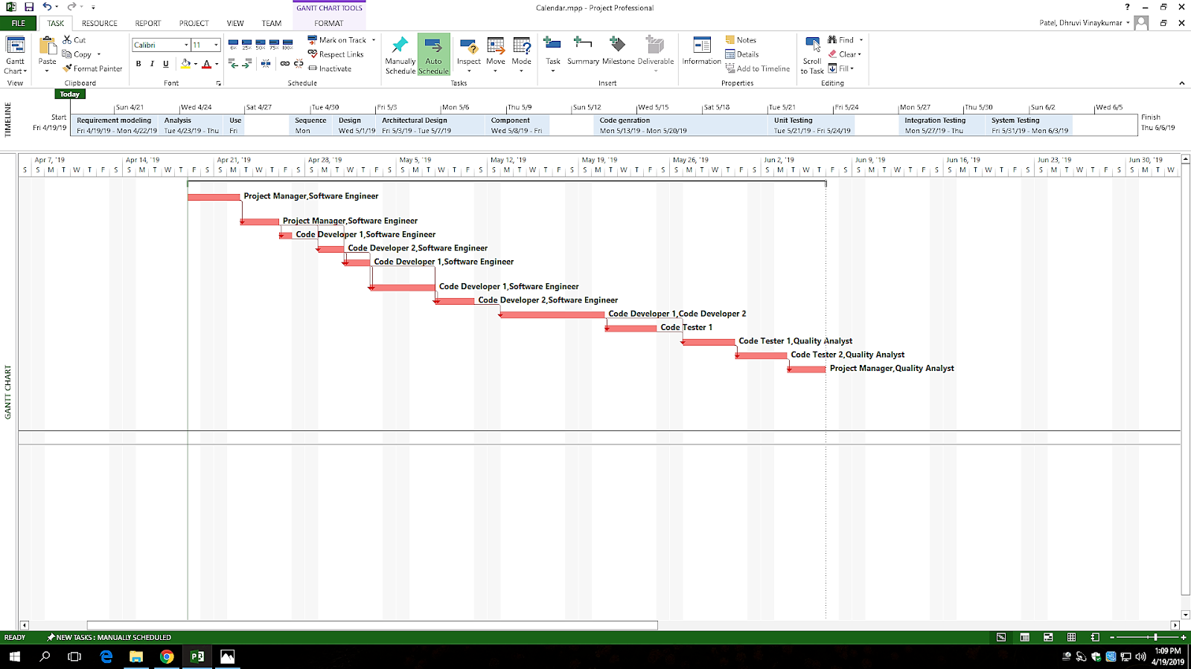
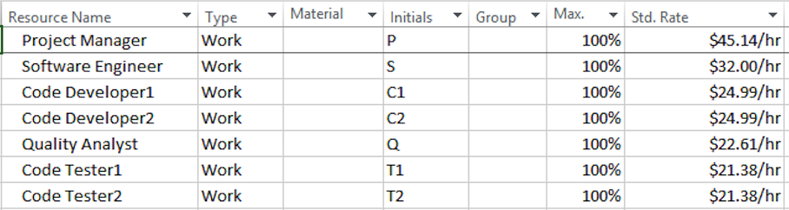
Project Scheduling

Slide 11
Cost Estimation Technique (Function Point)
 | Function Category | Count | Complexity |  |  | Count *complexity
 |  |  | Simple | Average | Complex
1 | Number of user input | 8 | 3 | 4 | 6 | 24
2 | Number of user output | 6 | 4 | 5 | 7 | 24
3 | Number of user queries | 3 | 3 | 4 | 6 | 9
4 | Number of data files and relational tables | 24 | 7 | 10 | 15 | 168
5 | Number of external interfaces | 4 | 5 | 7 | 10 | 20
 |  |  |  |  |  | GFP = 245
Gross Function Point: 245
Processing Complexity Adjustment (PCA): 1.16
Productivity: 8.12 FP per person-week
Project Duration: 35 days or 5 weeks
Complexity is based on the power point slides in chapter 23

Slide 12
Estimated Cost
Hardware Cost | Software Cost | Personnel Cost
Servers (Workstation): $1627.89 Monitors: $1199.99 Graphics Card: $174.99 Total:$8404.3 | Software License: $800 MS Project: $30 Total: $830 | 7 People Total = $14,966.58 (35 days)

Slide 13
Conclusion
Calendar Software:
- Performs the user-friendly functions of any regular calendar software
- Implemented using MVC architectural pattern
- Changes made: Added a unique feature called "Language Picker"
- The critical path showed the duration of 35 days to finish the project
- Overall Cost Estimation: $24,172.3

Slide 14
References
[1] Salary.com, “Hourly wage for Project Management Manager,” Salary.com. [Online]. Available: https://www1.salary.com/Project-Management-Manager-hourly-wages.html. [Accessed: 19-Apr-2019].
[2] F. Time, “How Much Does a Project Manager Make Hourly?,” Chron.com, 04-Apr-2017. [Online]. Available: https://work.chron.com/much-project-manager-make-hourly-7628.html. [Accessed: 19-Apr-2019].
[3] Salary.com, “Hourly wage for Software Engineer I,” Salary.com. [Online]. Available: https://www1.salary.com/Software-Engineer-I-hourly-wages.html. [Accessed: 19-Apr-2019].
[4] “Salaries,” Jobs. [Online]. Available: https://www.indeed.com/salaries/Computer-Programmer-Salaries. [Accessed: 19-Apr-2019].
[5] “Salaries,” Jobs. [Online]. Available: https://www.indeed.com/salaries/Quality-Assurance-Analyst-Salaries. [Accessed: 19-Apr-2019].
[6] “Average Software Tester Salary,” PayScale. [Online]. Available: https://www.payscale.com/research/US/Job=Software_Tester/Salary. [Accessed: 19-Apr-2019].
[7] “Software License Agreement Lawyers & Attorneys,” Priori. [Online]. Available: https://www.priorilegal.com/contracts/software-licensing-agreements. [Accessed: 19-Apr-2019].
[8] “Google Calendar Comparison with Similar Apps,” GetApp. [Online]. Available: https://www.getapp.com/collaboration-software/a/google-calendar/compare/. [Accessed: 19-Apr-2019].

Slide 15
[9] Newegg.com. (2019). HP Z4 G4 Workstation - 1 x Intel Xeon W-2125 Quad-core &#40;4 Core&#41; 4 GHz - 8 GB DDR4 SDRAM - 256 GB SSD - Newegg.com. [online] Available at: https://www.newegg.com/Product/Product.aspx?Item=1B4-001S-00AF7 [Accessed 19 Apr. 2019].
[10] “HP ENVY All-in-One Desktop - 27 - b220qd,” HP ENVY All-in-One Desktop - 27 - b220qd (2QT45AV_1). [Online]. Available: https://store.hp.com/us/en/pdp/hp-envy-all-in-one-desktop-27-b220qd-2qt45av-1. [Accessed: 19-Apr-2019].
[11] “PNY - NVIDIA GeForce GTX 1050 2GB GDDR5 PCI Express 3.0 Graphics Card - Black,” Best Buy. [Online]. Available: https://www.bestbuy.com/site/pny-nvidia-geforce-gtx-1050-2gb-gddr5-pci-express-3-0-graphics-card-black/5711723.p?skuId=5711723. [Accessed: 19-Apr-2019].
[12] Ian Sommerville, Software engineering, 10th ed. Harlow: Pearson Education, 2016.

