Slide 1
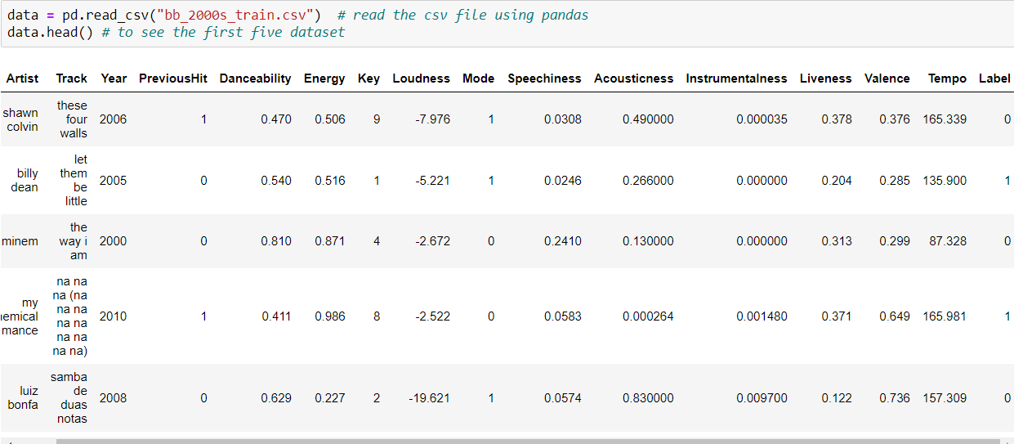
Dataset
Electrical & Computer Engineering Department and Department of Educational Psychology
Notes:
Invasive ductal carcinoma

Slide 2
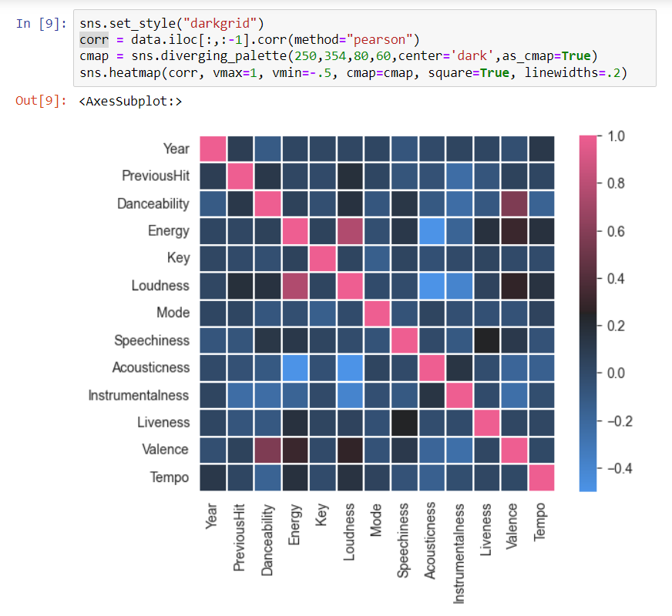
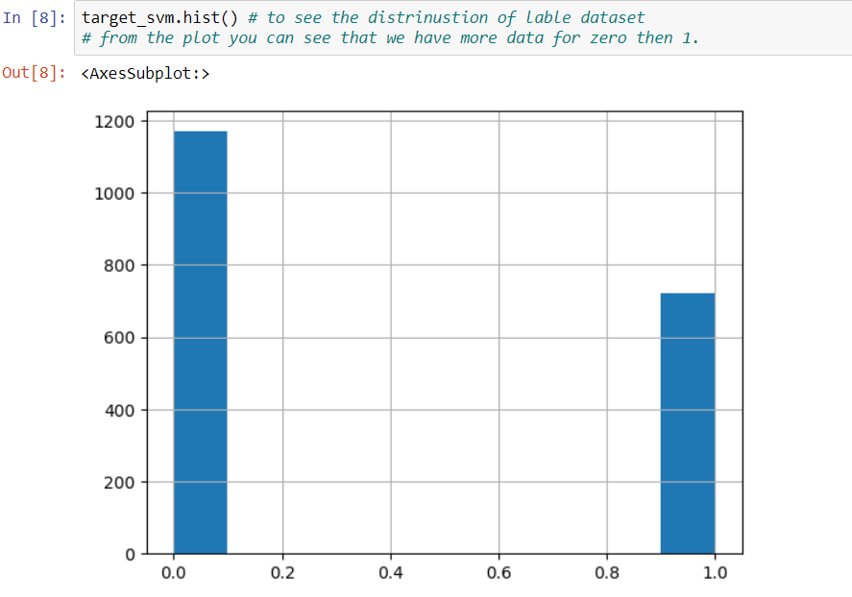
Dataset

Slide 3
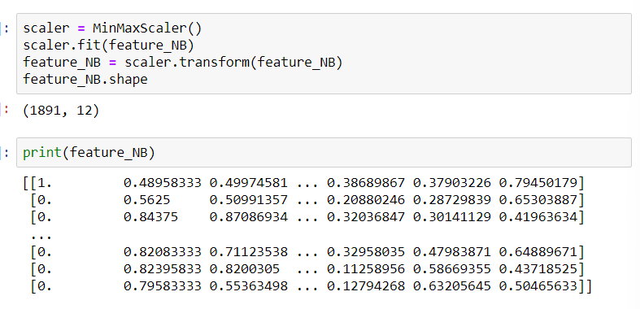
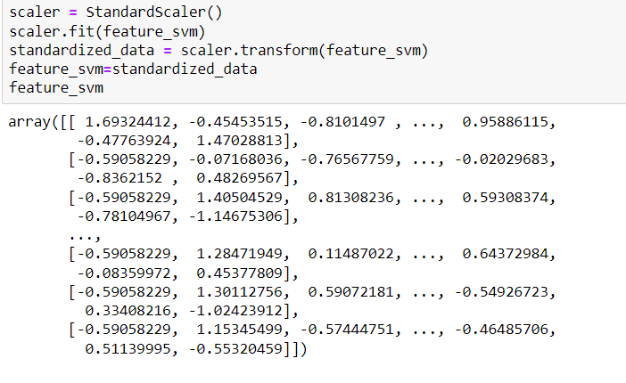
Dataset
Electrical & Computer Engineering Department and Department of Educational Psychology
Notes:
Invasive ductal carcinoma

Slide 4
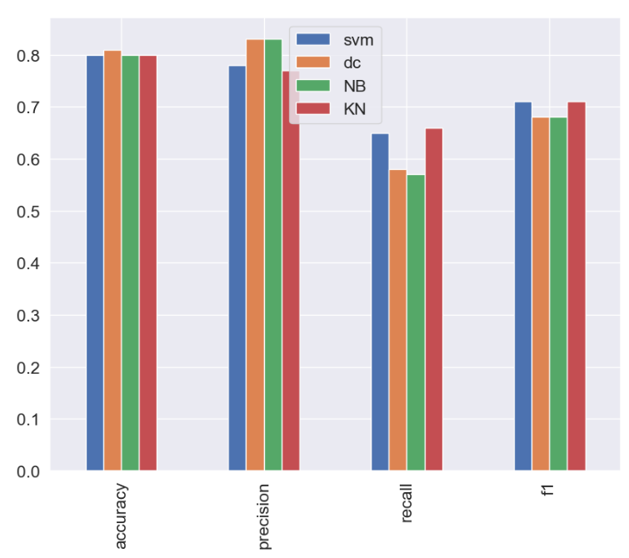
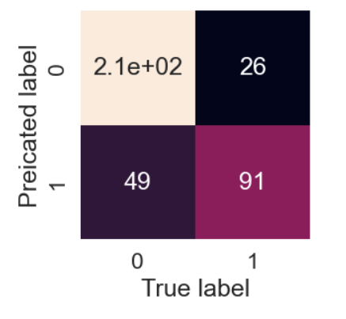
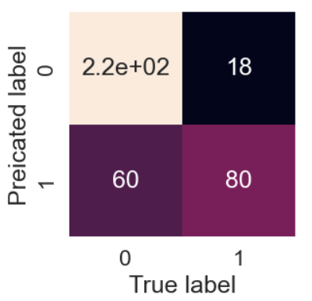
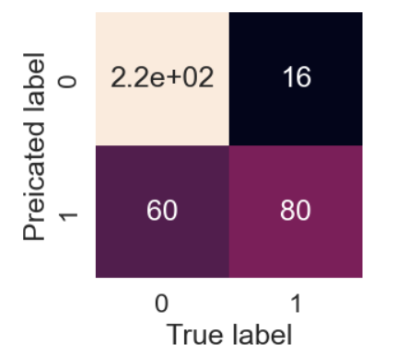
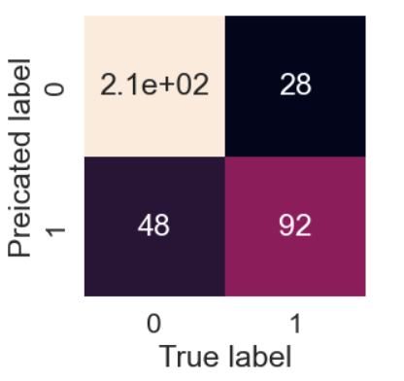
Results
SVM
DC
NB
KN
Notes:
precision recall f1-score support
0 0.79 0.92 0.85 239 1 0.82 0.57 0.67 140
accuracy 0.79 379
macro avg 0.80 0.75 0.76 379
weighted avg 0.80 0.79 0.78 379
RandomSearchCV has the same purpose of GridSearchCV: they both were designed to find the best parameters to improve your model. However, here not all parameters are tested. Rather, the search is randomized and all the other parameters are held constant while the parameters we are testing is variable.
2.1e+2 = 2.1 x 10² = 210
Svm = 77% randomsearch cv get the accuracy of 80.5
Precision - Indicates the proportion of positive identifications (model predicted class 1) which were actually correct. *****A model which produces no false positives has a precision of 1.0.
Recall - Indicates the proportion of actual positives which were correctly classified.
***** A model which produces no false negatives has a recall of 1.0.
F1 score - A combination of precision and recall. A perfect model achieves an F1 score of 1.0.

Slide 5
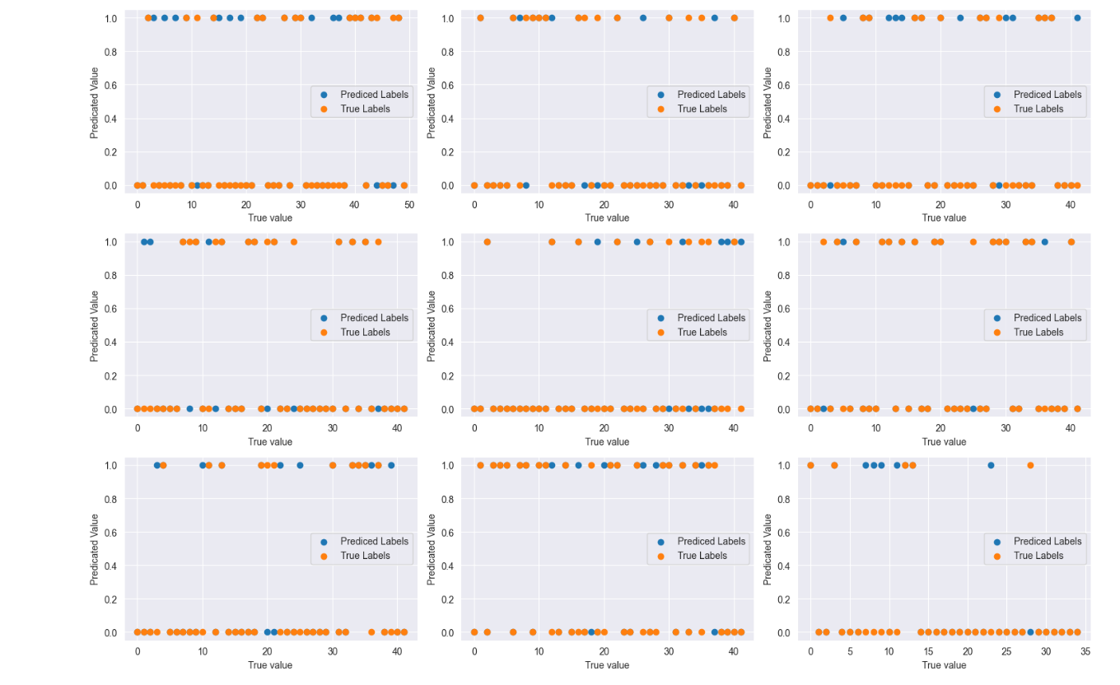
True value vs Predicted value
SVM Prediction

Slide 6
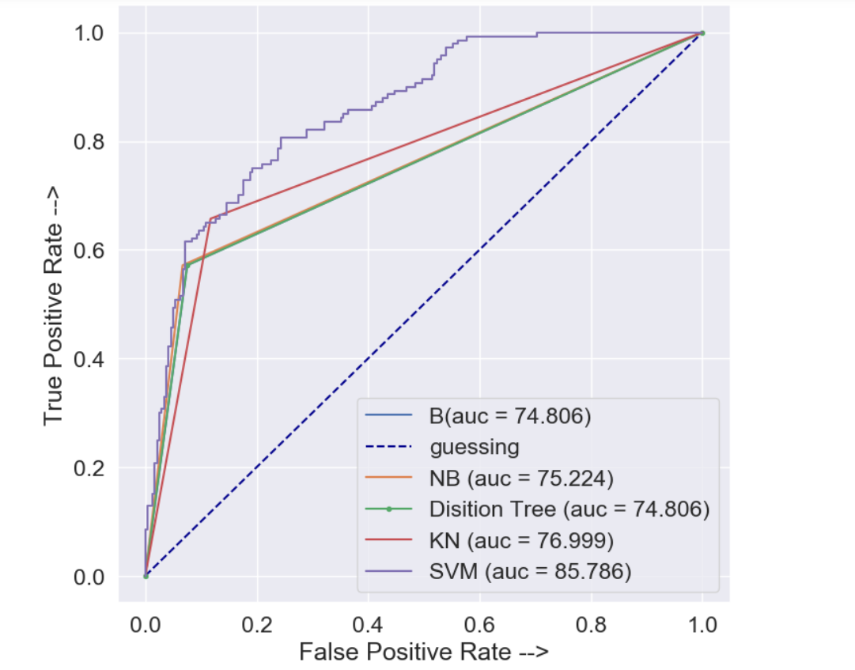
ROC Curve
Area under the receiver operating characteristic curve (AUC/ROC)
* ROC curve*
ROC curves are a comparison of a model's true positive rate (tpr) versus a model’s false positive rate (fpr).
True positive = model predicts 1 when the truth is 1
False positive = model predicts 1 when the truth is 0
True negative = model predicts 0 when the truth is 0
False negative = model predicts 0 when the truth is 1
Notes:
ROC curves typically feature true positive rate (TPR) on the Y axis, and false positive rate (FPR) on the X axis.

Slide 7
Thank you
Electrical & Computer Engineering Department and Department of Educational Psychology

