Slide 1
Brisk Tracking
Jonathan Hugo, Kevon Robinson, Anee Patel

Slide 2

What Is It?
An app that is able to send estimated wait times to users
The app contains:
a gps
A virtual queue
A see wait times page
A homepage
A trending page
And a weather page
Notes:
The app we created is an application that would be used to view the wait times to restaurants thus allowing users to time when to go to the restaurant or to decide if it worth visiting with time constraints in mind
Although the app seems very simple, we added many features that could assist users much more as it gets annoying hopping from one app to another just to get food.
We add things such as a gps to help the user navigate to their desired location,
A virtual queue which allows the user to enter a virtual line where once you are at the front of it, you would be notified thus allowing the user to know when they should leave their current location
A see wait times page that allows users to search for a website and view its estimated wait time
A homepage which simply contains recommendations based on past restaurants visited
A trending page that displays most bought meals based on data from social media sites
A weather page that shows the users recommended meals/restaurants based on the weather

Slide 3
Target Audience
Users who are typically busy and tight in time
workers and students
Users who want to be on time to events i.e meetings, classes.
Notes:
The target audience of our app is people who are short in time and are not to organized in terms of when they could take a lunch.
Our initial thought was, a user who has a meeting in a few minutes but wants to eat, thus the app can be used to see how long the wait would be to get food.
This idea can also connect to students as they have a set schedule for classes and may not be sure if walking all the way to a restaurant and waiting in the line would cause them to be late.
Over all the app is used to assist users in managing their time with meals.

Slide 4
Features
Top ranked features:
Virtual queue
Receiving live updates
Lowest Ranked Features:
GPS
Features Not Considered:
If a line to one restaurant is too long, the app will direct user to another restaurant
Notes:
We did not get to many recommended features as many people who did the survey did not know what to recommend
Although out of all the feature we were recommended , here are the top ranked feature, lowed ranked features and features we did not consider.
The top ranked feature are the virtual queue and being able to receive a live feed of the wait time
A virtual queue the was similar to Qless from sheridan was recommended
And the ability to see the wait times live was once of the most recommended features
As for lowed ranked features:
We just had the GPS feature as not many people had mentioned adding a gps but instead mentioned going to google instead
Features we did not consider is: a feature that directs the user to another restaurant if the restaurant they want to go to has too much of a long wait time

Slide 5
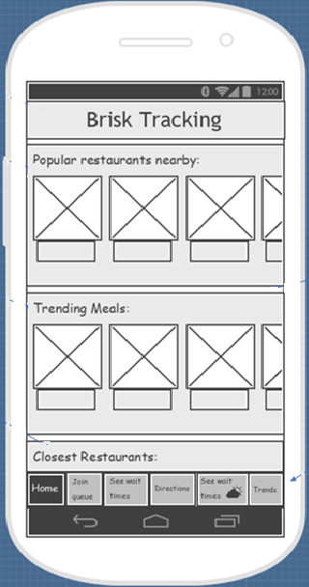
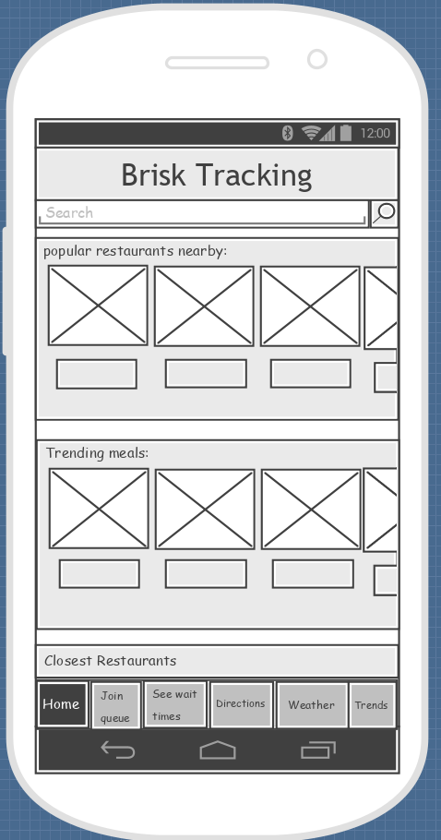
Home Page
‘See wait times’ button with weather logo changed into ‘weather’
Notes:
This is the initial homepage wireframe and update homepage wireframes
Through the tests, the homepage recieved no negative feed back, except for the bottom menu being missleading thus we changed the “see wait times” button with the weather logo in to a simple button that says “weather”

Slide 6
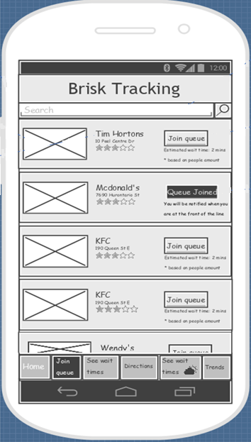
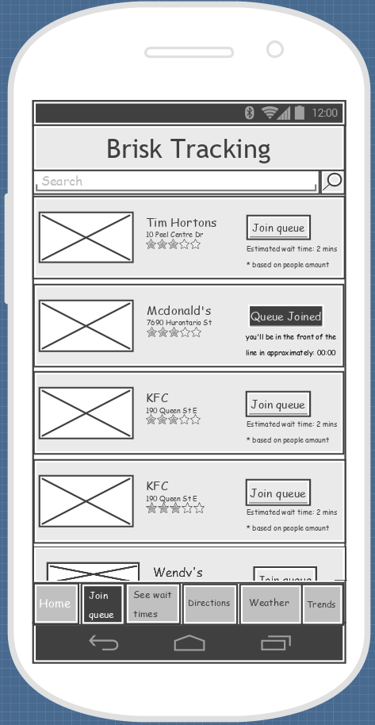
Virtual Queue
“You’ll be notified when you’re at the front of the line”, changed to “You’ll be in front of the line in approximately 0:00”
‘See wait times’ button with weather logo changed into ‘weather’
Notes:
This is the initial and updated wireframe of virtual queue feature. Here, only two things were changed, first is the comment which tells the user that they will be notified when they are in front of line, which is changed to a comment that tells the user the approximate time to reach in front of the line. Second is The ‘see wait times’ button with the weather logo which is changed to ‘weather’.

Slide 7
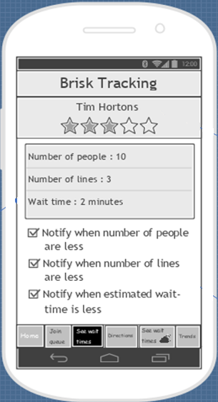
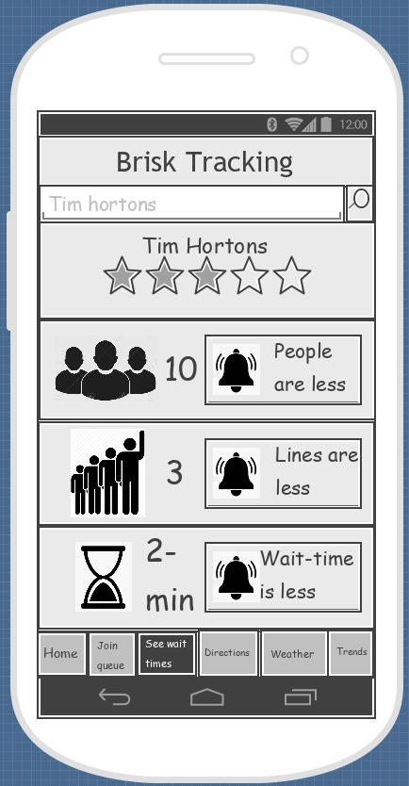
See wait times
A ‘search bar’ is added.
‘Texts’ replaced by ‘images’
‘Checkboxes’ for notifications replaced by ‘buttons’ with ‘bell-icon’
‘See wait times’ button with weather logo changed into ‘weather’
Notes:
In the initial wireframe of see wait times, the search bar was missing. So, it is added and most of the information was delivered by texts which is replaced by images to make it more user friendly page. Therefore, the texts which tells about the number of people, lines and estimated wait time is replaced by images. Also, one had to read texts to see what the checkboxes are for. So they are replaced with buttons at proper position with bell-icon to indicate that it’s for enabling the notifications when number of people are less or lines are less or the estimated wait time is less. And the see wait time button is replaced with weather button.

Slide 8
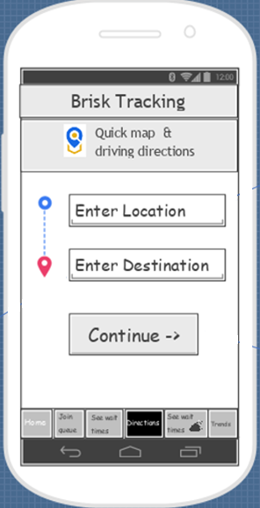
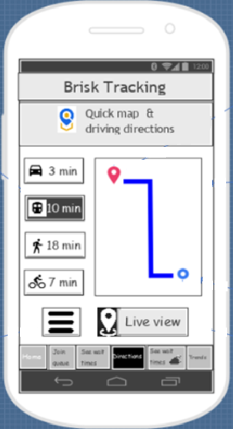
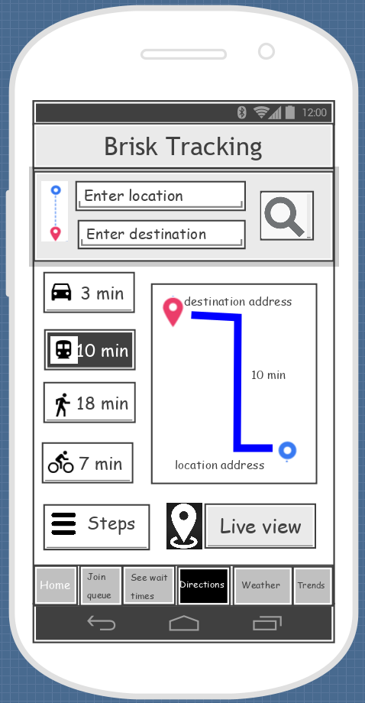
Directions
Textboxes to enter addresses are combined in one page
Addresses are displayed in the map along with the time
‘Steps’ keyword added
‘See wait times’ button with weather logo changed into ‘weather’
Notes:
Previously, we had two pages for directions, which is narrowed down to one page. The first page was having the textboxes where users can enter their current location and destination addresses, which is combined with the second page that asks for the addresses at the top and the map is shown in the middle along with the location and destination addresses. The three lined button is used for displaying steps in words which was very confusing so a step keyword is added to make it more specific. And the see wait times button with the weather logo is changed to weather.

Slide 9
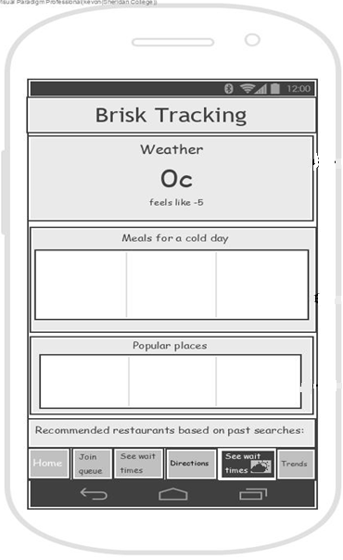
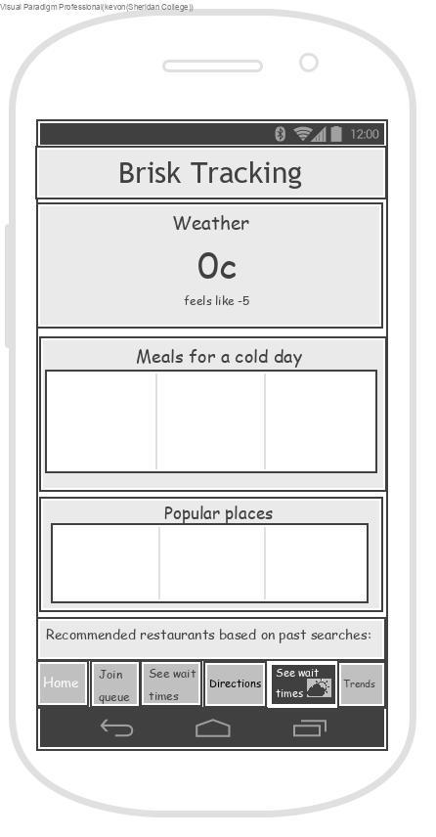

Weather
Small font size changed to larger fonts
‘See wait times’ button with weather logo changed into ‘weather’
Notes:
For weather not many changes were made, just the fonts were made a little large and in the bottom menu bar the see wait times button changed to weather button.

Slide 10
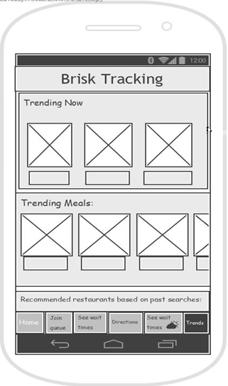

Trends
‘See wait times’ button with weather logo changed into ‘weather’
Notes:
For trends too, nothing needed changes except the misleading see wait times button which is changed to weather button.

Slide 11
Findings from user testing
What went well?
All tasks provided to users were cleared with success.
All users completed their tasks in a timely manner.
The first task received the most positive feedback due to its simplicity.
Overall most users seemed to like the way the elements were laid out in every page.
What didn’t go well?
For the second task, although most users managed to find the page, many overlooked the specific checkboxes to actually complete the task.
The three lined button to view the directions in text form caused confusion for a majority of users.

Slide 12
Findings from user testing
Positive feedback:
The virtual queue page received positive feedback the most.
All pages were clear and easily understood.
Trends page is useful when one isn’t sure where to eat at.
Negative feedback:
Notification checkboxes were not clear in see wait times page.
Too much texts in directions page.
Having the name ‘see wait times’ and a sun-cloud icon for weather caused confusion.
Surprise findings:
The second task surprised us the most as most users finished the longer third task much faster then the second task which seems much more simpler to us.

Slide 13
Lessons learned
Next Launch
The dominance of use of images rather than texts to deliver information.
The importance of buttons.
The size of fonts.
The use of specific and clear language.
The design of web application and pages.
The usefulness of user testing.
To be able to determine the traffic in the way to the restaurant.

