Slide 1
Project Presentation
Ankita Patel
Chaitanya Kaul
Rosy Parmar
Vishruth Krishna Prasad

Slide 2
Introduction
The goal of the project is to build an interactive tool for detecting plagiarism in programming assignments.
The target programming language will be Java.
We look for behavior-preserving transformations to achieve this goal.

Slide 3
PLATFORM SPECIFICATIONS
User Interface – Angular.JS , HTML, CSS, Bootstrap
UI tools – Electron.JS
Backend – Java
Project Management –Slack
IDE – Webstorm, IntelliJ
Test Framework – jUnit
Version Control: Github

Slide 4
Functionality
Registered user logs in to the system
User uploads two .java files and a preview of the two files are available. Then the user proceeds to check the document for plagiarism.
The system returns the statistics of the two files and also provides a visual representation of the same.
The statistics include test like – line comparison, object similarity, comment similarity, etc. and their similarity percentages in a tabular format.
The visual representation displays the similar content of the two input files marked with red color.

Slide 5
Algorithm
The plagiarism detector does the following :
Takes two .java file.
Line Comparison
counts the number of lines in both the files.
Creates AST for both the files
For creating the AST -> EclipseJDT Parser
Compare Structural Similarity
Takes two AST’s and compares the variables and objects in both the trees using AST’s compare() method.
Compare Comments
Takes two AST’s and compares the comments in both the trees using AST’s getComments() method.
Uses Levenshtein’s Algorithm.

Slide 6
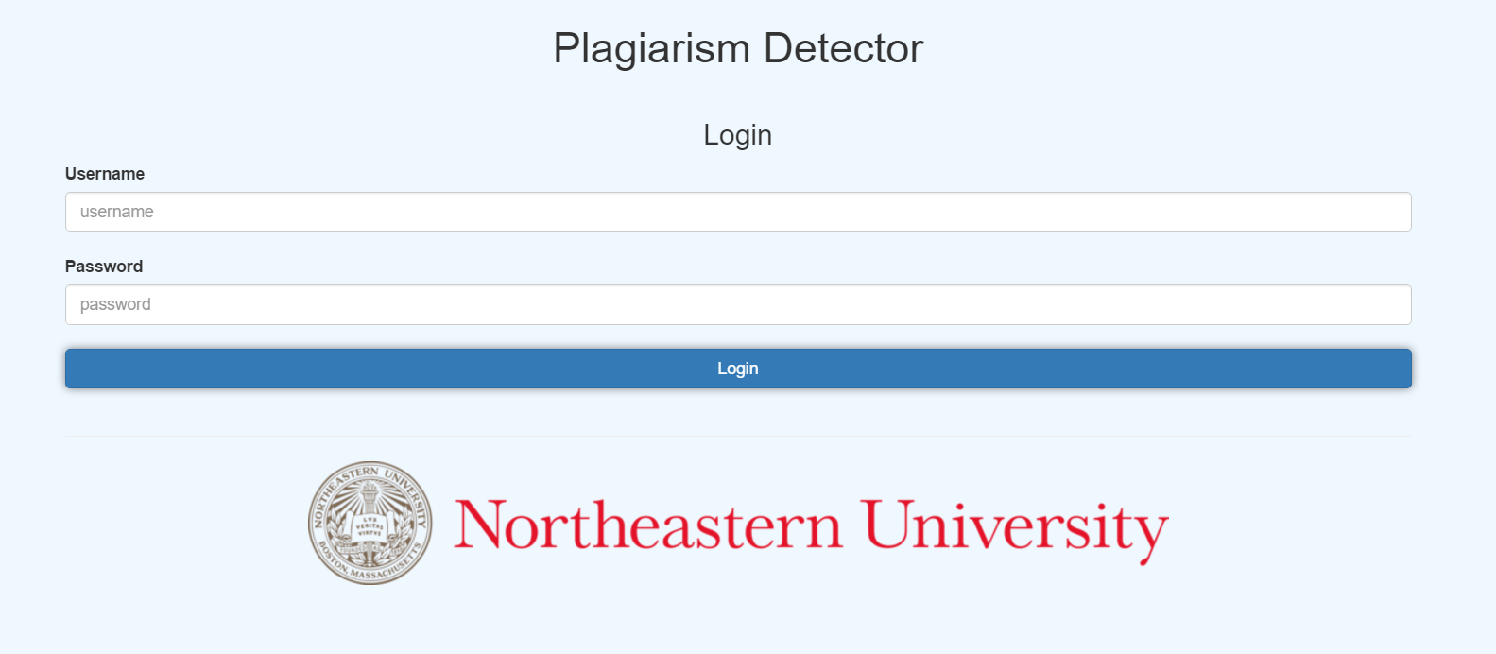
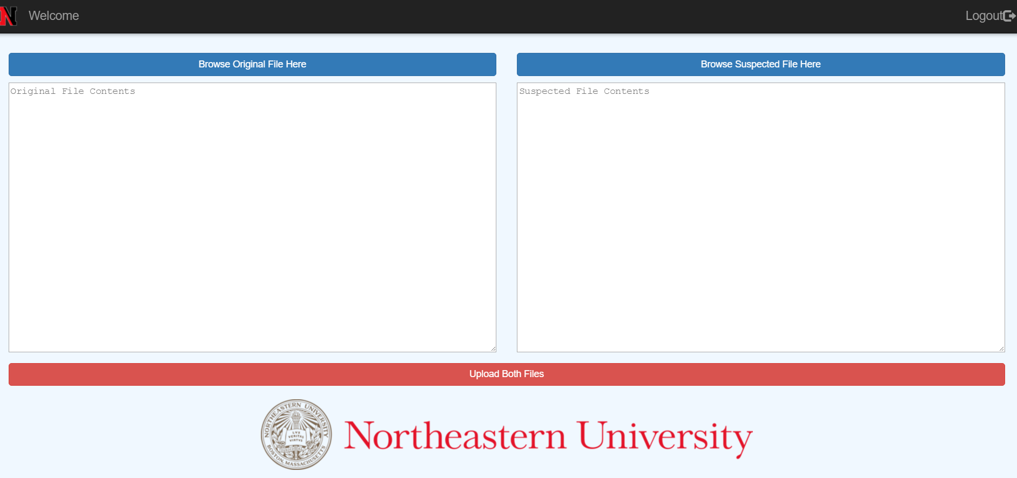
User Interface
Login
Upload two files

Slide 7
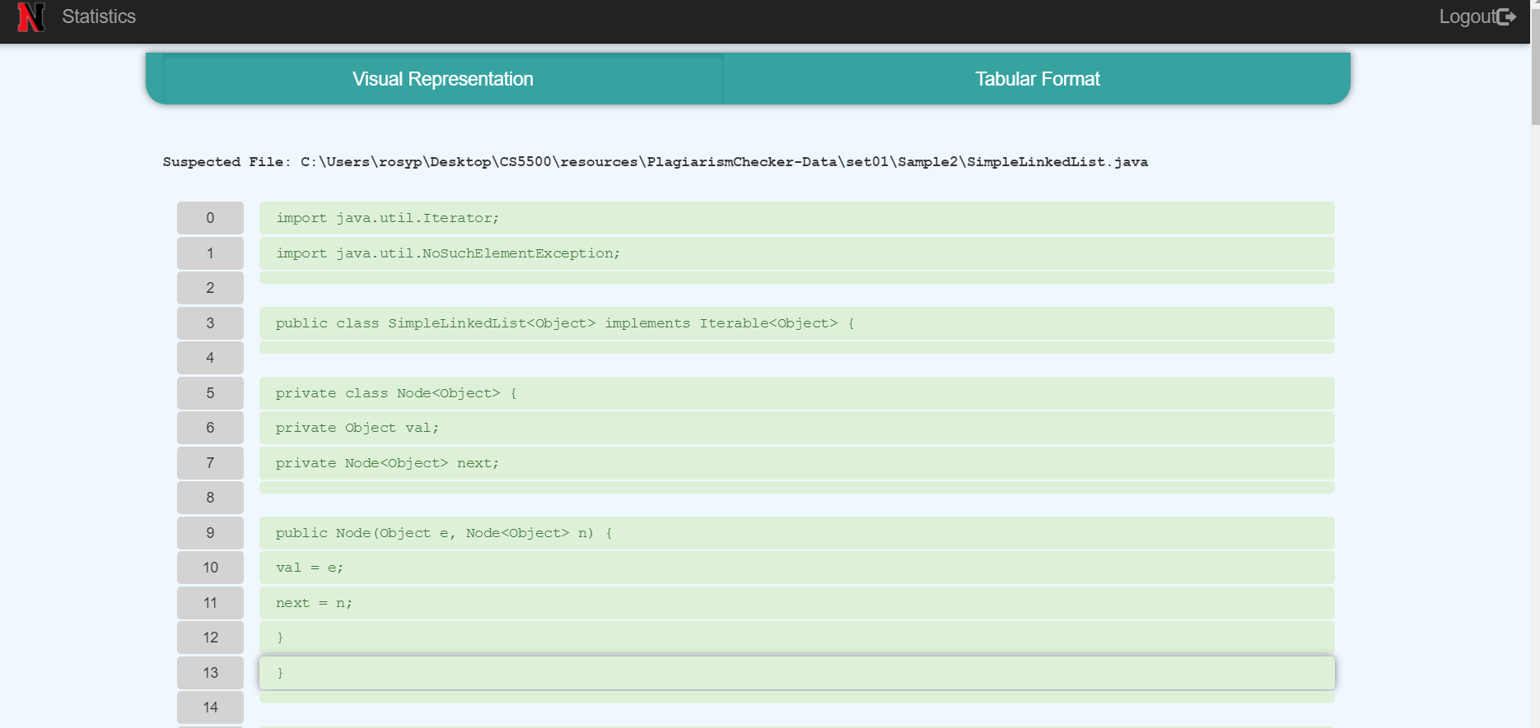
Visual Representation

Slide 8
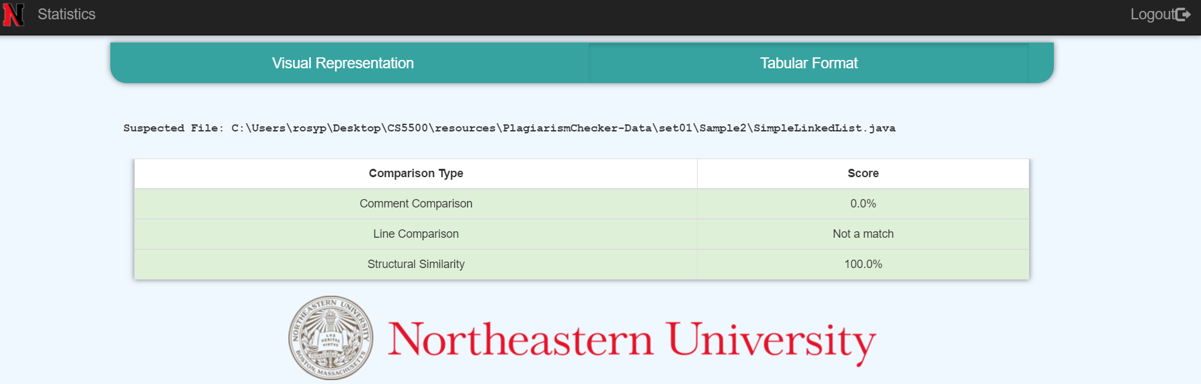
Tabular Representation

Slide 9
REFERENCES
Zhao, J., Xia, K., Fu, Y. and Cui, B., 2015, November. An AST-based code plagiarism detection algorithm. In Broadband and Wireless Computing, Communication and Applications (BWCCA), 2015 10th International Conference on (pp. 178-182). IEEE.
https://github.com/eclipse/eclipse.jdt.core
https://electronjs.org/

Slide 10
Thank You

