Slide 1

Brand kit · v0.1
11 Oct 2026
Notes:
Title slide. Lockup: logo/argonaut-agentic-horizontal-dark.png. Version and date from the brand sheet (argonaut-agentic-brand-sheet.png).

Slide 2



LOCKUPS
Horizontal
Horizontal · dark
Horizontal · light
Horizontal, no tagline · dark
Horizontal, no tagline · light
Notes:
Files: logo/argonaut-agentic-horizontal-{dark,light}.png and -horizontal-notag-{dark,light}.png (SVG versions sit next to them). Below 320 px wide, use the no-tagline lockup (brand sheet).

Slide 3




LOCKUPS
Stacked and icon
Icon · dark
Stacked · dark
Stacked · light
Icon · light
Notes:
Files: logo/argonaut-agentic-stacked-{dark,light}.png and logo/argonaut-agentic-icon-{dark,light}.png. Icon minimum size 24 px / 6 mm (brand sheet).

Slide 4
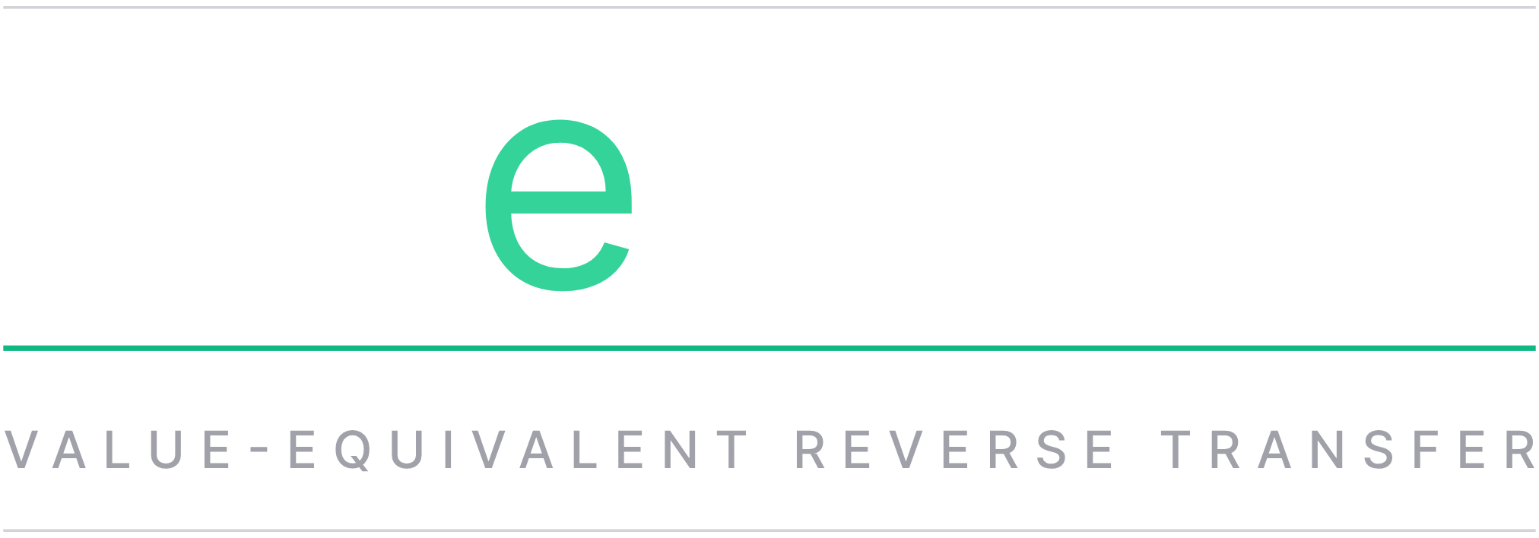
VERT MARK · VERSION B
VeRT: value-equivalent reverse transfer
Notes:
Chosen version B: vert/vert-mark-grey-short-ruled-b.svg (the stretched VeRT mark with off-white hairlines above and below), placed here as a PNG rasterised from the SVG because SVG does not survive Google Slides import. Line under the mark is from copy.md: 'VeRT: value-equivalent reverse transfer'.

Slide 5



VERT MARKS
Sub-mark variants
VeRT · dark
VeRT · light
VeRT · grey, short
VeRT sub-mark: lower-case green e for "equivalent", thin green rule, expansion in tracked caps.
Notes:
Files: vert/vert-mark-dark.png, vert/vert-mark-light.png, vert/vert-mark-grey-short.png. Caption from the brand sheet.

Slide 6
PALETTE · LIFTED FROM TRANSITION-INSIGHT GLOBALS.CSS
Colour
Night
#050505
--background 0 0% 2%
Panel
#0D0D0D
--card 0 0% 5%
Hairline
#292929
--border 0 0% 16%
Paper
#FAFAFA
--foreground 0 0% 98%
Zinc
#A1A1AA
.p3-brand-title-sub (zinc-400)
Zinc light
#D4D4D8
--p3-essay-subtitle-color (zinc-300)
Pop green
#10B981
--color-pop-green / --primary
Tagline green
#34D399
.p3-brand-tagline, link hover
Mint
#6EE7B7
brand-sub hover
Green on light
#059669
light-ground variant (added)
Notes:
Hex values from src/palette.py (DARK and LIGHT). Swatches are native rectangles: recolour them by editing fill. Headline white #FFFFFF (.p3-brand-title-main) is also used for h1 text on the cards.

Slide 7

TYPE
ARGONAUT AGENTIC
PAYMENT UTILITY
Tagline / kicker: Inter Bold, caps, tracking +0.34em, #34D399 @ 92%
Inter Bold 700 · white · tracking −0.04em Inter Regular 400 · #A1A1AA · tracking +0.06em
UBI may work like a reverse VAT.
Body: Inter Regular #A1A1AA, 1.38 leading. Keep it to two or three lines; the black does the talking.
Headlines: Inter Bold, sentence case, −0.03em. Green for one word, max.
AshitHand is not a Google Slides font, so handwritten bits are placed as images.
Ashit Hand · asides only, one per piece, his words
Notes:
Type specimen from the brand sheet. All live text here is Inter (available in Google Slides). The 'so yeah...' sample is a PNG rendered from src/assets/AshitHand-Regular.woff2.

Slide 8
CLEAR SPACE & MINIMUM SIZE
Give the ring room
x = ¼ of the ring's diameter. Keep x clear on all sides.
Icon: min 24 px / 6 mm.
Horizontal with tagline: min 320 px wide.
Below 320 px drop the tagline (horizontal-notag).
Never recolour the A green; green belongs to rules, taglines and one word.
Notes:
Wording from the clear-space section of the brand sheet. Not on the original list for this kit, so delete this slide if you don't need it. The dashed green box is a native shape marking the clear zone.

Slide 9
NAME + TAGLINE OPTIONS
01
Payment utility for a new Earth
The tagline on the lockups.
02
UBI may work like a reverse VAT.
03
Value-equivalent reverse transfer
04
Due consideration
From the note on the exchange: paid in kind, priced by an oracle, streamed back as income.
Notes:
From copy.md, 'Name + tagline options' (v2). Option 1 notes: your 'agentic payment utility' joined to the site's '...for a new Earth'. Options 2 and 3 are your words verbatim [A].

Slide 10
SUMMARY
UBI may work like a reverse VAT. VAT is essentially a payment to the commons for value added, meaning processing. VeRT runs the other way: a value-equivalent reverse transfer paid when a contribution in kind offsets a cost the commons would otherwise carry. Walking offsets the use of pharmacology; eating vegetables instead of refined carbohydrates or heavily processed foods does the same. IoT factors using the ISO 20022 standard confirm the activity, an oracle prices it against what it displaces, and the income is streamed in stablecoin. It should self-fund. It does need stablecoins to scale first.
Notes:
Summary (~100 words) from copy.md v2, verbatim (source markers [A]/[a] removed).

