Slide 1
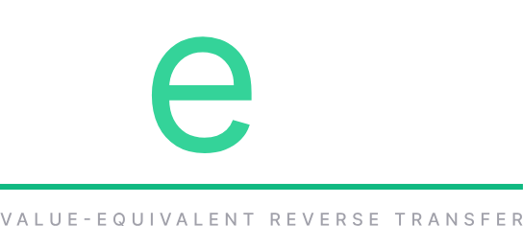
UBI may work like
a reverse VAT.
An agentic payment utility which reduces (processing) noise and energy through the domain, and encourages the consumption of raw/organic produce.
Notes:
Post caption (copy.md v2, card a):
UBI may work like a reverse VAT (value-added tax). VAT is a payment to the commons for processing. VeRT is a transfer back when the processing, energy and cost are avoided.
Source PNG: social/vert-a-vert-reverse-vat-1600x900.png

Slide 2
VeRT / IOT / ISO 20022
You're walking.
That streams you income.
♥ 112 BPM · 5.4 KM/H · GPS ✓ · ISO 20022 pacs.008
IoT factors using the ISO 20022 standard send heart rate, motion and location to confirm you're walking or riding. You keep the autonomy to drive.
Notes:
Post caption (copy.md v2, card b):
IoT factors using the ISO 20022 standard send information on heart rate and motion and location to confirm you're walking or riding - that streams you income. Walking offsets the use of pharmacology. You keep the autonomy to drive.
Source PNG: social/vert-b-walking-streams-income-1600x900.png

Slide 3
VeRT / FOOD
Raw and organic:
a credit, not a tax.
Eating vegetables instead of refined carbohydrates or heavily processed foods offsets costs the commons would otherwise carry.
HEAVILY PROCESSED
VAT
A payment to the commons for value added, meaning processing.
RAW / ORGANIC
VeRT
A transfer back: the processing, energy and cost avoided.
Notes:
Post caption (copy.md v2, card c):
Eating vegetables instead of refined carbohydrates or heavily processed foods offsets costs the commons would otherwise carry. VAT applies to processing; VeRT credits its absence.
Source PNG: social/vert-c-carb-no-credit-1600x900.png

Slide 4
VeRT / HOW IT SELF-FUNDS
Due consideration.
It should self-fund since consumption of organic and non-pharma product at scale would reduce public entitlement, transportation etc. expenditures.
YOU
Paid in kind
Factored movement (walking, riding), or creative effort that generates value. Attested over ISO 20022.
ORACLE
Equivalent price
The contribution is priced against what it displaces: pharma, fossil fuel...
BACK TO YOU
Streamed income
VeRT, paid in stablecoin.
Only possible once stablecoins really scale.
Notes:
Post caption (copy.md v2, card d):
It should self-fund since consumption of organic and non-pharma product at scale would reduce public entitlement, transportation etc. expenditures. You pay in kind, an oracle sets the equivalent price against what it displaces (pharma, fossil fuel), and the income is streamed back in stablecoin. Only possible once stablecoins really scale.
Source PNG: social/vert-d-self-fund-1600x900.png

