Slide 2
Problem Statement
Predict time taken by delivery person
You are working as a data scientist at a food delivery company. The company wants to improve its system that calculates ETA for delivery persons. Rather that relying on some fixed method/formula. The management has decided to develop intelligent software that can predict the time of arrival for the delivery persons.
Task
Develop a machine learning model that can calculate the time taken by the delivery person to deliver the order, given relevent information.
Dataset description
Train - 45593
Test - 11399
The columns providing in the dataset are as follows:

Slide 3
Problem Statement
Predict time taken by delivery person
You are working as a data scientist at a food delivery company. The company wants to improve its system that calculates ETA for delivery persons. Rather that relying on some fixed method/formula. The management has decided to develop intelligent software that can predict the time of arrival for the delivery persons.

Slide 4
Task
Develop a machine learning model that can calculate the time taken by the delivery person to deliver the order, given relevent information.

Slide 5
Dataset description
Train - 45593
Test - 11399

Slide 6
The columns providing in the dataset are as follows:
Columns_Name | Details
ID | Represent a unique identification of an entry.
Delivery_person_ID | Represent a unique identification of a delivery person.
Delivery_person_Age | Represent the age of a delivery person
Delivery_person_Ratings | Represent the average ratings given to the delivery person. (1 to 5)
Restaurant_latitude | Represent the latitude of the restaurant.
Restaurant_longitude | Represent the longitude of the restaurant.
Delivery_location_latitude | Represent the latitude of the Delivery location.
Delivery_location_longitude | Represent the longitude of the Delivery location.
Order_Date | Represent the date when the order was placed.
Time_Ordered | Represent the time when the order was placed.
Time_Order_picked | Represent the time when the order was picked from the restaurant.

Slide 7
Columns_Name | Details
Weather conditions | Represent the weather conditions (windy, sunny, cloudy, stormy, fog, sandstorms, etc.)
Road_traffic_density | Represent the road traffic density (Jam, High, Medium and Low)
Vehicle_condition | Represent the condition of the Vehicle. (Smooth, Good or Average)
Type_of_order | Represent the type of order (Snack, Meal, Buffet, Drinks, etc.)
Type_of_vehicle | Represent the type of vehicle one is using (Motorbike, Bicycle etc.)
multiple_deliveries | Represent the number of orders to be delivered in one attempt.
Festival | Represent whether day is festive or not.
City | Represent the city
Time_taken (min) | Represent the time taken by the delivery person to deliver the order. [TARGET]

Slide 8
Null values
ID 0
Delivery_person_ID 0
Delivery_person_Age 1854
Delivery_person_Ratings 1908
Restaurant_latitude 0
Restaurant_longitude 0
Delivery_location_latitude 0
Delivery_location_longitude 0
Order_Date 0
Time_Orderd 1731
Time_Order_picked 0
Weather conditions 616
Road_traffic_density 601
Vehicle_condition 0
Type_of_order 0
Type_of_vehicle 0
multiple_deliveries 993
Festival 228
City 1200
Time_taken (min) 0

Slide 9
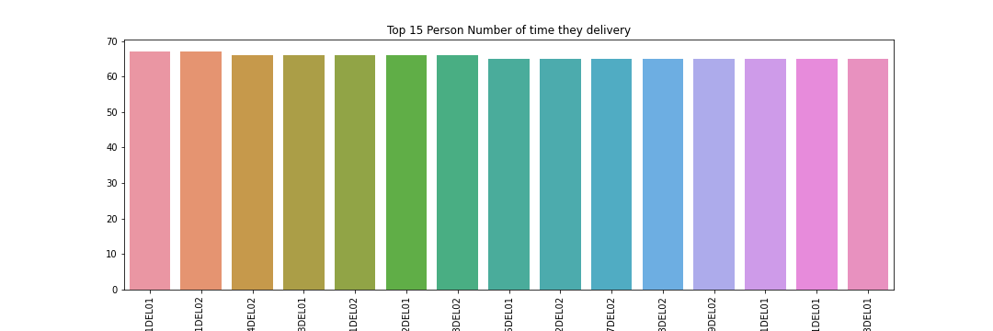
Top 15 Persons

Slide 10
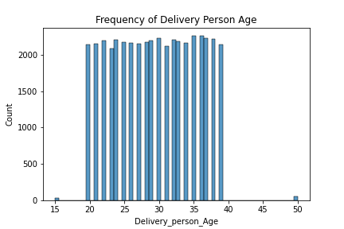
Delivery_person_Age
I fill null value in Age by same ratio by present train dataset, Because If I fill null value by Mean or Median value then Age data will be bias, so I fill this column value by own ratio.

Slide 11
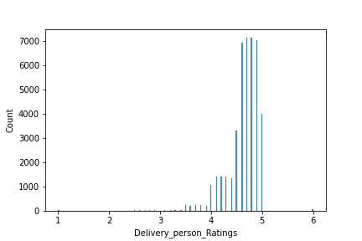
Delivery_person_Ratings
I fill null value in this feature by median value.
Because most of the delivery person have above 4.5 ratting.

Slide 12
Time_Orderd
First I break down this feature into Hour and Minute.
Then I fill missing value by own median value
For hour column fill with --> 19
For minute column fill with --> 30
Also, I cross verify with original data. (Counted which time is order book by customers)

Slide 13
Weather conditions
As per weather conditions data we clearly see that all weather condition have almost same amount of data.
And we have null values 616, as per my view If I fill only one weather condition, so my model will be bias.
So, I fill null value by using same ratio in both train and test data.

Slide 14
Road_traffic_density
In this features only 616 null value,
And most of the data shows traffic density is low
So I fill all null vale by low

Slide 15
multiple_deliveries
In this feature have 993 null value
And most deliveries carry only 1 item
So, I fill null value by 1

Slide 16
Festival
In this feature have only 228 null value
And majority delivery day don’t have any festival
So, I fill null value by “No”

Slide 17
City
In this feature have 1200 null value, and it also categorized by three categories Metropolitian, Urban, Semi-Urban.
And most of times Metropolitian customers orderd online food.
Therefore, I fill null value by ‘Metropolitian’.

Slide 18
Preprocessing for Model

Slide 19
For Order_Date
First, I convert order date into DateTime Format
After that I break this column into Six different columns
Date
Month
Week Number
Year
Quarter
Weekday
After I drop this column

Slide 20
For Time of Order & Time of Order Pickup
First, I converted these columns into time format
Then, I break down these columns into two part
Hour
Minute
After that I drop these columns

Slide 21
For all Object columns
I use label encoder, to convert all labeled or categorical data into numeric format

Slide 22
Model Building
First, I split train data into train and validation data by 95%:5% ratio.
I load all regressor models
And check all model’s losses (RMSC) for train and validation
As per my observation Cat-Boost-Regressor model have best result for both train and validation.

Slide 23
Hyper Tunning
I tune a model as per my knowledge.
And try to minimize loss (RMSC).
At the final I got r2 score on train data 81% and test data 81%.

