Slide 1
Does Smoking Cigarette or Marijuana increase criminal Activity or emotional Stress?
Fordham University Gabelli School of Business
Spring 2019 – Observational Studies
Darshan Patel
Prof. Frank Yoon

Slide 2
Problem
To understand the association between smoking cigarette and marijuana with criminal activity
To understand the association between smoking cigarette and marijuana with signs of emotional stress
Use propensity score matching and coarsened exact matching for matching techniques
Use doubly robust regression and BART (Bayesian Additive Regression Trees) for regression techniques

Slide 3
Data
Survey done by NSDUH (National Survey on Drug Use and Health) from 2017
56,276 subjects were interviewed
Information on various drugs such as tobacco, marijuana, crack, cocaine, heroin, hallucinogens, etc. were collected
Information on peoples’ social environment, youth experiences, mental health, depression, consumption of alcohol, substance abuse, etc. was also collected
A total of more than 2,500 variables of information
 | Cigarette Smoker? | Marijuana Smoker?
No | 28971 | 32031
Yes | 27305 | 24212

Slide 4
Data Preparation
Crime variables are measured as either YES, NO (or omitted or legitimate skip)
If a subject committed either theft, arson or burglary in the past year, note it as a YES for exhibiting criminal activity, otherwise NO
Emotional stress variables are measured on a scale of 0-5, with 0 being none of the time and 5 being all of the time
If a subject experienced the a mid level of nervousness, hopelessness or worthlessness in one particular month in the past year (>2), note it as a YES for feeling stressed, otherwise NO
Covariates used: gender, age group, race, employment status

Slide 5
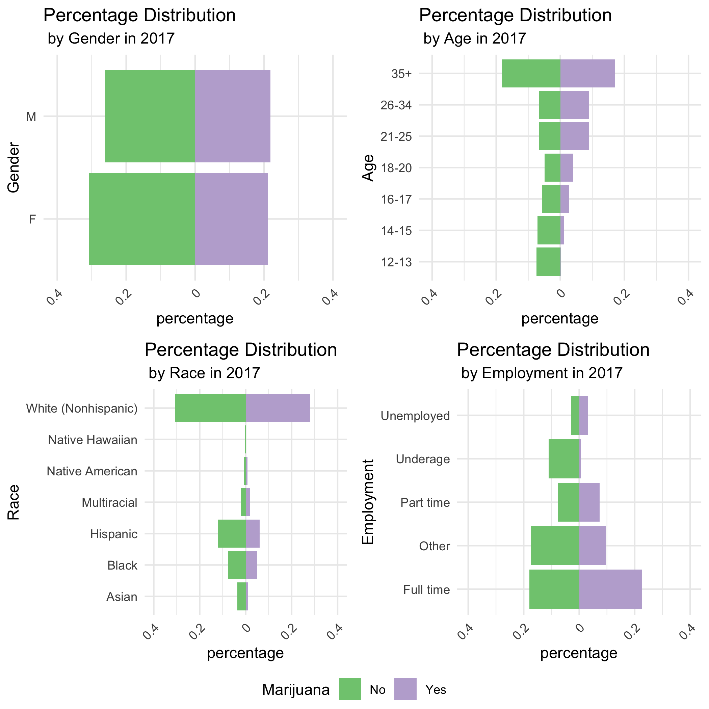
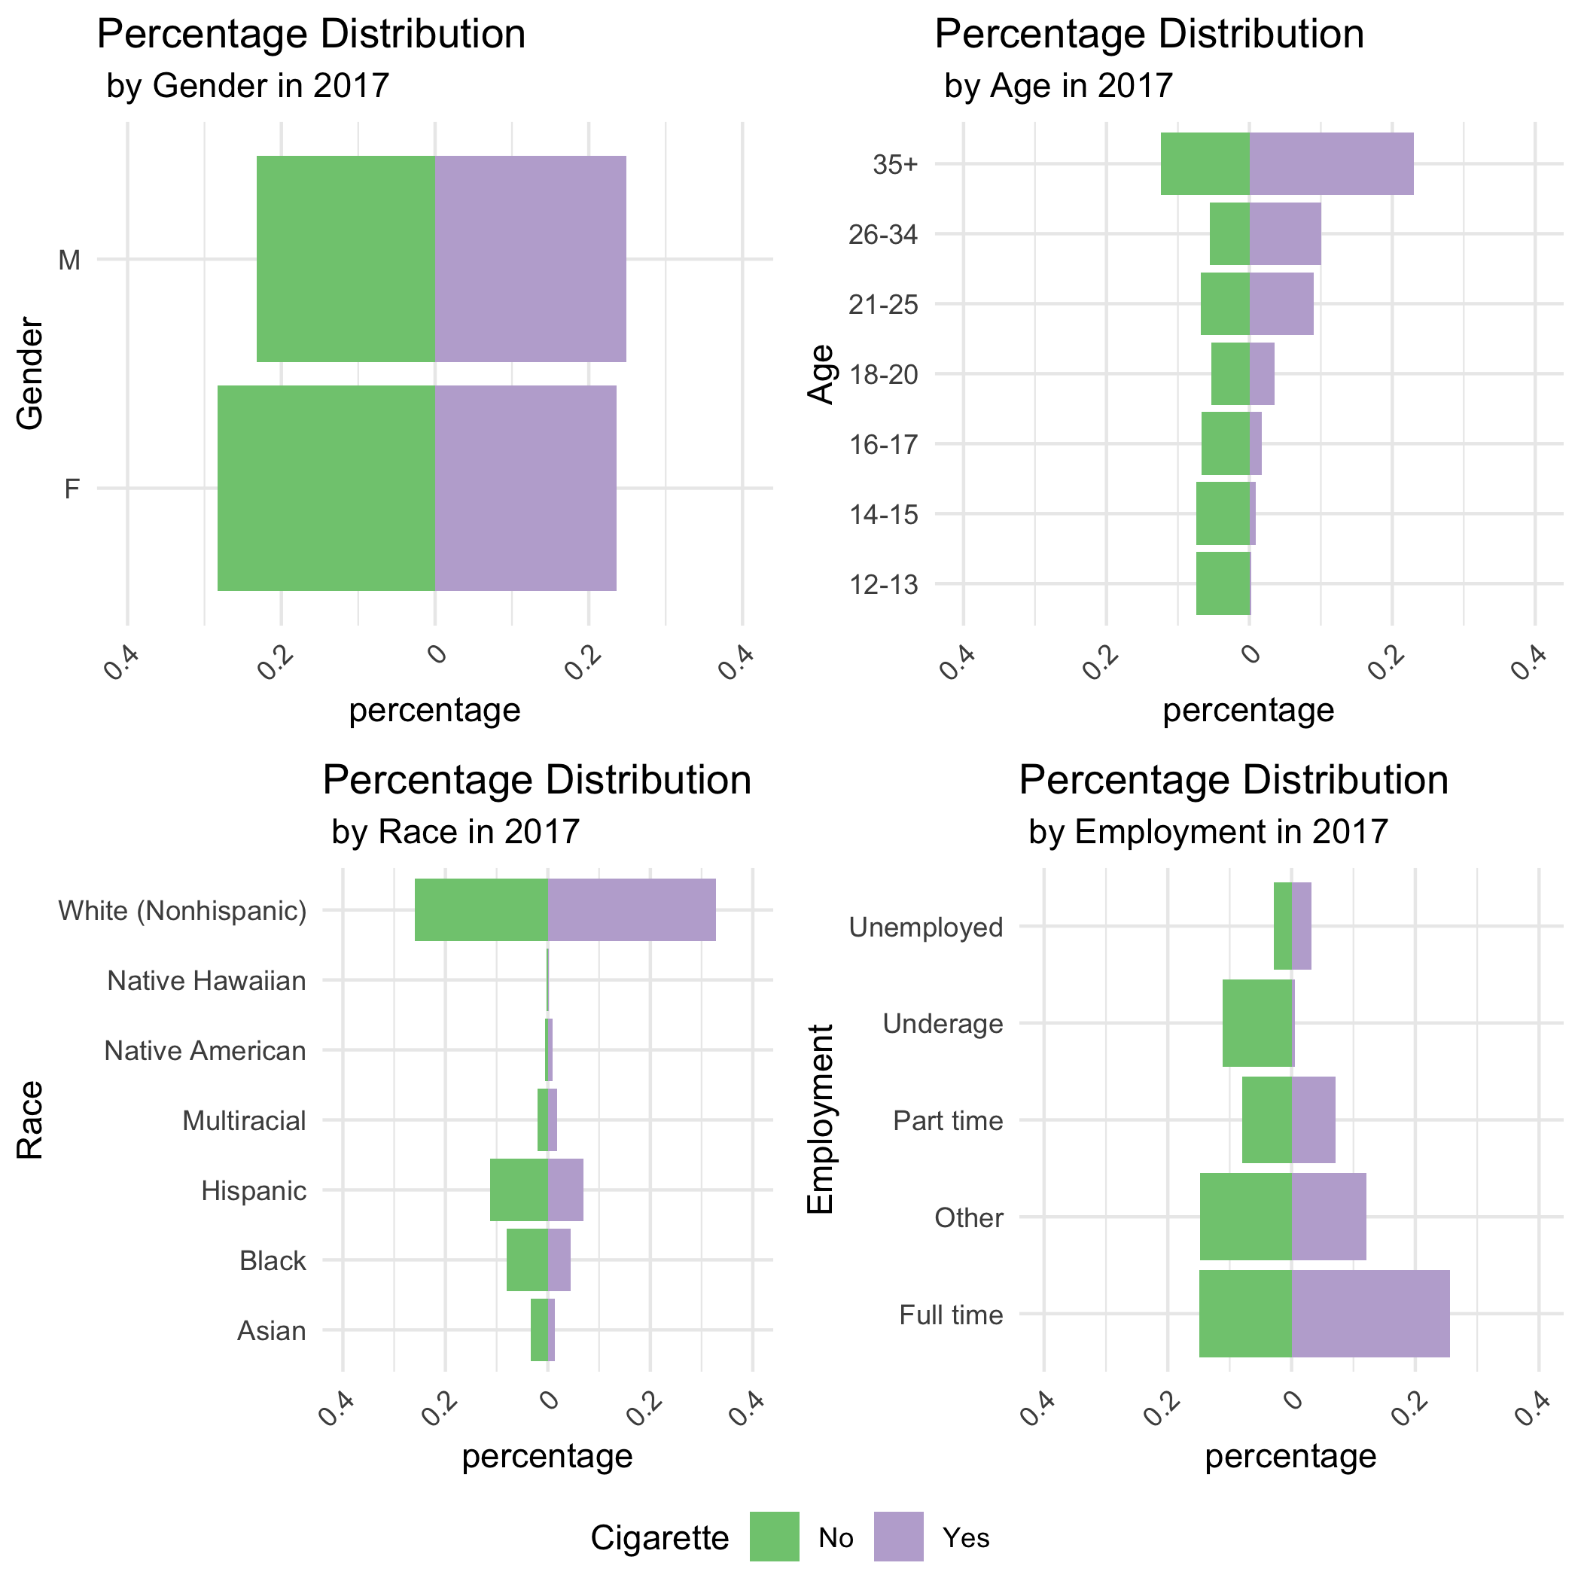
Covariates

Slide 6
Propensity Score Matching
Model | β | Matches | Nonmatches | p-value | Interp.
Cigarette/Crime | 0.18 | 124 | 62 | 0.68 | 19.96
Marijuana/Crime | -0.58 | 85 | 140 | 0.27 | -44.29
Cigarette/Stress | 0.12 | 284 | 1264 | 0.33 | 13.31
Marijuana/Stress | 0.50 | 1308 | 196 | 0.00 | 65.20

Slide 7
Coarsened Exact Matching
Model | % Non-Smokers Matched | % Smokers Matched | β (matched) Interp. | β (all) Interp.
Cigarette / Crime | 0.872 | 0.730 | 0.294 32.264 | 0.223 25.040
Marijuana / Crime | 0.929 | 0.738 | 0.108 11.487 | 0.084 8.812
Cigarette / Stress | 0.998 | 0.992 | 0.224 25.121 | 0.222 24.912
Marijuana / Stress | 0.996 | 0.992 | 0.391 47.981 | 0.389 47.588

Slide 8
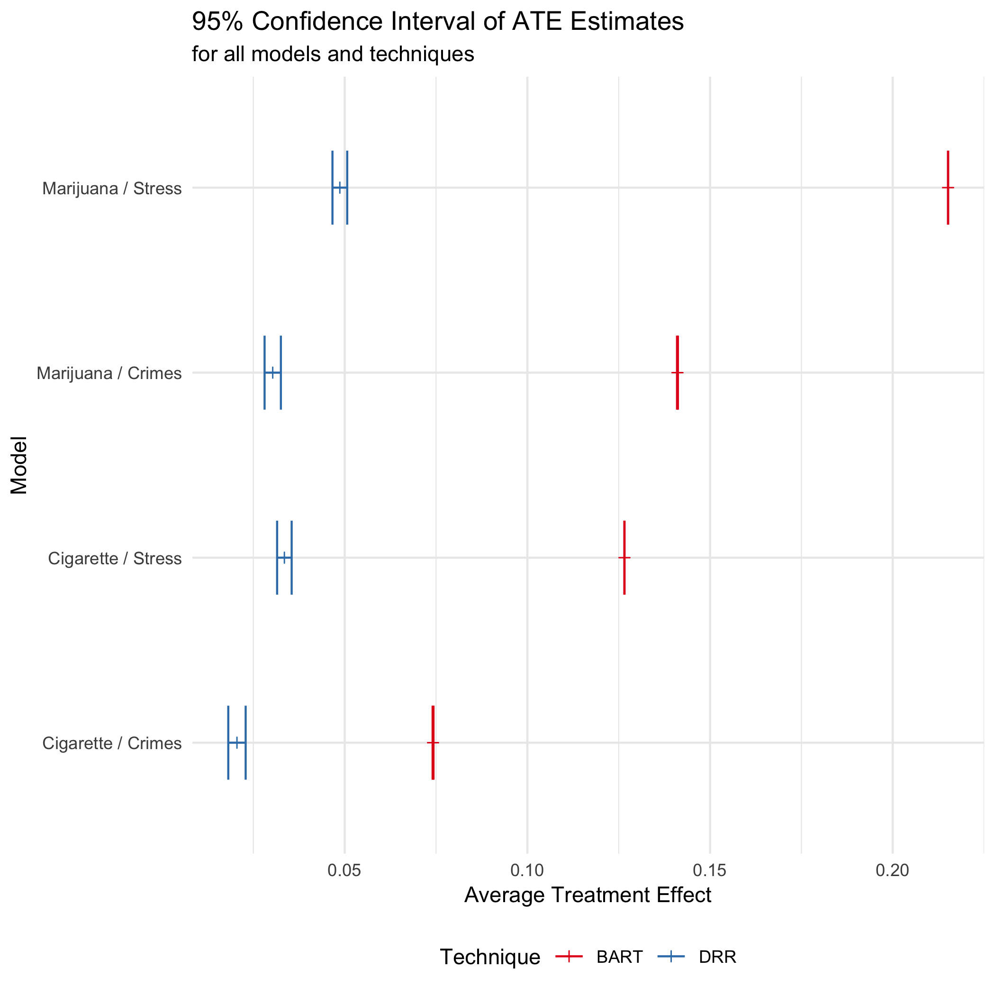
Doubly Robust Regression / Bayesian Additive Regression Trees
DRR – Bootstrapped 200 samples to form a ATE estimate for 1000 iterations
BART – 1000 iterations of the MCMC algorithm

Slide 9
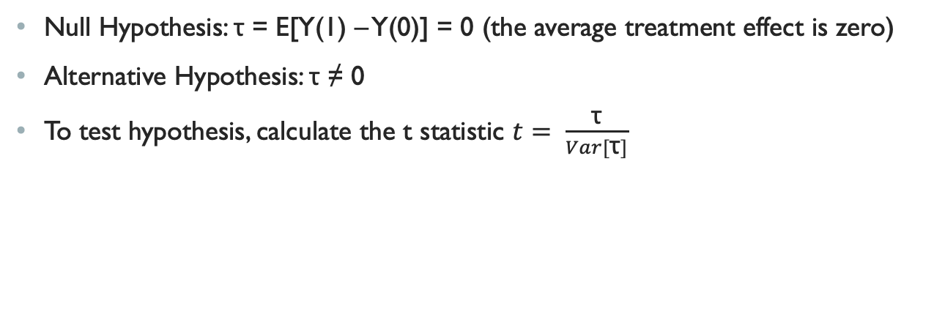
Neyman Hypothesis Testing
Null Hypothesis: τ = E[Y(1) – Y(0)] = 0 (the average treatment effect is zero)
Alternative Hypothesis: τ ≠ 0
To test hypothesis, calculate the t statistic $t= \frac{\text{τ}}{Var[\text{τ}]}$
Type | Model | t | degrees of freedom | p-value
DRR | Cigarette / Crime | 111.86 | 1396 | 0.00
DRR | Marijuana / Crime | 176.38 | 1396 | 0.00
DRR | Cigarette / Stress | 768.11 | 13532 | 0.00
DRR | Marijuana / Stress | 1099.70 | 13532 | 0.00
BART | Cigarette / Crime | 8024.30 | 1396 | 0.00
BART | Marijuana / Crime | 15261.09 | 1396 | 0.00
BART | Cigarette / Stress | 192563.10 | 13532 | 0.00
BART | Marijuana / Stress | 327328.40 | 13532 | 0.00

Slide 10
Conclusion
Marijuana use and emotional stress are correlated as well as cigarette use and criminal behavior
Coarsened exact matching matched more data than propensity score matching
BART method calculated ATE estimates with higher precision
No average treatment effects were zero after performing doubly robust regression modeling or BART
Smoking cigarette or marijuana increases the odds of committing a burglary, arson or theft crime; it also increases the odds of exhibiting emotional stress by either nervousness, hopelessness or worthlessness

Slide 11
Future Considerations
Look at other drugs in the dataset (heroin, methamphetamines, crack, cocaine), other crimes (robbery, DUI, fraud), other emotional stress indicators (nothing could cheer you up, everything was an effort, restlessness)
Add more covariates such as marital status, being in the military force, sexual identity
Use targeted maximum likelihood estimation to find ATE and ATT
Note that ATT was omitted in this study
Bootstrap different sample sizes in DRR algorithm to see effect on confidence interval
Higher/lower threshold for emotional stress during data preparation

