Slide 1
Online Retail Sales Data Analysis
Deepkumar Patel
Harsh Hirpara
Het Anghan
2025 Winter
ALY6140 Python & Analytics Technology
Dr. Harpreet Sharma

Slide 2
Index
Background Information
Research Questions
Dataset Overview
Exploratory Data Analysis (EDA) & Visualizations
Predicting Sales Revenue (Regression Analysis)
Predicting Customer Retention (Classification Analysis)
Customer Segmentation (Clustering Analysis)
Conclusion & Key Takeaways
Recommendations & Business Applications
References

Slide 3

Background Information
Growth of e-commerce and the need for data-driven insights
Importance of sales forecasting, customer retention prediction, and segmentation
How machine learning models help in business decision-making

Slide 4
Research Questions
Can we predict total revenue based on historical sales data?
Can we predict customer retention and identify at-risk customers?
How can we segment customers based on purchasing behavior?

Slide 5
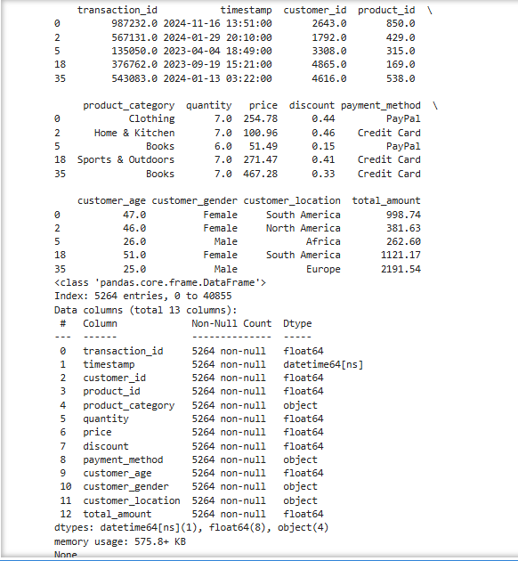
Dataset Overview
Online Retail Sales Dataset
Source: Kaggle
Total Records: 40,856 transactions (sampled from 1 million)
Key Features: transaction_id, timestamp, customer_id, product_id, product_category, quantity, price, discount, payment_method, customer_age, customer_gender, customer_location, total_amount

Slide 6
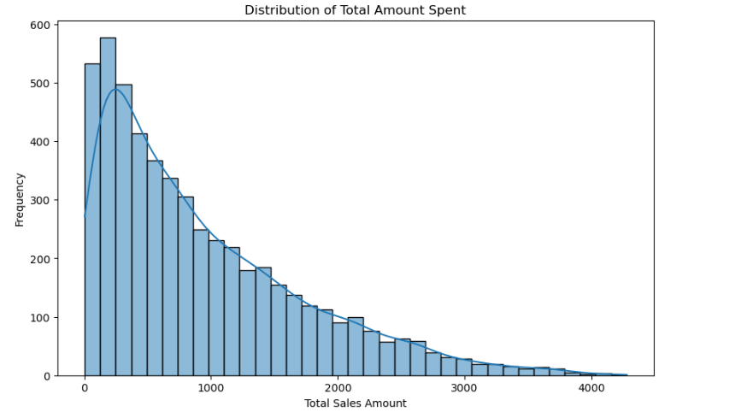
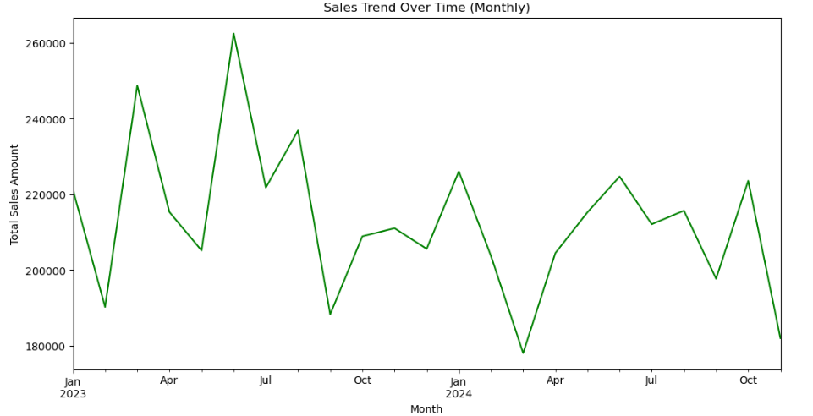
Exploratory Data Analysis (EDA) & Visualizations
Data Cleanup: Handling missing values, duplicates, outliers.
Key Insights:
Distribution of Sales: Customer spending behavior and patterns.
Sales Over Time: Seasonal trends in revenue.

Slide 7
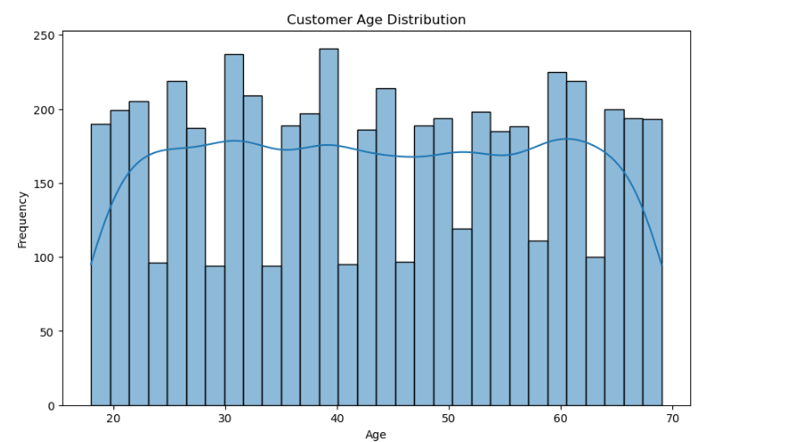
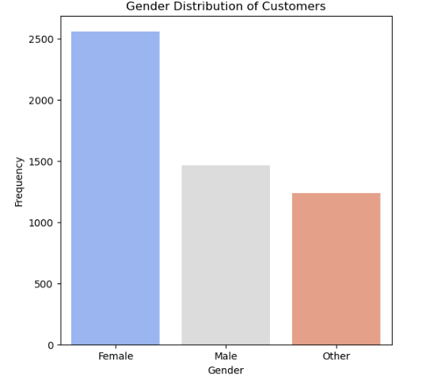
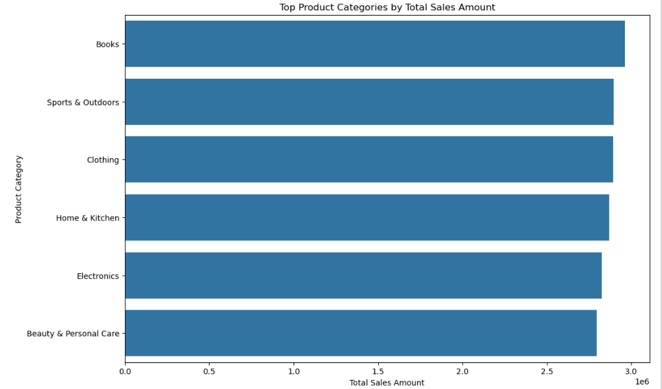
Exploratory Data Analysis (EDA) & Visualizations
Customer Demographics: Age & gender distribution
Top-Selling Categories: Highest revenue-generating product categories

Slide 8
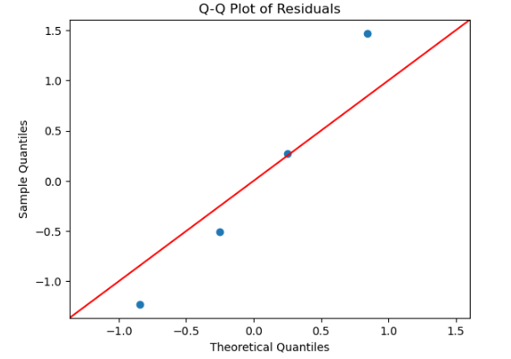
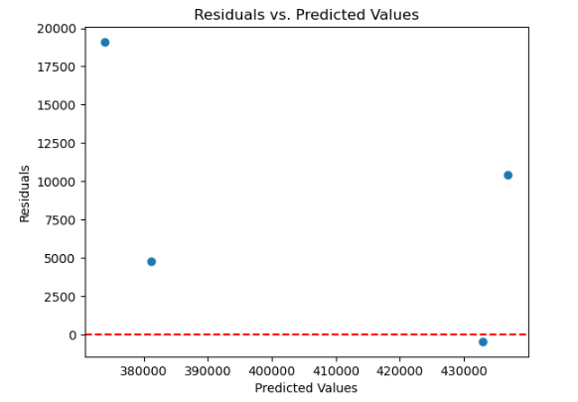
Predicting Sales Revenue (Regression Analysis)
Model Used: Linear Regression
Performance Metrics:
R² Score: 0.81 (81% variance explained)
MSE: 124,102,408.62
Regression Assumptions Checked: Linearity, Multicollinearity (VIF analysis)
Key Takeaways: Revenue can be predicted with high accuracy, aiding inventory & demand planning

Slide 9
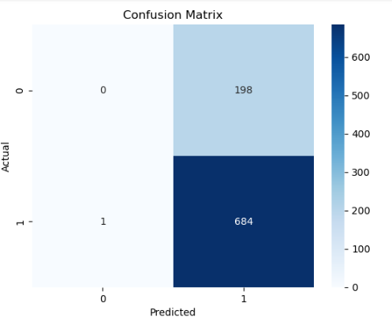
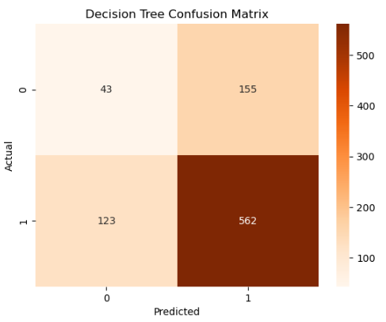
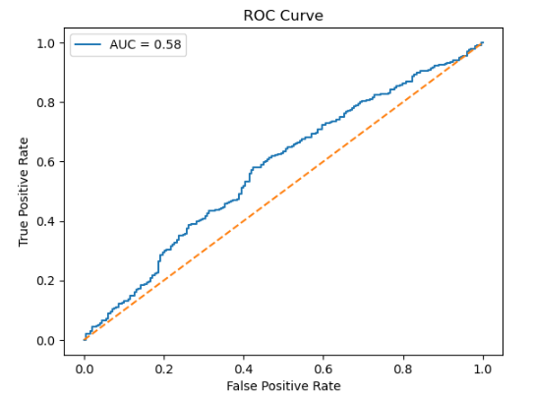
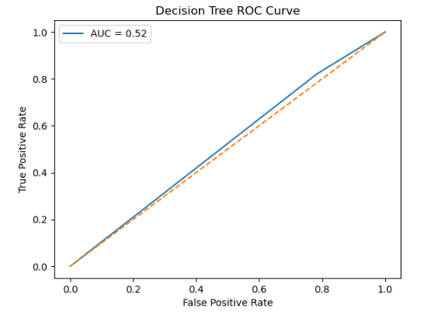
Predicting Customer Retention (Classification Analysis)
Models Compared: Logistic Regression vs. Decision Tree Classifier
Model | Accuracy (%) | Precision (%) | Recall (%) | F1 Score (%)
Logistic Regression | 77.46 | 77.55 | 99.85 | 87.30
Decision Tree | 68.52 | 78.38 | 82.04 | 80.17
Key Findings:
Logistic Regression outperforms Decision Tree in identifying at-risk customers (higher recall).
Businesses can use this model for targeted retention campaigns.

Slide 10
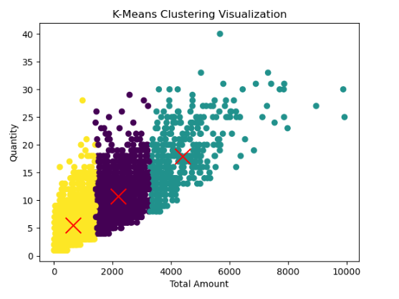
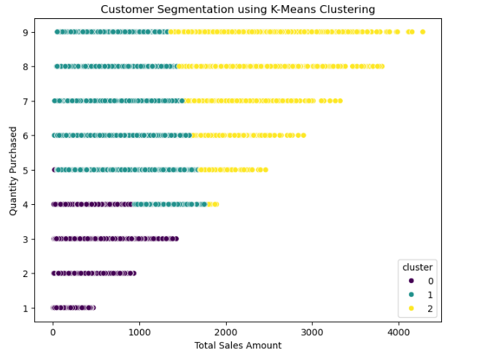
Customer Segmentation (Clustering Analysis)
Model Used: K-Means Clustering (3 clusters)
Evaluation Metrics:
Silhouette Score: 0.59 (Moderate cluster quality)
Inertia: 945,597,268.22
Business Impact:
Identified High-Value Customers: Helps with personalized marketing.
Segmented Low-Engagement Customers: Target retention efforts

Slide 11
Conclusion & Key Takeaways
Sales Forecasting: Regression model effectively predicts revenue, aiding business planning.
Customer Retention: Logistic Regression model accurately predicts churn, allowing proactive retention strategies.
Customer Segmentation: K-Means clustering groups customers into distinct buying behaviors, supporting targeted marketing.

Slide 12
Recommendations & Business Applications
Optimize inventory based on revenue predictions.
Develop targeted marketing campaigns for high-value customers.
Use customer segmentation to create personalized offers and reduce churn.

Slide 13
References
Kaggle. (2020). Online retail data. Kaggle. https://www.kaggle.com/datasets/joaovicente/online-retail
Smith, J., & Brown, L. (2021). E-commerce trends in data analysis. Journal of Data Analytics, 12(3), 45-67. https://doi.org/10.1016/j.jda.2021.05.003
Stewart, R., & White, S. (2019). Data-driven decision making in retail (1st ed.). Retail Insights Press.
McDonald, A. (2020, July 15). Using machine learning for sales forecasting. DataScience.com. https://www.datascience.com/sales-forecasting-ml

Slide 14
Thank You

