Slide 1

INCOGNIT

Slide 2
ALUMNI TRACKING SYSTEM
Organization Name : Government Of GOA.
Problem Statement : The Directorate of Higher Education has 7 Government Colleges and 26 aided colleges under it. Altogether, more than 10000 students that pass out from them every year either choose to opt for further studies, work or have their own startups. Currently, there is no mechanism for the colleges and the Directorate to keep a track of the students passing out. Hence, the problem is to develop a web based application for colleges and the Directorate to keep a track of the Alumni. The said application should have the following features :-
(a) allow the Alumni members to register themselves
(b) allow colleges to verify and authenticate their registered alumni
(c) provision for alumni members to update their details
(d) allow the colleges to search details based on criteria such as year, subject, etc.
(e) allow the Directorate to search details based on criteria such as colleges, year, subject, etc.
(f) send messages and emails to alumni members
(g) group chats, create events, publish notices on the portal
(h) Security features with login for every user.
Problem Statement Code : DR111
Team Leader Name : Darsh Patel
College Code : 1-3509532580

Slide 3
Alumni Tracking System
Alumni Tracking System is an online application which can act as a interactive medium between the old students and the School, College, University or institution.
An Alumni Tracking System is a web-based application which helps the institutions to track old students for future endeavors.
At the same time it helps the alumni to communicate with the institution, maybe a school, or college or a university and with the old batch mates.
The Main Goal of Alumni Tracking System is to strategically build and maintain their alumni network, by facilitating engagement, community-building, networking, communications and many other functionalities.

Slide 4
IDEA / APPROACH DETAILS
The Idea is to develop a web based application which provides a mechanism to manage the alumni.
We need to build provision for :
1. Alumni
A Student of a College Who had Completed Any Course From Particular College.
2. College
A College Which is Approved By Government Of Goa.
3. Directorate of Higher Education (By Govt. Of Goa)
An Organization / Association Which Manages All The Matters Related to Education In Goa.

Slide 5
[ Overall Diagram ]
Request for verification of college
Colleges
Response
Association Sends Response Of Verification
Alumni
If college
registered
[ Got Activation Link ? ]
System
Sends Activation
Link
College Registration
Directorate of
Higher
Education
Add Alumni with bulk registration with excel Sheet
Activate & Register Account
YES
Verified
Colleges can
Registration & verification of Alumni (Manually)
NO
Verified
Directorate of
Education
can
Verified
Alumni can
create groups chat/networks.
Write blog post , create events & Publish notices
search details based on criteria such as colleges, year, subject, etc.
create post in blog section.
Search details based on criteria such as year , subject etc.
post a jobs
create post in blog , publish news & events
interact with alumni recruiters , college
Monitor the activities carried out by alumni
Manage fundraising projects
Send regular updates by SMS & email to alumni
Request for fundraising projects
Grant Fund Raising Projects For Request To Association
Manage Inquiries & feedback.
Request For Alumni Services Like LOR , Degree Request etc
Sending Regular Updates By SMS & Email To Colleges

Slide 6
PROVISION FOR ALUMNI
The Following Functionalities Will be Provided To Alumni :
Registration of Alumni.
Alumni can be registered in two ways :
By College :
Manual Registration :
System
College
1. College Adds Alumni Details
2. System Sends A Verification Email
Alumni
3. Alumni Verifies Email , Mobile No. & Registration Details
3. Alumni got registered.
System
[ YES ]
Alumni
1. Alumni Registers on portal
Record Found ?
[ NO ]
College
3. Application Reviewed
By College
2. System Checks For
Alumni Records

Slide 7
PROVISION FOR ALUMNI
Allow alumni to create networks , groups for a chat.
To share new endeavors to specific people alumni can create networks.
For the discussion purpose alumni can create various groups.
Update Alumni’s profile.
It Will help alumni to update his/her basic information , contact information , education , work experience , networks/groups , expertise & skill information which will help him to find their job according to their interest.
Create a post in his/her blog section.
This will help alumni to share their innovative ideas , research information & thoughts on particular topics & reports on new emerging technologies.
Find Other Alumni On Portal.
Alumni can find his/her batch mates & other alumni with search filters like username , college , pass out year , subject & advanced search filters like maps & directory to search the alumni.

Slide 8
PROVISION FOR ALUMNI
Create Polls For Opinions.
Alumni can create polls by asking questions & providing relevant options for the poll to know the opinions , views on various topics.
Post Jobs On The Portal.
If Alumni owns business or alumni is doing the job in company & needs employees for a particular job then he/she can create job for particular position.
once the job posted in the portal then he/she can get the statistics about how many people have seen this, how many people are applied for this job , how many are interested & how many aren’t interested.
Communicate With College.
Alumni can communicate with the college for Alumni Services As Following :
Transcript
LOR (Letter of Recommendation)
Degree Request
Business Promotion
Campus Visit

Slide 9
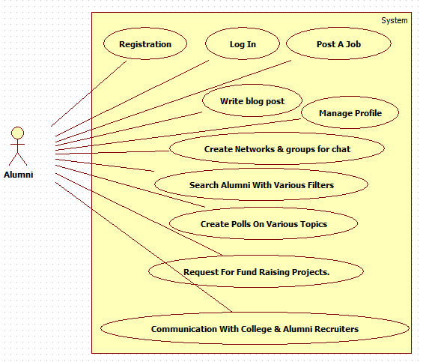
PROVISION FOR ALUMNI
Interact With Alumni Recruiters.
Alumni can send message to the respective recruiter who has posted a job for alumni regarding job application.
Request For Fund-Raising Projects.
If Alumni is working on a research project or any other type of project & needs fund then he/she can request for funds to the college.

Slide 10
PROVISION FOR COLLEGES
First of all The College SPOC have to do registration with required documents & then college can perform following functionalities :
Register , Verify & Authenticate Alumni.
Colleges can do Bulk Registration of alumni in the single click By Providing Necessary Details As Mentioned in Excel Sheet.
If Alumni Doesn’t Get The Activation Link Then Alumni can do manually Registration & colleges will verify the alumni details & authenticate the alumni.
Create Events.
Colleges can create events like Annual Meet , Reunions , Homecomings, Chapter Meet-ups for alumni.
Alumni can book the event’s tickets online from the portal.
Search Alumni.
College can find alumni with search filters like username, pass out year , subject & advanced search filters like maps & directory to search the alumni.

Slide 11
PROVISION FOR COLLEGES
Write Blog Post.
It allows colleges to share their achievements , awards , prestigious memories , reports on their industrial visits & activities etc.
Monitor polls , blog posts & job applications of alumni.
It is Necessary for college to manage all the activities carried out by alumni. So for that college can block/unblock the alumni on the portal that means alumni’s polls & blog posts are no longer available on the portal.
Manage Different Alumni Services.
Once the request is received for LOR(Letter of Recommendation) , Transcript , Degree Request then it will be managed by the colleges & response will be sent to alumni by Email & SMS.
Manage Fund-Raising Projects.
Once the request is received for fund raising project then college will verify it & if it is valid then this request will be passed to the Directorate of Higher Education.

Slide 12
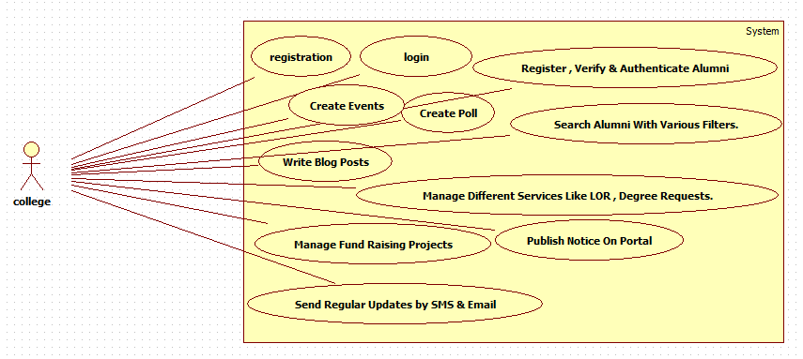
PROVISION FOR COLLEGES
Publish Notices on the portal.
Colleges can create notices on the portal regarding Fee collection , Holiday etc.
Send Regular Updates to Alumni.
Colleges Can Send Job Opportunities , Upcoming Events , News etc to alumni by Email & SMS.

Slide 13
PROVISION FOR DIRECTORATE OF HIGHER EDUCATION (By Govt. Of GOA)
The Following Functionalities Will be Provided To The Directorate of Higher Education or Alumni Association:
Search Colleges & Alumni On Portal.
Directorate of Higher Education can search details based on criteria such as colleges , year , subject & advanced search filters like maps & directory to search the alumni.
Create Discussion / Polls For Opinions.
Directorate of Higher Education can create polls by asking questions & providing relevant options for the poll to know the opinions , views on various topics.
For the discussion Directorate of Higher Education can create a thread for discussion.
Write a blog post , publish news & create events.
Directorate of Higher Education can share their achievements , awards , prestigious memories , reports on their international papers & activities etc By Writing Blog post.
Directorate of higher education can publish news on researches , latest technology trends etc.
Directorate of higher education can create events like central Annual Meet , Reunions , Homecomings, Chapter Meet-ups for alumni & Alumni can book the event’s tickets online from the portal.

Slide 14
PROVISION FOR DIRECTORATE OF HIGHER EDUCATION
Manage Fund-Raising Projects.
Once the Fund-Raising Project Request comes then it is going to be reviewed by the expert jury then the requested fund is granted or rejected.
Once it is granted then all the alumni of various colleges can donate to the project.
Monitor All the Activities carried out by all alumni &colleges.
Directorate of Higher Education can monitor all the activities & if any suspicious activity found then it can suspend the alumni or college.
Inquiry , Feedback manager & Contact Support.
Directorate of Higher Education manages the inquiry made by alumni.
Alumni can share their feedback & feedback will be received to the Directorate of Higher Education for further improvement.
Directorate of Higher Education Provides Contact support for any assistance.
Send Regular Updates To Colleges.
Directorate of Higher Education sends Updates Regarding Central Events , News & further endeavours to colleges by Email & SMS.

Slide 15
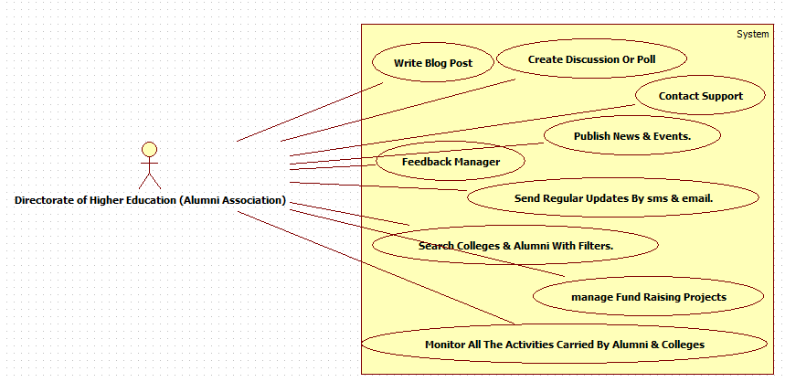
PROVISION FOR DIRECTORATE OF HIGHER EDUCATION

Slide 16
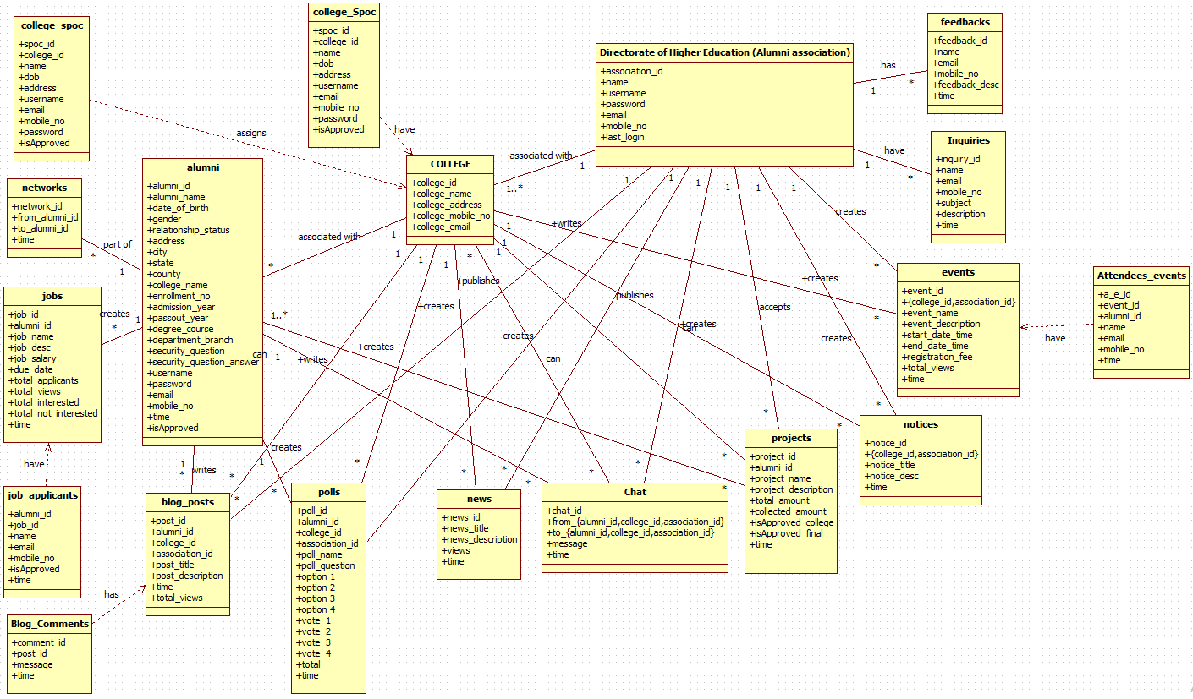
[Class Diagram]

Slide 17


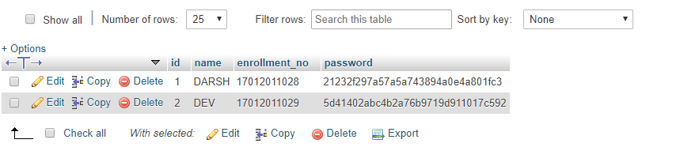
Out Of This :
For The Security Purpose, We Will Add and Image Captcha and Google reCAPTCHA service that protects us from spam. It uses advanced risk analysis techniques to tell humans and bots apart.
To Save Passwords In Database We Can Use One Of The Hashing or Encryption-Decryption Algorithms Like MD5 , SHA256 , AES , DES etc.
ex. MD5
If Any Suspicious Activity Found Then A Security Question Will be Asked that has been provided during the registration. If answered successfully then & then he/she will be able to continue otherwise redirected to home.

Slide 18
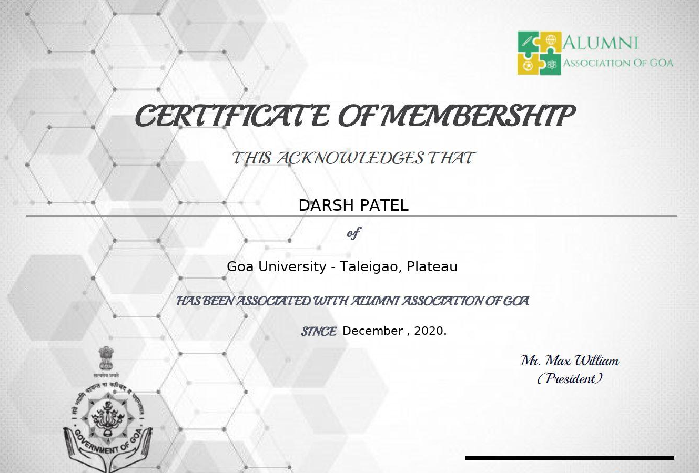
UNIQUENESS
Digital Certificates for Alumni.
Once the Alumni Registers & got verified & authenticated by the system then a Digital Certificate Will be Issued to alumni for being part of the Portal/System. Late on it will also help alumni recruiters to verify the alumni.

Slide 19
UNIQUENESS
Fund-Raising Projects.
Effortlessly Keeping Track of Alumni.
Open Discussion Forum.
Send Targeted Communication.
Improved Security With Google reCAPTCHA & Image Captcha.
ChatBot For Support.
Local Language Support (By Google).
One Click Login Support With Google , Facebook etc.

Slide 20
Technology Stack
For The Successful Implementation The Following Technologies Will be Used :
HTML
CSS
JavaScript
Ajax
jQuery
Python (Flask)
API , Frameworks & Libraries For Different Services
Database (MySQL)

Slide 21
THANK YOU !

