Slide 1


Slide 2
Alumni Tracking System
In General, Alumni Tracking System is an online application which can act as an interactive medium between the old students and the School, College, University or institution.
But In Context To P.S, It Will Be 3 Layer Architecture Model Which Involves ,
Alumni From Different Colleges Of Goa.
College SPOCs From Various Colleges.
Directorate Of Higher Education (DHE) Members.
The Main Goal of Alumni Tracking System is to strategically build and maintain their alumni network, by facilitating engagement, community-building, networking & communications.

Slide 3
OUR IDEA / APPROACH

Slide 4
Request For Verification Of College SPOC
Colleges
Response
DHE Sends Response Of Verification
Alumni
If college
spoc
registered
[ Got Activation Link ? ]
Alumni Tracking System
Sends Activation
Link
College Registration
Directorate of
Higher
Education
Add Alumni with bulk registration with excel Sheet
Activate & Register Account
YES
Verified
College
SPOC can
Registration & verification of Alumni (Manually)
NO
Verified
Alumni can
Verified
DHE Member
can
create groups chat/networks.
Write blog post , create events & Publish notices
search details based on criteria such as colleges, year, subject, location, etc.
create post in blog section.
Search details based on criteria such as year , subject etc.
post a jobs
create post in blog , publish news & events
interact with alumni recruiters , college
Create Polls For Opinions
Manage fundraising projects
Send regular updates by SMS & email to alumni
Request for fundraising projects
Grant Fund Raising Projects For Request To
DHE
Manage Inquiries & feedback.
Request For Alumni Services Like LOR , Degree Request etc
Sending Regular Updates By SMS & Email To Colleges

Slide 5
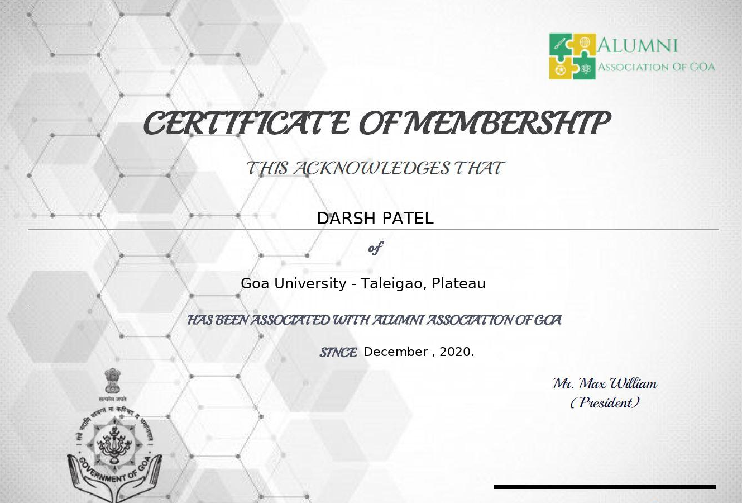
MAKE A DIFFERENCE
The Following Functionalities Make this Alumni Tracking System Extra-Ordinary compare to the other Ordinary Alumni Tracking System :
Digital Certificates for Alumni.
[Alumni Certificate]

Slide 6
UNIQUENESS
Fund-Raising Projects.
Effortlessly Keeping Track of Alumni.
Open Discussion Forum.
Send Targeted Communication.
Improved Security With Google reCAPTCHA & Image Captcha.
ChatBot For Support.
Local Language Support (By Google).
One Click Login Support With Google , Facebook etc.

Slide 7
THANK YOU !

