Slide 1
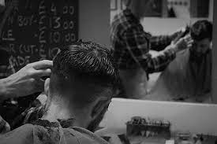
Project name :
Hair studio

Slide 2
Silver oak college of computer application

Slide 3
Subject name : INTERSHIP OJT
DIV:A
SEM: 2nd
Name: Patel Dev S.
Er: 2204030102222

Slide 4

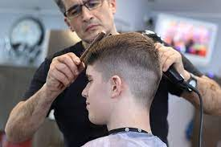
Get a Fresh Look with Our Haircut Services with

Slide 5
Introduction of the Company
Welcome to our hairstyle company, where we believe that everyone deserves to feel confident and beautiful in their own skin. We specialize in providing top-notch hairstyling services, ranging from trendy haircuts and stunning hair colors to luxurious hair treatments and extensions. Our team of professional hairstylists are dedicated to helping you achieve your dream hairstyle, whether it's a chic and edgy look or a classic and elegant style. We use only the best quality products and the latest hairstyling techniques to ensure that you leave our salon feeling happy and satisfied with your new look. Let us help you transform your hair and boost your confidence - visit us today☺

Slide 6
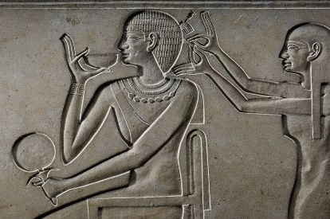
History of the haircut
The history of hairstyle companies shows how hair has always been an essential aspect of human expression and identity, and how the industry has adapted to changing trends and technologies over time

Slide 7

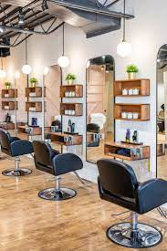
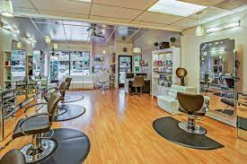
Images of the Salon

Slide 8
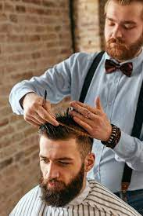
Haircut Services for Men and Women
Men
Hair cut
Hairstyle
Facial
Hair color
Beard cut

Slide 9
Thank you

