Slide 1
Car Diagnosis
Dhiren Patel (dhirenbh)
Prithvi Shah (pshah7)
Notes:
<number>

Slide 2
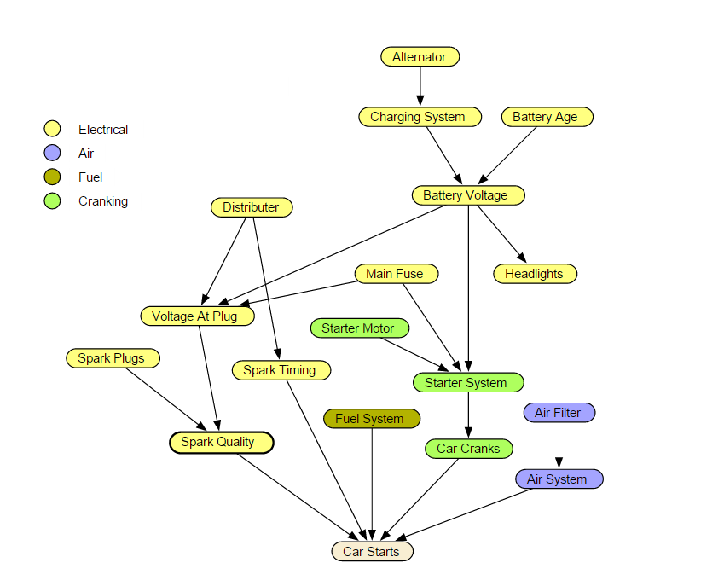

Slide 3
Nature of CPDs : Hybrid (Tabular and Tree based)
All Variables are discrete in given dataset.
The parameters have been determined from the raw data:
https://www.norsys.com/netlibrary/
Sample Variable Details:
Alternator: two level factor (okay, faulty)
Charging System: two level factor (oay, faulty)
Main fuse: two level factor (okay, blown)
Battery age: three level factor (new, old, very old)
Distributor: two level factor (okay, faulty)
Starter Motor: two level factor (okay, faulty)
Battery Voltage: three level factor (strong, weak, dead)

Slide 4
Some sample queries that could be made on the network are:
p(Distributor=faulty|Car Starts=false, Spark Plugs=okay)
p(Battery Age=Old|Starter System=faulty, Car cranks=true)
Proposed Inference Algorithm to be used:
1) Clique Tree Algorithm
2) Gibbs Sampling

