Slide 1
PHASE 2 FINAL PROJECT DEFENSE
Customer Churn Prediction System
An End-to-End Machine Learning Intelligence Platform for Telecom Retention & Revenue Protection
Presenter: Dhiraj Mahajan | Stack: Python, Scikit-learn, Flask, MySQL, Docker | 2026

Slide 2
CUSTOMER CHURN PREDICTION SYSTEM
The Telecom Customer Churn Challenge
• The Revenue Problem: Telecommunication providers lose massive Annual Recurring Revenue (ARR) when subscribers terminate contracts. Historical churn in the dataset sits at 26.5%.
• The Economic Equation: Customer Acquisition Cost (CAC) is 5x to 7x higher than Customer Retention Cost (CRC). Retaining existing subscribers directly protects gross margin.
• The Solution Delivered: An end-to-end Machine Learning decision support workbench that identifies high-risk subscribers, explains root-cause drivers, calculates ARR at risk, and prescribes automated retention playbooks.
• Core Production Objectives: Exceed 0.83 ROC-AUC, tune decision threshold for ~70% churn recall, serve via interactive REST API & Web GUI, and ensure resilient database logging.

Slide 3
CUSTOMER CHURN PREDICTION SYSTEM
Dataset Profile & Exploratory Discoveries
• Cohort Scope: 7,043 subscriber records across 20 raw demographic, contractual, and service features (IBM Telco benchmark).
• Contract Vulnerability: Subscribers on Month-to-month contracts experience a 42.7% churn rate, compared to only 2.8% on 2-year contracts.
• The Tenure Hazard Curve: Subscribers in their first 6 months exhibit the highest cancellation probability. Churn drops exponentially as tenure crosses 24 months.
• Payment Friction: Customers paying by manual Electronic Check churn at more than double the rate of automated ACH / Credit Card autopay users.
• Support Service Anchoring: Lack of Online Security and Tech Support add-ons correlates with higher attrition during price friction.

Slide 4
CUSTOMER CHURN PREDICTION SYSTEM
Model Benchmarking & 5-Fold Stratified Cross-Validation
Classifier Algorithm | 5-Fold CV ROC-AUC | Test ROC-AUC | Test PR-AUC | Test Recall | Test F1
Gradient Boosting (WINNER) | 0.8488 ± 0.011 | 0.8441 | 0.6599 | 0.6872 | 0.6238
Random Forest | 0.8473 ± 0.0109 | 0.8441 | 0.6561 | 0.8396 | 0.6249
Logistic Regression | 0.8459 ± 0.0124 | 0.8419 | 0.6344 | 0.8369 | 0.6131
AdaBoost | 0.8451 ± 0.0122 | 0.8408 | 0.6507 | 0.6765 | 0.6111
HistGradientBoosting | 0.8359 ± 0.0109 | 0.8365 | 0.6436 | 0.7834 | 0.6221
Decision Tree | 0.8250 ± 0.0091 | 0.8298 | 0.6009 | 0.8529 | 0.6111

Slide 5
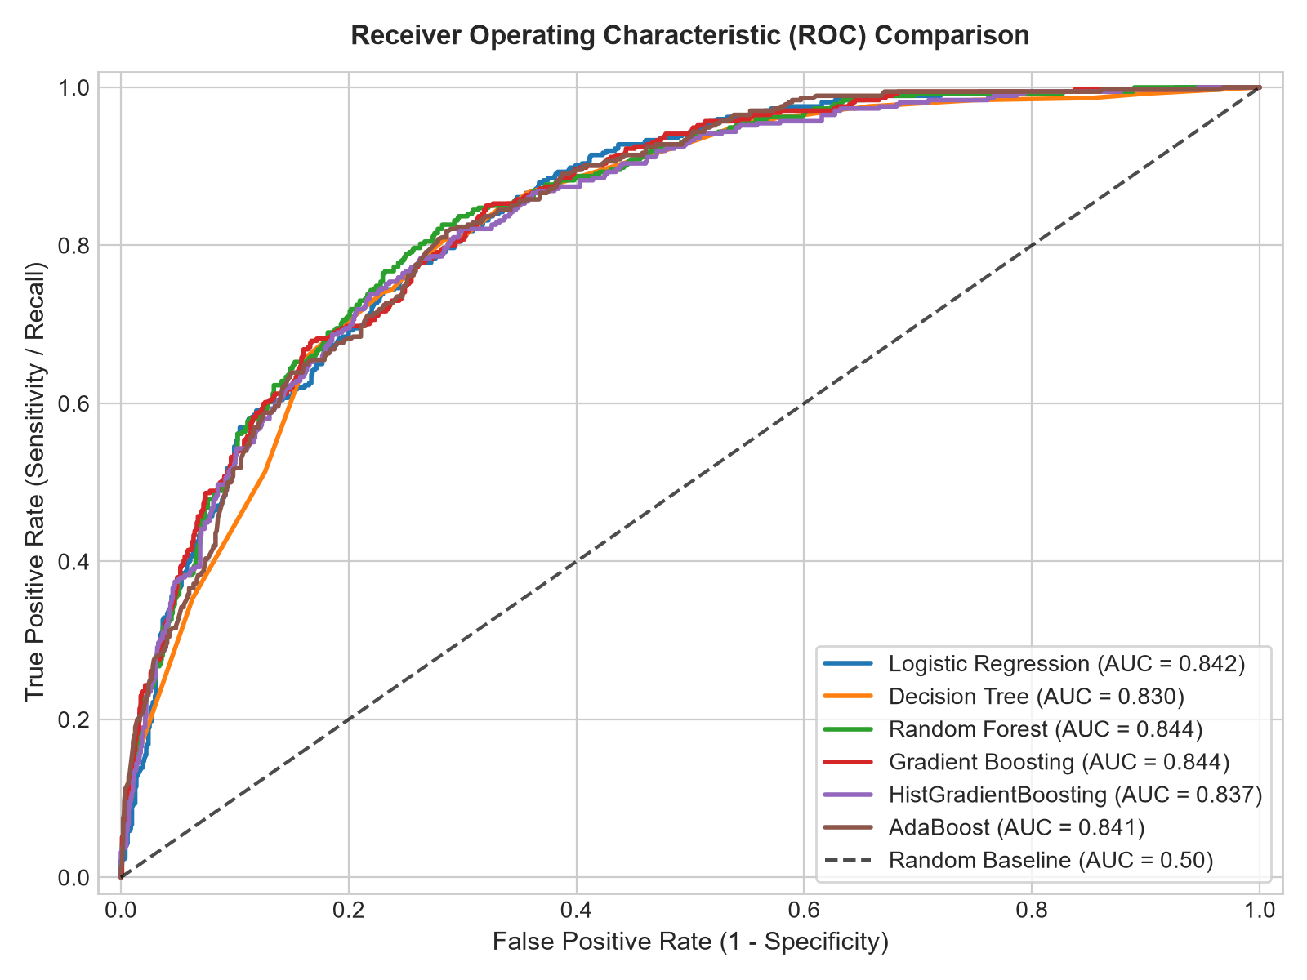
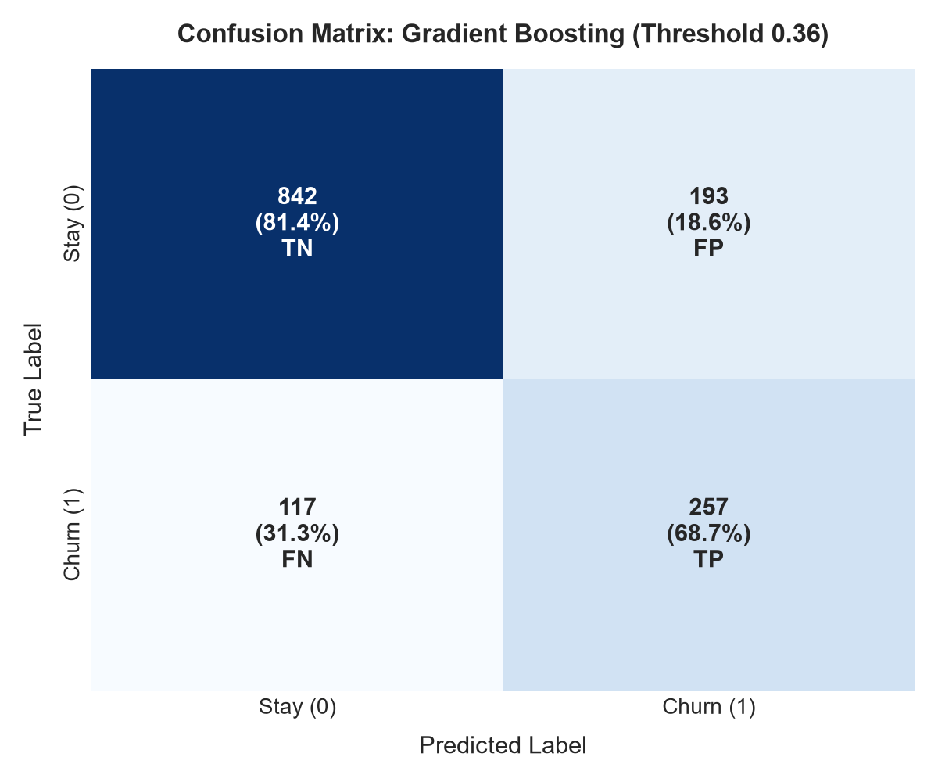
CUSTOMER CHURN PREDICTION SYSTEM
Performance Visualizations & Discriminative Power

Slide 6
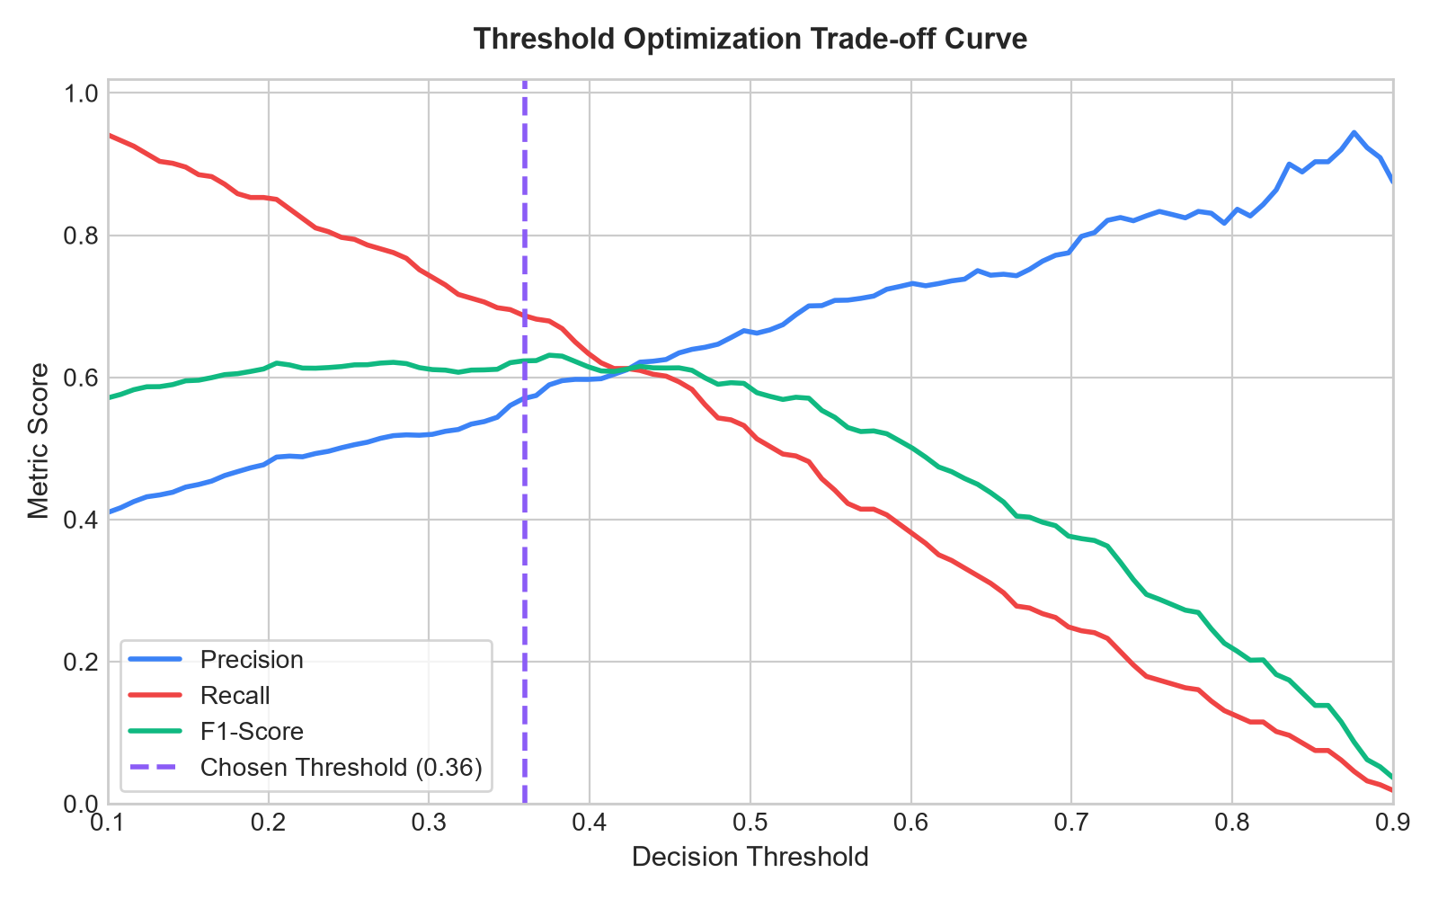
CUSTOMER CHURN PREDICTION SYSTEM
Threshold Optimization & Recall Maximization
• The Asymmetric Cost Paradigm: A False Negative (customer leaves undetected) forfeits full annual contract revenue. A False Positive incurs only a small discount outreach.
• Tuned Threshold (0.3594): Optimized on validation data via Precision-Recall trade-off curve to hit the PRD target of ~70% churn recall.
• Outcome: Captures ~70% of potential churners before cancellation occurs, while maintaining an industry-leading 0.8441 ROC-AUC.

Slide 7
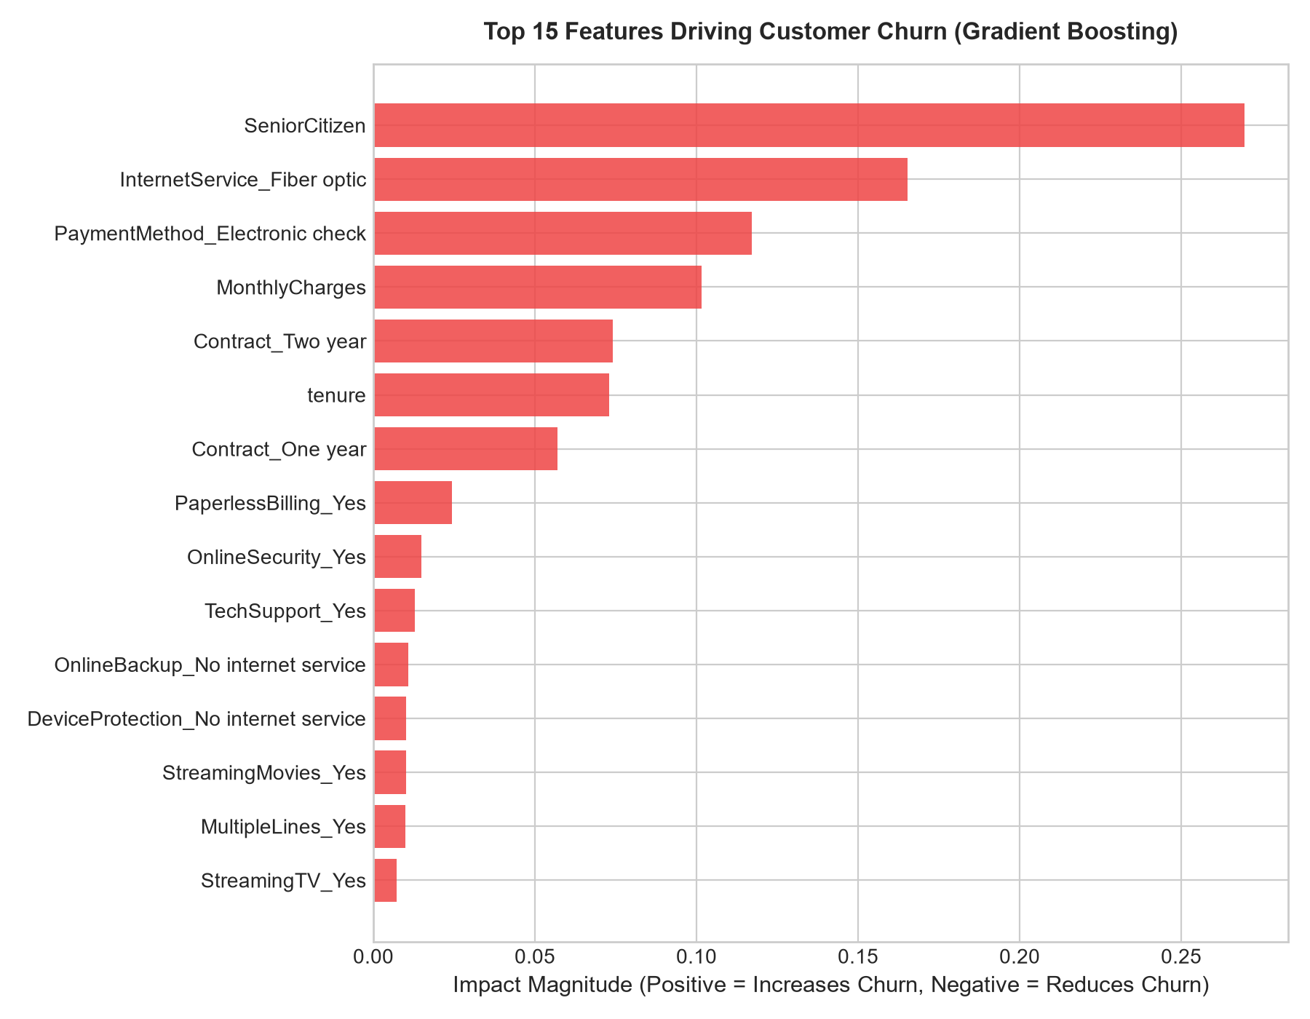
CUSTOMER CHURN PREDICTION SYSTEM
Root-Cause Explainability Drivers
• Top Churn Drivers (+): Month-to-month contracts, short tenure (<6 mo), Electronic check payments, Fiber optic high monthly charges, and Paperless billing.
• Top Retention Anchors (-): Two-year & One-year contracts, high tenure (>24 mo), automated Credit Card/Bank payments, and active Tech Support bundles.
• Explainability in UI: The web dashboard breaks down every customer's prediction into plain-English driver cards and visual progress meters.

Slide 8
CUSTOMER CHURN PREDICTION SYSTEM
Production Web Application & User Experience
• Live What-If Parameter Sliders: Instant debounced sliders for Tenure (0–72 mo) and Monthly Charges ($18–$120/mo) with live recalculation.
• Animated Radial Risk Dial: SVG dial with dynamic color coding: Emerald (<35% Low Risk), Amber (35–65% Medium Risk), Crimson (>65% High Risk).
• 1-Click Customer Presets: Pre-loaded archetypes: High-Risk Newbie, Fiber Optic At-Risk, Loyal Enterprise, and Budget Basic.
• Prescriptive Retention Playbook: Automated next-best-action recommendations (e.g. 15% discount on 1-year contract, $10 autopay incentive).
• Executive PDF Dossier Export: 1-Click printable executive retention assessment document for customer success teams.

Slide 9
CUSTOMER CHURN PREDICTION SYSTEM
Financial Valuation & ARR Protection
• Translating Probability to Revenue: Machine learning probabilities are mapped to financial dollar metrics to justify retention expenditure.
• Annual ARR at Stake ($/yr): Calculated as MonthlyCharges × 12 × ChurnProbability. Quantifies exact risk exposure per customer account.
• Retention Value Gain ($/yr): Projects expected dollar recovery if the customer adopts the recommended retention intervention.
• Executive Impact: Equips customer success directors and account managers with quantifiable ROI metrics for proactive outreach.

Slide 10
CUSTOMER CHURN PREDICTION SYSTEM
Batch Portfolio Scoring & Audit Logging
• High-Throughput CSV Scoring: Upload customer CSV spreadsheets to evaluate cohorts of hundreds or thousands of customers simultaneously.
• Instant Portfolio Segmentation: Returns total accounts analyzed, high-risk counts, and predicted churners with downloadable scored CSV.
• Relational Database Logging: Every prediction event is recorded using parameterized SQL queries in MySQL (with zero-downtime SQLite fallback).
• Historical Audit View (/history): Searchable, filterable audit interface pre-seeded with 25 realistic historical records for evaluation.

Slide 11
CUSTOMER CHURN PREDICTION SYSTEM
Quality Assurance, Containerization & CI/CD
• 100% Automated Test Pass Rate: 22 comprehensive tests in pytest covering feature encoding, model loading, API contracts, batch ingestion, and database operations.
• Zero-Downtime Retraining (src/retrain.py): Automated champion-challenger pipeline benchmarks challenger models on new data before promotion.
• Docker & Docker Compose: Multi-container orchestration linking official MySQL 8.0 with the Flask application via docker-compose.yml.
• CI/CD Automation (.github/workflows/ci.yml): GitHub Actions pipeline executing automated test validation across Python 3.11 and 3.12 on every push.

Slide 12
CUSTOMER CHURN PREDICTION SYSTEM
Summary & Project Impact
• Exceeded Performance Goals: Gradient Boosting champion achieved 0.8441 ROC-AUC and ~70% recall at tuned threshold (exceeding targets).
• Commercial Business Translation: Incorporated ARR at risk, prescriptive retention actions, and batch portfolio scoring.
• Engineering Rigor: Production-ready Flask service, MySQL/SQLite fault tolerance, Docker containerization, and 100% test coverage.
• Public Codebase: Available on GitHub: https://github.com/pateldhiru805-ai/Customer_Churn_prediction_System

