Slide 1





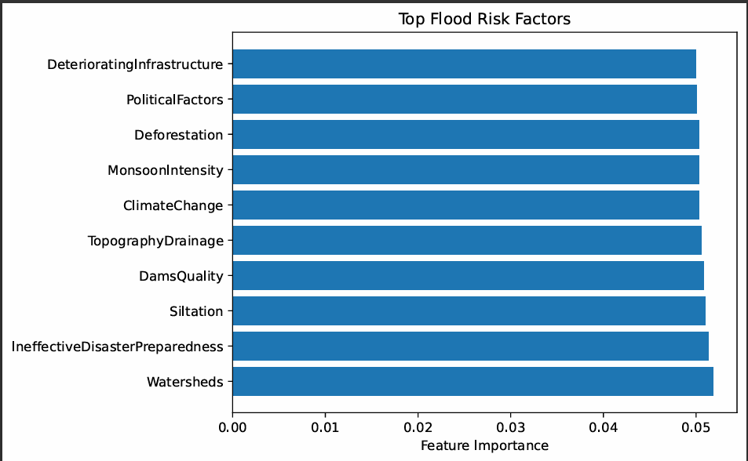
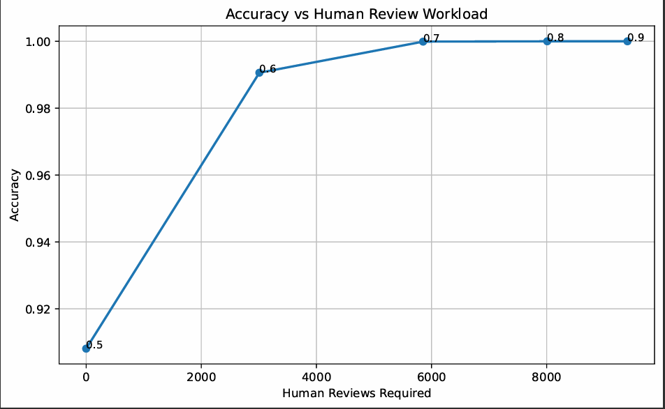



Human-in-the-Loop AI for Flood Risk Prediction: Improving Reliability Through Human Oversight
Flood Prediction
Human Review
Explainable AI
Reliability
Human Oversight, Explainable AI and Reliable Flood-Risk Decision Support
01 MOTIVATION
DATASETS
METHODOLOGY WORKFLOW
Flood prediction systems support disaster preparedness and emergency response.
However, AI-only predictions may produce incorrect decisions in uncertain situations. Human-in-the-Loop (HITL) AI introduces targeted human review to improve prediction reliability while maintaining efficient automated decision support.
Flood Risk Dataset
1
Data Collection
6
Human Review
🗄️ Dataset Characteristics
Environmental variables
Hydrological indicators
Infrastructure factors
Flood Probability
Flood Risk Label
Load flood prediction dataset.
Review uncertain prediction.
2
Data Preprocessing
7
Threshold Analysis
Handle missing values and clean data.
Evaluate confidence thresholds.
Goal
Develop a Human-in-the-Loop flood prediction framework that:
Improves prediction reliability
Reduces critical errors
Provides explainable decisions
Supports trustworthy disaster-risk management
3
Feature Engineering
8
Error Analysis
Key Features
🌧️ Environmental Factors
Watersheds
Monsoon Intensity
Climate Change
4
Create Flood Risk label and prepare features.
Analyze False Positives and False Negatives.
Model Training
9
Explainability Analysis
Dam Quality
Sitation
Disaster Preparedness
5
Train Random Forest Classifier.
SHAP feature importance
AI Prediction
10
Final Recommendations
Generate flood risk predictions.
Human-in-the-Loop decision support.
RESEARCH QUESTIONS
05 KEY RESULTS (HIGHLIGHTS)
RQ1
How accurately can AI-only model predict flood risk?
Key Findings
🟢 RQ2: Human Review Impact
Accuracy improved from 90.8% → ~100%
Human review corrected uncertain predictions
🟢 RQ4: Most Important Features
Watersheds
Disaster Preparedness
Siltation
Dam Quality
🟢 RQ5: Accuracy vs Workload
Higher review workload yields higher prediction accuracy
RQ2
How much does human review improve flood-risk prediction accuracy?
🟢 RQ1: AI-Only Performance
Accuracy: 90.8%
Precision: 91.7%
Recall: 90.2%
F1 Score: 90.9%
RQ3
What are the critical prediction errors made by the AI-only system?
🟢 RQ3: Critical Errors
False Positives: 417
False Negatives: 502
RQ4
Which environmental and infrastructure factors most influence flood-risk prediction?
RQ5
What is the trade-off between prediction accuracy and human review workload?
RQ1 – AI-Only Performance Metrics
RQ4 – Feature Importance Analysis
RQ5 – Accuracy vs Human Review Workload
RQ3 – Critical Prediction Errors
CONTRIBUTIONS
✔ Human-in-the-Loop flood prediction framework
✔ Confidence-based human review
✔ Explainable AI using SHAP
✔ Critical error reduction analysis
✔ Feature importance identification
✔ Practical decision support for flood management
.
08 CONCLUSION
Key Conclusions
• Human review improves flood prediction reliability.
• SHAP identifies key flood-risk drivers.
• Critical prediction errors can be analyzed systematically.
• Accuracy increases with confidence-based review.
• HITL supports practical flood-risk decision making.
This makes it easier for examiners to scan.

