Slide 1
NORTHEASTERN UNIVERSITY
Capstone · Mid-Term Presentation
Exploring Global Seaweed Production
Seaweed Industry
with an Interactive Dashboard & AI Chat
Team: Dhruvkumar · Devarsh · Deepkumar · Darshil · Poe
Live demo: seaweed-industry.vercel.app
Data + AI
Data: FAO global seaweed tables
Seaweed Industry · Capstone Mid-Term
1 / 28
Notes:
Good morning everyone. Thank you for being here. I'm presenting our capstone mid-term: the Seaweed Industry project. Over the past several weeks, our team has explored the global seaweed dataset from the FAO and built two things on top of it — an interactive dashboard with twelve tabs, and an AI chat that lets anyone ask questions in plain English. The live link is on this slide, and I'll walk you through what we built, what we found, and where we're headed next.

Slide 2
EXECUTIVE SUMMARY
What we built, in one minute
● Company / context: PSIA Pacific States Industry Association seaweed data exploration.
● Problem: The FAO publishes rich global seaweed data, but it's stored across four large CSV tables that are hard for non-technical stakeholders to explore.
● Our solution: A web app with two surfaces (1) a 12-tab interactive dashboard, and (2) "PSIA AI", a natural-language chat that turns plain English into SQL and answers your question with data.
● Impact: Anyone analyst, sponsor, researcher can answer market questions in seconds without writing code or SQL.
● Status: Live at seaweed-industry.vercel.app
AT A GLANCE
12 dashboard tabs
5 KPI lenses
1 AI chat (text-to-SQL)
4 FAO tables
5 team members
Seaweed Industry · Capstone Mid-Term
2 / 28
Notes:
Here's the project in one minute. The Food and Agriculture Organization publishes seaweed production and value data going back decades, across four separate CSV tables. The data is great, but it's hard to explore without SQL skills. So we built two things. First, a twelve-tab interactive dashboard that visualizes the data across geography, species, economics, and several KPIs. Second — and this is the part we're most excited about — we built PSIA AI, a chat interface where you can type a question in plain English and it generates SQL, queries the data, and shows you the answer. The whole thing is live right now at seaweed-industry.vercel.app. On the right you can see the scale: twelve tabs, five KPIs, one AI chat, four tables, five teammates.

Slide 3
THE TEAM
Who built what
D
Dhruvkumar Patel
EDA, preprocessing, DuckDB schema, 12-tab React dashboard, FastAPI backend, Text-to-SQL pipeline, embeddings & few-shot retrieval, chat UI, deployment, testing, docs.
Technical Lead (full-stack)
D
Devarsh
Validates FAO source records. Owns Export Value of Seaweed Products ($/year) and Companies Founded (by End Use).
Data Prep & KPI Owner
D
Deepkumar
Handles missing values and status-flag rules. Owns Price per Wet Tonne by Species and End Use ($/tonne).
Data Prep & KPI Owner
D
Darshil
Normalizes fields across the four FAO tables. Owns Wet vs. Processed Kelp Demand and Gross Value of Seaweed Industry Output ($/year).
Data Prep & KPI Owner
P
Poe
Cross-checks aquaculture vs. capture aggregates. Owns Value of Seaweed ($/lb).
Data Prep & KPI Owner
Seaweed Industry · Capstone Mid-Term
3 / 28
Notes:
Quick team intros. I'm Dhruvkumar — I'm the technical lead and have owned the full-stack work: EDA, preprocessing, the DuckDB schema, the twelve-tab React dashboard, the FastAPI backend, the text-to-SQL pipeline including embeddings and few-shot retrieval, the chat UI, deployment, testing, and the docs. Devarsh validates FAO source records and owns the Export Value KPI plus Companies Founded by End Use. Deepkumar handles missing values and status-flag rules; he owns the Price per Wet Tonne KPI. Darshil normalizes fields across the four FAO tables and owns Wet vs. Processed Kelp Demand and Gross Value of Industry Output. And Poe cross-checks aquaculture against capture aggregates and owns the Value per Pound KPI.

Slide 4
PROJECT OBJECTIVES
Five KPI lenses on global seaweed
Our goal: explore the FAO seaweed data through five KPI lenses and make those views accessible to non-technical users.
KPI 1
KPI 2
KPI 3
KPI 4
KPI 5
Export Value of Seaweed Products
Gross Value of Industry Output
Value of Seaweed
Price per Wet Tonne
Wet vs. Processed Kelp Demand
$ / year
$ / year
$ / lb
$ / tonne · by species & end-use
tonnes
How much economic value flows out of producing nations each year.
Total value generated by the sector: aquaculture + capture combined.
Unit economics what's a pound of seaweed worth?
How pricing varies across species and how the product is used.
Demand split between raw wet kelp and processed forms.
Seaweed Industry · Capstone Mid-Term
4 / 28
Notes:
Our project doesn't try to promise a hard business KPI. Instead, we picked five lenses to explore the data through. First, Export Value of Seaweed Products — how much economic value is flowing out of producing countries every year. Second, Gross Value of Industry Output — the combined value of aquaculture and wild capture. Third, Value of Seaweed per pound — the unit economics, basically what a pound of seaweed is worth. Fourth, Price per Wet Tonne, broken down by species and end use, so we can see how species and use cases drive pricing. And fifth, Wet versus Processed Kelp Demand — how the market splits between raw and processed kelp. Each KPI is owned by one team member, and the dashboard has a dedicated tab for each.

Slide 5
DATA SOURCES
Four FAO tables, loaded into an in-memory database
At app startup the backend loads four FAO CSV files into DuckDB. No external database — fast, simple, reproducible.
seaweed_aquaculture_quantity
Farming quantity (tonnes)
ALSO INCLUDED
PSIA documents
seaweed_aquaculture_value
Farming value (USD)
Industry briefing PDFs from PSIA, kept alongside the CSVs in /dataset for context and definitions.
seaweed_capture_quantity
Wild capture quantity (tonnes)
seaweed_global_production
Combined production (tonnes)
Seaweed Industry · Capstone Mid-Term
5 / 28
Notes:
All of our data comes from the FAO — the Food and Agriculture Organization of the UN. We use four tables: aquaculture quantity in tonnes, aquaculture value in dollars, wild capture quantity in tonnes, and a combined global production table also in tonnes. At app startup the FastAPI backend reads these four CSVs straight into DuckDB, which is an in-memory analytical database. There's no separate database server to manage and no network latency — queries are very fast. We also keep PSIA-published industry documents in the dataset folder for context on definitions and end-uses, though they're not queried by the dashboard.

Slide 6
METHODOLOGY
From raw CSV to a question, you can ask in normal basic language
01
02
03
04
Wrangle
Model
Visualize
Conversate
Clean FAO CSVs · normalize country & species · validate status flags
Load into DuckDB · build the schema · define joins
12 React tabs · Recharts + Plotly · KPI cards
Embed schema + few-shot examples · Groq LLM → SQL · summarize result
Two surfaces share the same data layer: the dashboard renders pre-built charts, while the AI chat generates SQL on the fly.
Seaweed Industry · Capstone Mid-Term
6 / 28
Notes:
Here's our pipeline in four steps. Step one — Wrangle. The team cleans the FAO CSVs, normalizes country and species names, and validates the FAO status flags. Step two — Model. The cleaned CSVs go into DuckDB at app startup, with a schema and join keys defined. Step three — Visualize. We built twelve React tabs using Recharts and Plotly. KPI cards summarize the headline numbers. Step four — Conversate. This is the AI chat. We embed the schema and a set of few-shot examples, send the user's question to a Groq-hosted Llama 70B model, get SQL back, run it on DuckDB, and then have the LLM summarize the result in plain English. The key insight: both surfaces — dashboard and chat — share the exact same data layer.

Slide 7
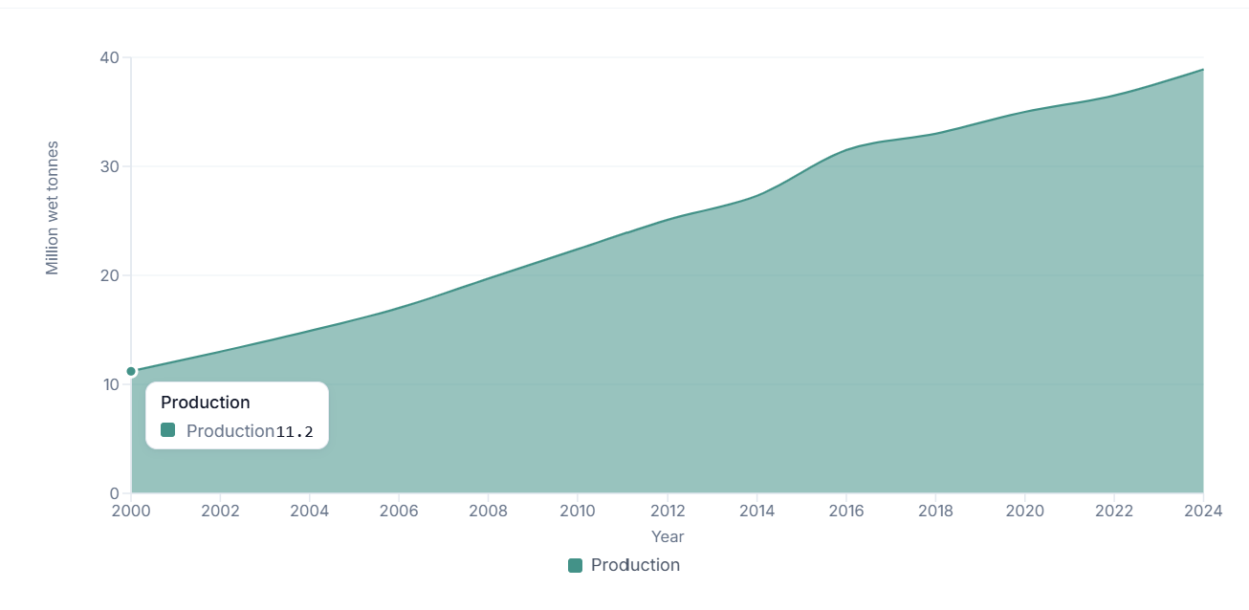
EDA · INSIGHT 1
Global seaweed production has grown ~10× since 1980
● Production climbed from roughly 11.2M tonnes/year in 2000 to over 38.9M tonnes/year today.
● Growth is dominated by Asia: China alone accounts for ~60% of recent global output.
● Wild capture has been roughly flat; almost all growth is from aquaculture.
● The 2000s and 2010s saw the steepest acceleration as kelp farming scaled.
Seaweed Industry · Capstone Mid-Term
7 / 28
Notes:
Let's start with the headline EDA finding. Global seaweed production has grown by roughly ten times since 1980, from about three million tonnes a year to over thirty-five million tonnes today. When you look at this chart, the growth is almost entirely driven by Asia — China alone is around sixty percent of recent global output. Wild capture has barely moved in forty years. Almost all of this growth comes from aquaculture — people farming seaweed deliberately. The acceleration really kicked in during the 2000s and 2010s as commercial kelp farming scaled up. For the live demo, this chart sits on the Overview tab.

Slide 8
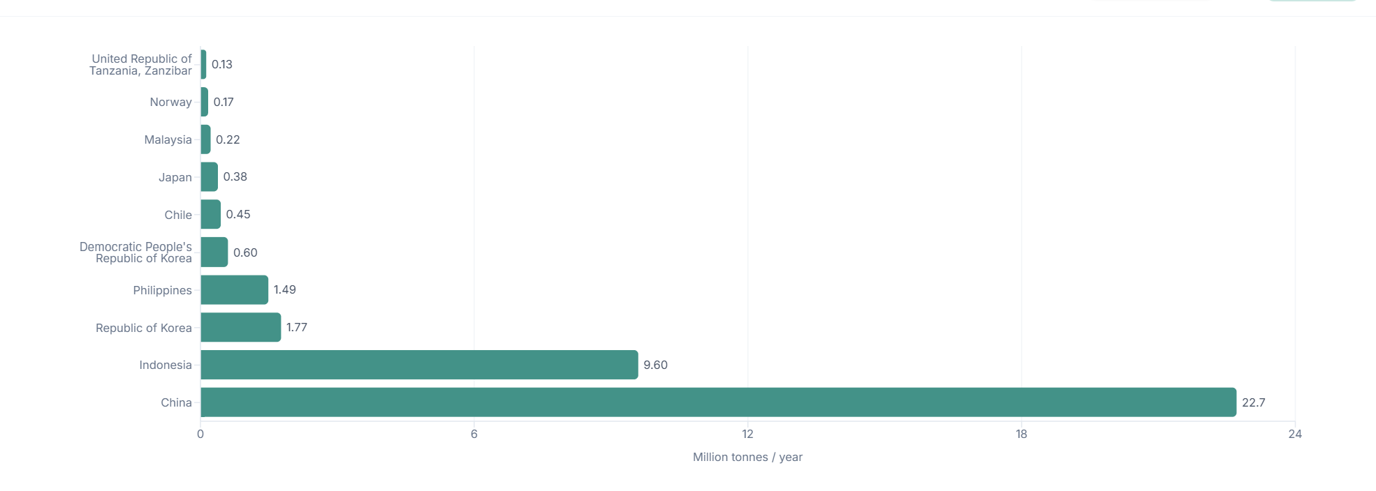
EDA · INSIGHT 2
Five countries produce ~99% of the world's seaweed
● Top 5 in 2022: China, Indonesia, Republic of Korea, Philippines and Democratic People’s Republic of Korea.
● China (22.7M tonnes) and Indonesia (9.6M tonnes) together are ~85% of global output.
● The remaining ~190 countries combined contribute roughly 1%.
● Concentration creates supply-chain risk any policy shift in China or Indonesia ripples globally.
Top 5 producer of the world’s seaweed
Seaweed Industry · Capstone Mid-Term
8 / 28
Notes:
Insight number two — the global seaweed market is extraordinarily concentrated. In 2022, the top five countries — China, Indonesia, South Korea, the Philippines, and North Korea — produced about ninety-nine percent of the world's seaweed. China alone produced over twenty-two million tonnes; Indonesia produced over nine million. Together those two countries are roughly eighty-five percent of global output. The other hundred and ninety-plus countries combined contribute about one percent. This is a real supply-chain risk story — any policy shift, weather event, or trade restriction in China or Indonesia ripples through the entire global market.

Slide 9
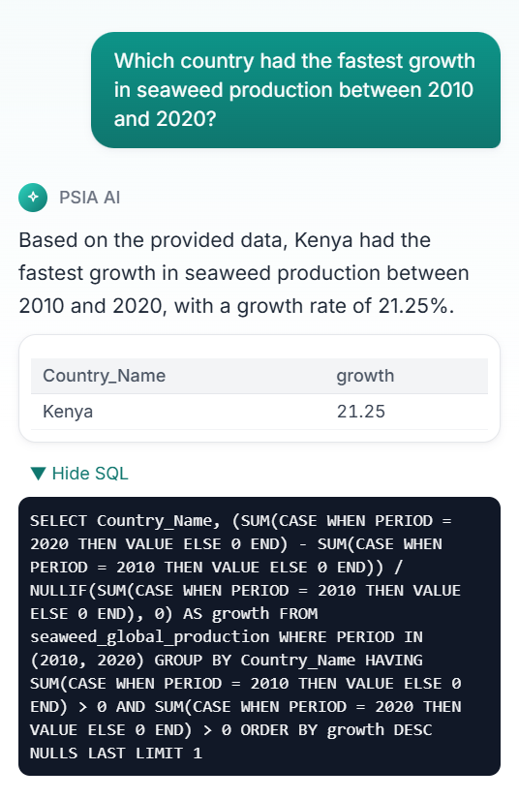
EDA · INSIGHT 3
Kenya is the fastest-growing producer between 2010 and 2020
● Kenya led the world in growth rate from 2010 → 2020 at (≈ 21.25× starting volume).
● Several African and small-island economies showed similarly fast (but small-base) growth.
● Caveat: when the starting base is tiny, growth rates look dramatic still useful as a signal for where capacity is being built.
● Watching emerging producers helps PSIA spot which markets might matter in 5–10 years.
FASTEST GROWTH
Kenya
+21.25× growth
2010 → 2020
Source: AI chat query · live result
Seaweed Industry · Capstone Mid-Term
9 / 28
Notes:
Insight three is about emerging producers. While the headline volume is dominated by China and Indonesia, the fastest-growing producer between 2010 and 2020 was actually Kenya, with about twenty-one times growth — that's a 2125 percent increase. Several other African and small-island economies showed similarly fast growth rates. Now there's an important caveat here: when the starting base is tiny, growth rates look very dramatic. But it's still a useful signal — it tells us where new capacity is being built. For PSIA, watching emerging producers is how you spot which markets might matter in five or ten years. By the way — we didn't compute this by hand. We asked the AI chat 'which country had the fastest growth between 2010 and 2020' and it returned the answer. I'll show that exact query later.

Slide 10
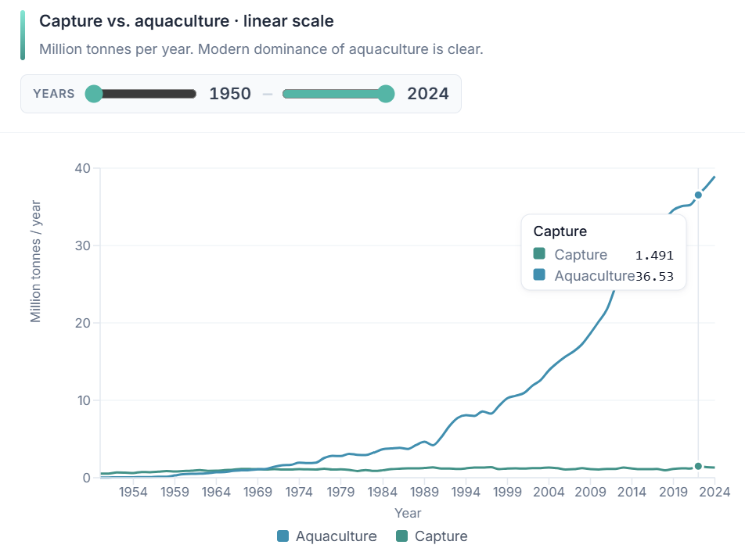
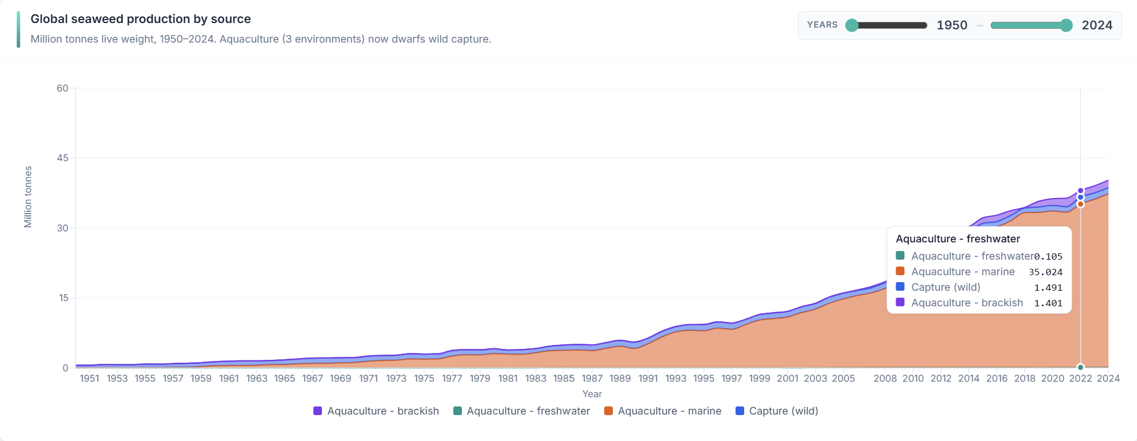
EDA · INSIGHT 4
Aquaculture dominates: wild capture has been flat for 40 years
● Wild capture volumes have been roughly flat since the early 1980s.
● Aquaculture volumes are now ~97% of global seaweed production.
● The structural shift mirrors what happened in finfish farmed surpassed wild decades ago.
● Implication: any future-supply analysis is really an aquaculture analysis. Wild capture is a footnote.
Seaweed Industry · Capstone Mid-Term
10 / 28
Notes:
Insight four is structural. If you split global production into wild-caught seaweed and farmed seaweed, the wild capture volumes have been roughly flat since the early 1980s. Almost all of the ten-times growth we saw earlier is coming from aquaculture. Today aquaculture is about ninety-seven percent of global seaweed production. The structural shift mirrors what happened in finfish — farmed surpassed wild decades ago. The big implication for our sponsor: when we talk about future supply, we're really talking about aquaculture. Wild capture is essentially a footnote now.

Slide 11
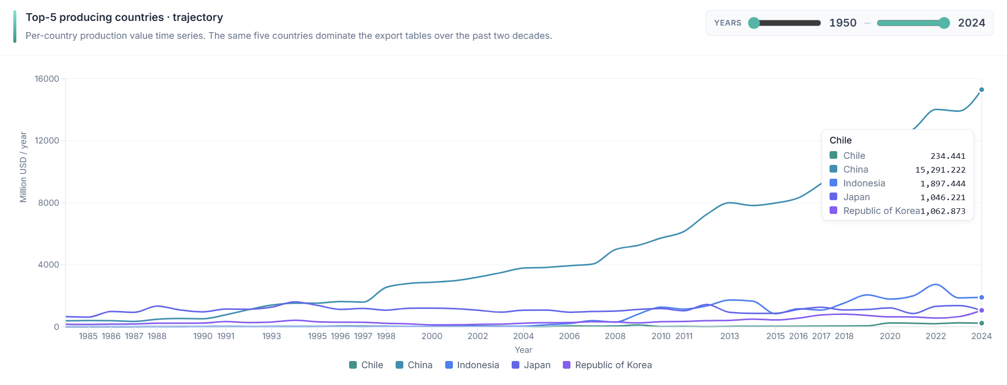
KPI · #1
Export Value of Seaweed Products
● Tracks dollars flowing out of producing nations through exports.
● Volatility tied to currency, demand shocks (e.g., Asian food markets), and species mix.
● China and Indonesia again dominate, but Republic of Korea punches above its volume share on value.
● Useful for understanding which countries capture economic value vs. just produce volume.
Seaweed Industry · Capstone Mid-Term
11 / 28
Notes:
KPI one is Export Value of Seaweed Products, measured in dollars per year, and owned by Devarsh. This tracks the dollars flowing out of producing nations through exports. It's volatile because it depends on currency, demand shocks in Asian food markets, and the species mix. China and Indonesia dominate again, but interestingly, South Korea punches above its volume share on value — meaning their seaweed sells for more per tonne. This KPI is useful because it separates the countries that just produce volume from the countries that actually capture economic value.

Slide 12
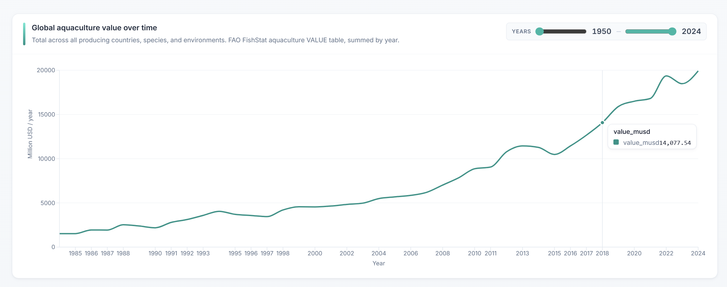
KPI · #2
Gross Value of Industry Output
● Aquaculture value + capture value combined, by country and by year.
● Reveals the true economic size of the global seaweed sector.
● Aquaculture value far exceeds capture value consistent with the volume picture.
● A useful sanity check: gross output should roughly track production × average price.
Seaweed Industry · Capstone Mid-Term
12 / 28
Notes:
KPI two is Gross Value of Industry Output, in dollars per year. This is owned by Darshil. It's basically aquaculture value plus capture value combined, broken down by country and year. This is the metric you'd cite if someone asked 'how big is the global seaweed industry, in dollars?' Aquaculture value massively outweighs capture value, which is consistent with the volume picture we saw. It's also a useful sanity check — gross output should track roughly equal to production times average price.

Slide 13
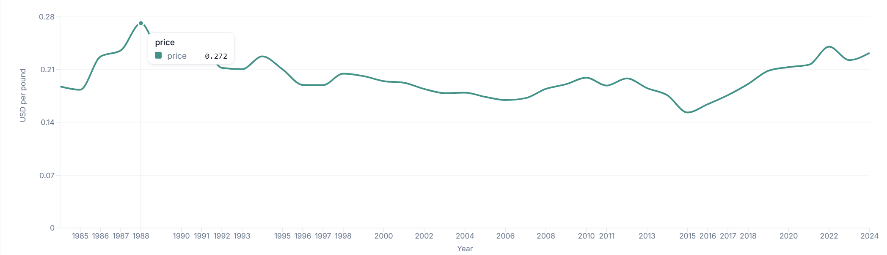
KPI · #3
Value of Seaweed
● Unit economics. Strips out volume to ask: 'what's a pound actually worth?'
● Computed as total value ÷ total quantity, by country & year, normalized to USD per pound.
● Small-volume producers can have surprisingly high $/lb (niche species, premium markets).
● Helps identify high-margin opportunities outside the high-volume players.
Seaweed Industry · Capstone Mid-Term
13 / 28
Notes:
KPI three is Value of Seaweed, in dollars per pound, owned by Poe. This is the unit economics view. By dividing total value by total quantity and converting to dollars per pound, you strip out the volume effect and ask the question: what's a pound of seaweed actually worth? What's interesting is that small-volume producers can have surprisingly high dollars-per-pound numbers — they're often growing niche species or selling into premium markets. This KPI helps us spot high-margin opportunities outside the high-volume players.

Slide 14
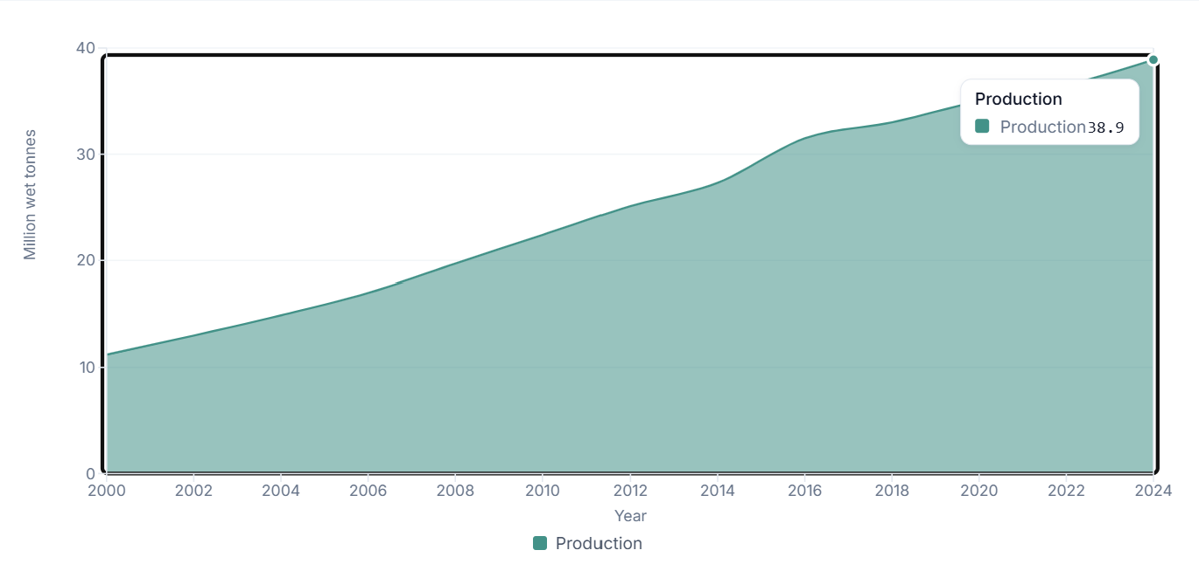
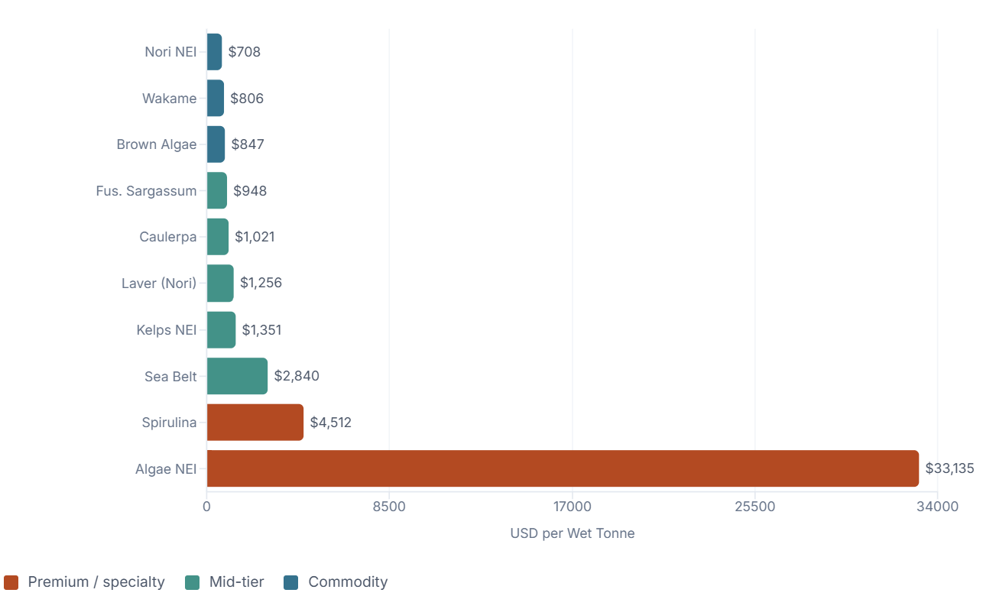
KPI · #4
Price per Wet Tonne
● Pricing varies enormously across species some species are 10× more valuable per tonne.
● End-use matters too: human food, hydrocolloids, animal feed, fertilizer all price differently.
● Pulled from PSIA pricing data see the PSIA Pricing tab.
● This is the KPI most directly relevant for new entrants choosing what species to farm.
Seaweed Industry · Capstone Mid-Term
14 / 28
Notes:
KPI four is Price per Wet Tonne, broken down by species and by end use. This is owned by Deepkumar. Two things drive pricing dramatically. First, the species itself — some species sell for ten times more per tonne than others. Second, the end use — whether the seaweed is going into human food, into hydrocolloids like carrageenan, into animal feed, or into fertilizer. We pulled this pricing data from PSIA's documents, and you can see it on the PSIA Pricing tab — there's a species-by-end-use heatmap. This is arguably the most directly actionable KPI: if someone is thinking about entering the industry, this tells them what to grow and who to sell to.

Slide 15
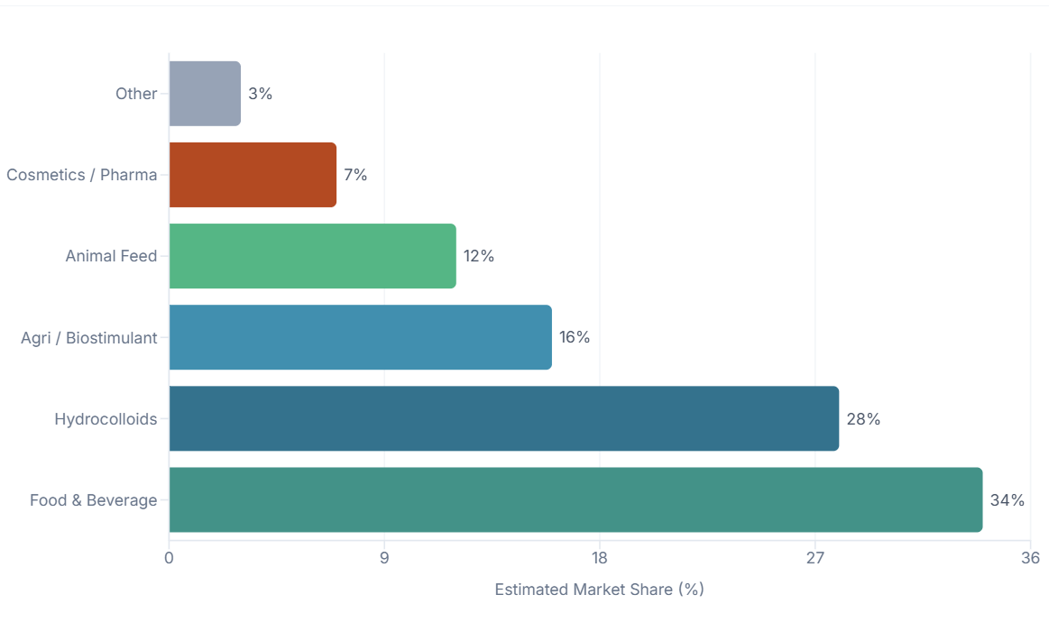
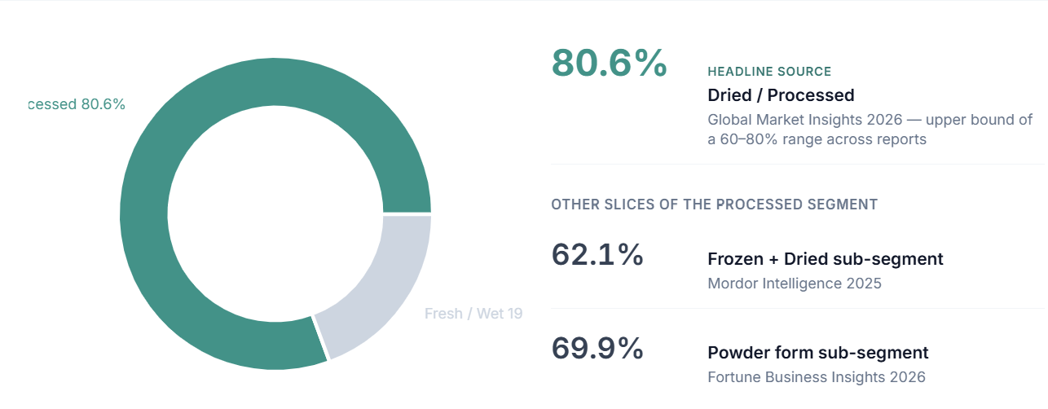
KPI · #5
Wet vs. Processed Kelp Demand
~80% of global kelp demand is processed (dried, powder, extract); only ~20% is sold raw and wet.
Food & Beverage (34%) and Hydrocolloids (28%) drive over 60% of processed demand; agriculture and cosmetics are smaller but growing.
Seaweed Industry · Capstone Mid-Term
15 / 28
Notes:
Opening line (hook):
"Most kelp pulled from the ocean never reaches the consumer as kelp it's transformed first. That transformation is where the money sits.“
Core message (one sentence to anchor the slide):
The kelp value chain is overwhelmingly tilted toward processed forms, and whoever controls processing controls the margin.
Walking through the donut chart (left):
"Roughly 4 out of every 5 kilos of kelp demand is for processed forms dried, frozen, powdered, or extracted."
"Only about 1 in 5 is consumed as fresh/wet kelp."
"Within the processed slice itself, powders and frozen+dried products dominate these are the formats that move through global supply chains.“
Walking through the bar chart (right):
"Food & Beverage and Hydrocolloids together absorb over 60% of demand these are the anchor markets."
"Agriculture and animal feed are mid-tier but growing fast as biostimulants gain traction."
"Cosmetics and pharma are small in volume but high in margin the premium frontier.“
Strategic takeaway (close strong):
"Raw kelp is a commodity. Processed kelp is a product. The bottleneck and the opportunity is processing capacity."
"Anyone entering this space without a processing strategy is selling at the lowest point on the value curve."

Slide 16
SOLUTION
Architecture overview
Frontend · React + Vite
How a chat question becomes an answer:
12 dashboard tabs (Recharts + Plotly) · ChatPanel UI · Tailwind
1.
User types a question in plain English.
2.
Backend retrieves few-shot examples via embeddings; resolves entities (e.g., 'USA' → 'United States of America').
Backend · FastAPI
POST /chat endpoint · request orchestration · CORS · health check
3.
Groq LLM generates SQL grounded in the FAO schema.
4.
DuckDB runs the SQL on the in-memory tables.
Data + AI
DuckDB (4 FAO tables) · BAAI/bge-small embeddings · Groq Llama 3.3 70B
5.
LLM summarizes the result in plain English; UI shows answer, table, and the SQL.
Seaweed Industry · Capstone Mid-Term
16 / 28
Notes:
Opening line (make it land for non-technical listeners):
"Think of this system as a translator. The user speaks English. The database speaks SQL. Our job is to bridge them accurately, and in seconds.“
One-sentence anchor:
"Three layers what the user sees, what coordinates the request, and what holds the data and the intelligence."
Walking through the architecture (left side, top to bottom):
Frontend — what the user touches. "A web app built with React. 12 dashboard tabs for visual exploration, plus a chat panel for asking questions in plain English."
Backend — the coordinator. "FastAPI receives the chat request, routes it, and manages the conversation between the AI model and the database."
Data + AI — the brain and the memory. "DuckDB holds four FAO datasets in memory for fast queries. Embeddings help the system find similar past questions. Groq's Llama 3.3 70B is the language model doing the heavy lifting."
Walking through the 5-step flow (right side):
Use this framing: "Let me show you what happens in the 2–3 seconds between a user asking a question and getting an answer."
Step 1 — Ask. "User types something like 'How much kelp did Korea produce in 2020?'"
Step 2 — Understand. "The system looks up similar past questions for guidance, and resolves shortcuts — 'USA' becomes 'United States of America' so the database recognizes it."
Step 3 — Translate. "The AI writes the SQL query, guided by the structure of the FAO dataset so it doesn't make up tables or columns."
Step 4 — Execute. "DuckDB runs the query against the data."
Step 5 — Explain. "The AI takes the raw result and rewrites it in plain English. The user sees the answer, the data table behind it, and the SQL — for transparency."
Closing line:
"The key design choice: we never let the AI guess what's in the data. It always grounds its answer in the actual FAO schema. That's how we keep it honest."

Slide 17
USE CASE
Who uses this, and how it creates value
Industry Analyst
PSIA Sponsor
Researcher / Student
NEEDS
NEEDS
NEEDS
Needs to answer market questions quickly
Wants a high-level view of where the industry is going
Building their own analysis or paper
HOW THEY USE IT
HOW THEY USE IT
HOW THEY USE IT
Opens the dashboard or asks the chat: 'Top 5 producers in 2022' → answer in 3 seconds, no SQL required.
Scans Overview + KPI tabs to see headline trends — production, value, pricing — in one place.
Uses the dashboard for exploration, then asks the chat for specific cuts and copies the SQL it generates.
Seaweed Industry · Capstone Mid-Term
17 / 28
Notes:
Who uses this and how. We see three personas. First, an industry analyst someone whose day-to-day job is answering market questions. They open the dashboard or just ask the chat 'top five producers in 2022' and they have the answer in three seconds. No SQL skill required. Second, a PSIA sponsor they want the high-level picture. They scan the Overview tab and the KPI tabs to see headline trends in production, value, and pricing, all in one place. Third, a researcher or student building their own analysis. They use the dashboard for exploration, then ask the chat for specific data cuts, and they can actually copy the SQL the chat generates and use it in their own work.

Slide 18
DEMO · DASHBOARD
12 tabs at a glance
Overview
Countries
Regions
Species
Economics
EDA
KPI · Export Value
KPI · Gross Output
KPI · Value per Lb
PSIA · Demand
PSIA · Pricing
Every tab follows the same pattern: a KPI row up top, the main visualization in the middle, and an Insights list below highlighting the takeaway. The Insights list is generated from the chart's underlying data so as the data updates, the takeaways stay in sync.
Seaweed Industry · Capstone Mid-Term
18 / 28
Notes:
Opening line:
"Twelve tabs sounds like a lot. But once you've seen one, you've seen them all by design."
One-sentence anchor:
"The dashboard is wide on coverage but narrow on learning curve. Every tab works the same way."

Slide 19
DEMO · PSIA AI
Ask your data — in plain English
Click the chat icon, type a question, and PSIA AI generates SQL, queries DuckDB, and answers you back.
What makes it useful:
● Plain English → SQL
No need-to-know table names, columns, or joins. Type the question; get the data.
● Entity resolution
We map informal names to canonical ones — 'USA' resolves to 'United States of America'.
● Few-shot grounded
Embeddings retrieve similar example queries; the LLM uses them to write better SQL.
● Transparent
Every answer shows the SQL it ran — so you can verify, edit, or copy it.
● Graceful failure
Nonsense questions ('Mars production') return None instead of hallucinated numbers.
Seaweed Industry · Capstone Mid-Term
19 / 28
Notes:
Opening line (the hook that sells the feature):
"Most people who need data can't write SQL. Most people who write SQL aren't the ones asking the business questions. This bridges that gap."
One-sentence anchor:
"We've taken a database and given it a conversation."

Slide 20
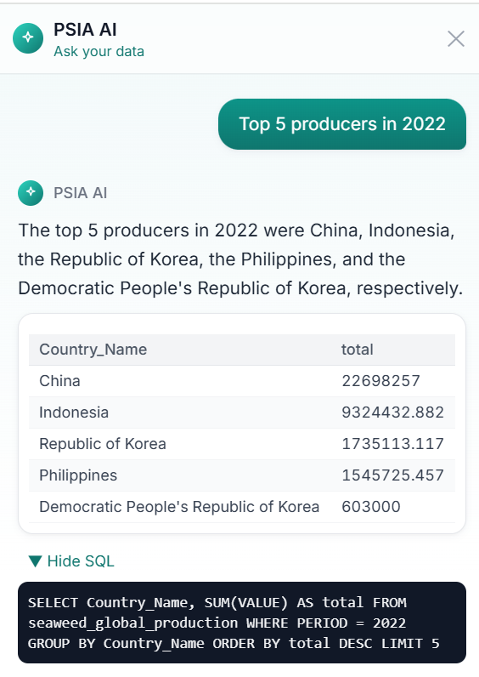
AI CHAT · #1
Top-N query: 'Top 5 producers in 2022'
WHAT THE CHAT DID
● We typed 'Top 5 producers in 2022' natural language, no table names.
● The chat generated a clean SUM + GROUP BY + ORDER BY + LIMIT 5 SQL query.
● Returned China, Indonesia, Republic of Korea, Philippines, and DPR Korea.
● Also produced a one-sentence English summary above the table.
TAKEAWAY
Plain English → correct SQL → clean answer, in seconds.
Seaweed Industry · Capstone Mid-Term
20 / 28
Notes:
Here's our first chat example. We typed 'Top 5 producers in 2022' — just like that, in English.
On the left you can see the response.
The chat generated a SUM with GROUP BY and ORDER BY LIMIT 5 exactly the SQL you'd write by hand.
The result is China at roughly twenty-two million, Indonesia at nine million, then Korea, the Philippines, and Democratic Republic Korea.
Above the table, there's a one-sentence English summary. This is the bread-and-butter use case the kind of question an analyst asks ten times a day, answered in seconds.

Slide 21
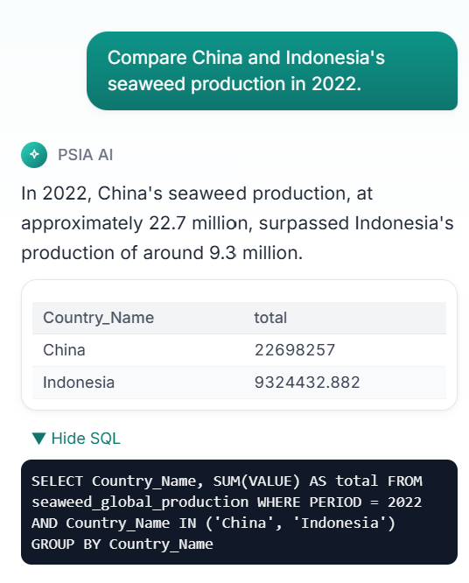
AI CHAT · #2
Comparison query: 'Compare China and Indonesia in 2022'
WHAT THE CHAT DID
● The chat parses two entities and a year filter from one English sentence.
● Generates a clean WHERE … IN (…) AND PERIOD = 2022 query with GROUP BY.
● Returned China at 22.7M tonnes vs Indonesia at 9.3M tonnes.
● The English summary explicitly states which country produced more.
TAKEAWAY
Multi-entity comparisons work out of the box — no special syntax needed.
Seaweed Industry · Capstone Mid-Term
21 / 28
Notes:
Example two a comparison query.
We typed 'Compare China and Indonesia's seaweed production in 2022’.
The chat parses two entities and a year filter from a single sentence.
It generates a WHERE country in China comma Indonesia AND period equals 2022, with a GROUP BY.
Returns China at 22.7 million and Indonesia at 9.3 million. And it doesn't just dump numbers it produces a sentence: 'China's production at approximately 22.7 million surpassed Indonesia's production of around 9.3 million.' Multi-entity comparisons work out of the box.

Slide 22
AI CHAT · #3
Analytical query: 'Fastest growth, 2010 → 2020'
WHAT THE CHAT DID
● The chat understood 'growth between 2010 and 2020' as a percentage change calculation.
● Generated a sophisticated CASE-WHEN SQL with NULLIF guarding against zero base.
● Correctly excluded countries with zero baseline to avoid divide-by-zero.
● Result: Kenya, with +21.25× growth a finding that's hard to spot by eye.
TAKEAWAY
The chat can do real analysis, not just lookups.
Seaweed Industry · Capstone Mid-Term
22 / 28
Notes:
Example three is where it gets impressive. We asked 'which country had the fastest growth in seaweed production between 2010 and 2020'. This isn't a lookup — it's a calculation. The chat understood that 'growth' means a percentage change. Look at the SQL on the left: it generated a CASE-WHEN expression that subtracts the 2010 value from the 2020 value and divides by the 2010 value. It even uses NULLIF to guard against divide-by-zero, and a HAVING clause to exclude countries with no baseline. The answer is Kenya at twenty-one point twenty-five — meaning Kenya grew twenty-one times in that decade. This is the kind of insight that's genuinely hard to spot just by eyeballing a chart.

Slide 23
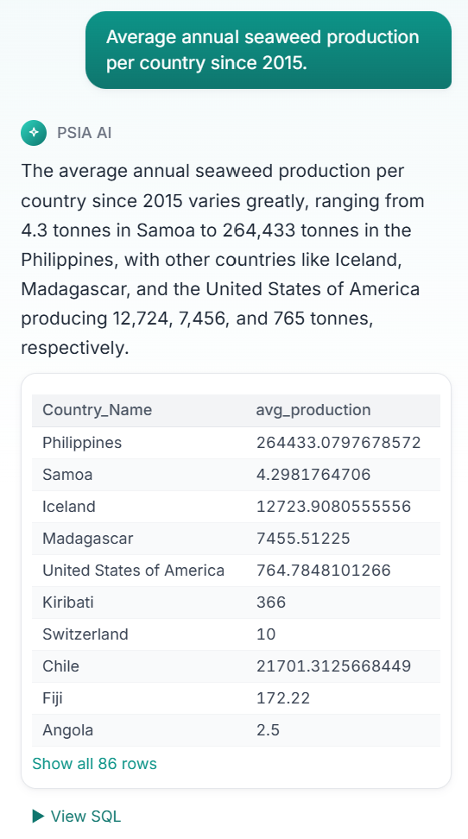
AI CHAT · #4
Aggregate query: 'Average annual production per country since 2015'
WHAT THE CHAT DID
● Aggregation across both time and grouping needs AVG, GROUP BY country, WHERE year ≥ 2015.
● Returned 86 rows ranging from Samoa (4.3 tonnes/year) to the Philippines (264,433 tonnes/year).
● Highlights the dynamic range of the data six orders of magnitude across producers.
● Pagination link ('Show all 86 rows') for full inspection.
TAKEAWAY
Wide-result queries are returned with pagination, not truncated.
Seaweed Industry · Capstone Mid-Term
23 / 28
Notes:
Example four — a wide aggregate. We asked 'average annual seaweed production per country since 2015'. This is a heavier query — it needs an AVG, a GROUP BY country, and a WHERE on the year. The chat returned eighty-six rows. The Philippines averaged about 264 thousand tonnes per year. Samoa averaged about four point three tonnes per year. That's six orders of magnitude of variation across producers — which itself is an important insight. And notice the 'Show all 86 rows' link at the bottom — wide results aren't silently truncated; they're paginated.

Slide 24
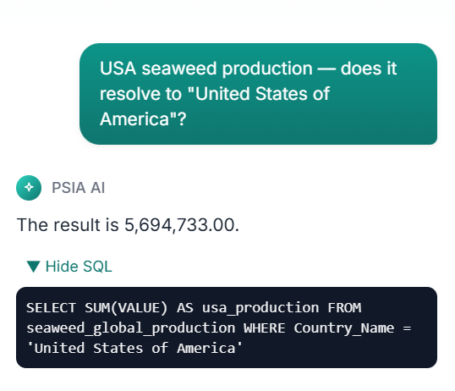
AI CHAT · #5
Entity resolution: 'USA' → 'United States of America'
WHAT THE CHAT DID
● We deliberately tested an informal name: 'USA'.
● The embeddings resolved it to the canonical FAO label 'United States of America'.
● Generated SQL filters Country_Name = 'United States of America' exact match.
● Returned the correct total (5,694,733), proving the resolution worked end-to-end.
TAKEAWAY
Users can be sloppy with names; the system handles it.
Seaweed Industry · Capstone Mid-Term
24 / 28
Notes:
Example five is a robustness check. The FAO data uses very formal country names — like 'United States of America' or 'Republic of Korea'. Real users won't type those names. So we tested 'USA'. The chat used embeddings to recognize that 'USA' is a colloquial reference to 'United States of America' and generated SQL with the canonical name. The query ran and returned the correct total — about 5.7 million. This is what we mean by entity resolution. Users can be sloppy with names and the system still works.

Slide 25
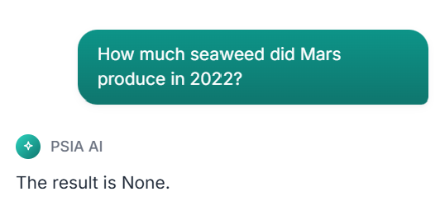
AI CHAT · #6
Graceful failure: 'How much seaweed did Mars produce in 2022?'
WHAT THE CHAT DID
● We asked a deliberately silly question about Mars which obviously isn't in the FAO data.
● The chat ran a valid SQL query against the data — and found nothing.
● Returned an honest 'The result is None.' no hallucinated number.
● This is the LLM-safety property we care about most: don't make stuff up.
TAKEAWAY
Honest 'I don't know' is the most important feature of a data assistant.
Seaweed Industry · Capstone Mid-Term
25 / 28
Notes:
Last AI chat example, and arguably the most important one. We asked a deliberately silly question: 'How much seaweed did Mars produce in 2022'. Obviously Mars isn't in the FAO data. What we wanted to see is what the chat does — does it hallucinate a number? Does it crash? Does it apologize? What it did is the right thing: it ran a valid SQL query, found no results, and returned 'The result is None.' No invented number. No fabricated answer. This is the property we care about most. For a data assistant, an honest 'I don't know' is more valuable than a confident wrong answer.

Slide 26
THINGS TO DO LATER
What's next, and when
AI Chat v2
Multi-turn conversations, charts inside chat replies, more entity-resolution coverage, better edge-case handling.
Now → 2 weeks before final
More Data Sources
Pricing data beyond PSIA, trade-flow data (UN Comtrade), regulatory/permit data broaden the questions we can answer.
2–3 weeks before final
Forecasting Model
Add a production / demand forecast likely a simple time-series model (Prophet or ARIMA) per country & species.
Final 2 weeks
Stretch: User testing
Sit a real analyst in front of the chat, watch them ask questions, log what breaks. Use it to tune few-shot examples.
Final week
Seaweed Industry · Capstone Mid-Term
26 / 28
Notes:
Here's what's left between now and the final. Four buckets. First, AI Chat version two. We want multi-turn conversations — meaning the chat remembers the previous question. We also want charts rendered inside the chat reply, not just tables. And we want broader entity-resolution coverage. Timeline: starts now, lands two weeks before the final. Second, more data sources. We want pricing data beyond what PSIA has shared, trade-flow data from UN Comtrade, and regulatory or permit data. That broadens the range of questions our system can answer. Timeline: two to three weeks before final. Third, a forecasting model. We'll add a simple time-series forecast — probably Prophet or ARIMA — per country and species. Timeline: final two weeks. Fourth, as a stretch goal, user testing. We want to sit a real analyst in front of the chat, watch them ask questions, and log what breaks. We'd use those logs to tune our few-shot examples. Timeline: final week if we have time.

Slide 27
QUESTIONS & CONCERNS
Where we'd love your feedback
Q1
Data coverage
FAO is comprehensive globally but light on US-specific detail. Should we bring in NOAA or state-level US data?
Q2
Chart choice
We picked the charts we thought were most useful. Are there cuts you expected to see and didn't?
Q3
AI chat UX
Right now, the chat shows the SQL by default. Is that useful for sponsors, or noise? Should it be collapsed?
Q4
Forecasting scope
For the final, should we forecast at the country level, species level, or KPI level? Where's the most value?
Q5
How was the presentation and the dashboard
Seaweed Industry · Capstone Mid-Term
27 / 28

Slide 28
Thank you.
Questions?
Live demo: seaweed-industry.vercel.app
Team: Dhruvkumar · Devarsh · Deepkumar · Darshil · Poe
Seaweed Industry · Capstone Mid-Term
28 / 28
Notes:
Thank you so much for your time. The demo is live right now at seaweed-industry.vercel.app — please feel free to try the chat yourself during Q&A. I'd love to take any questions, especially feedback on the four areas we just listed.

