Slide 1
TRAFFIC
LIGHT CONTROLLER
TRAFFIC LIGHT
EEL2020 DIGITAL DESIGN COURSE PROJECT

Slide 2
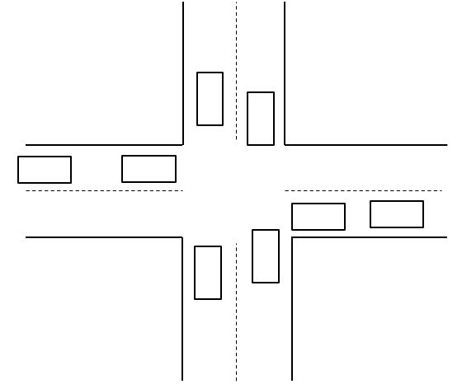
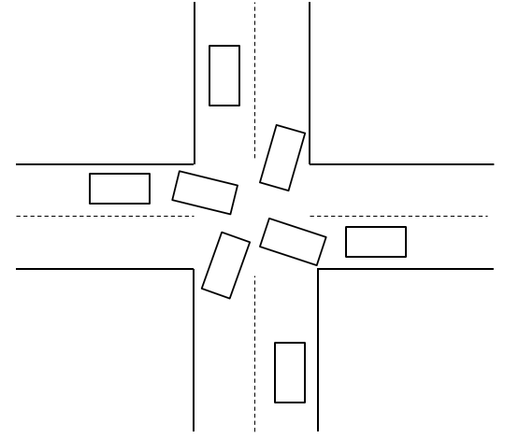
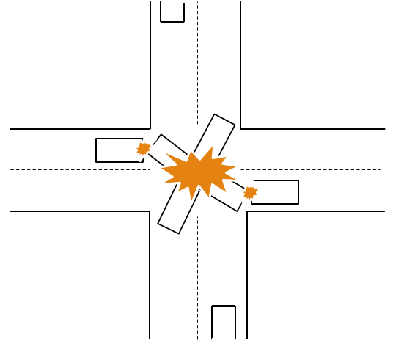
PROBLEM STATEMENT
TRAFFIC LIGHT

Slide 3
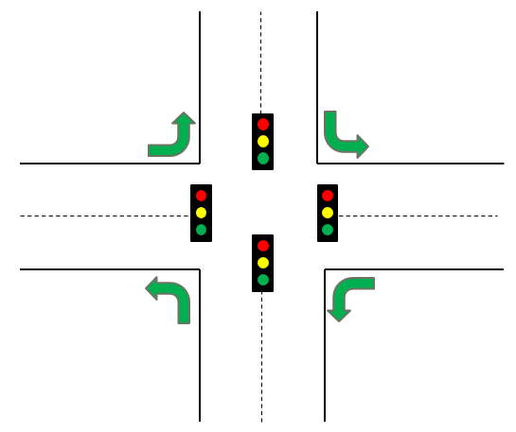
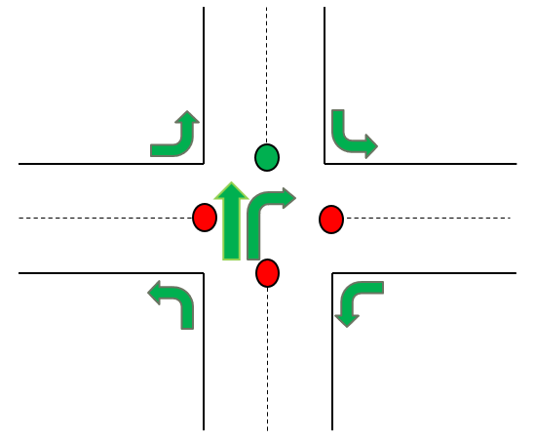
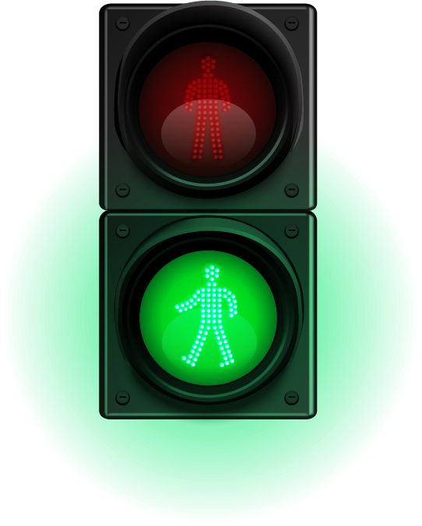
SOLUTION
TRAFFIC LIGHT

Slide 4

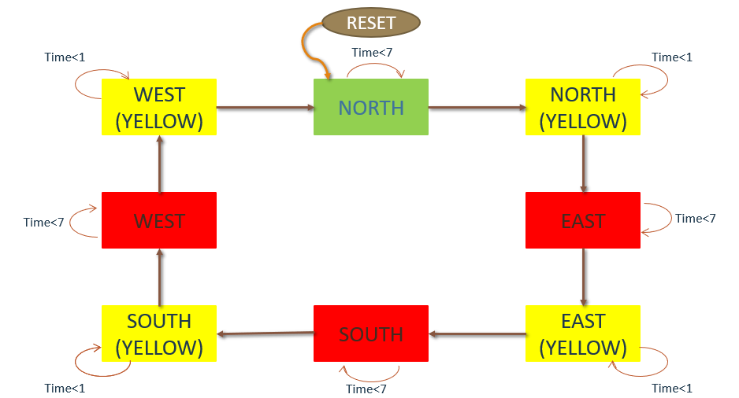
STATE DIAGRAM
TRAFFIC LIGHT

Slide 5
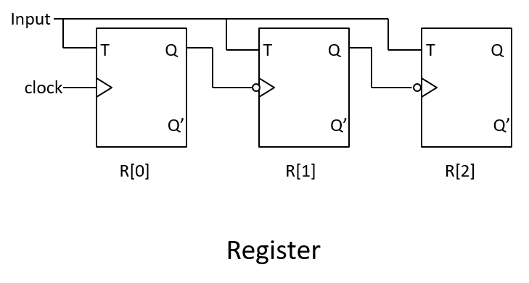

CIRCUIT DIAGRAM

Slide 6
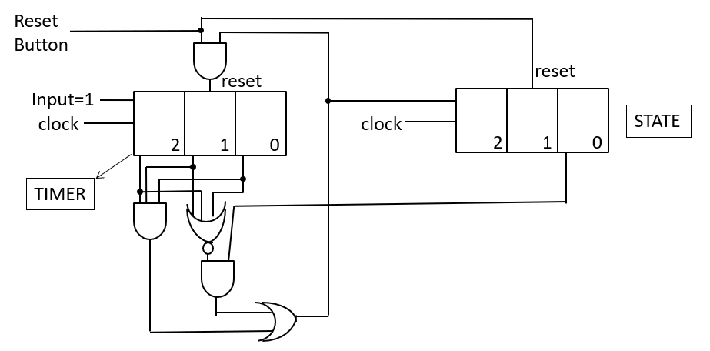
CIRCUIT DIAGRAM

Slide 7
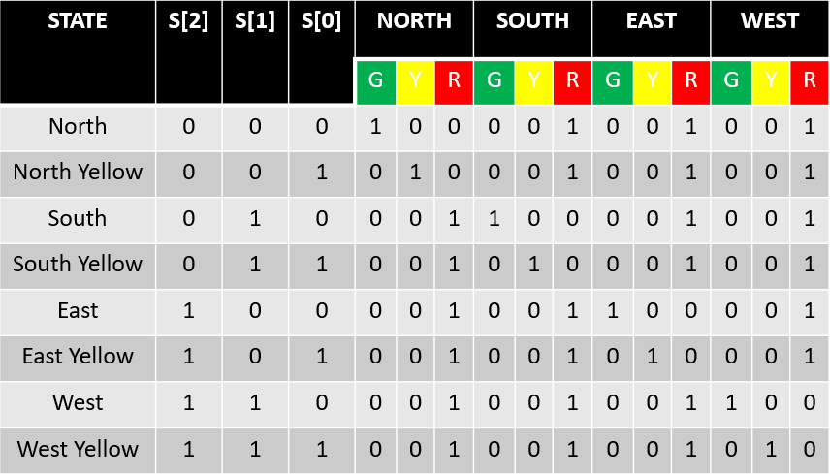
TRUTH TABLE FOR LIGHTS
TRAFFIC LIGHT

Slide 8

LOGIC EQUATIONS
NG = S0’ & S1’ & S2’
NY = S0 & S1’ & S2’
NR = (NG + NR)’
SG = S0’ & S1 & S2’
SY = S0 & S1 & S2’
SR = (SG + SR)’
EG = S0’ & S1’ & S2
EY = S0 & S1’ & S2
ER = (EG + ER)’
WG = S0’ & S1 & S2
WY = S0 & S1 & S2
WR = (WG + WR)’

Slide 9
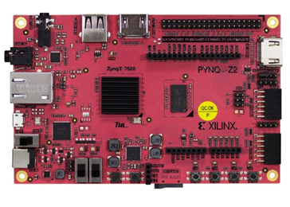
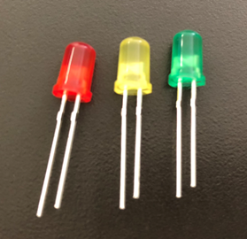
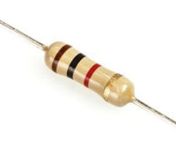
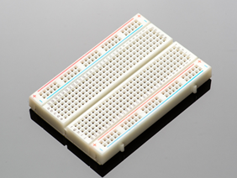
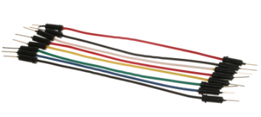
REQUIREMENTS
PYNQ-Z2 BOARD
LEDs
RESISTORS
BREADBOARD
WIRES

Slide 10
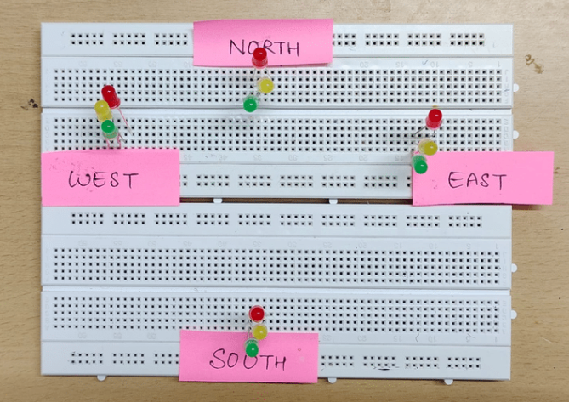
IMPLEMENTATION ON BOARD
TRAFFIC LIGHT

