Slide 1
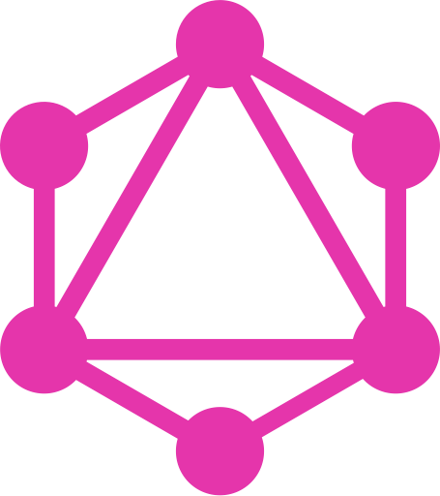
GraphQL An Introduction
By Girish Patel

Slide 2
Agenda:
What Is GraphQL
Advantages Of GraphQL Over REST
Some Disadvantages
Demonstration Of A Simple NodeJS GraphQL Server Built Using Express.js
Questions

Slide 3
What Is GraphQL?
GraphQL is a data query language for APIs and a runtime for fulfilling those queries with your existing data.
GraphQL provides a complete and understandable description of the data in your API.
Gives clients the power to ask for exactly what they need and nothing more.
(Source: GraphQL.org)

Slide 4
It can provide a more efficient, powerful and flexible alternative to REST
GraphQL supports reading, writing (mutating) and subscribing to changes to data (realtime updates)

Slide 5

Graph???QL

Slide 6
Application Data Graphs
A lot of data in modern applications can be represented using a graph of Nodes and Edges,
Nodes: Represent Objects
Edges: Represent relationship between these Object

Slide 7
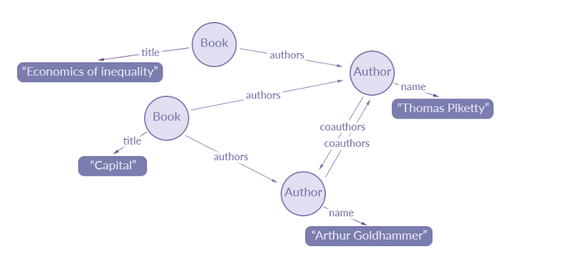
A data graph representation of an extract of data for a simple library catalogue:
Source: https://blog.apollographql.com/the-concepts-of-graphql-bc68bd819be3

Slide 8
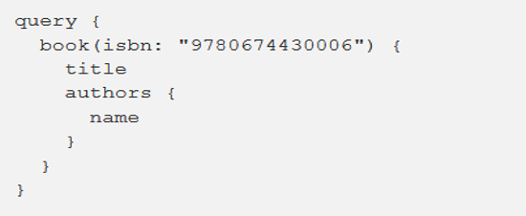
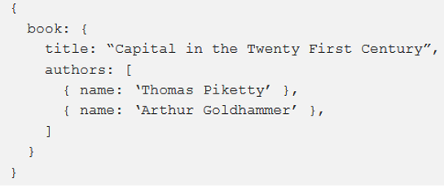
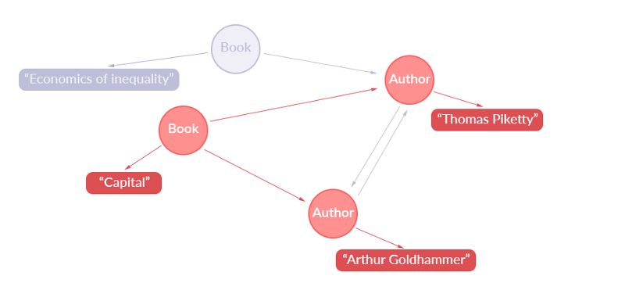
Simple GraphQL Query:
Returns this JSON:
Representation Of Extracted Data:

