Slide 1

GraphQL An Introduction
By Girish Patel

Slide 2
Agenda:
What Is GraphQL
Advantages Of GraphQL Over REST
Some Disadvantages
Demonstration Of A Simple NodeJS GraphQL Server Built Using Express.js
Questions

Slide 4
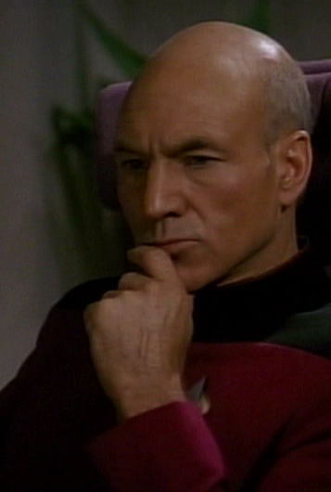
Graph???QL

Slide 5
Application Data Graphs
A lot of data in modern applications can be represented using a graph of Nodes and Edges,
Nodes: Represent Objects
Edges: Represent relationship between these Object

Slide 6
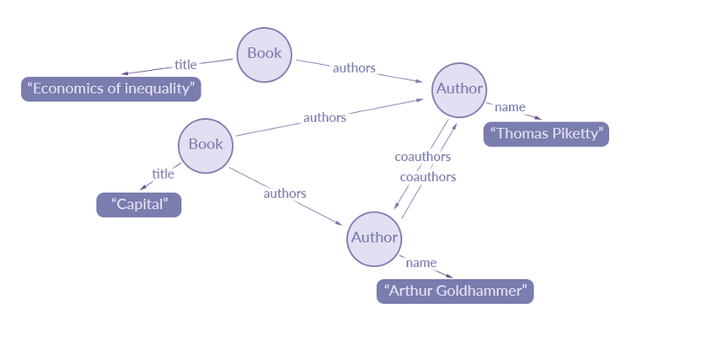
A data graph representation of an extract of data for a simple library catalogue:
Source: https://blog.apollographql.com/the-concepts-of-graphql-bc68bd819be3

Slide 7
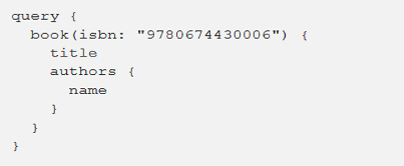
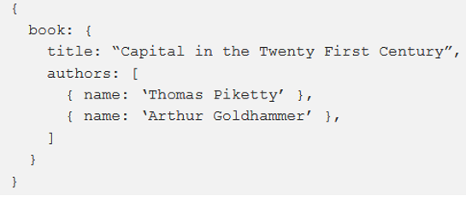
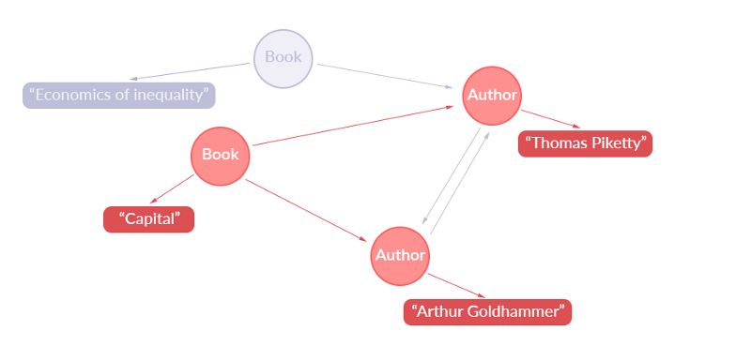
Simple GraphQL Query:
Returns this JSON:
Representation Of Extracted Data:

