Slide 1
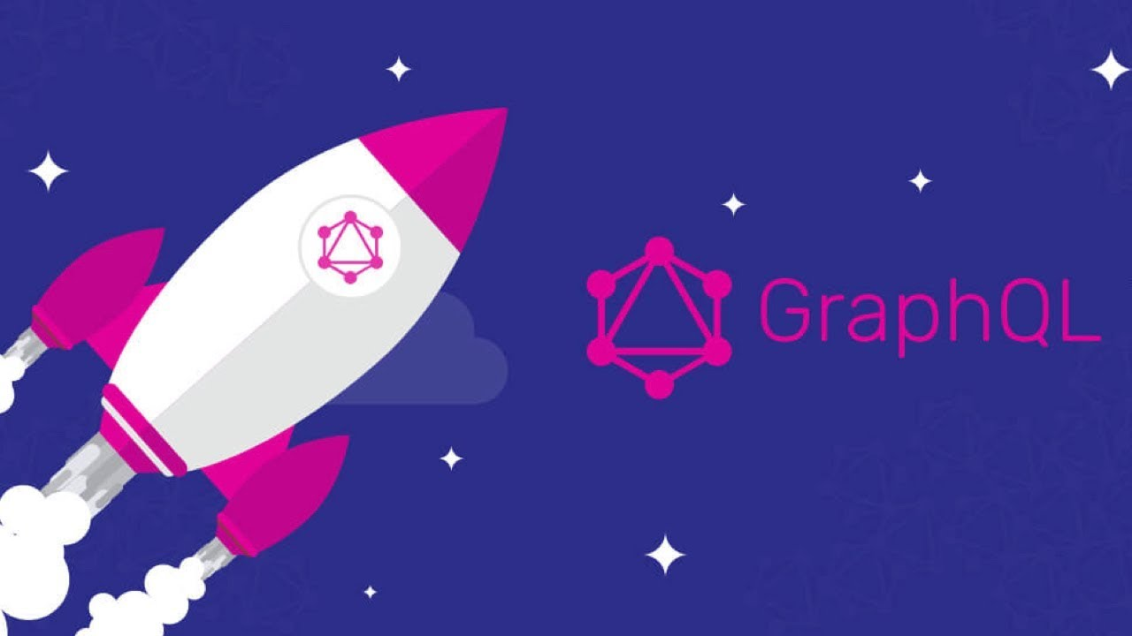

Slide 2
What is GraphQL?
“GraphQL is a query language for APIs and a runtime for fulfilling those queries with your existing data.
GraphQL provides a complete and understandable description of the data in your API, gives clients the power to ask for exactly what they need and nothing more, makes it easier to evolve APIs over time, and enables powerful developer tools.”
(Source: GraphQL.org)

Slide 3

Who’s using GraphQL?

Slide 4
GraphQL is a language-independent specification (not a tool) for client-server communication.
GraphQL isn’t tied to any specific database or storage engine
It can provide a more efficient, powerful and flexible alternative to REST
Open sourced in 2015, GraphQL was developed by Facebook internally during the transition from its HTML5-powered mobile apps to native apps.
Since it became open source in 2015, GraphQL has been enjoying a growing activity. It is used by teams of all sizes in many different environments and languages to power mobile apps, websites, and APIs.
GraphQL is a declarative data fetching specification and query language for APIs.
GraphQL supports reading, writing (mutating) and subscribing to changes to data (realtime updates)

Slide 5
Query Language For Application Data Graphs
A lot of data in modern applications can be represented using a graph of nodes and edges (lines), with nodes representing objects and the edges representing relationships between these objects.
For example, say there is a very simple cataloguing system for a library and the catalogue has a books and authors and each of these books has at least one author. The authors also have co-authors with whom the author has written at least one book.

Slide 6
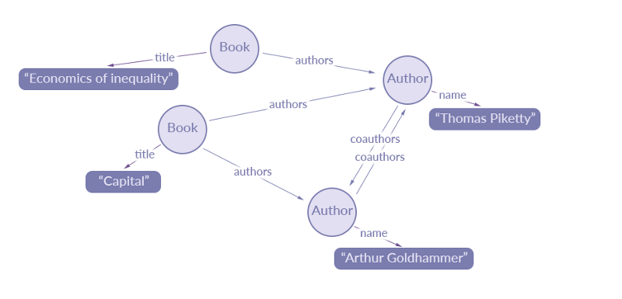
A data graph representation of an extract of data for a simple library catalogue may look like the following:
(Source: https://blog.apollographql.com/the-concepts-of-graphq)

Slide 7
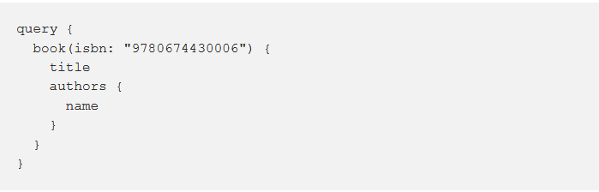
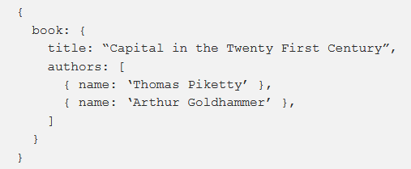
An example of a GraphQL query:
A GraphQL query is a string sent to the runtime that returns JSON to the client.
Below is an example of a GraphQL query we could run against the data graph above:
Once the server resolves the query, it returns this JSON query result:

Slide 8
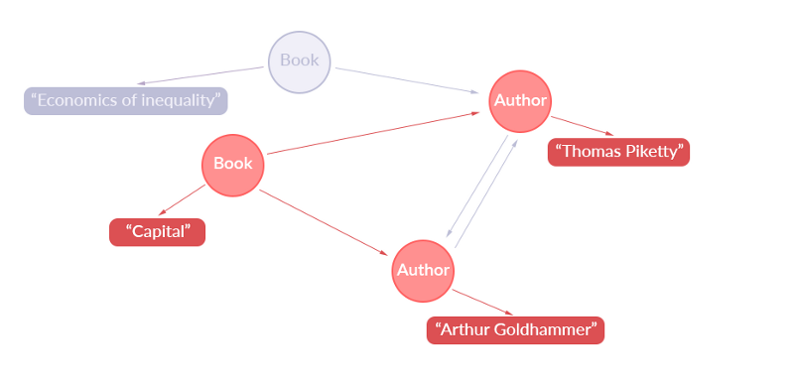
Below is a representation of what data has been extracted in terms of the application data graph:

Slide 9
GraphQL has three main characteristics
It uses a type system (like TypeScript) to describe data.
It makes it easier to aggregate data from multiple sources and access nested objects without making multiple API fetches.
It lets the client specify exactly what data it needs.

Slide 10
It uses a type system (like TypeScript) to describe data.
A GraphQL query can be ensured to be valid within a GraphQL type system at development time allowing the server to make guarantees about the response. This makes it easier to build high-quality client tools
GraphQL uses a schema, or a data definition, to describe how the data to be retrieved is organized in the query and the response. Anyone who has worked with an ORM (object-relational mapper) should find GraphQL’s data schema definitions familiar:
type Movie {
id: ID
title: String
released: Date
director: Director
}
type Director {
id: ID
name: String
movies: [Movie]
}

Slide 11
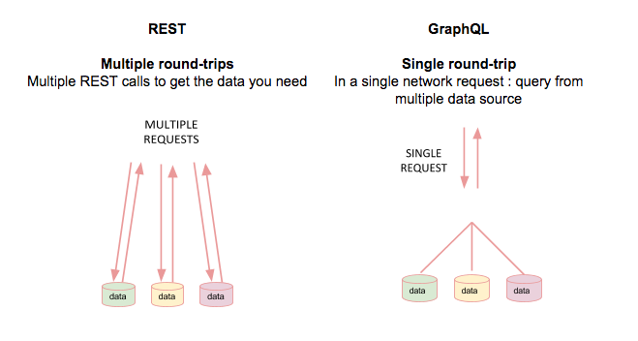
It makes it easier to aggregate data from multiple sources:
The user is able to make a single call to fetch the required information rather than to construct several REST requests to fetch the same.
there’s no need to call multiple endpoints from the client or aggregate the data manually like you have to with traditional REST data fetching.
you specify exactly the data you need and GraphQL gives you exactly what you asked for

Slide 12
Lets say we have an API that lets us retrieve an author along with the posts he/she has created, and in turn get the comments on each of the posts.
With REST, we might have the following endpoints:
/authors/:id to fetch an author
/authors/:id/posts endpoint to fetch the post of that particular author.
/authors/:id/posts/:id/comments that fetches the comments on the posts.
As you can see, we need to make requests to three different endpoints in
other to accomplish our scenario above.
We then need to do some extra scripting to combine the data.
(https://blog.pusher.com/rest-versus-graphql/)

Slide 13
With REST, you would have to call all of these endpoints for each item in the list, filter down the data you need, and aggregate all of the remaining data into the shape your components consume.
GET /api/dogs/breeds
GET /api/dogs/images
GET /api/dogs/activities
Not only is this approach time-consuming, it’s also prone to error and difficult to reuse logic across platforms. Compare this with GraphQL’s declarative way to query data:
const GET_DOGS = gql`
query {
dogs {
id
breed
image {
url
}
activities {
name
}
}
}
`;

Slide 14
Here, we’re describing the shape of the object we want to receive from the server. GraphQL takes care of combining and filtering the data while returning exactly what we ask for.
Smaller payloads
Since the response back from the server contains only the properties you specify in your query, GraphQL can significantly reduce payload size compared to a REST endpoint. Let’s take a look at our dogs query from earlier in the article:
const GET_DOGS = gql`
query {
dogs {
id
breed
image {
url
}
activities {
name
}
}
}
`;
The response back from the server will be a list of dog objects with id, breed, image, and activities properties. It doesn’t matter if the underlying REST endpoints we call in our resolvers return back objects with 100 properties! All of those extraneous properties will be filtered out before the response is sent back to the client.

Slide 15
With GraphQL, we only need to make a request to one endpoint (the GraphQL server) with the following query along with the author id:
{
author {
name
posts {
title
comments {
comment
}
}
}
}
A GraphQL query itself is a hierarchical set of fields. The query is shaped just like the data it returns. It is a natural way for product engineers to describe data requirements.

Slide 16
and we would get a response like:
{
"data": {
"author": {
"name": "Chimezie Enyinnaya",
"posts": [
{
"title": "How to build a collaborative note app using Laravel",
"comments": [
{
"comment": "Great article."
}
]
},
{
"title": "Event-Driven Laravel Applications",
"comments": [
{
"comment": "I love event driven applications! :)"
}
]
}
]
}
}
}

Slide 17
in the REST implementation, notice we have three different endpoints and to fetch the data for our scenario we will have to make three different requests to the server. In the GraphQL implementation on the other hand we only make a single request to the server. GraphQL reduces network requests by allowing us fetch or retrieve all the data we need in a single query.
REST APIs are usually a collection of endpoints, where each endpoint represents a resource. So when a client needs data from multiple resources, it needs to perform multiple round-trips to a REST API to put together the data it needs.
With GraphQL, we can basically shift this multi-request complexity to the server-side and have the GraphQL layer deal with it. The client asks the GraphQL layer a single question and gets a single response that has exactly what the client needs.

Slide 18
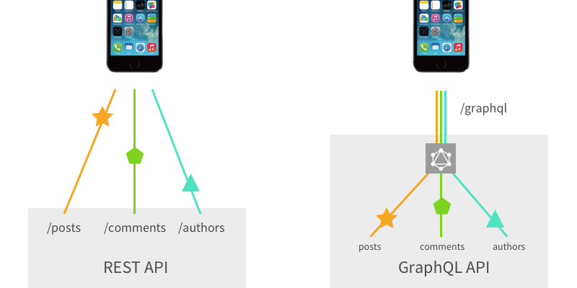
Data Fetching

Slide 19
It lets the client specify exactly what data it needs.
Query responses are decided by the client rather than the server. A GraphQL query returns exactly what a client asks for and no more.
REST requests are always returning the full set of data which is available for a certain resource. There is no way to limit the request to only retrieve a subset of data fields.
By using the GraphQL query language you can exactly describe what the response should look like. You’re able to specify which fields should be included to limit the response to the data which is needed. Furthermore you can use the graph and combine connected entities within one GraphQL data query. No additional server round trips needed.
Over Fetching / Under Fetching: Another common problem which occurs when using RESTful services is the problem of over / under fetching. So what does that exactly mean? Let’s get back to the previous example. By using endpoint mydomain.com/posts/:id we’re fetching data for a specific post. Each post might comprise the following properties: id, title, user, and body. You’ll always get back the complete set of data. There is no way to limit the response to only contain a subset of data like title and user.

Slide 20
Over/Under Fetching
It is easy to fetch more than the data you need with REST, because each endpoint in a REST API has a fixed data structure which it is meant to return whenever it is hit. So, most times we just make do with the data we need and end up ignoring the rest. Also, REST makes it easy to under fetch data hence making us perform additional requests to other endpoints in order to fetch associated data.
In a REST API, there is no client request language. Clients do not have control over what data the server will return. There is no language through which they can do so. More accurately, the language available for clients is very limited.
For example, the READ REST API endpoints are either:
GET /ResouceName - to get a list of all the records from that resource, or
GET /ResourceName/ResourceID - to get the single record identified by that ID.
A client can’t, for example, specify which fields to select for a record in that resource. That information is in the REST API service itself and the REST API service will always return all of the fields regardless of which ones the client actually needs. GraphQL’s term for this problem is over-fetching of information that’s not needed. It’s a waste of network and memory resources for both the client and server.

Slide 21
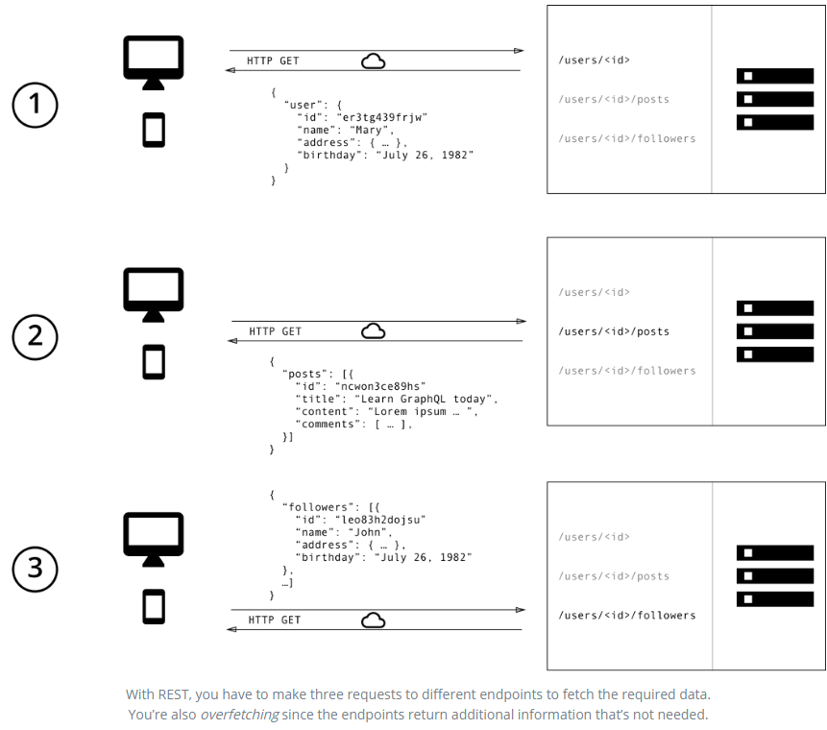

Slide 22
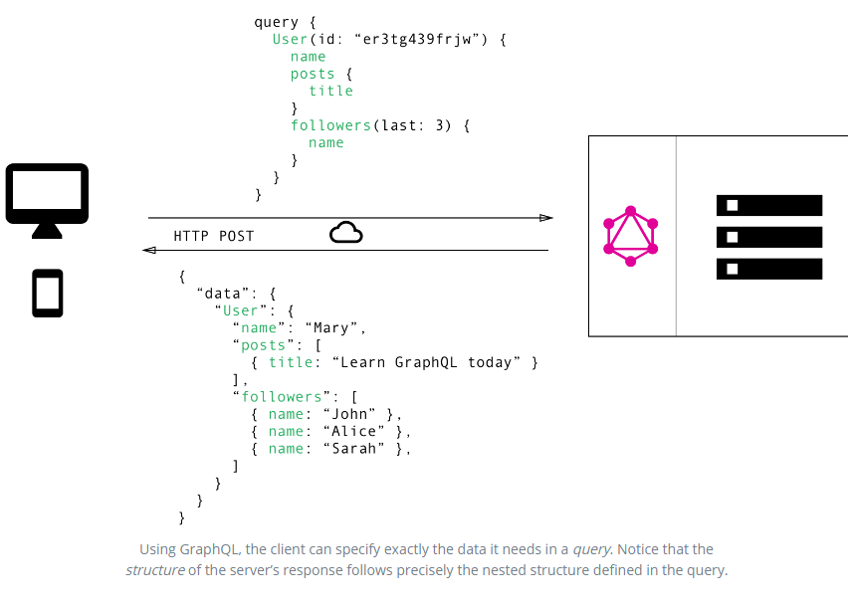

Slide 23
Error Handling
Error handling in REST is pretty straightforward, we simply check the HTTP headers to get the status of a response. Depending on the HTTP status code ( 404, 503, 500 etc) we get, we can easily tell what the error is and how to go about resolving it. GraphQL on the other hand, when operated over HTTP, we will always get a 200 OK response status. When an error occurs while processing GraphQL queries, the complete error message is sent to the client with the response. Below is a sample of a typical GraphQL error message:
{
"errors": [
{
"message": "Field \"hello\" must not have a selection since type \"String\" has no subfields.",
"locations": [
{
"line": 2,
"column": 9
}
]
}
]
}

Slide 24
Caching
Since HTTP already implements caching, and REST is implemented using HTTP, the client can use HTTP caching to avoid refetching resources. GraphQL has no caching mechanism in place, hence leaving the clients with the responsibility of taking care of caching on their end.

Slide 25
Versioning
Often when consuming third-party REST APIs, we see stuff like v1, v2, v3 etc. which simply indicate the version of the REST API we are using. This leads to code redundancy and less maintainable code.
With GraphQL, there is no need for versioning as we can easily add new fields and types to our GraphQL API without impacting existing queries. Also, we can easily mark fields as deprecated and the fields will be excluded from the response gotten from the server.
One other big problem with REST APIs is versioning. If you need to support multiple versions, that usually means new endpoints. This leads to more problems while using and maintaining those endpoints and it might be the cause of code duplication on the server.
This is especially important for mobile clients because we can’t control the version of the API they’re using. Once installed, a mobile app might continue to use that same old version of the API for years. On the web, it’s easy to control the version of the API because we just push new code. For mobile apps, that’s a lot harder to do.
GraphQL lets a client-side developer add new queries to retrieve data, even if that information is in a different version of the app. You simply write a query and you get the data you want. You never need to create a custom data endpoint from the server side or ask a server-side developer to create one for you. Additionally, you can retrieve most of the data for a given view with just one request to the server.

Slide 26
Mutation:
A GraphQL request can be either a query (read operation) or a mutation (write operation). For both cases, the request is a simple string that a GraphQL service can interpret, execute, and resolve with data in a specified format. The popular response format that is usually used for mobile and web applications is JSON.

Slide 27
Setting Up GraphQL
Need a client
Need a server (Node.js + Express)
GraphQL is a specification, you will find many libraries to help you implement GraphQL in many different languages such as JavaScript, Java, PHP, Python, Go, etc.
Major GraphQL clients include Apollo Client[6] and Relay.[7] GraphQL servers are available for multiple languages, including Haskell, JavaScript, Python,[8] Ruby,
Java, C#, Scala, Go, Elixir,[9] Erlang, PHP, R, and Clojure.

Slide 28
GraphQL Ecosystem
Clients
Relay: powerful GraphQL client developed by Facebook, heavily optimized for performance. It is only available on the web.
Apollo Client: community-driven effort to build a powerful, flexible and production ready GraphQL client for all major development platforms. It support various frontend frameworks (React, Angular and Vue) and platforms (iOS, Android).
Server
GraphQL.js: the reference implementation of the GraphQL specification, designed for running GraphQL in a Node.js environment.
Graphql-tools: a package that enables you to build a production-ready GraphQL.js schema using the GraphQL schema language, rather than using the GraphQL.js type constructors directly. This allows additional support for resolvers, unions, interfaces, custom scalars, modularizing your schema, and more.
Apollo-server: a production-ready Node.js GraphQL server library that supports Express, Connect, Hapi, Koa, and other popular Node HTTP servers, with built-in features like persisted queries, batching, and more. Apollo Server works with any GraphQL client, like Apollo, Relay, and more.
For a complete list of GraphQL reference implementations for various languages, check server libraries section on http://graphql.org/code.

Slide 29
Disadvantages of GraphQL
One important threat that GraphQL makes easier is resource exhaustion attacks (AKA Denial of Service attacks). A GraphQL server can be attacked with overly complex queries that will consume all the resources of the server. It’s very simple to query for deep nested relationships (user -> friends -> friends …), or use field aliases to ask for the same field many times. Resource exhaustion attacks are not specific to GraphQL, but when working with GraphQL we have to be extra careful about them.
There are some mitigations we can do here. We can do cost analysis on the query in advance and enforce some kind of limits on the amount of data one can consume. We can also implement a time-out to kill requests that take too long to resolve. Also, since GraphQL is just a resolving layer, we can handle the rate limits enforcement at a lower level under GraphQL.
If the GraphQL API endpoint we’re trying to protect is not public and is meant for internal consumption of our own clients (web or mobile), we can use a whitelist approach and pre-approve queries that the server can execute. Clients can just ask the servers to execute pre-approved queries using a query unique identifier. Facebook seems to be using this approach.

Slide 30
Authentication and authorization are other concerns that we need to think about when working with GraphQL. Do we handle them before, after, or during a GraphQL resolve process?
To answer this question, think of GraphQL as a DSL (domain specific language) on top of your own backend data fetching logic. It’s just one layer that we could put between the clients and our actual data service (or multiple services).
Think of authentication and authorization as another layer. GraphQL will not help with the actual implementation of the authentication or authorization logic. It’s not meant for that. But if we want to put these layers behind GraphQL, we can use GraphQL to communicate the access tokens between the clients and the enforcing logic. This is very similar to the way we do authentication and authorization with RESTful APIs.

Slide 31
Caching
Caching is built into in the HTTP specification which RESTful APIs are able to leverage. GET vs POST semantics related to caching are well defined enabling browser caches, intermediate proxies, and server frameworks to follow. The following guidelines can be followed:
GET requests can be cached
GET requests can stay in browser history
GET requests can be bookmarked
GET requests are idempotent
GraphQL doesn’t follow the HTTP spec for caching and instead uses a single endpoint. Thus, it’s up to the developer to ensure caching is implemented correctly for non-mutable queries that can be cached. The correct key has to be used for
the cache which may include inspecting the body contents.
While you can use tools like Relay or Dataloader that understands GraphQL semantics, that still doesn’t cover things like browser and mobile caching.
https://www.slideshare.net/yosriady/graphql-in-an-age-of-rest

