Slide 1
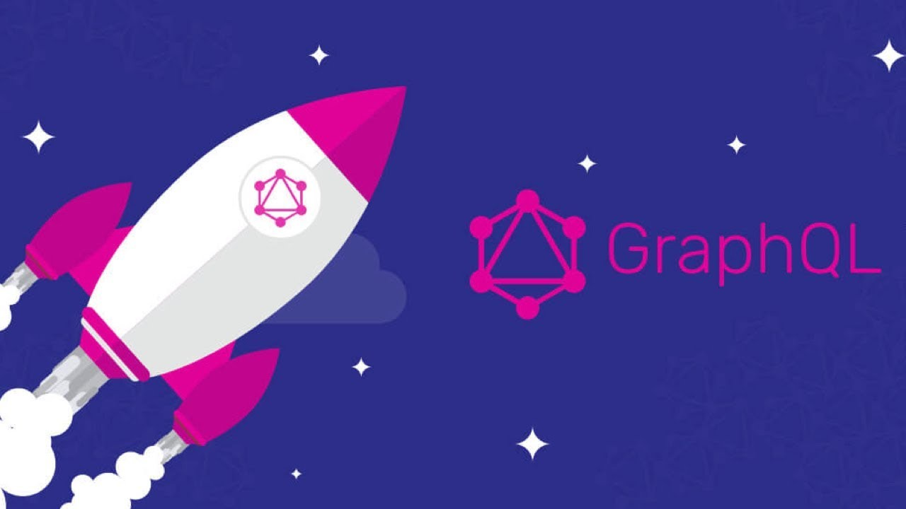

Slide 2
What is GraphQL?
“GraphQL is a query language for APIs and a runtime for fulfilling those queries with your existing data.
GraphQL provides a complete and understandable description of the data in your API, gives clients the power to ask for exactly what they need and nothing more, makes it easier to evolve APIs over time, and enables powerful developer tools.”
(Source: GraphQL.org)

Slide 3
Open sourced in 2015, GraphQL was developed by Facebook internally during the transition from its HTML5-powered mobile apps to native apps.
It can provide a more efficient, powerful and flexible alternative to REST
GraphQL supports reading, writing (mutating) and subscribing to changes to data (realtime updates)

Slide 4

Graph??? QL

Slide 5
Application Data Graphs
A lot of data in modern applications can be represented using a graph of nodes and edges,
Data represented using a graph of nodes and edges (lines).
Nodes represent objects and the edges represent relationships between these objects.

Slide 6
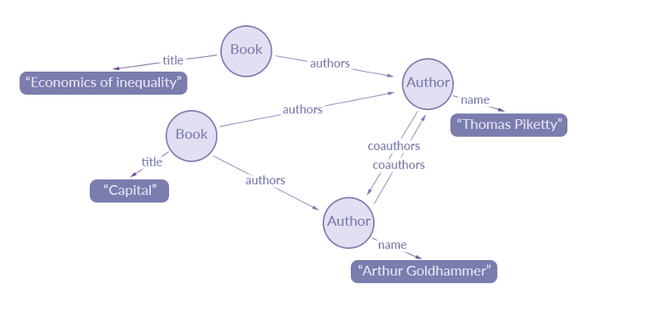
A data graph representation of an extract of data for a simple library catalogue:
(Source: https://blog.apollographql.com/the-concepts-of-graphq)

Slide 7
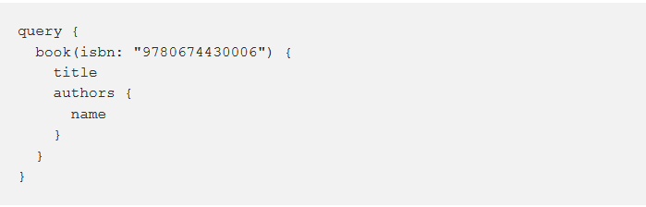
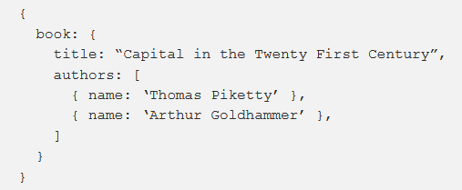
Simple GraphQL Query:
Returns this JSON query result:

Slide 8
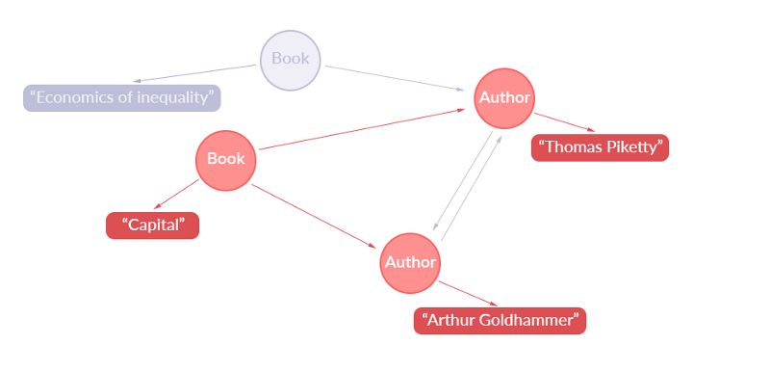
Representation of what data has been extracted from the application data graph:

Slide 9
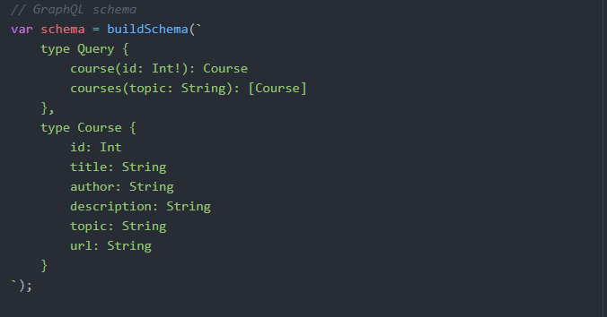
GraphQL uses a type system:
Below is an example of a schema which are used in a server-side runtime to describe data and validate GraphQL queries.

Slide 10
REST vs GraphQL Data Fetching
Imagine we have an API that lets us:
retrieve user details
the posts he/she has created
the followers the user has.

Slide 11
With REST, we might have the following endpoints:
/users/<id> to fetch a user
/users/<id>/posts to fetch the post of that particular user
/users/<id>/followers to fetch the followers of that particular user

Slide 12
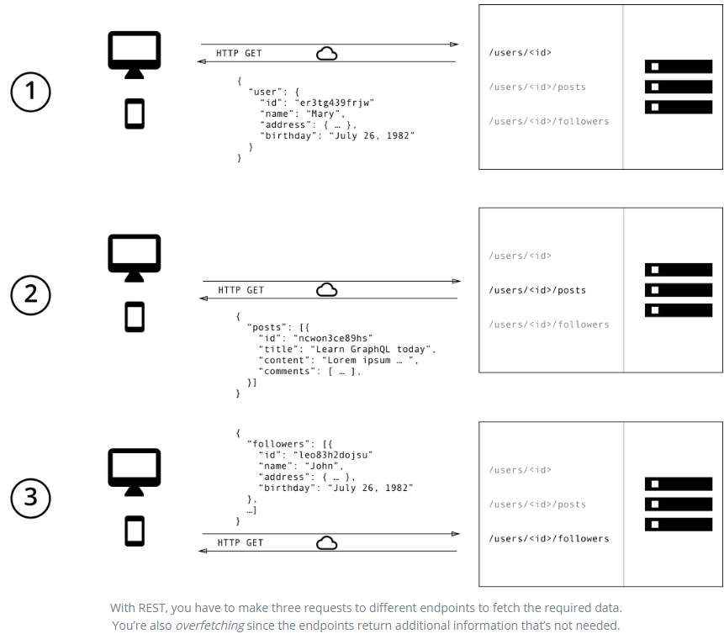

Slide 13
To fetch the data for our scenario we will have to make three different requests to the server.

Slide 14
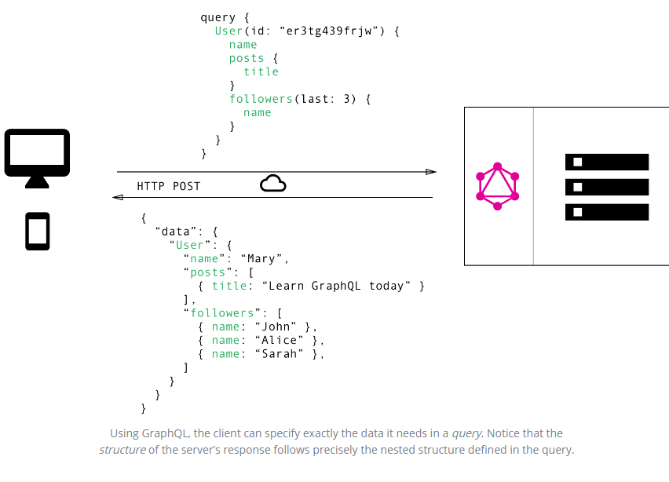

Slide 15
In the GraphQL implementation we only make a single request to the server.
GraphQL reduces network requests by allowing us fetch or retrieve all the data we need in a single query.

Slide 16
REST APIs:
are usually a collection of endpoints, where each endpoint represents a resource
when a client needs data from multiple resources, it needs to perform multiple round-trips to a REST API to put together the data it needs.

Slide 17
GraphQL:
we can basically shift this multi-request complexity to the server-side and have the GraphQL layer deal with it.
The client asks the GraphQL layer a single question and gets a single response that has exactly what the client needs.

Slide 18
REST API
Each resource endpoint has a fixed data structure and which is returned
REST requests are always returning the full set of data which is available for a certain resource. There is no way to limit the request to only retrieve a subset of data fields.
So, most times we just make do with the data we need and end up ignoring the rest.
A client can’t, for example, specify which fields to select for a record in that resource. That information is in the REST API service itself and the REST API service will always return all of the fields regardless of which ones the client actually needs.
It’s a waste of network and memory resources for both the client and server.
In the example below we get all the followers for the user and all the detail of each user.

Slide 20
GraphQL
Query responses are decided by the client rather than the server. A GraphQL query returns exactly what a client asks for and no more.
You’re able to specify which fields should be included to limit the response to the data which is needed.
In the example below we can specify that we want only want the names of the user’s last 3 followers:

Slide 22
Mutations
Most discussions on GraphQL focuses on declarative data fetching, but a complete data platform needs to be able to manipulate or change data. It must be able to create, update and delete data. An API should have CRUD operations. CRUD simply means CREATE, READ, UPDATE, DELETE.
A GraphQL query performs the READ operation in a GraphQL API while a GraphQL mutation performs other operations such as CREATE, UPDATE and DELETE. This simply means that queries don't change data, a mutation does.

Slide 23
GraphQL supports reading, writing (mutating) and subscribing to changes to data (realtime updates)

Slide 24
Versioning REST APIs
Often when consuming third-party REST APIs, we see stuff like v1, v2, v3 etc. which simply indicate the version of the REST API we are using. This leads to code redundancy and less maintainable code.
One other big problem with REST APIs is versioning. If you need to support multiple versions, that usually means new endpoints. This leads to more problems while using and maintaining those endpoints and it might be the cause of code duplication on the server.

Slide 25
Versioning
While there's nothing that prevents a GraphQL service from being versioned just like any other REST API, GraphQL takes a strong opinion on avoiding versioning by providing the tools for the continuous evolution of a GraphQL schema.
Why do most APIs version? When there's limited control over the data that's returned from an API endpoint, any change can be considered a breaking change, and breaking changes require a new version. If adding new features to an API requires a new version, then a tradeoff emerges between releasing often and having many incremental versions versus the understandability and maintainability of the API.
In contrast, GraphQL only returns the data that's explicitly requested, so new capabilities can be added via new types and new fields on those types without creating a breaking change. This has led to a common practice of always avoiding breaking changes and serving a versionless API.

Slide 26
Versioning GraphQL
With GraphQL, there is no need for versioning as we can easily add new fields and types to our GraphQL API without impacting existing queries. Also, we can easily mark fields as deprecated and the fields will be excluded from the response gotten from the server.
GraphQL lets a client-side developer add new queries to retrieve data, even if that information is in a different version of the app. You simply write a query and you get the data you want. You never need to create a custom data endpoint from the server side or ask a server-side developer to create one for you. Additionally, you can retrieve most of the data for a given view with just one request to the server.
This is especially important for mobile clients because we can’t control the version of the API they’re using. Once installed, a mobile app might continue to use that same old version of the API for years. On the web, it’s easy to control the version of the API because we just push new code. For mobile apps, that’s a lot harder to do.

Slide 27
Rapid Product Iterations on the Frontend
A common pattern with REST APIs is to structure the endpoints according to the views that you have inside your app. This is handy since it allows for the client to get all required information for a particular view by simply accessing the corresponding endpoint.
The major drawback of this approach is that it doesn’t allow for rapid iterations on the frontend. With every change that is made to the UI, there is a high risk that now there is more (or less) data required than before. Consequently, the backend needs to be adjusted as well to account for the new data needs. This kills productivity and notably slows down the ability to incorporate user feedback into a product.
With GraphQL, this problem is solved. Thanks to the flexible nature of GraphQL, changes on the client-side can be made without any extra work on the server. Since clients can specify their exact data requirements, no backend engineer needs to make adjustments when the design and data needs on the frontend change.

Slide 28
GraphQL Server Libraries
GraphQL is a specification You will find server libraries to help you implement GraphQL in a variety of languages including:
C# / .NET,
Clojure,
Elixir,
Erlang,
Go,
Groovy,
Java,
JavaScript,
PHP,
Python,
Scala,
Ruby

Slide 29
JavaScript Server Libraries
GraphQL.js is the reference implementation of the GraphQL specification, designed for running GraphQL in a Node.js environment.
express-graphql is the reference implementation of a GraphQL API server over an Express webserver.

Slide 30
GraphQL Clients
GraphQL client is code that makes a POST request to a GraphQL Server
GraphQL clients can be found for C# / .NET, Clojurescript, Go, Java / Android, JavaScript, Swift / Objective-C iOS, Python

Slide 31
JavaScript GraphQL Clients
Two of the most popular ones are:
Relay: powerful GraphQL client developed by Facebook, heavily optimized for performance. It is only available on the web.
Apollo Client: community-driven effort to build a powerful, flexible and production ready GraphQL client for all major development platforms. It support various frontend frameworks (React, Angular and Vue) and platforms (iOS, Android).
A complete list of GraphQL client and server implementations for various languages can be found at http://graphql.org/code

Slide 32
GraphQL disadvantages
One important threat that GraphQL makes easier is resource exhaustion attacks (AKA Denial of Service attacks). A GraphQL server can be attacked with overly complex queries that will consume all the resources of the server. It’s very simple to query for deep nested relationships (user -> friends -> friends …), or use field aliases to ask for the same field many times. Resource exhaustion attacks are not specific to GraphQL, but when working with GraphQL we have to be extra careful about them.
There are some mitigations we can do here. We can do cost analysis on the query in advance and enforce some kind of limits on the amount of data one can consume. We can also implement a time-out to kill requests that take too long to resolve. Also, since GraphQL is just a resolving layer, we can handle the rate limits enforcement at a lower level under GraphQL.
If the GraphQL API endpoint we’re trying to protect is not public and is meant for internal consumption of our own clients (web or mobile), we can use a whitelist approach and pre-approve queries that the server can execute. Clients can just ask the servers to execute pre-approved queries using a query unique identifier. Facebook seems to be using this approach.

Slide 33
Caching
Caching is built into in the HTTP specification which RESTful APIs are able to leverage. GET vs POST semantics related to caching are well defined enabling browser caches, intermediate proxies, and server frameworks to follow. The following guidelines can be followed:
GET requests can be cached
GET requests can stay in browser history
GET requests can be bookmarked
GET requests are idempotent
GraphQL doesn’t follow the HTTP spec for caching and instead uses a single endpoint. Thus, it’s up to the developer to ensure caching is implemented correctly for non-mutable queries that can be cached. The correct key has to be used for
the cache which may include inspecting the body contents.
While you can use tools like Relay or Dataloader that understands GraphQL semantics, that still doesn’t cover things like browser and mobile caching.

Slide 34
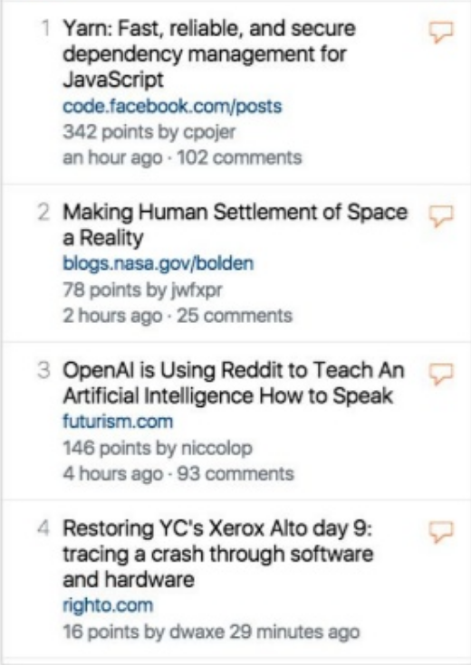

Slide 35
https://www.slideshare.net/nburk/react-graphql
https://blog.apollographql.com/the-concepts-of-graphql-bc68bd819be3
https://www.google.com/search?q=graphql+talk+slides&ie=utf-8&oe=utf-8&client=firefox-b-ab
https://www.slideshare.net/AhmadHafizIsmail/introduction-to-graphql-or-how-i-learned-to-stop-worrying-about-rest-apis
https://www.slideshare.net/SudheerJ3/graphql-api-crafts-presentation
http://slidedeck.io/OlegIlyenko/presentation-graphql-introduction
https://andela.com/insights/graphql-types-relationships/
https://medium.com/@anilktalla/graphql-4a2bdfa08e9a
https://medium.com/codingthesmartway-com-blog/creating-a-graphql-server-with-node-js-and-express-f6dddc5320e1
https://www.howtographql.com/basics/1-graphql-is-the-better-rest/
https://www.slideshare.net/nburk/react-graphql
Tutorials
https://scotch.io/tutorials/a-practical-graphql-getting-started-guide-with-nodejs
https://www.howtographql.com/basics/2-core-concepts/
https://graphql.org/learn/
https://www.prisma.io/blog/graphql-sdl-schema-definition-language-6755bcb9ce51
https://www.slideshare.net/InfoQ/serverless-graphql

Slide 36
