Slide 1
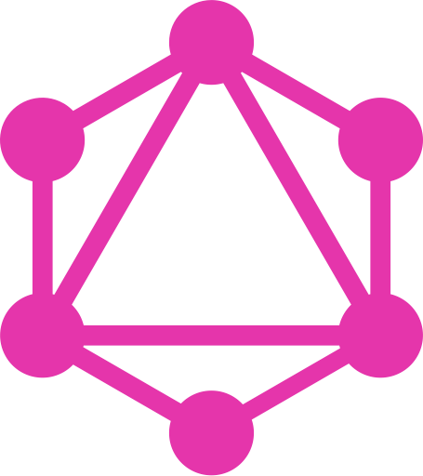
GraphQL An Introduction
By Girish Patel

Slide 2
Agenda:
What Is GraphQL
GraphQL API Components
GraphQL Server And Clients Libraries
Demonstration Of A Simple NodeJS GraphQL Server
GraphQL Pros & Cons
Questions

Slide 3
What is GraphQL
A specification, developed by Facebook and open sourced in 2015
A query language for your API and server-side runtime for executing API calls
Isn't tied to any specific database or storage engine
It can provide a more efficient, powerful and flexible alternative to REST
Apart from Facebook, users of GraphQL include:
GitHub, Shopify, Twitter, Coursera, Yelp, Wordpress, Pinterest

Slide 4

Graph??? Query Language
Notes:
Initially I wondered what does the Graph part of the name refer to? Found that it refers to….

Slide 5
Application Data Graphs
A lot of data in modern applications can be represented using a Graph of Nodes and Edges

Slide 6
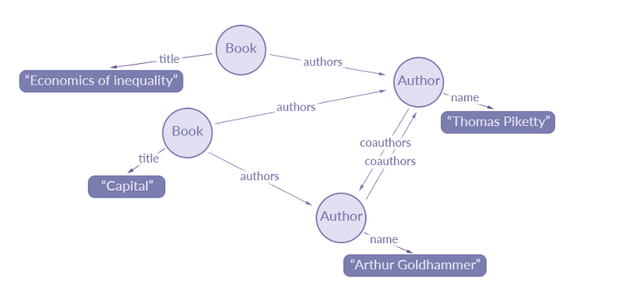
Extract Of Data From A Book Application:
Nodes: Represent Objects
Edges: Represent relationship between these Object
Source: https://blog.apollographql.com/the-concepts-of-graphql-bc68bd819be3

Slide 7
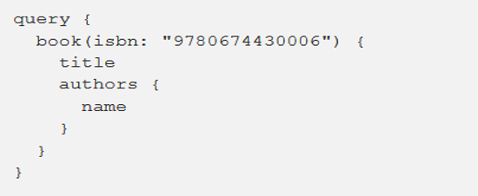
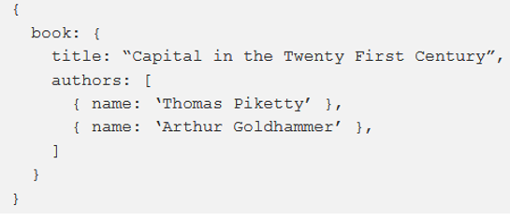
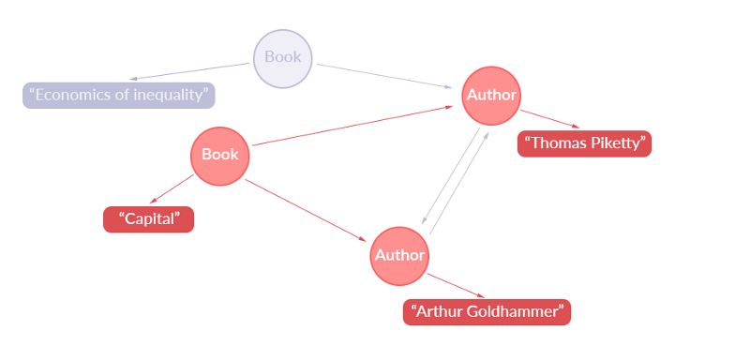
Simple GraphQL Query:
Returns this JSON:
Representation Of Extracted Data:

Slide 8
GraphQL API Components
Three main building blocks:
Queries
Schema
Resolvers

Slide 9
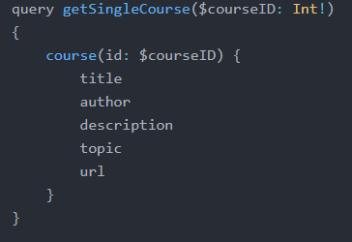
Queries
Operation Type
Operation name
Sent from the Client to the Server
Operation type: either a query, mutation or subscription
Operation name: Optional but for debugging and server-side logging reasons, it’s useful to give your queries meaningful names.
Variable Definitions: where you declare the types of variables you are planning to provide
Fields: What data we want returned from query
Variable Definitions
Query to run on GraphQL Server
Fields
Notes:
Don’t worry too much if things are 100% clear in the next few slides.
Hopefully it will become a bit later on when we put all 3 components together on one slide and see how they interact with each other.

Slide 10
The GraphQL Schema
The single source of truth in GraphQL applications
Can be seen as a contract between the server and the client
Defines the data available from the API and how clients can request it
Used to validate GraphQL queries
Strongly typed and most commonly defined using the GraphQL Schema Definition Language

Slide 11
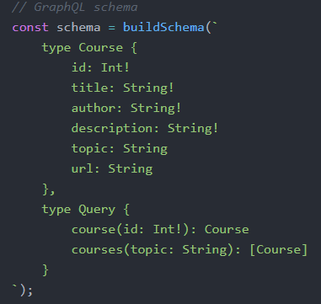
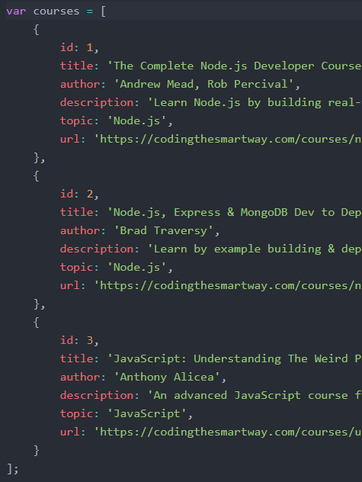
A Simple Schema
type Course
An Object Type
Defines the structure of the courses ‘data model’
type Query
A Root Type
Equivalent to GET in REST
Defines queries which are of operation type query
Other Root Types are:
type Mutation: equivalent to POST, UPDATE and DELETE in REST
type Subscription: Provides Realtime Updates. Currently experimental
Data set
Notes:
Here’s a simple schema for this set of data.
Type Query: course query is expecting an integer as an argument and returns a Course object

Slide 12
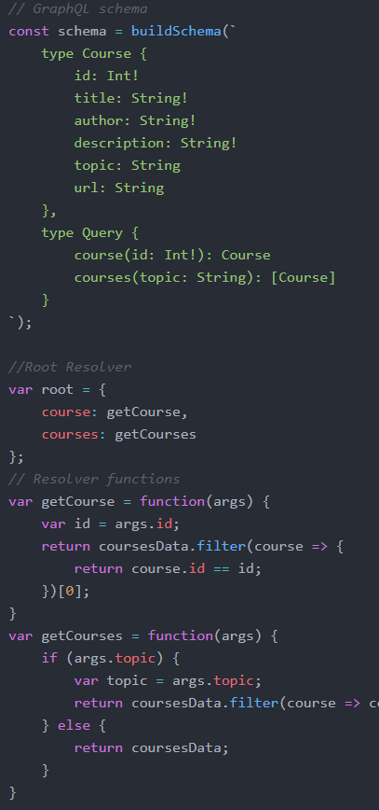
Resolvers
Provide the instructions for mapping a GraphQL operation defined in the schema to an action which is usually a function
Query Operation called course is mapped to the getCourse resolver function
Operation called courses inside type Query is mapped to getCourses function

Slide 13
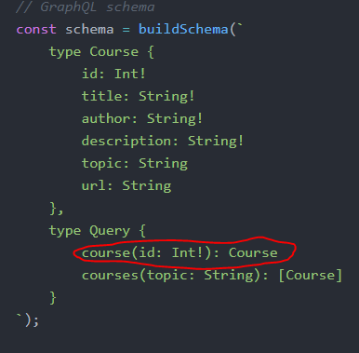
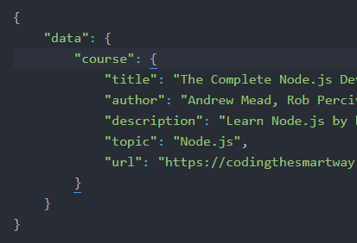
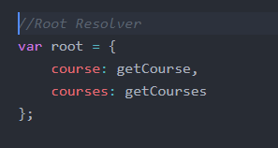
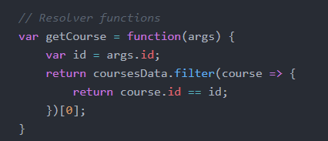
Put it all together
Validation against Schema
Checks query ‘course’ is defined in the schema and variable is of expected type.
Checks data requested in the query exists in the ‘Course’ object.
Client
Server
Query sent to server
Resolver defines what function to execute
Returns Data
Function
getCourse is executed

Slide 14
Live Demonstration
A simple GraphQL Server built in a Node.js environment using:
GraphQL.js (the original reference implementation of the GraphQL specification)
Express Web Server
express-graphql (middleware between GraphQL and Express)
Source Code: https://github.com/patelg123/graphql-server

Slide 15
Server Libraries For Other Platforms
Many other programming languages support GraphQL. These include:
C# / .NET, Clojure, Elixir, Erlang, Go, Groovy, Java,
PHP, Python, Scala, Ruby
Full list available at https://graphql.org/code/#server-libraries

Slide 16
JavaScript Client Libraries
Used to interact with the GraphQL API from client side
Two of the most popular are:
Apollo Client: A powerful JavaScript GraphQL client, designed to work well with React, React Native, Angular, or just plain JavaScript.
Relay: Facebook's framework for building React applications that talk to a GraphQL backend.

Slide 17
Client Libraries For Other Platforms
Again there is support in other programming languages
These include:
C# / .NET, Clojurescript, Go, Java / Android, Swift /
Objective-C iOS, Python
Full list available at https://graphql.org/code/#graphql-clients

Slide 18
GraphQL Pros

Slide 19
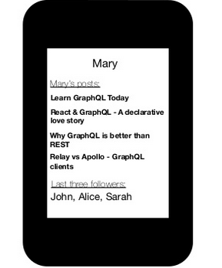
Blog Application
Imagine we have to build something that:
Displays user’s name
Shows the posts he/she has created
Shows the followers the user has

Slide 20
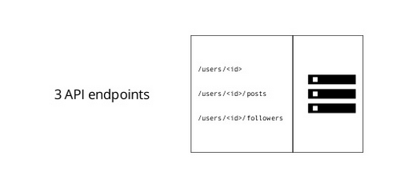
Blogging App With REST
With REST, we might have the following endpoints:
/users/<id> to fetch a user
/users/<id>/posts to fetch the post of that particular user
/users/<id>/followers to fetch the followers of that particular user

Slide 21
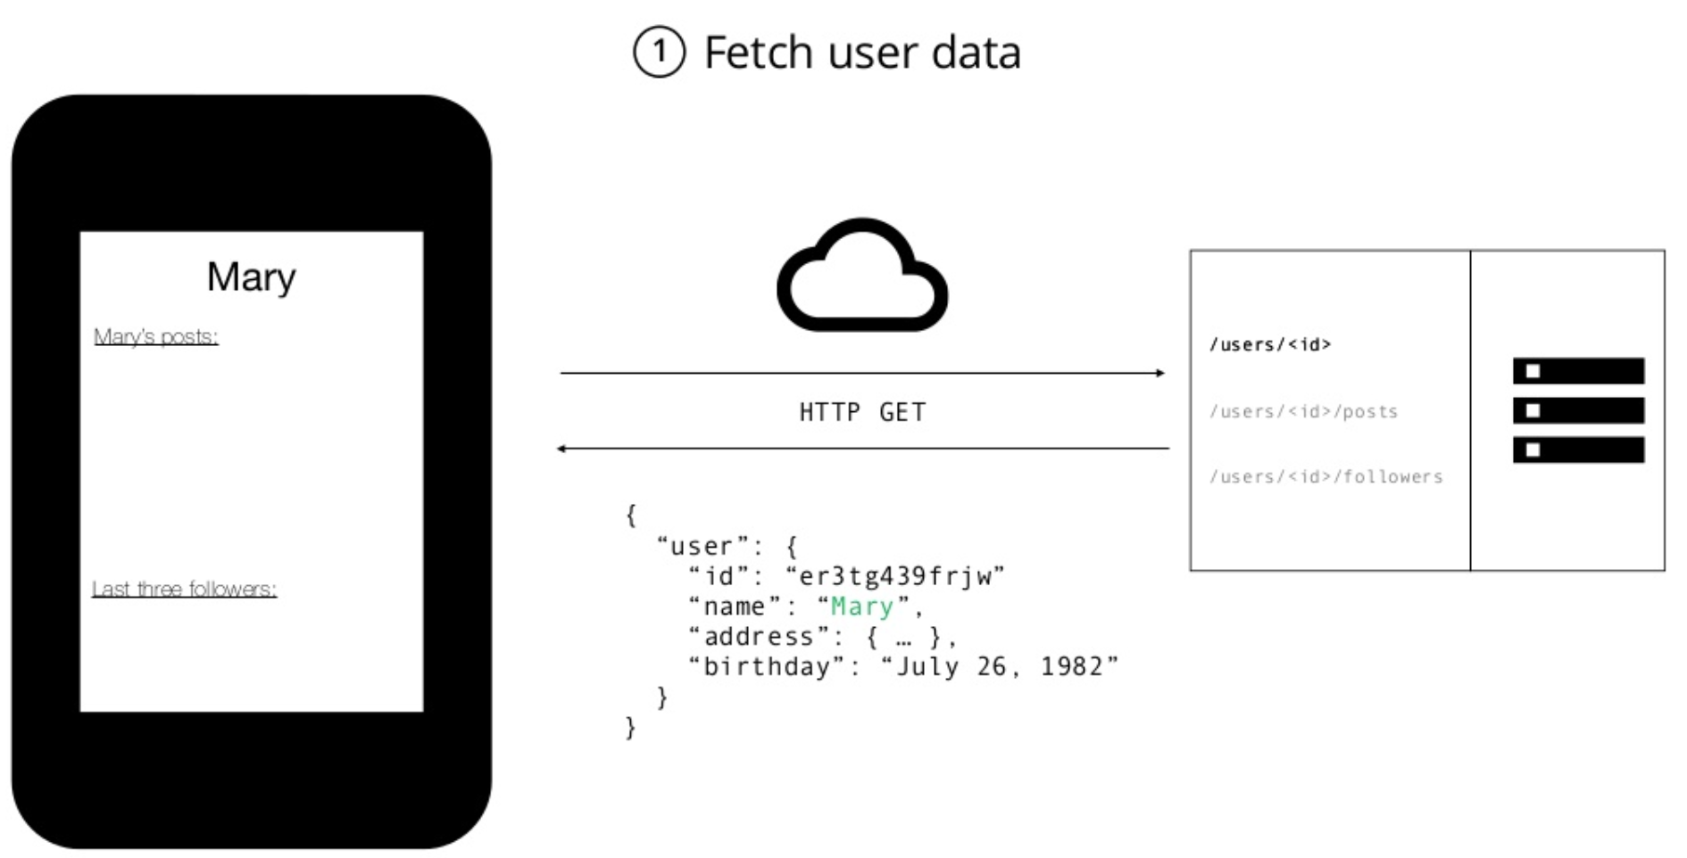
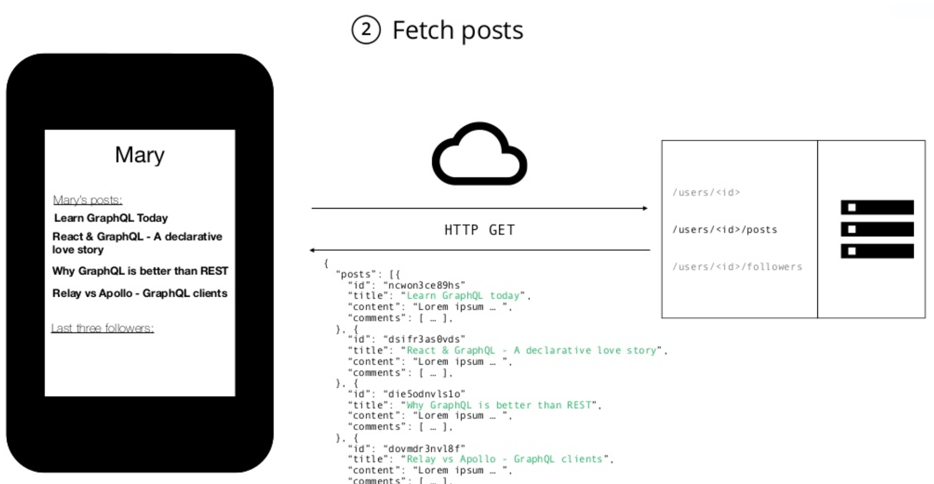
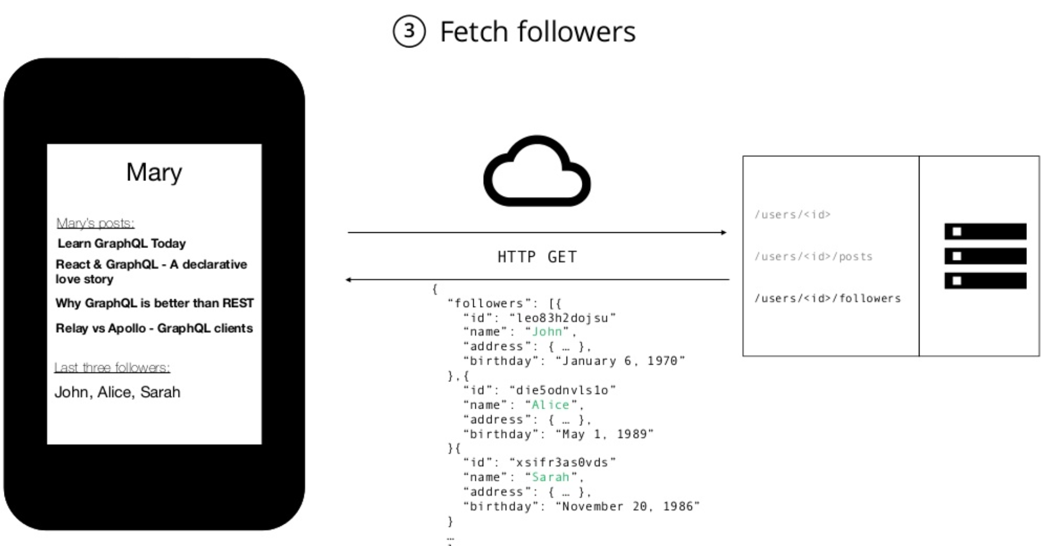
With REST…..
Have to make three requests to different endpoints:
You are also overfetching since the endpoints return additional information that is not needed.

Slide 22
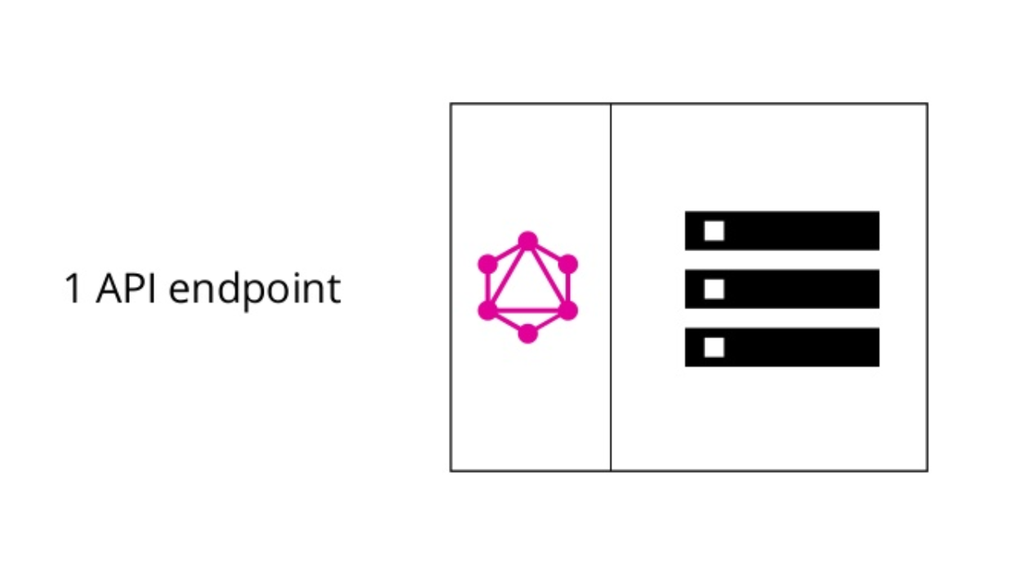
Blogging App With GraphQL

Slide 23
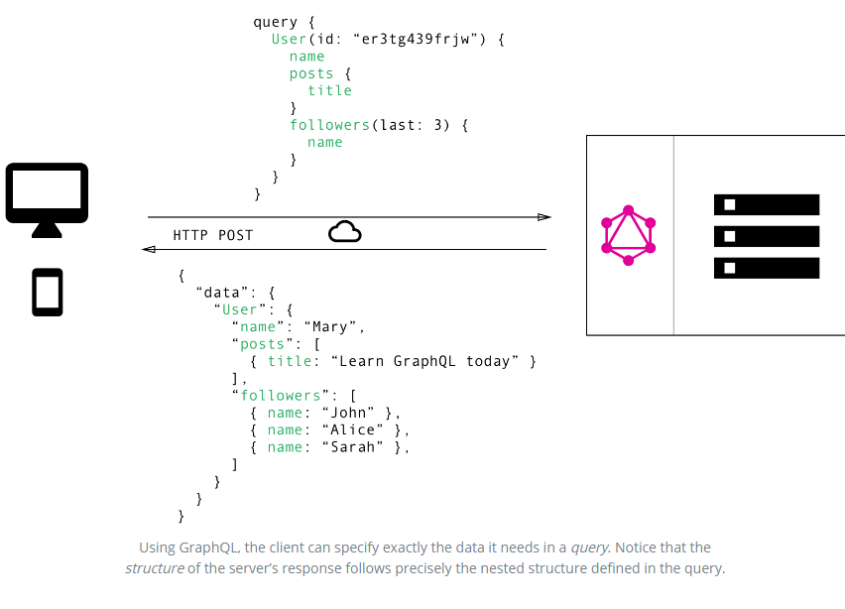
GraphQL…..
Reduces network requests by allowing the retrieval of all the data we need in a single query
Client can specify exactly what data is required (no overfetching)
Basically shifts this multi-request complexity to the server-side

Slide 24
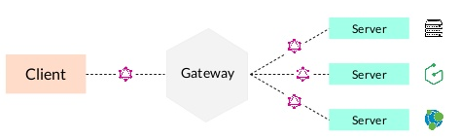
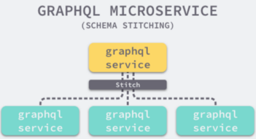
GraphQL Schema Stitching
Schema Stitching allows the creation of a single GraphQL schema from multiple underlying GraphQL APIs (sub-schemas)
These sub-schemas can be either local to the server, or running on a remote server
Useful with microservices architecture
Each microservice can have its own GraphQL endpoint which can be consolidated to create one GraphQL API gateway.

Slide 25
No Need For Versioning:
Can easily add new fields and types to our GraphQL API without impacting existing queries

Slide 26
No Need To Create A Custom Data Endpoints:
Exact data requirements are specified on the client side
GraphQL server will only return those requested by the client

Slide 27
Strongly Typed
Being strongly-typed should make GraphQL less error prone
Can be validated during compile-time

Slide 28
GraphQL Introspection
GraphQL has a built-in introspection system that publishes the Schema’s structure
Provides information about what queries are supported and what data is available.
Makes it easier to autogenerate API documentation

Slide 29
Some GraphQL Cons

Slide 30
Denial of Service Attacks
A GraphQL server can be attacked with overly complex queries that can consume all the resources of the server.
Although not specific to GraphQL, we have to be extra careful and have put in place mitigation functionality
Such as:
Query validation
Query timeout
Limiting the maximum depth of incoming queries
Limiting the amount of objects that can be returned

Slide 31
GraphQL API request are most commonly implemented using HTTP POST
Need to set up your own caching support as you can not use native HTTP caching mechanisms
Requests can not be bookmarked
Request do not stay in browser history
You can require that the clients use GET for all requests, but it's not ideal, because mutations will get cached too

Slide 32
Should you consider Using GraphQL?
Some scenarios where GraphQL could provide a good solution include:
The data available from your API is changing frequently. GraphQL reduces the need for versioning
You are building rich UI/UX based mobile applications. If these applications are used over slow networks GraphQL helps you load only what you need and with few network requests
Your application has multiple schemas from multiple sources
You have many clients with different requirements from your API. GraphQL reduces the need for multiple custom end points
You are working with Microservices architecture

Slide 33
Thank You For Listening

Slide 34
Questions…..

Slide 35
GraphQL Server Libraries
As GraphQL is a specification you can find server libraries to help you implement GraphQL in a variety of languages including:
C# / .NET, Clojure, Elixir, Erlang, Go,Groovy, Java, JavaScript, PHP, Python, Scala, Ruby

Slide 36
Conclusion
If you have a simple REST API and deal with data that is relatively consistent over time, you would be better off sticking with your REST API. For companies that deal with rapidly-changing data, and have the engineering resources to devote to rearchitecting their API platforms, GraphQL can solve many of the pain points experienced with REST APIs.
if you find yourself working with rapidly-changing data at scale, it could be a great solution for your business.

Slide 40
What Is GraphQL?
GraphQL is a data query language for APIs and a runtime for fulfilling those queries with your existing data.
GraphQL provides a complete and understandable description of the data in your API.
Gives clients the power to ask for exactly what they need and nothing more.
(Source: GraphQL.org)

