Slide 1
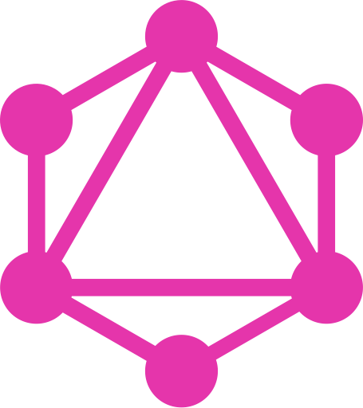
GraphQL An Introduction
By Girish Patel

Slide 2
Agenda:
What Is GraphQL
Advantages Of GraphQL Over REST
Some Disadvantages
Demonstration Of A Simple NodeJS GraphQL Server Built Using Express.js
Questions

Slide 3
What Is GraphQL?
GraphQL is a data query language for APIs and a runtime for fulfilling those queries with your existing data.
GraphQL provides a complete and understandable description of the data in your API.
Gives clients the power to ask for exactly what they need and nothing more.
(Source: GraphQL.org)

Slide 4
What is GraphQL
A query language for your API
And a server-side runtime for executing queries

Slide 5
It can provide a more efficient, powerful and flexible alternative to REST
GraphQL supports reading, writing (mutating) and subscribing to changes to data (realtime updates)

Slide 6

Graph???QL

Slide 7
Application Data Graphs
A lot of data in modern applications can be represented using a graph of Nodes and Edges,
Nodes: Represent Objects
Edges: Represent relationship between these Object

Slide 8
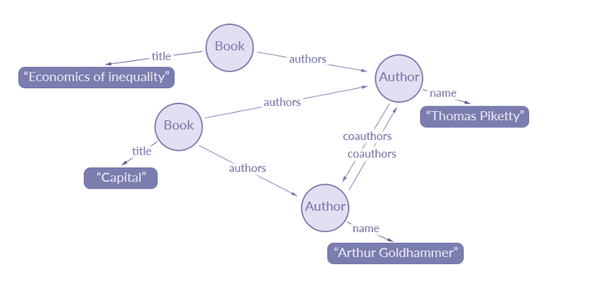
A data graph representation of an extract of data for a simple library catalogue:
Source: https://blog.apollographql.com/the-concepts-of-graphql-bc68bd819be3

Slide 9
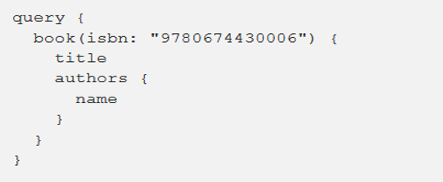
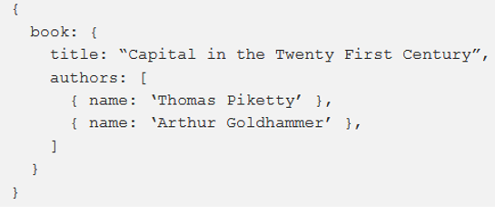
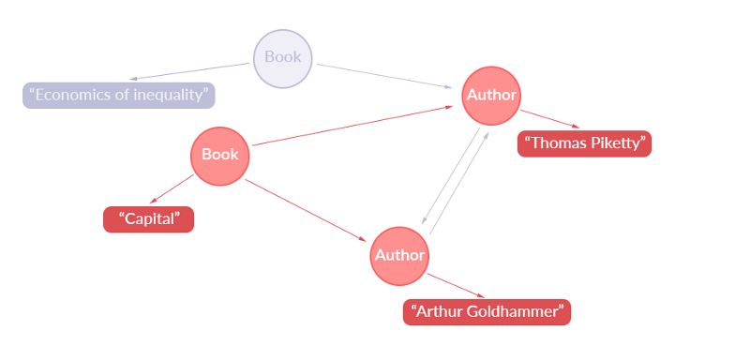
Simple GraphQL Query:
Returns this JSON:
Representation Of Extracted Data:

Slide 10
Fundamental Language Constructs
Schema
Resolvers
Queries

Slide 11
The GraphQL Schema
Used in the GraphQL server-side runtime
Describes the data available from the API
Defines how clients can request data from the API
Validates GraphQL queries
Can be seen as a contract between the server and the client

Slide 12
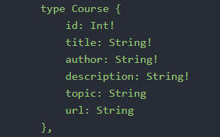
GraphQL Schema Definition Language
One of the most common ways to define Schema
Typed Language
Below is a simple example of an Object Type defined using GraphQL SDL:

Slide 13
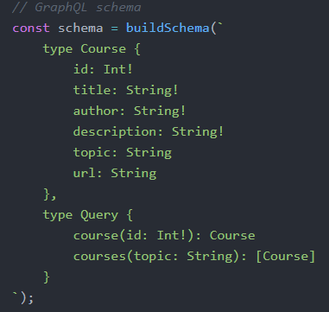
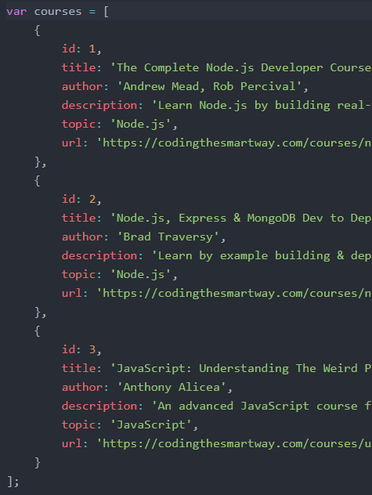
A Simple Schema
type Course
an Object Type.
defines the structure of the course ‘model’.
type Query
a type of Root Type
Equivalent to GET in REST
Other Root Types are:
type Mutation: equivalent to POST,
UPDATE and DELETE in REST
type Subscription: Provides Realtime Updates. Currently experimental

Slide 14
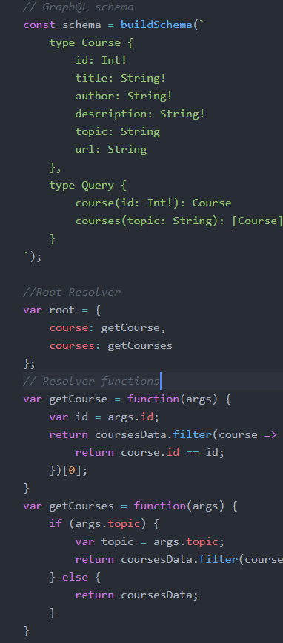
Resolvers
Responsible for mapping operations to actual functions
operation called course inside type Query is mapped to getCourse function
operation called courses inside type Query is mapped to getCourses function

Slide 15
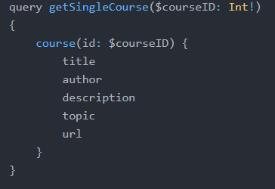
Queries
Operation Type
Operation name
Operation type: either a query, mutation or subscription
Operation name: For debugging and server-side logging reasons, it’s useful to give your queries meaningful names.
Variable Definitions: where you declare the types of variables you are planning to provide
Fields: What data we want returned from query
Variable Definitions
Query to run on GraphQL Server
Fields

Slide 16
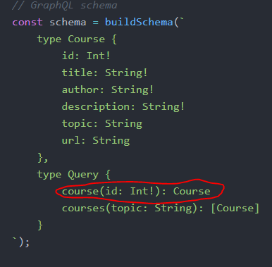
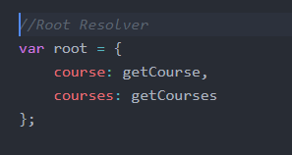
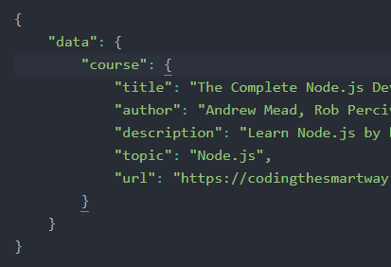
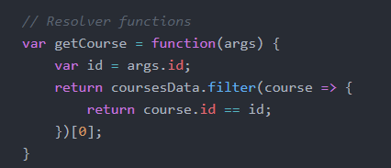
Put it all together
Sent to GraphQL server
Validated against Schema

Slide 17

Live Demo

Slide 18
GraphQL Advantages

Slide 19
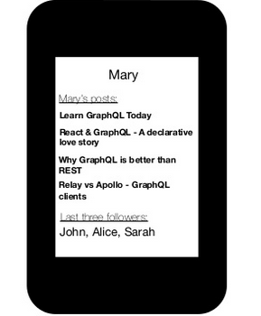
Blog Application
Imagine we have build an API that lets us:
Retrieve user details
Shows the posts he/she has created
Shows the followers the user has.

Slide 20
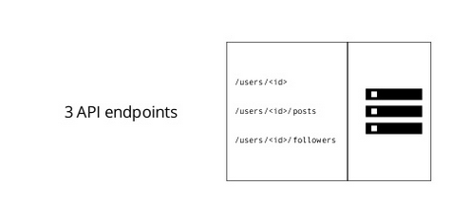
Blogging App With REST
With REST, we might have the following endpoints:
/users/<id> to fetch a user
/users/<id>/posts to fetch the post of that particular user
/users/<id>/followers to fetch the followers of that particular user

Slide 21
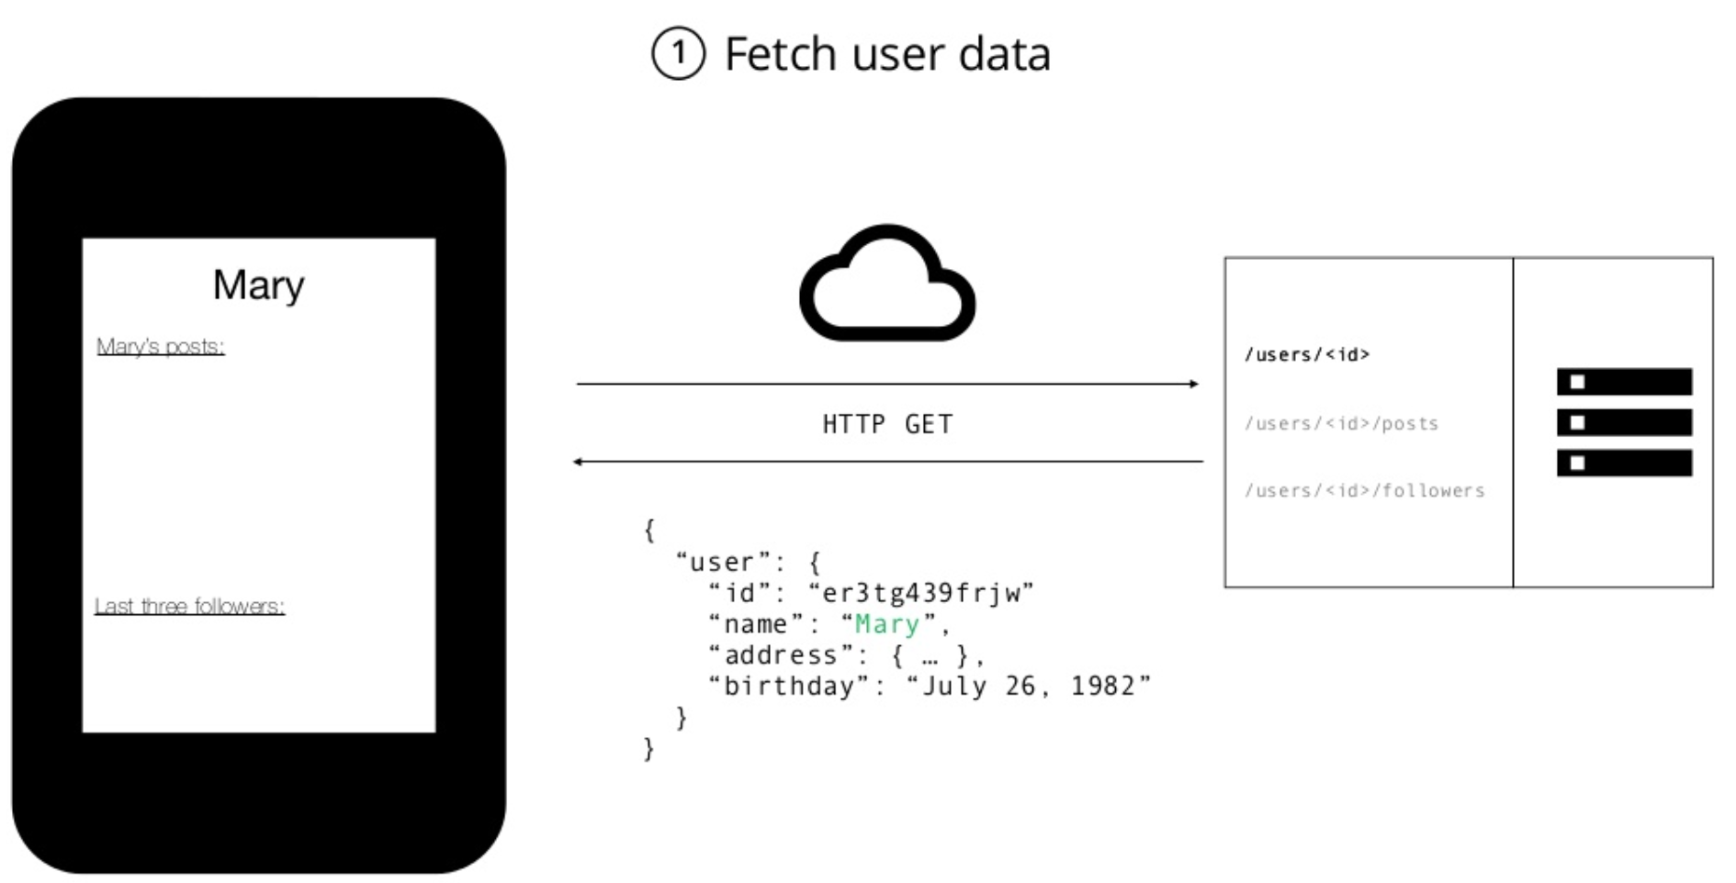

Slide 22
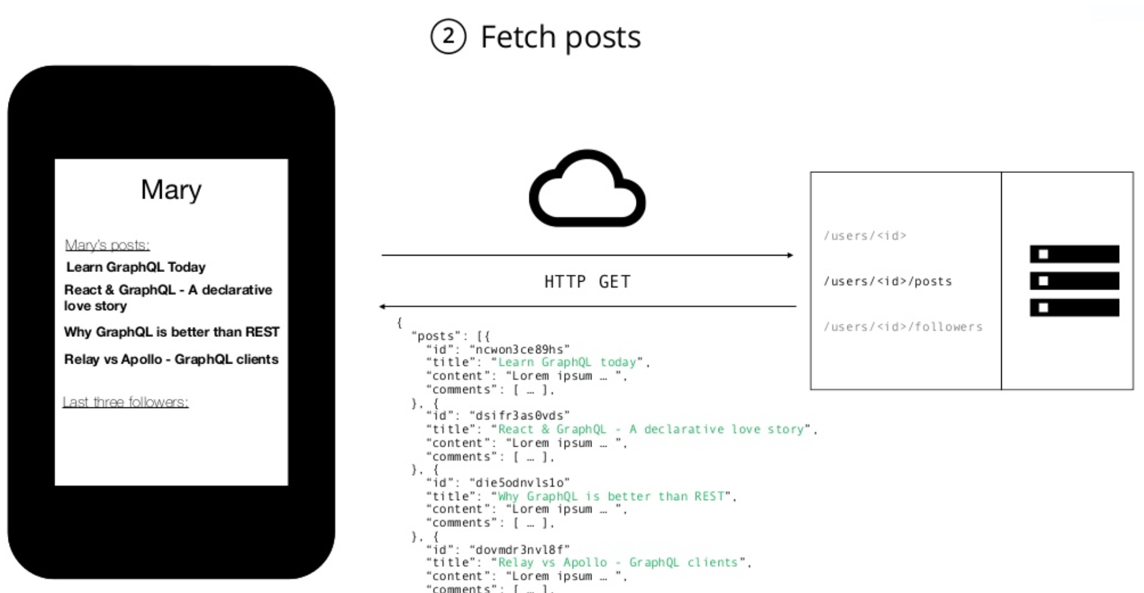

Slide 23
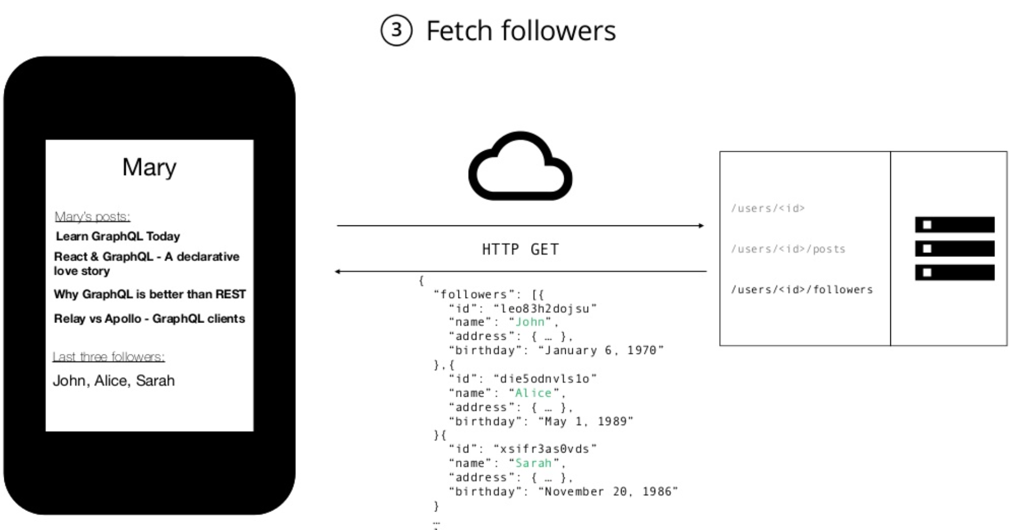

Slide 24
With REST…..
Have to make three requests to different endpoints
You are overfetching since the endpoints return additional information that is not needed.

Slide 25
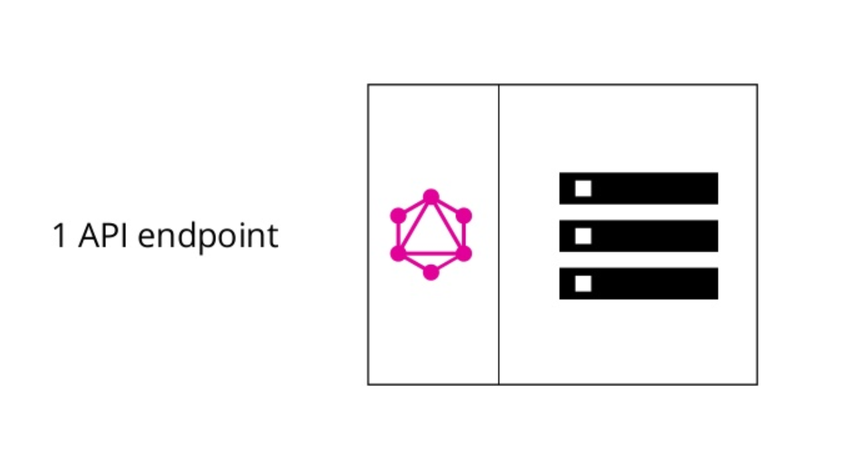
Blogging App With GraphQL

Slide 26
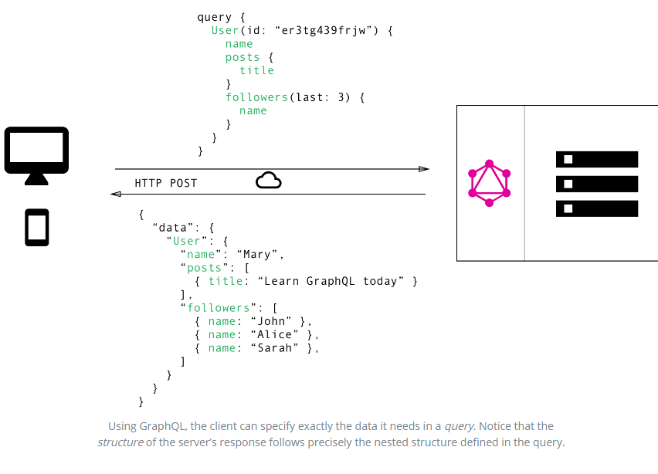

Slide 27
With GraphQL…
Only make a single request to the server
GraphQL reduces network requests by allowing us fetch or retrieve all the data we need in a single query
We (Client) can specify exactly what data is required (no over fetching)
we can basically shift this multi-request complexity to the server-side and have the GraphQL layer deal with it.

Slide 28
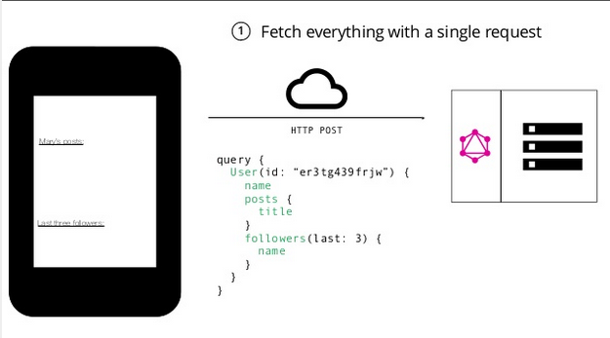
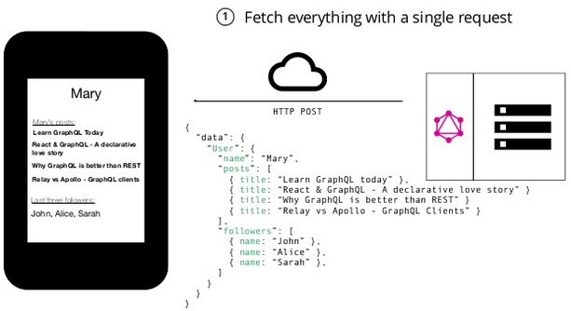

Slide 29
Conclusion
If you have a simple REST API and deal with data that is relatively consistent over time, you would be better off sticking with your REST API. For companies that deal with rapidly-changing data, and have the engineering resources to devote to rearchitecting their API platforms, GraphQL can solve many of the pain points experienced with REST APIs.
if you find yourself working with rapidly-changing data at scale, it could be a great solution for your business.

