Slide 1

GraphQL An Introduction
By Girish Patel

Slide 2
Agenda:
What Is GraphQL
Advantages Of GraphQL Over REST
Some Disadvantages
Demonstration Of A Simple NodeJS GraphQL Server Built Using Express.js
Questions

Slide 3
What Is GraphQL?
GraphQL is a data query language for APIs and a runtime for fulfilling those queries with your existing data.
GraphQL provides a complete and understandable description of the data in your API.
Gives clients the power to ask for exactly what they need and nothing more.
(Source: GraphQL.org)

Slide 4
What is GraphQL
A query language for your API
And a server-side runtime for executing queries

Slide 5
It can provide a more efficient, powerful and flexible alternative to REST
GraphQL supports reading, writing (mutating) and subscribing to changes to data (realtime updates)

Slide 6

Graph???QL

Slide 7
Application Data Graphs
A lot of data in modern applications can be represented using a graph of Nodes and Edges,
Nodes: Represent Objects
Edges: Represent relationship between these Object

Slide 8
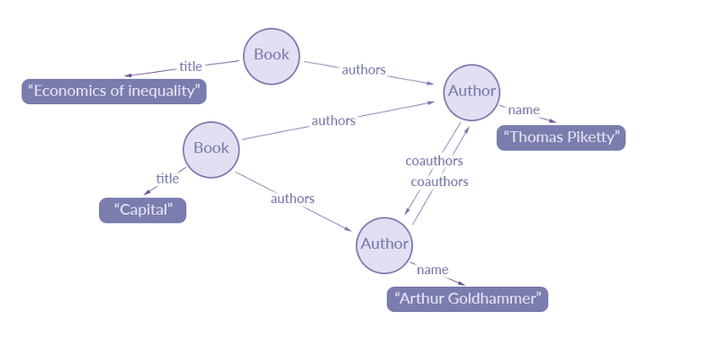
A data graph representation of an extract of data for a simple library catalogue:
Source: https://blog.apollographql.com/the-concepts-of-graphql-bc68bd819be3

Slide 9
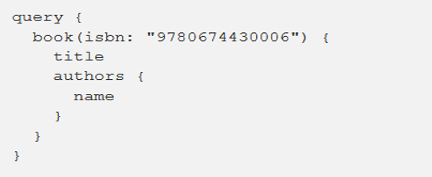
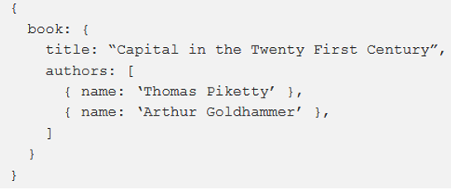
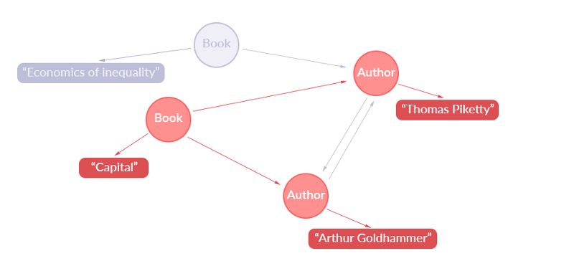
Simple GraphQL Query:
Returns this JSON:
Representation Of Extracted Data:

Slide 10
Fundamental Language Constructs

Slide 11
The GraphQL Schema
Used in the GraphQL server-side runtime
Describes the data available from the API
Defines how clients can request data from the API
Validates GraphQL queries
Can be seen as a contract between the server and the client

Slide 12
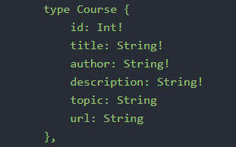
GraphQL Schema Definition Language
One of the most common ways to define Schema
Typed Language
Below is a simple example of an Object Type defined using GraphQL SDL:

Slide 13
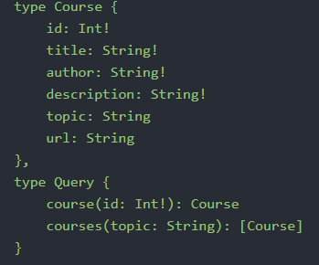
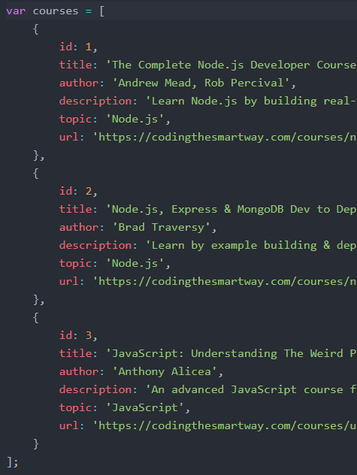
A Simple Schema
type Course
an Object Type.
defines the structure of the courses ‘model’.
type Query
a type of Root Type
Equivalent to GET in REST
Other Root Types are:
type Mutation: equivalent to POST,
UPDATE and DELETE in REST
type Subscription: Provides Realtime Updates. Currently experimental

Slide 14
Queries

Slide 15
Resolvers

Slide 16
Live Demo

