Slide 1

Expense
Splitter
G U I D E D B Y : R O H I T S I R

Slide 2
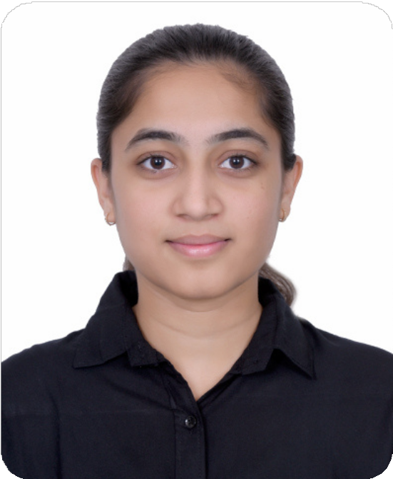
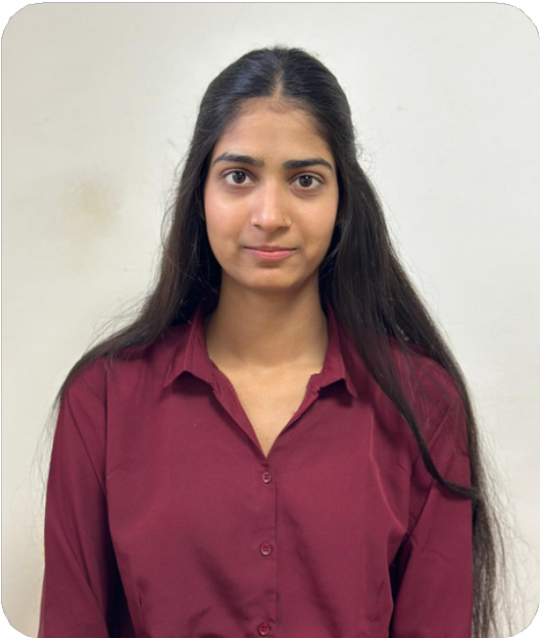
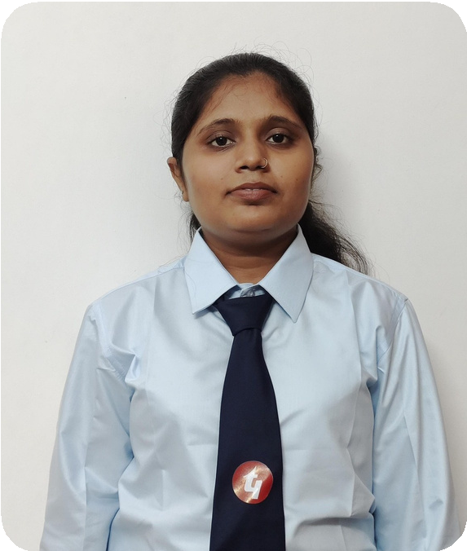
Our Team
Hani Patel
Neelam Patel
Shila Kumari

Slide 3


Objective
Manage group expenses Split expenses equally Reduce calculation errors Record all expenses
User friendly interface

Slide 4




Technology Used
HTML
TAILWIND CSS
JAVA SCRIPT
JSON

Slide 5
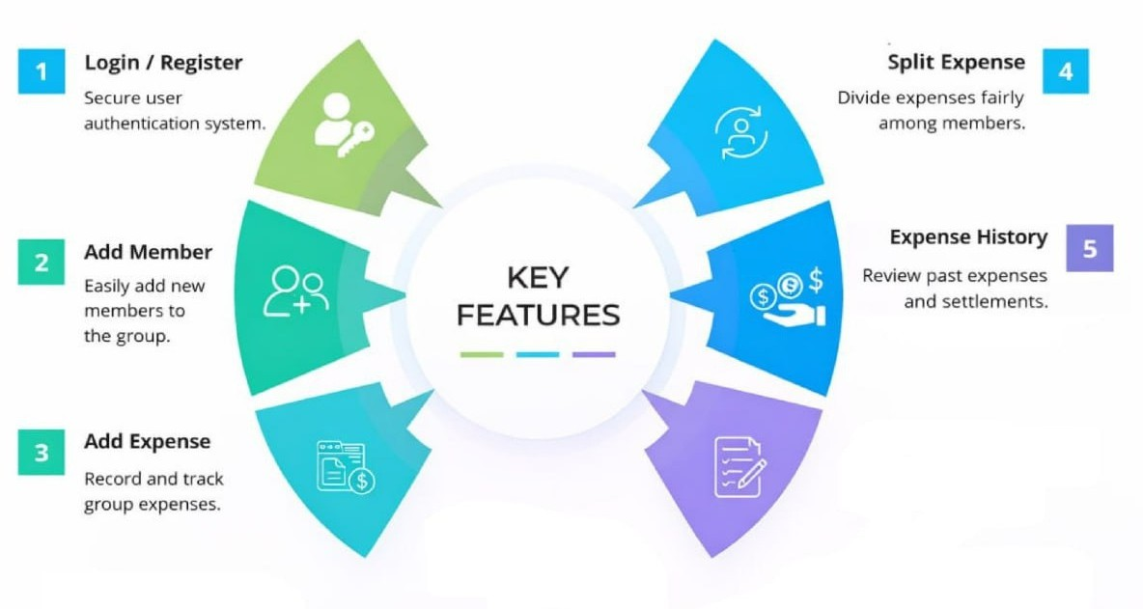



Slide 6

Thank
You
Now we are going to implementation part

